Slide 1
Digital Environments
Computer Systems, Hardware and Peripherals

Slide 2
Recall from last lesson
https://forms.microsoft.com/e/u0vYydn2SF
An email should by now have arrived with the link attached.

Slide 3
Starter Activity: Features and Characteristics
5 mins
Work with the peers on your row (2s/3s) to explain two features and two characteristics of:
Personal computers
Mobile Devices
Servers
Smart/Internet-enabled (IoT) devices
A feature is something integral to the device, its most important…features
A characteristic is something which distinguishes it from other similar devices…a defining characteristic

Slide 4


Slide 5


Hardware and Peripherals
Note this down
Define hardware →
The physical parts and individual components within a computer system which work together to process inputs, store data and output data
Define peripheral →
Any external device that provides input +/ output for the computer

Slide 6
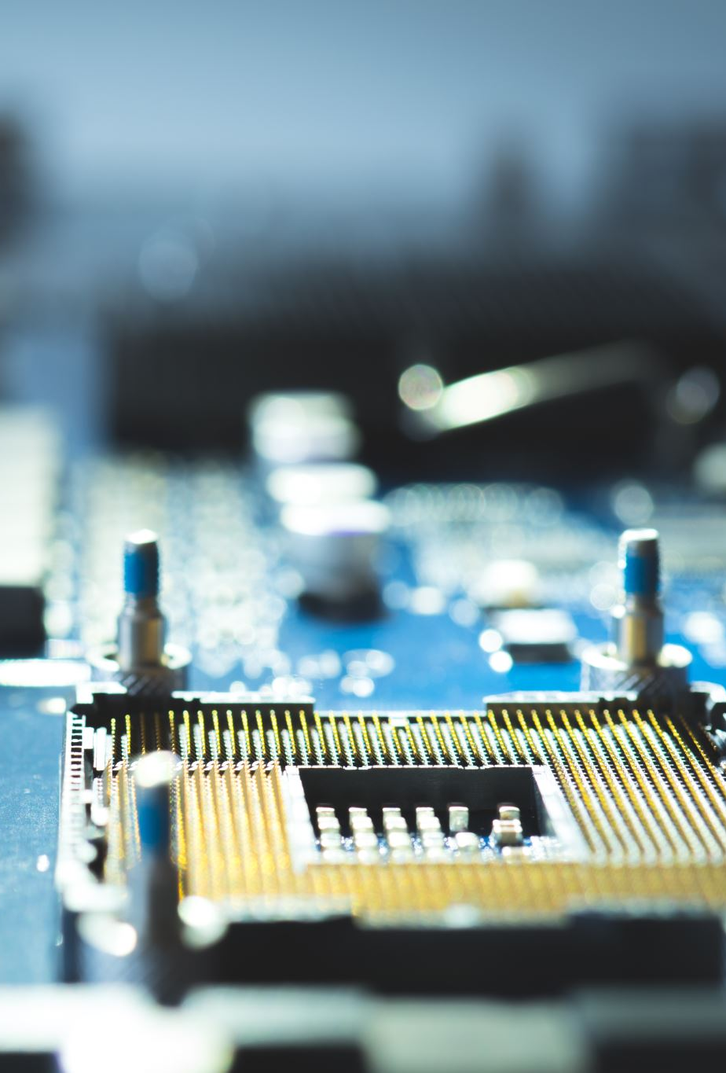
Input Devices
Note this down
There are a huge array of computer input devices, some we use every day, like a keyboard and mouse, others we may never use, such as a barcode scanner
Input devices may have two-way communication with the device, such as wireless keyboards and mice may be able to report their charge level to the PC, or PC software may be able to change RGB settings on the mouse
Their distinguishing characteristics will be the data they allow to be inputted

Slide 7
Input Devices
Note this down
Keyboards are quite simple: Each key press completes a circuit within the keyboard, which signals the keyboard’s processor to identify what key was pressed and what the ASCII code is for the key – this will then be converted into binary and sent along the USB data line to the PC
Mice work similarly: The mouse constantly sends its x/y co-ordinates from centre (converted into binary) through the USB data line, any mouse clicks/macro key clicks will be converted to binary the same as the keyboard and sent through USB data

Slide 8
Output Devices
Note this down
Input devices provide input for computer system calculations, output devices provide a human-understandable format for the output of the computer system
Visual Display Units (VDUs) are the most typical and common output device type and cover monitors
Other types of output device include sound (speakers) and print/physical (printers)

Slide 9
Input/Output (I/O) Peripheral Device Summary
Stuff to learn
You need to be comfortable explaining the uses, features and characteristics of I/O devices, including generic peripherals
The key components are in this presentation, however, you should try and familiarise yourself with some less widely use devices and how they relate to the same structure
Input is physically received from user
Physical input engages logic from the peripherals to convert this into binary
Binary can be transmitted via any medium, typically Bluetooth or USB
Output devices work in the opposite way, binary sent to output device will be accordingly converted into sound/visual/physical signals
I/O Devices all involve Digital/Analogue Conversion (DAC) or Analogue/Digital Conversion (ADC)

Slide 10
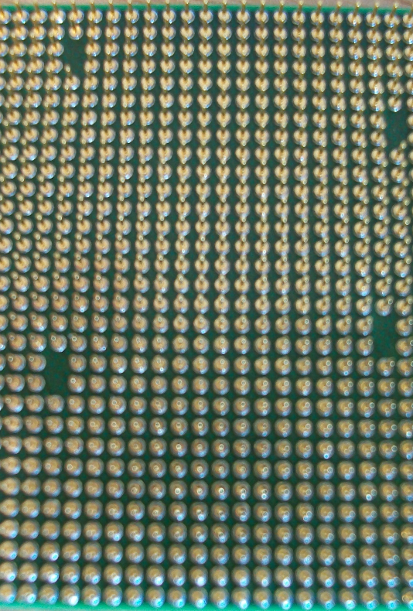
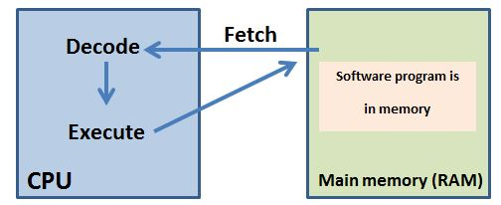
Hardware: Processors
Note this down
Also called ‘Central Processing Units (CPUs)’
A processor is a collection of logical circuits that respond to and process instructions given to them via software – they have a limited amount of instructions they can carry out, focusing on fetching, decoding and executing
The “Fetch Execute Cycle” is an important part of this process

Slide 11
Processors: Components
Note this down
Arithmetic Logic Unit (ALU) – The arithmetic and logic operations take place here.
Control Unit (CU) – Decodes the instruction, splits it into the opcode and operand and identifies the specific arithmetic operation.
Clock – The purpose is to keep all the processor components synchronised. The clock controls the processor so that it can process the instructions one-by-one and in the correct order.
Registers – Memory locations on the CPU. Much faster than cache and RAM however also much smaller. Used to store frequently accessed data and instructions. There are two types of registers: general purpose and registers dedicated to a specific purpose.

Slide 12
Fetch-decode-execute cycle
Note this down
von Neumann architecture
The instructions are loaded into memory
The processor fetches the instruction from the main memory
The instruction is decoded so the CPU knows what to do with the instruction
The processor then decodes and executes the instruction
The result of the instruction can be stored in memory
The next instruction is then fetched from main memory and the cycle repeats itself

Slide 13
Processors: Characteristics
Note this down
Make/Model – Intel (Core i3 or i5 or i7) / AMD (Ryzen 3 or 5 or 7) / ARM (Cortex-A)
Socket Type - The connection between motherboard and processor
AMD processor have pins on the bottom which touch contacts on the socket
Intel processors have connectors which touch pins on the socket
Clock Speed – Measured in GigaHertz (GHz), defines the processor calls per second, not a tell-it-all performance metric
Cache Size – Small amounts of memory on the processor itself that store the dataset the processor is currently working in
Cache is layered in terms of speed (L1/L2/L3 – L1 is the fastest)

Slide 14
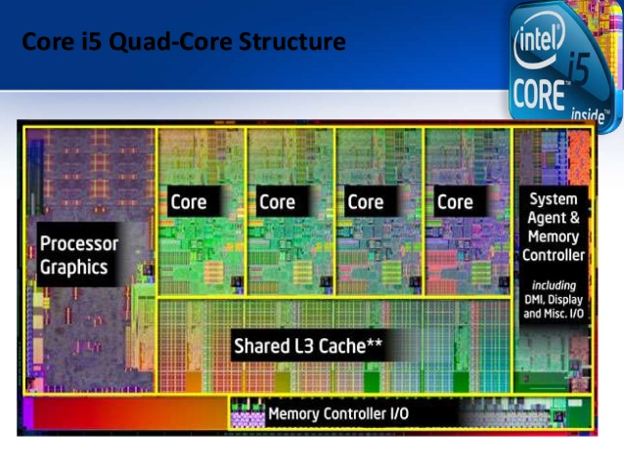
Processors: Characteristics - Cores
Note this down
Processors have many internal components as discussed, many processors will have multiple copies of each, stored in cores
Each core will typically have its own ALU, Clock and CU’s allowing the processor to parallelise tasks
Some cache is shared and slightly slower (L3)

Slide 15
Main Memory (Random Access Memory [RAM])
Note this down
The purpose of main memory is to store the instructions/data from the programs currently running on a computer system and to temporarily hold the data needed by those programs.
RAM memory is volatile - when the computer is turned off the contents of volatile memory is lost.
When you create a document that you do not save, if the computer crashes, the document will be lost because it is only stored in RAM which is volatile memory. If you have saved the document to the hard disk drive then you will be able to retrieve the document once power has returned.
Every time the computer is powered up key files from the Operating System will be copied into the RAM from storage, this is what happens during the boot sequence and is why Solid State storage allows for faster boot times

Slide 16
Main Memory: Characteristics
Note this down
CAS = Column Address Strobe
When your CPU requests data from RAM, the memory controller specifies a row and a column in the RAM’s grid-like structure.
The CAS latency is the number of clock cycles it takes, after sending the column request, for the RAM to actually deliver the first piece of data.
The higher the ‘DDR’ (Double Data Rate), the more improved the RAM characteristics, we are currenting using DDR4 for system memory
Data Rates – How fast data can be transferred, up to 3.2Gb/s
CAS Latency – The time it takes between the processor requesting data and it being received
Redundancy – Some memory modules will have redundancy, such as ECC for use in servers, to detect and fix errors

Slide 17
Secondary Storage (Storage [HDDs and SSDs])
Note this down
Non-volatile and long term – data will be stored accurately without power for a very long time
Types – magnetic (hard-disks), optical (CD’s) and solid state drives (SSD’s/USB memory stick)
Magnetic drives are sensitive to movement, require significant power compared to SSD’s and are quite loud and bulky
Optical drives are prone to damage and have a limited storage capacity
SSDs are very fast, require little power and are less prone to damage, although are more expensive to manufacture

Slide 18
Secondary Storage: Characteristics
Note this down
Type (Magnetic, Optical, Flash/Solid-State)
Capacity (GB, TB, PB, EB)
Portability (Internal, External, etc.)
Durability (Scratchable, easily damageable, interference prone, losable)
There is a difference between the binary value of capacity and the decimal/denary value of capacity.
MiB vs MB

Slide 19
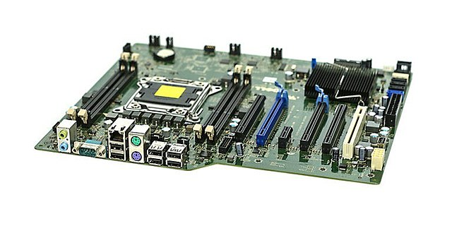
Motherboards
A motherboard is a large Printed Circuit Board (PCB) which provides a base for all other hardware components to connect, draw-power and communicate
Motherboards are central to an entire system and a poor choice can have drastic effects on both system functionality as well as performance, compatibility between all parts must be ensured

Slide 20
Remember this?
CMOS Battery
CPU Socket
Internal I/O Connectors
RAM Slot
Expansion Card Slots
External I/O Connectors

Slide 21
Motherboards: Characteristics
Note this down
Form factor – the standard physical size of the motherboard, ensure this is compatible with your case! This will also determine the amount of RAM slots available, and expansion slots for hardware such as graphics cards
I/O and connectors – The more expensive the motherboard, the more connections that will be available, be it more powerful WiFI, inbuilt Bluetooth or advanced sound processing

Slide 22
Cooling
Note this down
All PC hardware will draw power, and will therefore output heat
Some components, such as the processor and graphics card, can output upward of 500W of heat, with some systems producing as much heat as a halogen heater designed to heat a room!
To ensure hardware does not get too hot to function, different types of cooler can be used to redirect the hot air away from hardware and out of the case

Slide 23
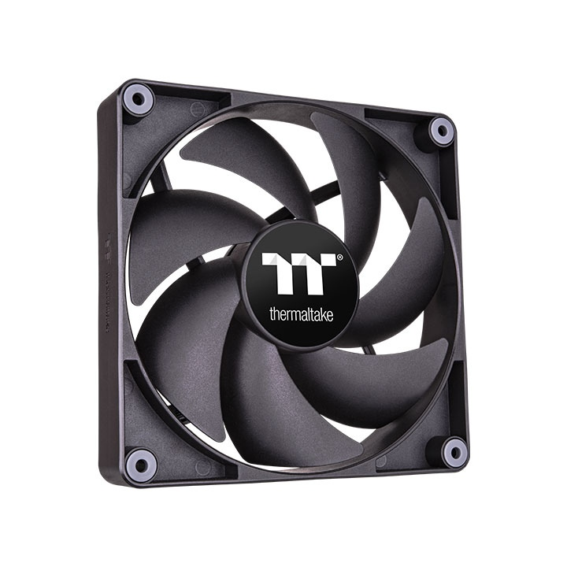
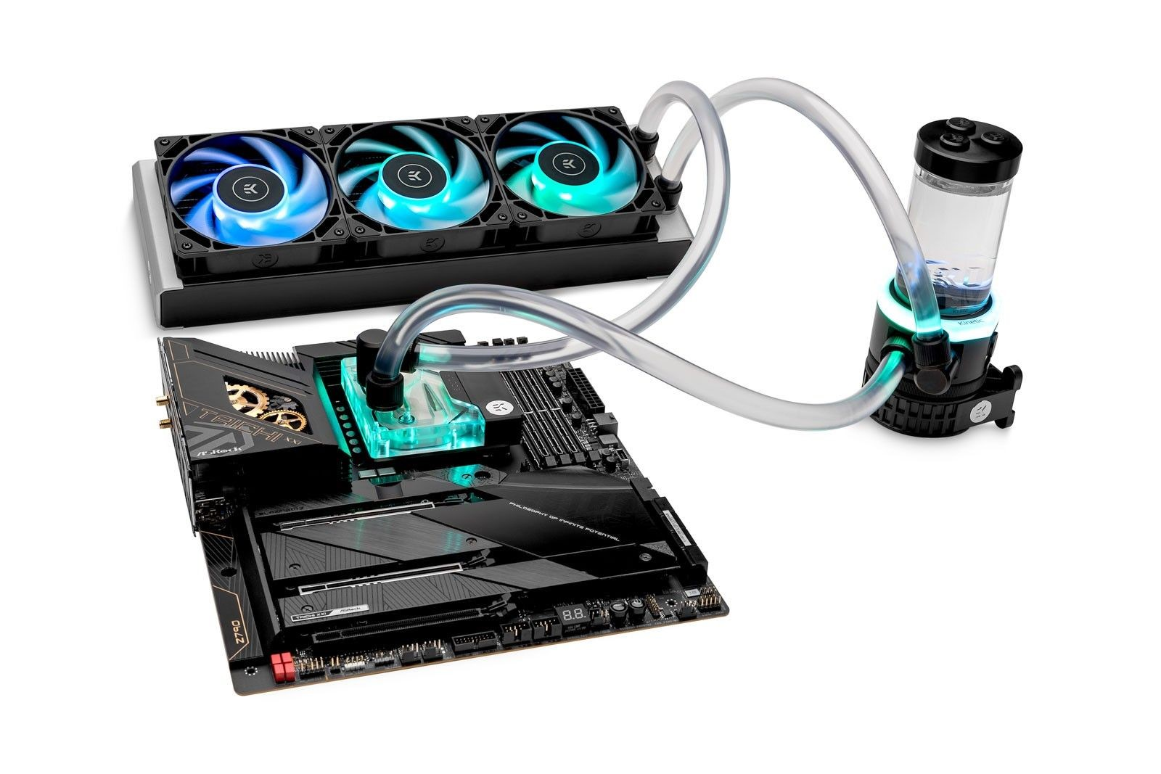
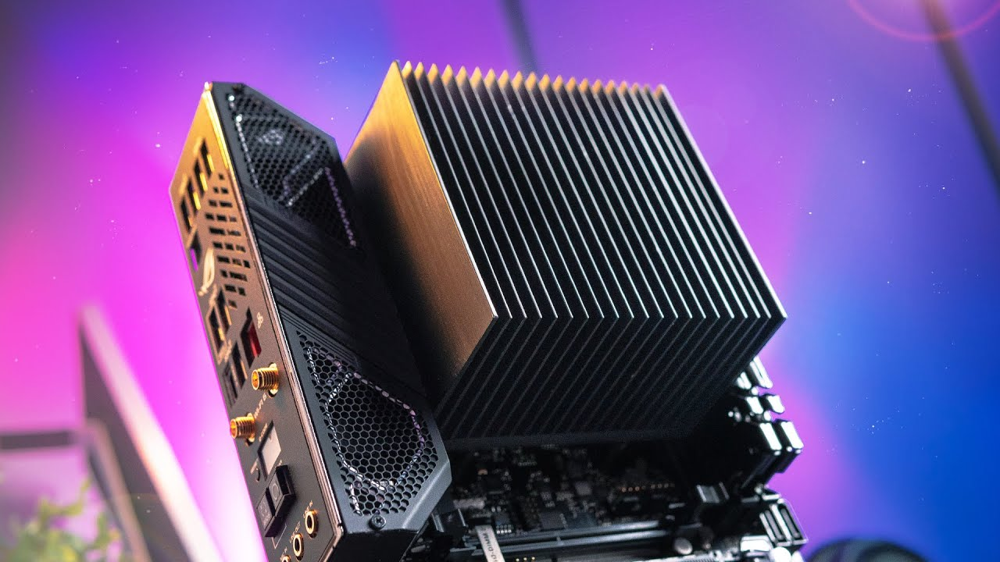
Cooling: Types and Characteristics
Note this down
The main purpose of the cooling system of a PC is to bring in cool air to the case and remove warm air
The two main ways to do this are by using fans or by using liquid cooling
Low-power PC’s and laptops sometimes do not need fans to achieve this, and can rely on passive cooling

Slide 24
Sensors
Note this down
There are two obvious types of sensor used within PCs
Temperature – if components are getting too hot, reduce their power usage and increase fan speed
Voltage/Current (Power) – increase power as cooling and component temperature allows
However, some types of PC are now making use of more advanced sensors to provide additional functionality
Infrared – detecting when a human is near a device, or looking at it, to turn the screen on and off

Slide 25

Task and Homework
Homework
In a Word document, design a computer system, including choices for:
Processor
Motherboard
Memory
Case
Storage
Graphics Card
Power Supply
Cooling
This PC will be used within an office environment, for MS Office/Teams, Emails and web browsing – justify your choice of all components using the characteristics discussed today
Upload to the Assignment Page.
Deadline: Midnight before next lesson

Slide 26
Sample Texts
True / False:
PLEASE LOG IN
PLEASE LOG IN
Do not delete this slide nor move it from the second last slide in the deck

Slide 27











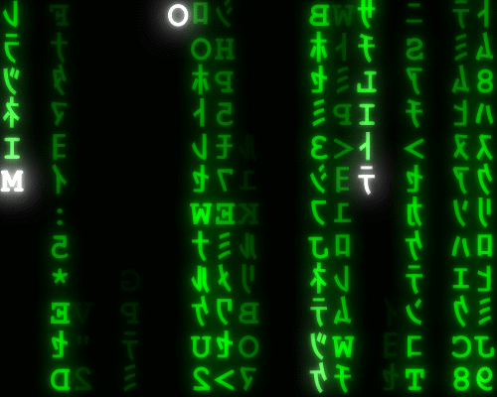
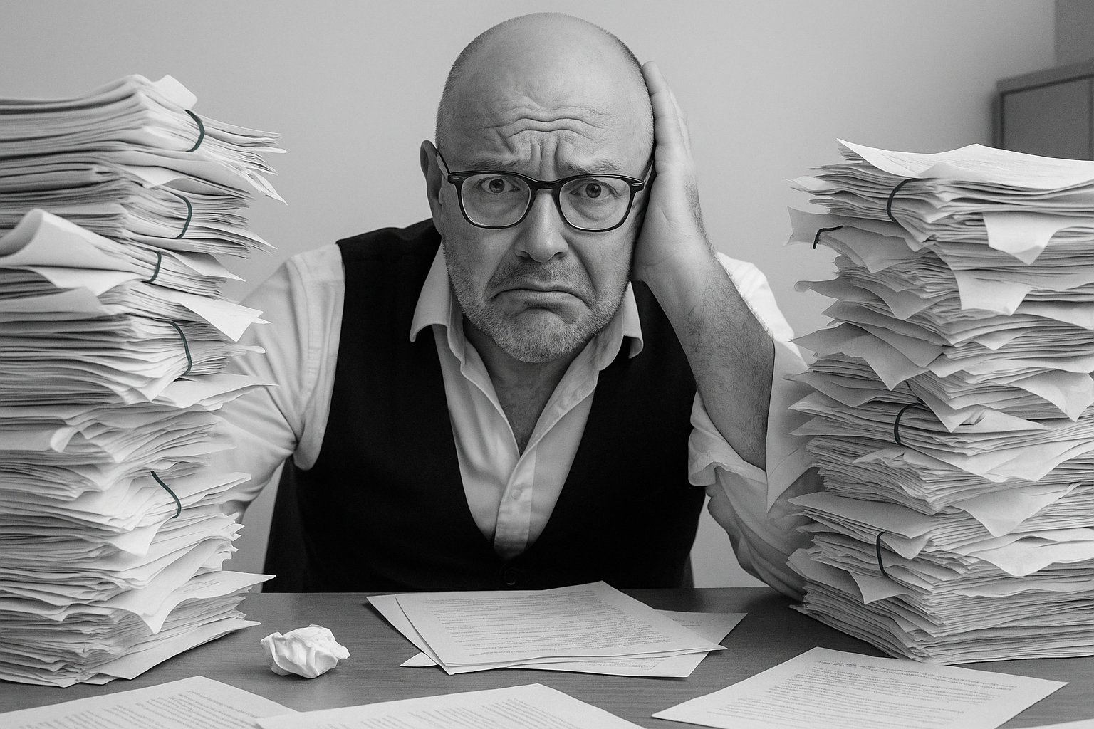


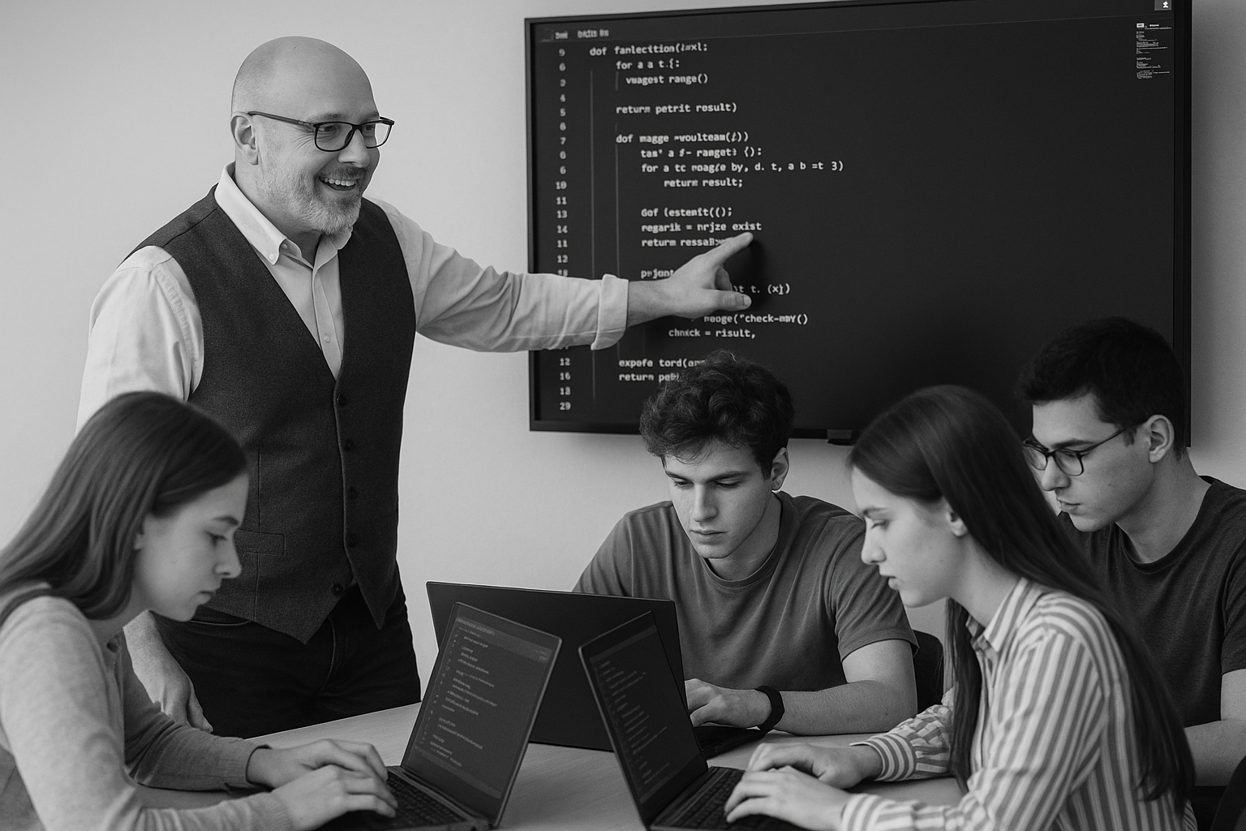
<title>
Note this down
Xmins
Do not delete this slide nor move it from the second last slide in the deck

