Slide 1
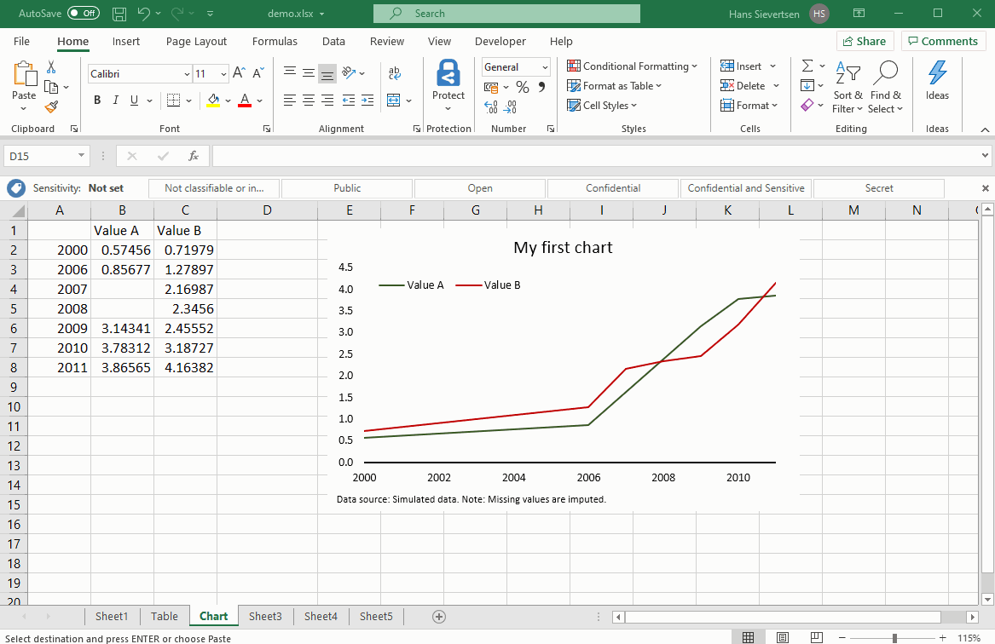
Application Software and IDEs
Lesson 4

Slide 2
Recall from last lesson
https://forms.cloud.microsoft/e/pVEJVa0JXw
An email should by now have arrived with the link attached.

Slide 3
Application Software
Lesson 4

Slide 4


Word Processing Software
Document creation
Images
Tables
Programmable in VBA (Visual Basic for Applications)
Other Office objects can be inserted
  such as an Excel Spreadsheet

Slide 5

Spreadsheets
Store numeric and alphanumeric data in columns and rows
Undertake calculations on that data
  When one piece of data changes, other data that refer to that data also updates
Sort data
Generate real-time graphs
Store small quantities of data that is not worth placing on a database

Slide 6



Databases
Store and retrieve information
MySQL and SQLite offer no front end
  Requires separate coding to create desktop access
Access can create simple front ends and connect to internal data sources or external such as MySQL
Data can be queried and manipulated using SQL (Structured Query Language)

Slide 7



Email
Send and receive eMail using
  SMTP to send
  IMAP or POP3 to receive
Gmail used web-only client
Outlook has both web and app clients
Thunderbird is app only

Slide 8

Application Software Debate
Working Independently
A small charity is setting up and can only afford to prioritise one software package first.
Prepare a 2-minute pitch arguing why one piece of software should come first. Use whatever tools you wish.
The Class will vote on the winner
25 mins
Word processor
Spreadsheet
Database
Email

Slide 9
Homework
Research a real-world case where poor choice of software caused problems
  such as data loss or project failure
Write a short (300 word) paragraph describing what happened and how the right software could have prevented it.
Deadline:
Midnight before next lesson

Slide 10
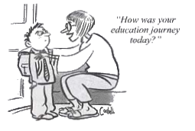







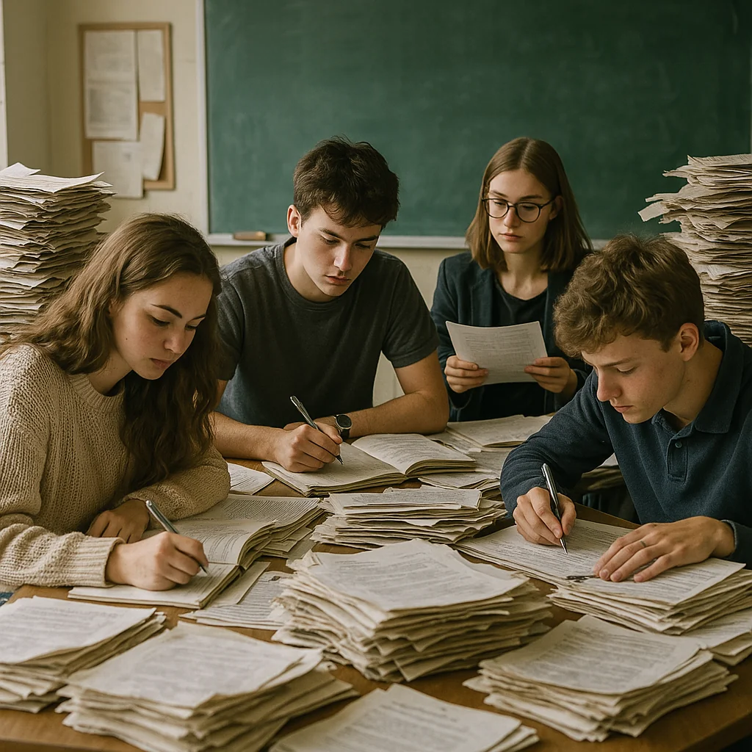



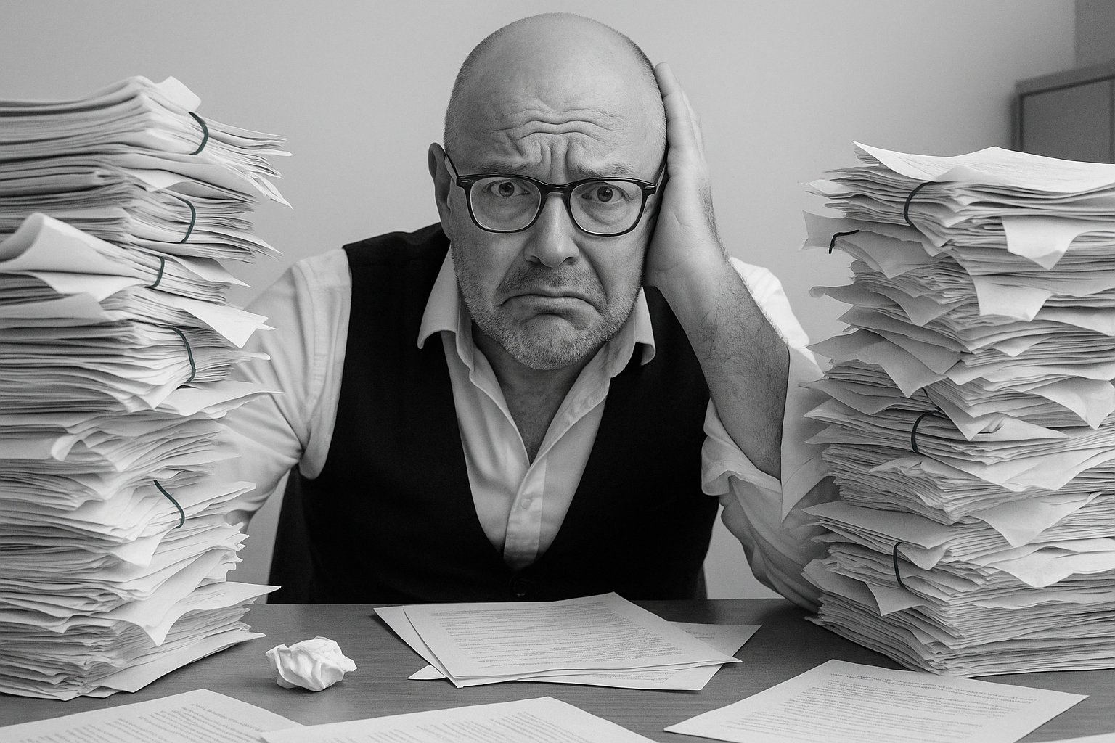

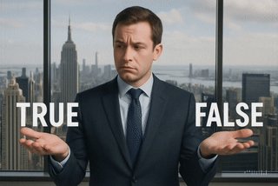
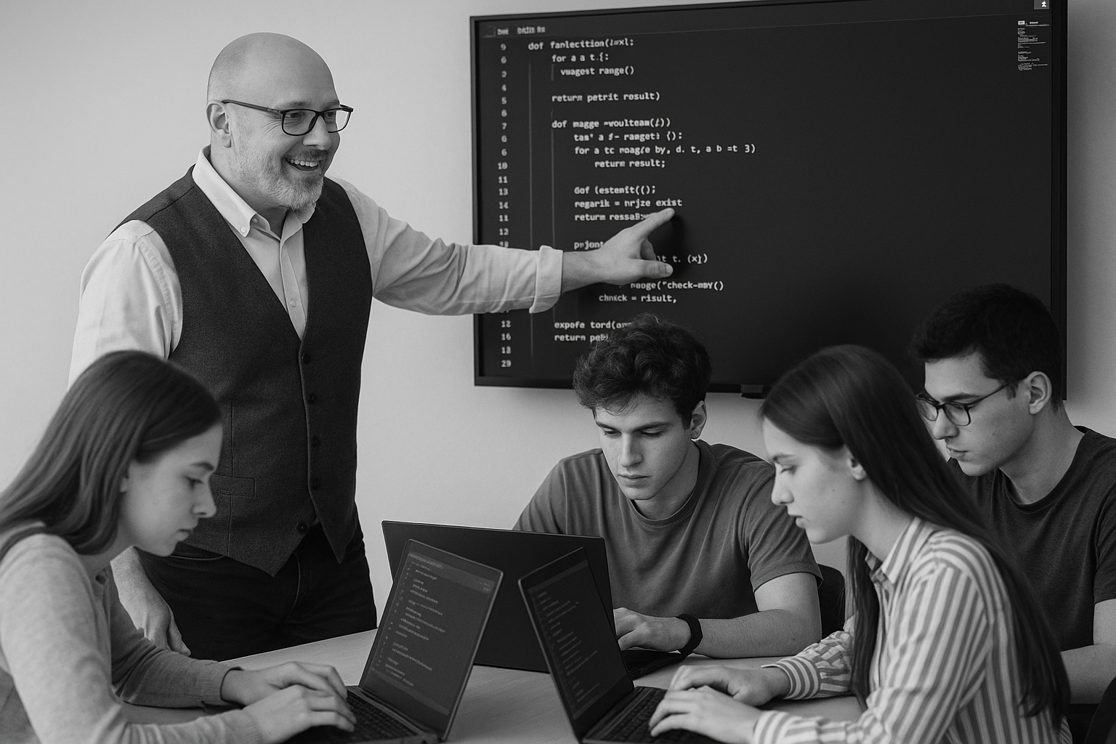
<title>
Note this down
Deadline:
Midnight before next lesson
Xmins
In small groups
Working Independently
In pairs
codeblock
Do not delete this slide nor move it from the second last slide in the deck

