Slide 1
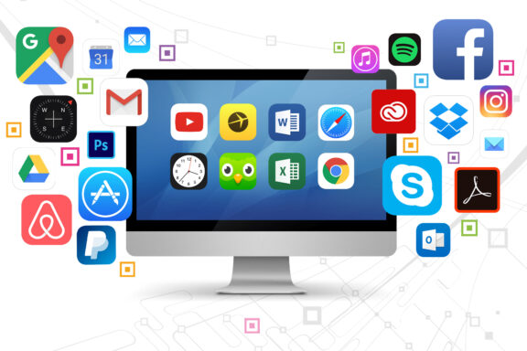
Software
DSD Digital Environments Lesson 3

Slide 2
Recall from last lesson
https://forms.cloud.microsoft/e/k4pgcvUB63
An email should by now have arrived with the link attached.

Slide 3
Software
DSD Digital Environments Lesson 3

Slide 4


Would an OS do this? or
Formats a paragraph
Decides which program gets CPU time
Checks your spelling
Encrypts data sent across the network

Slide 5

Let’s think about Software
Note this down
Your documents
This is software
Word
Excel
Paint
Utilities
Operating System
Firmware
Peripherals
This is hardware
Hardware

Slide 6
There are 5 key types of Operating System
Note this down
Batch Processing
Multitasking
Real-Time
Network
Mobile

Slide 7
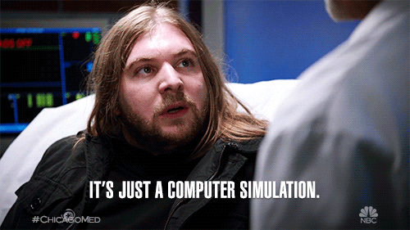
OS Role Play
We will need 5 groups
I will give you one of the instruction cards, a pen and some blank cards if you need them
You all have a couple of minutes to work out how to act out on the card
And a couple of minutes to show us your simulation in action which results in the key learning points
Notes:
1. Batch Operating System
Scenario: You are working in a payroll department in the 1970s. The company has 1000 payslips to print.
Simulation Steps:
Students line up holding “jobs” (pieces of paper with tasks written on them).
One student is the scheduler: collects jobs into a pile.
Scheduler processes them all at once, with no interaction from the “users.”
At the end, everyone gets their completed job back.
Key Learning Points:
Handles large volumes of non-interactive jobs.
Jobs are processed in batches, not one at a time with interaction.
Efficient for repetitive tasks (e.g., payroll, billing).
2. Multitasking Operating System
Scenario: You are on a modern PC running Word, Spotify, and a web browser.
Simulation Steps:
Three students each act as a program (Word, Spotify, Browser).
One student is the CPU with a stopwatch/timer.
Every 5 seconds, the CPU gives attention to a different “program.”
Each “program” says what it’s doing when given CPU time.
Key Learning Points:
Uses time-slicing so many tasks appear to run at once.
Interrupts allow urgent jobs to break in.
What you see: smooth multitasking.
3. Real-Time Operating System
Scenario: You are controlling a self-driving car.
Simulation Steps:
Students act as sensors:
One calls out “Obstacle!”
Another calls out “Turn left!”
One student is the CPU: must respond immediately to each input with an action card (Brake! or Turn wheel!).
Any delay could cause a “crash.”
Key Learning Points:
Prioritises immediate responses.
Used in safety-critical systems (cars, planes, medical devices).
No tolerance for delay.
4. Network Operating System
Scenario: You are running a computer lab with shared files and printers.
Simulation Steps:
Several students act as “users” logging in.
One student is the server: gives out login permissions and grants access to shared resources (file, printer).
Users request a file or print job; the server decides if they can access it.
Key Learning Points:
Provides resource sharing (files, printers).
Manages user accounts and communication.
Centralises security and management.
5. Mobile Operating System
Scenario: You are using a smartphone to play music, check messages, and save battery.
Simulation Steps:
Three students act as apps (Music, Messages, Game).
One student is the OS: decides which apps run and when.
When “battery is low,” the OS shuts down some apps or dims the “screen” (student holding a sign).
Apps complain, but OS keeps control.
Key Learning Points:
Designed for smartphones and tablets.
Balances low power use with performance.
Prioritises user experience (smooth multitasking, battery life).
With these cards, each group can act out their OS in under 5 minutes, then present back to the class.

Slide 8
Batch Processing
Note this down
Scenario
You are working in a payroll department in the 1970s. The company has 1000 payslips to print.
Simulation Steps
Students line up holding 'jobs' (pieces of paper with tasks written on them).
One student is the scheduler: collects jobs into a pile.
Scheduler processes them all at once, with no interaction from the 'users.'
At the end, everyone gets their completed job back.
Key Learning Points
Handles large volumes of non-interactive jobs.
Jobs are processed in batches.
Efficient for repetitive tasks (e.g., payroll, billing).

Slide 9
Multi-Tasking
Note this down
Scenario
You are on a modern PC running Word, Spotify, and a web browser.
Simulation Steps
Three students each act as a program (Word, Spotify, Browser).
One student is the CPU with a stopwatch/timer.
Every 5 seconds, the CPU gives attention to a different 'program.'
Each 'program' says what it’s doing when given CPU time.
Key Learning Points
Uses time-slicing so many tasks appear to run at once.
Interrupts allow urgent jobs to break in.
Smooth multitasking for the user.

Slide 10
Real-Time Operating System
Note this down
Scenario
You are controlling a self-driving car.
Simulation Steps
Students act as sensors: one calls out 'Obstacle!', another calls out 'Turn left!'.
One student is the CPU: must respond immediately to each input with an action card (e.g., 'Brake!' or 'Turn wheel!').
Any delay could cause a 'crash.'
Key Learning Points
Prioritises immediate responses.
Used in safety-critical systems (cars, planes, medical devices).
No tolerance for delay.

Slide 11
Network Operating System
Note this down
Scenario
You are running a computer lab with shared files and printers.
Simulation Steps
Several students act as 'users' logging in.
One student is the server: gives out login permissions and grants access to shared resources (file, printer).
Users request a file or print job; the server decides if they can access it.
Key Learning Points
Provides resource sharing (files, printers).
Manages user accounts and communication.
Centralises security and management.

Slide 12
Mobile Operating System
Note this down
Scenario
You are using a smartphone to play music, check messages, and save battery.
Simulation Steps
Three students act as apps (Music, Messages, Game).
One student is the OS: decides which apps run and when.
When 'battery is low,' the OS shuts down some apps or dims the 'screen' (student holding a sign).
Apps complain, but OS keeps control.
Key Learning Points
Designed for smartphones and tablets.
Balances low power use with performance.
Prioritises user experience (smooth multitasking, battery life).

Slide 13
Utilities
Note this down
Utilities are small, system-orientated applications which exist to keep your system running
They often have a small but powerful set of features
Examples include:
file management
defragmenters
compression
package managers
protection
backup

Slide 14
Utilities Carousel
Working Independently
I have given you a double-sided worksheet
Move around the six scenarios and identify which one would be the appropriate one.
10 mins

Slide 15
Explain it to a 10 year-old
In pairs
Nothing beats trying to explain something to someone in really simple terms
In pairs, one student explains either an OS type or a utility to the other as if they were a child.
Swap roles.
Share the funniest/clearest examples.
As we covered earlier
10 mins

Slide 16
Homework
Find a screenshot of a system utility on your home PC/laptop, or one of the College machines
Write 3 bullet points explaining:
What it does.
Why it’s useful.
What might happen if you didn’t use it.
Deadline:
Midnight before next lesson

Slide 17
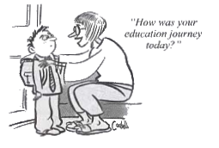







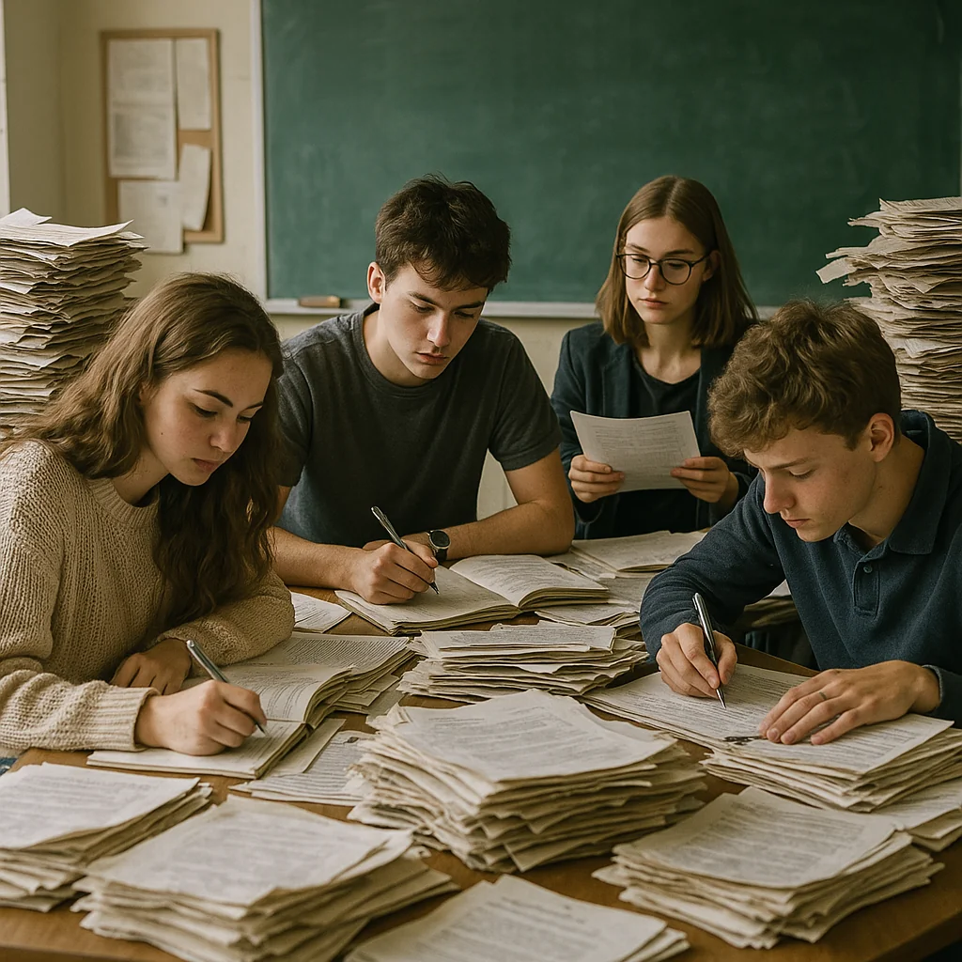



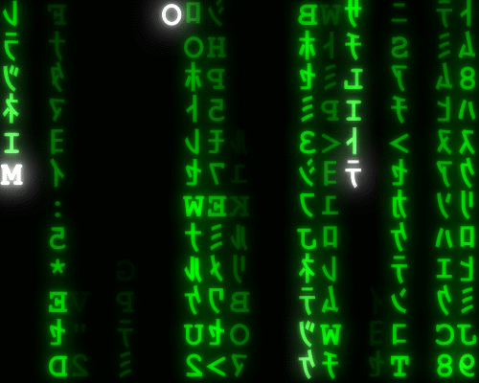



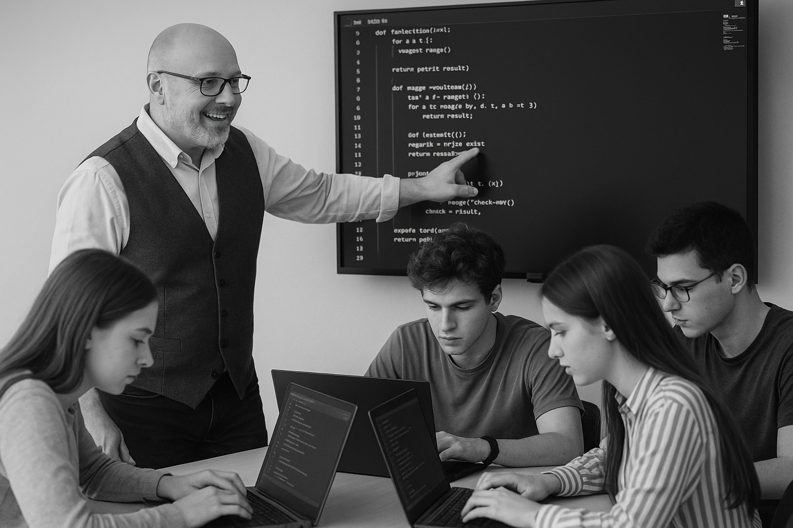
<title>
Note this down
Deadline:
Midnight before next lesson
Xmins
In small groups
Working Independently
In pairs
codeblock
Do not delete this slide nor move it from the second last slide in the deck

