Slide 1

Welcome
You can sit where you like to begin with.
Please log in to your computers open Teams
and visit this class: T Level DSD Y1 Group A/B or visit:
https://forms.office.com/e/BzTG2CNnyw
and complete a short quiz for me to get to know you.

Slide 2


Simon Rundell
I am your teacher for this course.
30+ years experience as a Software Developer

Slide 3
My lessons
Before each lesson I will set a small bit of preparation
  A video to watch
  Something to read
  Something to look up and make some notes
Most lessons will begin with a recall of things we have done in the recent and less recent past
At the end of each lesson I will set a small task
  A video to watch
  Something to look up and make some notes
  A task to undertake

Slide 4
My expectations
That you will do the preparation and be equipped for the lesson
That you will do the set task in time for the next lesson
During the lesson:
  Focus Zone – no phones unless I have specified you to use them
  Listen when I am teaching
    No headphones or earbuds when I am talking
    Engage with the content and the exercises
  Ask relevant questions

Slide 5
My expectations
When working:
  Don’t chat with your neighbours – silence is standard
  Headphones/earbuds is a privilege not a right
  Be prepared to stop, turn and listen when I countdown.
  Don’t be distracted by off-topic web browsing, email checking or other time-wasting

Slide 6
You can expect from me
Lessons that are grounded in my experience
Theory and practice
Commitment to teaching and supporting you well
Help as and when you need it – just ask!

Slide 7

Questions on any of that

Slide 8
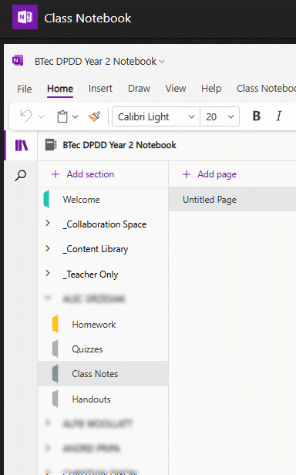
Using the Teams Class Notebook
Teams
Class Notebook
<Your Name>
Class Notes
Create New Page “Digital Environments”
When you see:
Note this down
This is where I expect you to make notes under the appropriate lesson heading

Slide 9
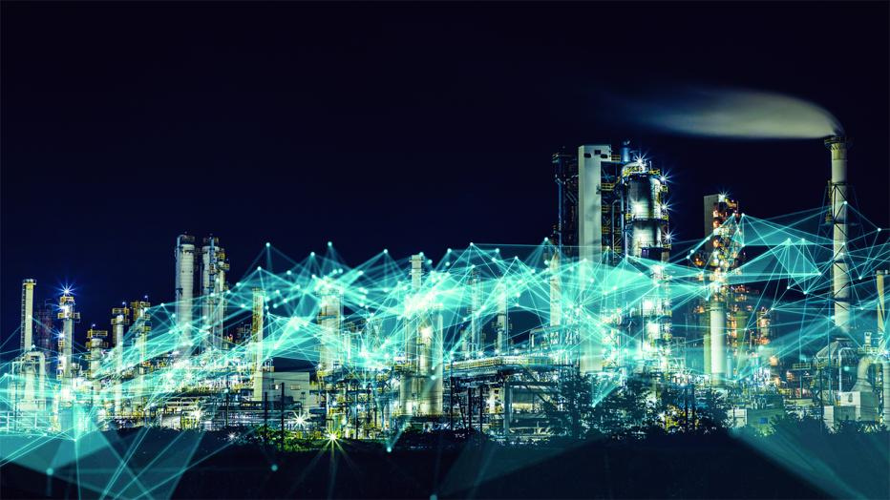
Digital Environments
Lesson 1

Slide 10
What is a Computer?
Talk with your neighbour

Slide 11
My definition:
Note this down
A digital machine designed to undertake calculations
A grown-up calculator?

Slide 12
What can you do with these calculations?
Store numbers to undertake Mathematics and Physics
Store text and images as digital information
Manipulate text and images to create documents
Draw images on screen and animate them
Play games with those animated images
Monitor environments and control systems based upon that information
Build systems capable of inferring answers based upon other information (Artificial Intelligence)

Slide 13
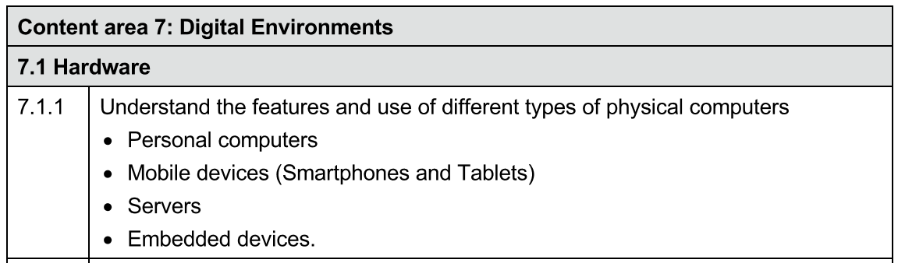
From the course specification:
p36

Slide 14
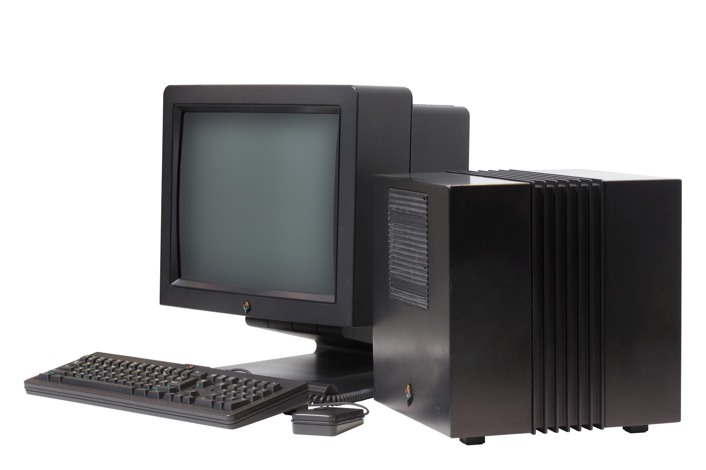
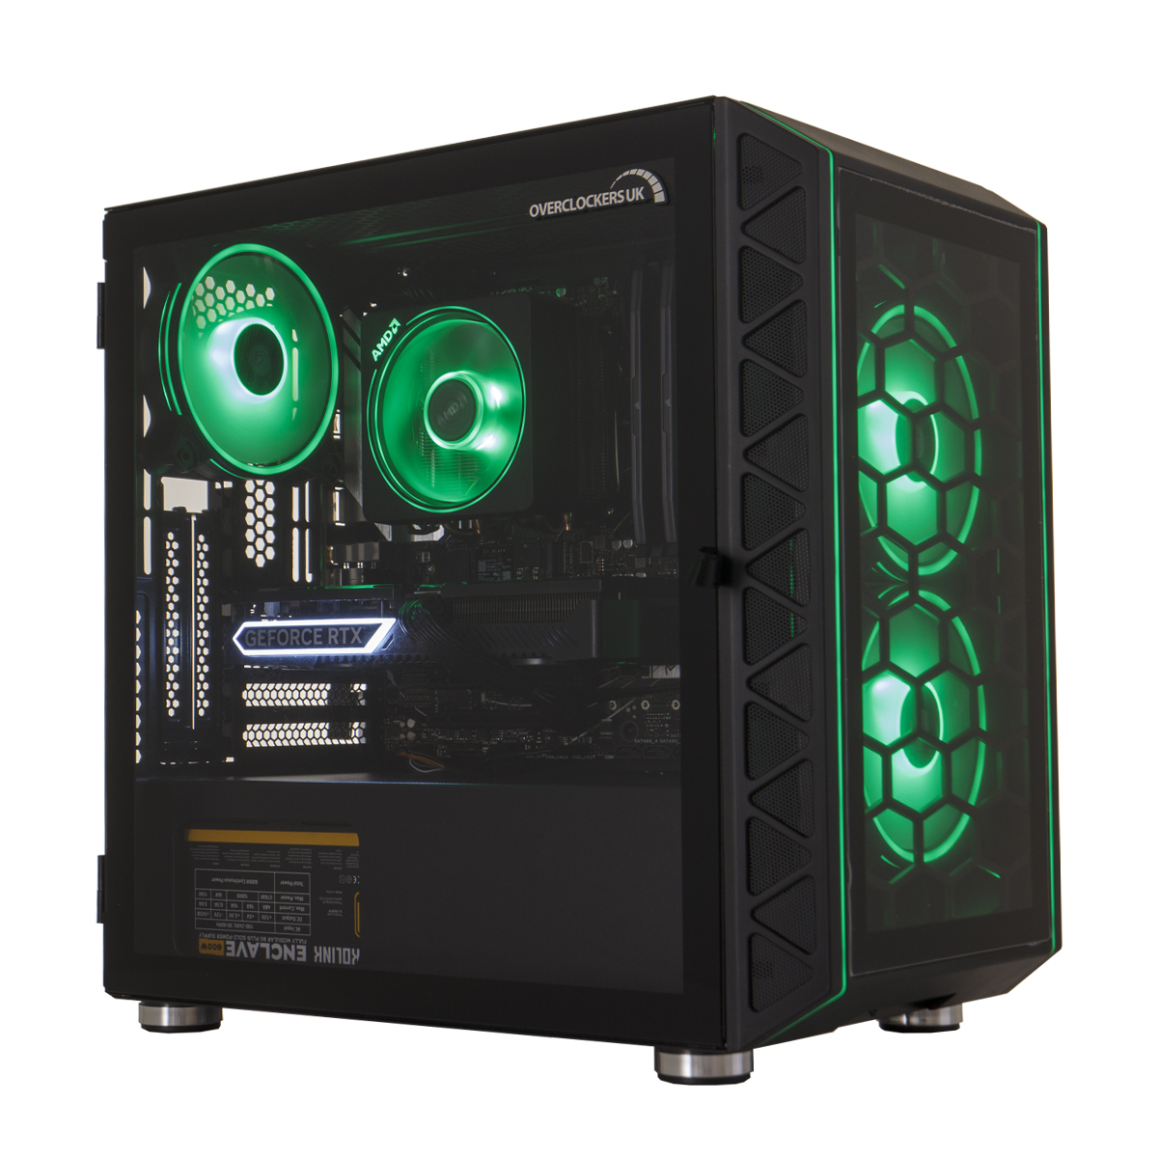
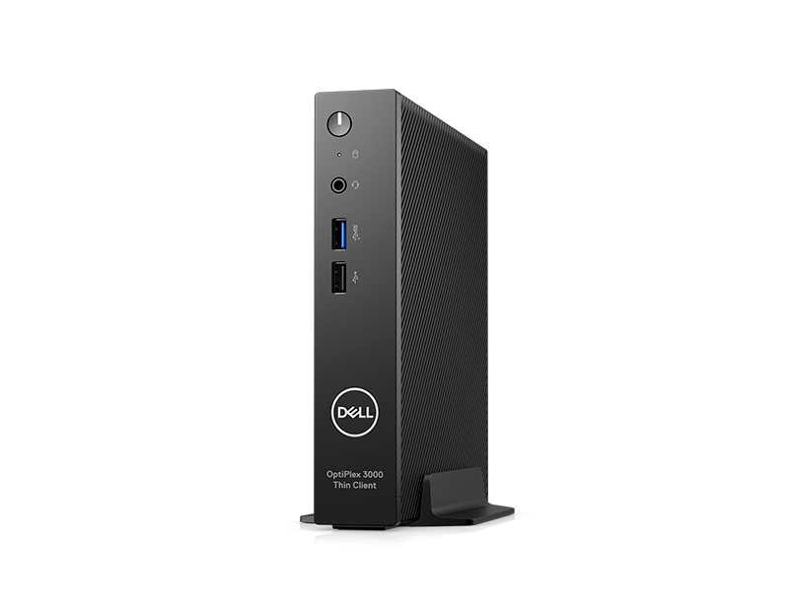
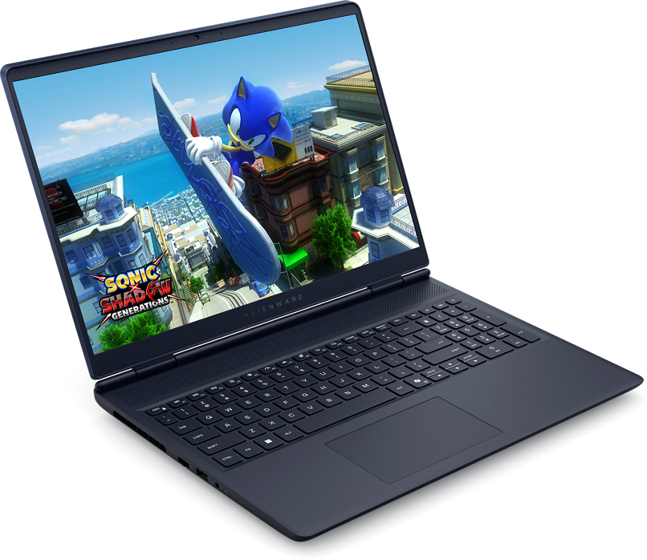
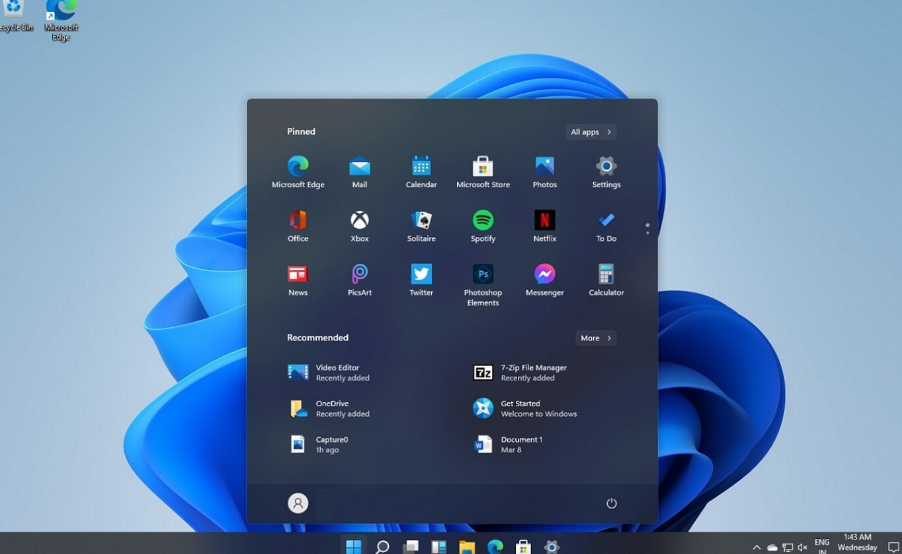
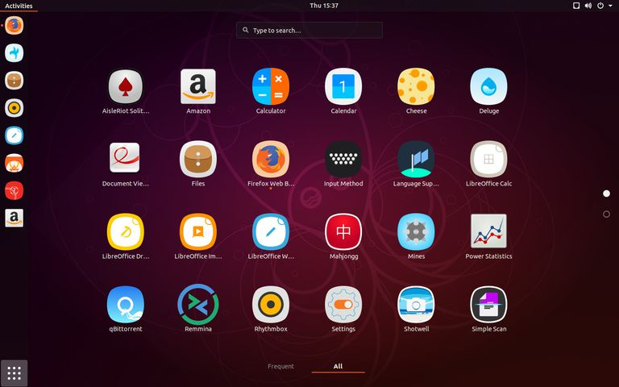
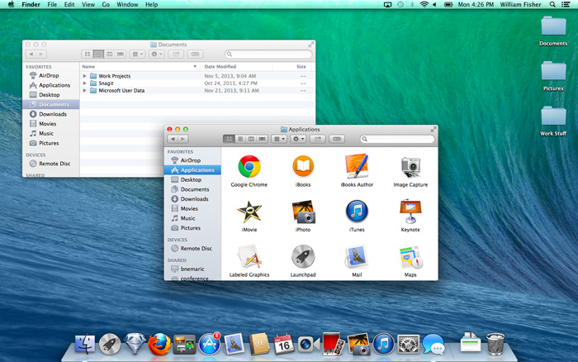
Personal Computers
Note this down
Desktop Computers
  PCs
  Workstations
  Thin Clients
  Laptops
Main Operating Systems:
  Windows
  Linux
  OSX

Slide 15
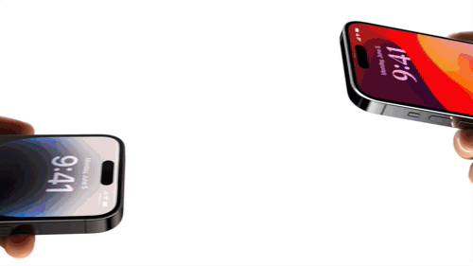
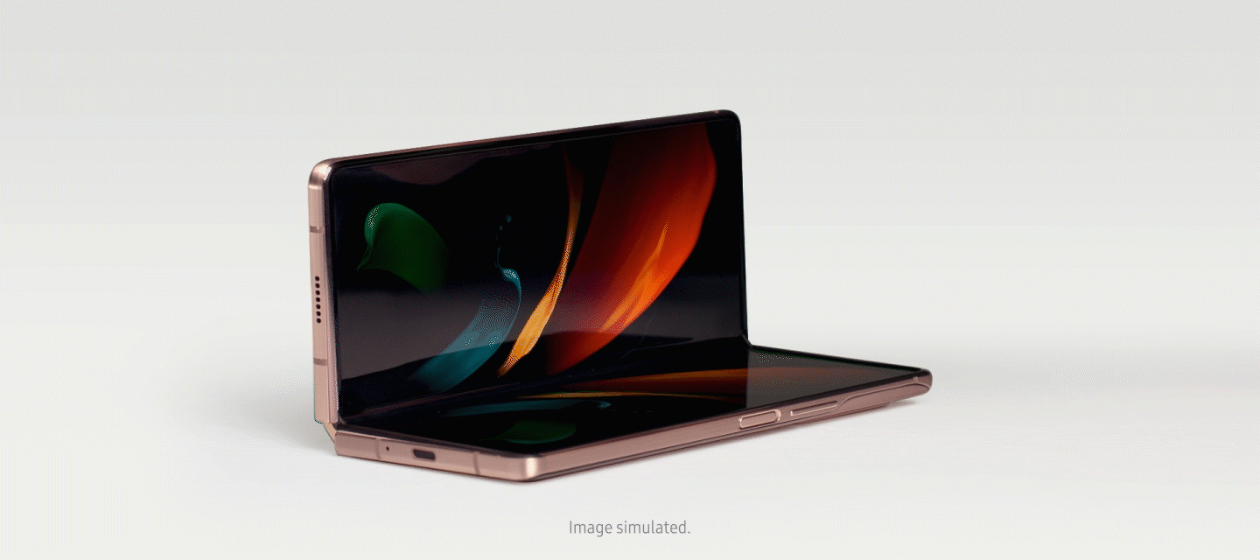
Mobile Devices
Note this down
Smartphones
Tablets
The difference?
Size.

Slide 16
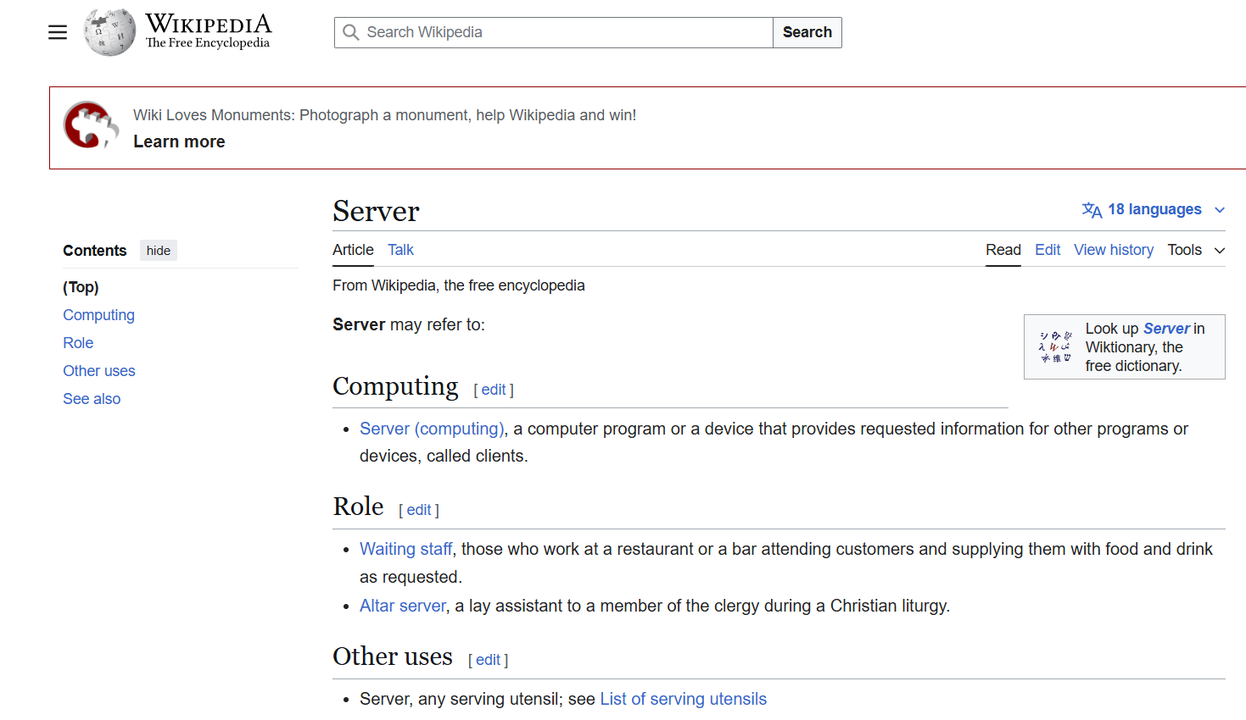



Servers
Visit: https://en.wikipedia.org/wiki/Server

Slide 17
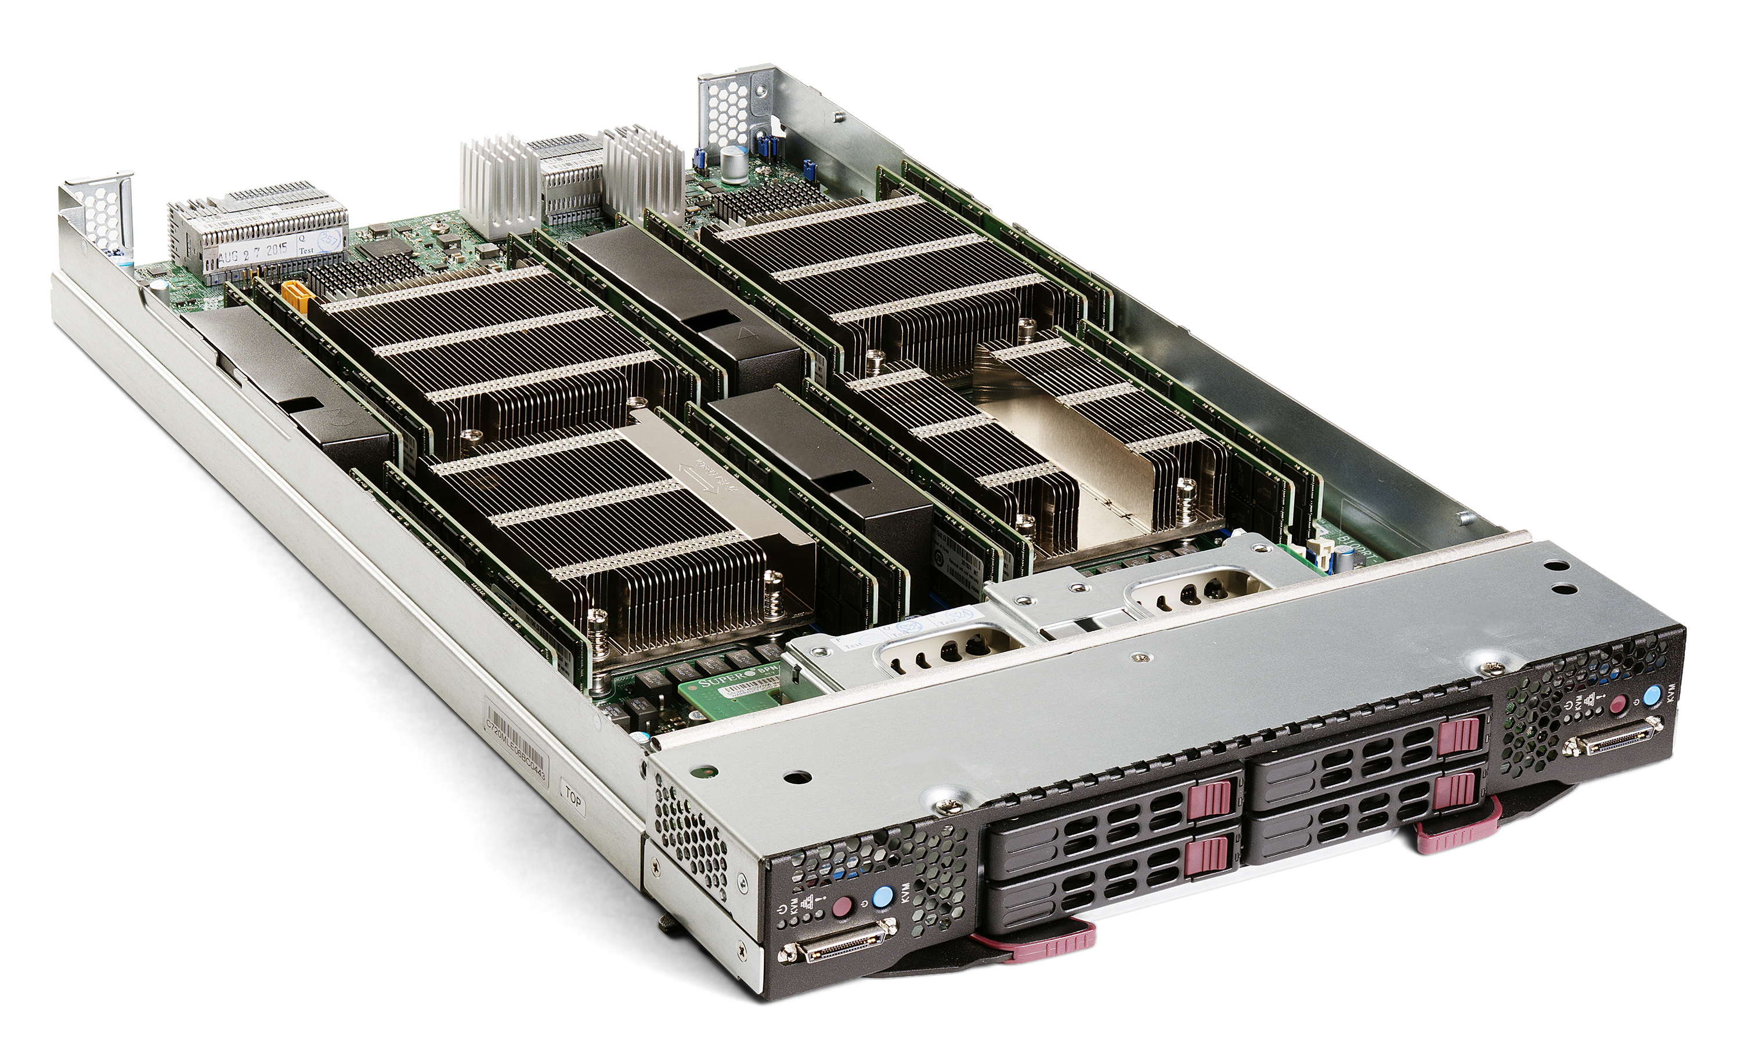
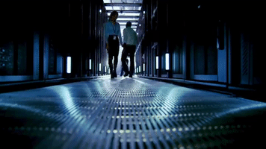
Servers
Note this down
Machines dedicated to delivering information over networks as requested:
  Files
  Web Pages
  Data
  Images
  Printing
Any machine can work as a Server but most are highly expensive, fault-tolerant and fast: housed in massive super-cooled data centres

Slide 18
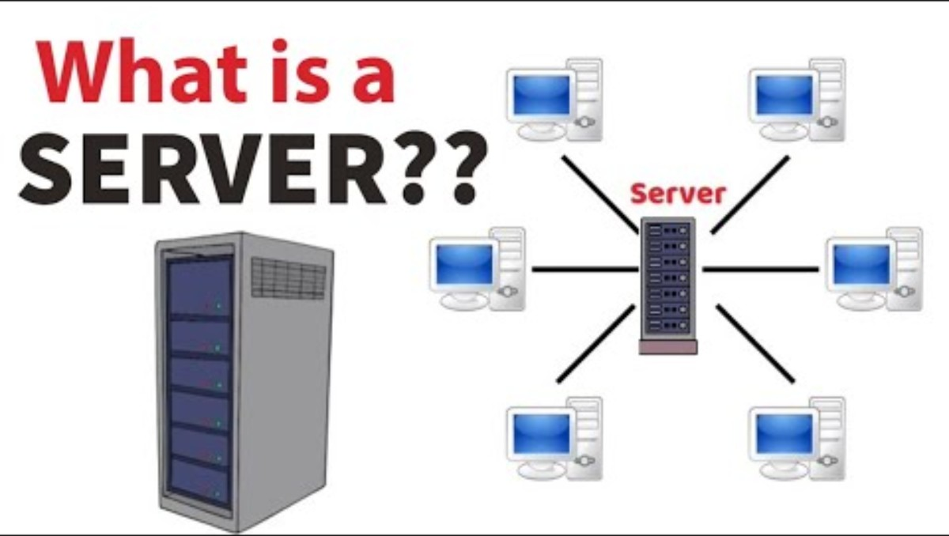

Slide 19
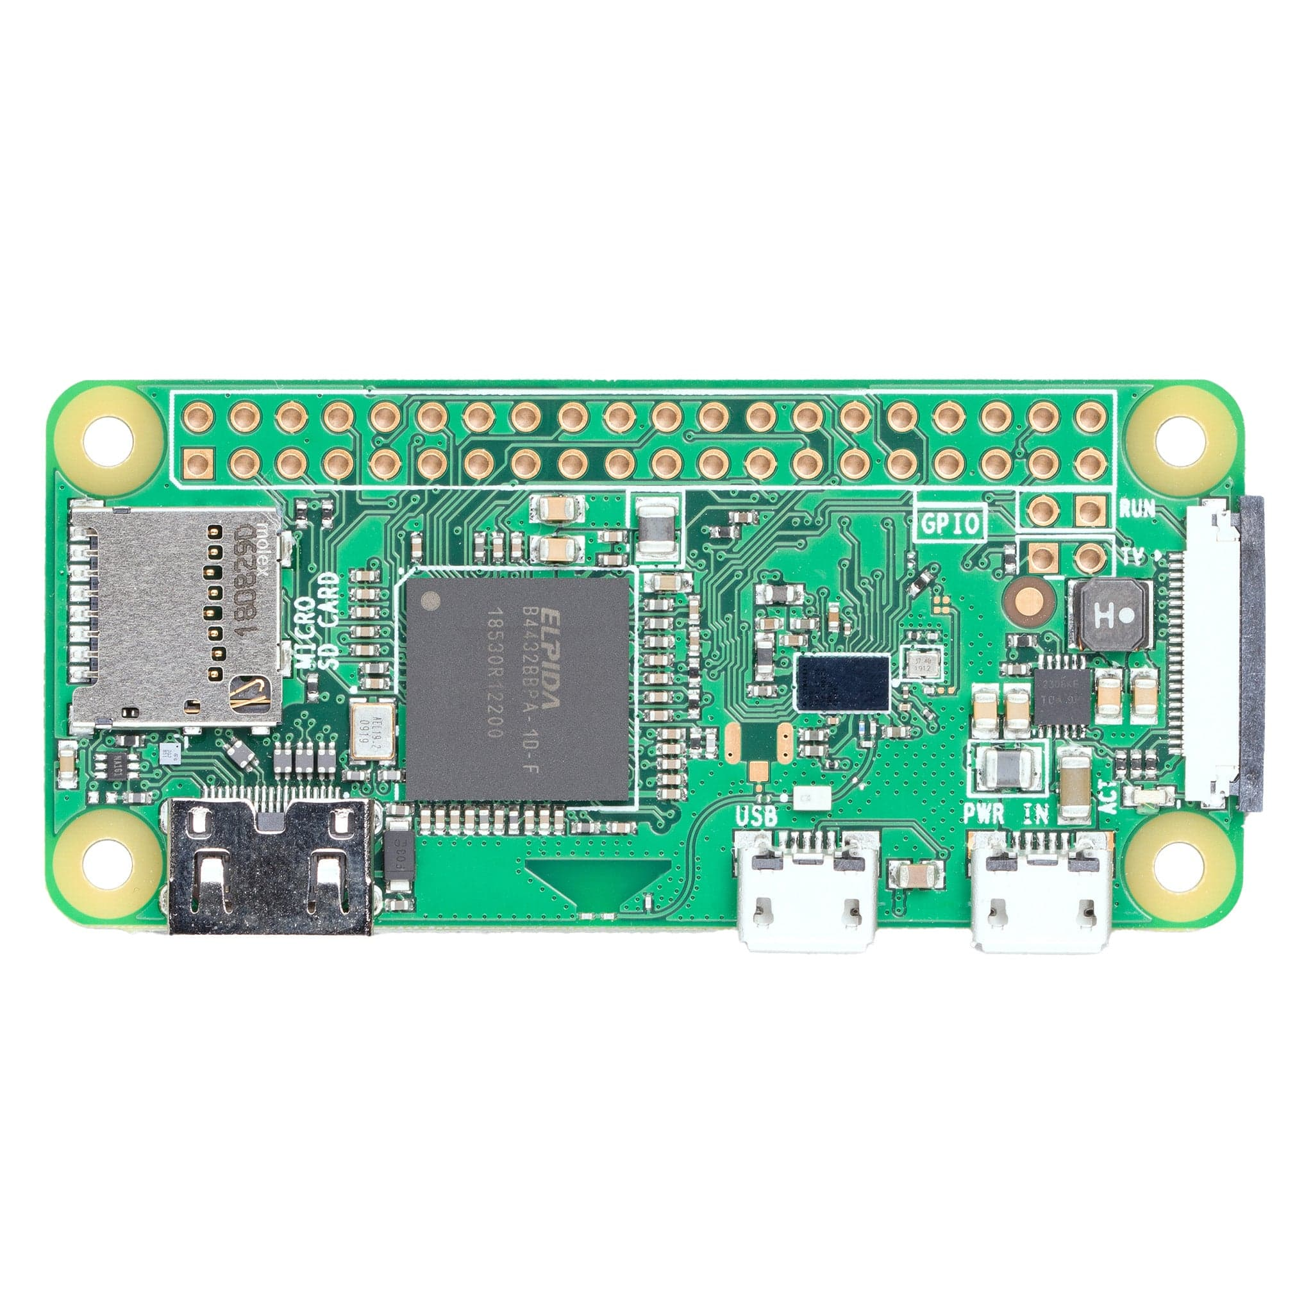
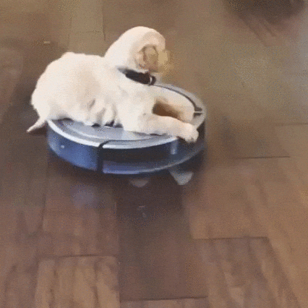
Embedded Devices
Note this down
Small Single-board computers that fit into other devices:
  Washing Machines
  Fridges
  Robot Vacuum Cleaners
  Cars
  …and almost anything else that is electronic
Often programmed with a dedicated function in mind

Slide 20


Slide 21
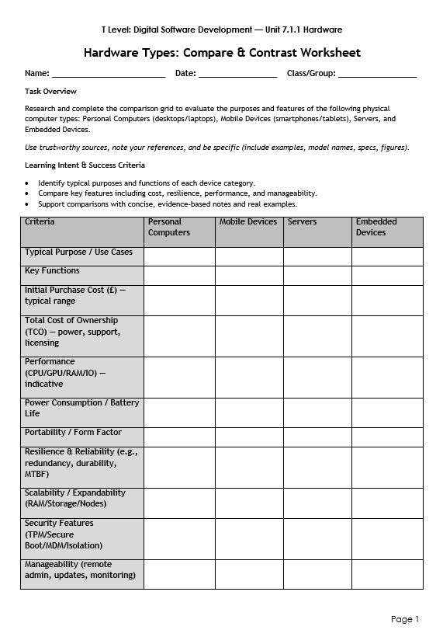
Worksheet Activity
Research and complete the online worksheet
You will find it in Class Teams / Classwork / Digital Environments / Hardware Comparison Worksheet
Add to your Teams Class Notebook by end of lesson

Slide 22

Homework – See Teams Assignments
Deadline:
Midnight before next lesson
Find a job role that uses each type of system:
  Personal Computers
  Servers
  Embedded Systems
Create a Word document and explain how they might use them.
Upload it to the homework assignment entry.

Slide 23
Sample Texts
True / False:
PLEASE LOG IN
PLEASE LOG IN
Do not delete this slide nor move it from the second last slide in the deck

Slide 24
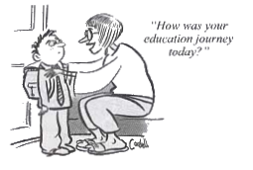







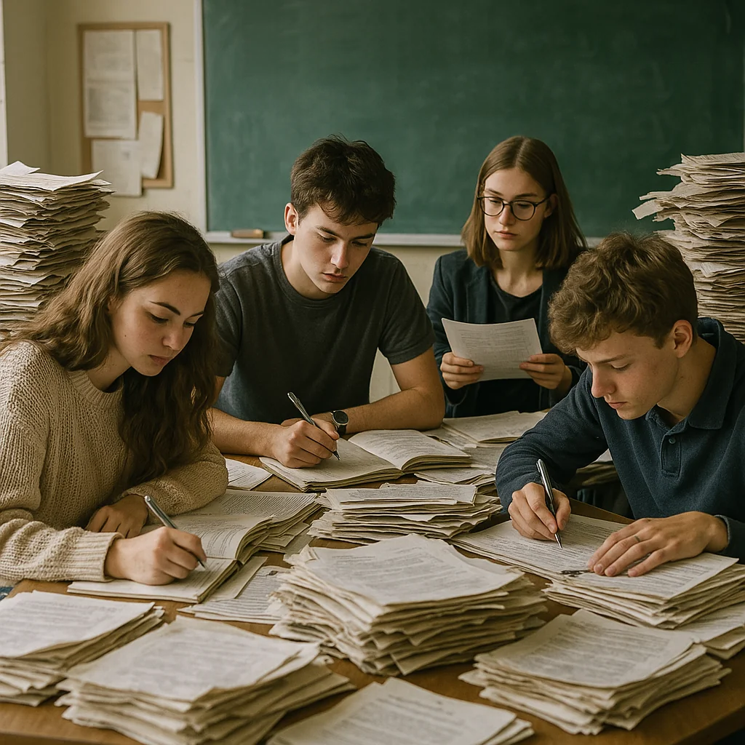


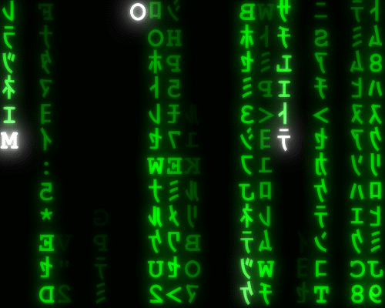
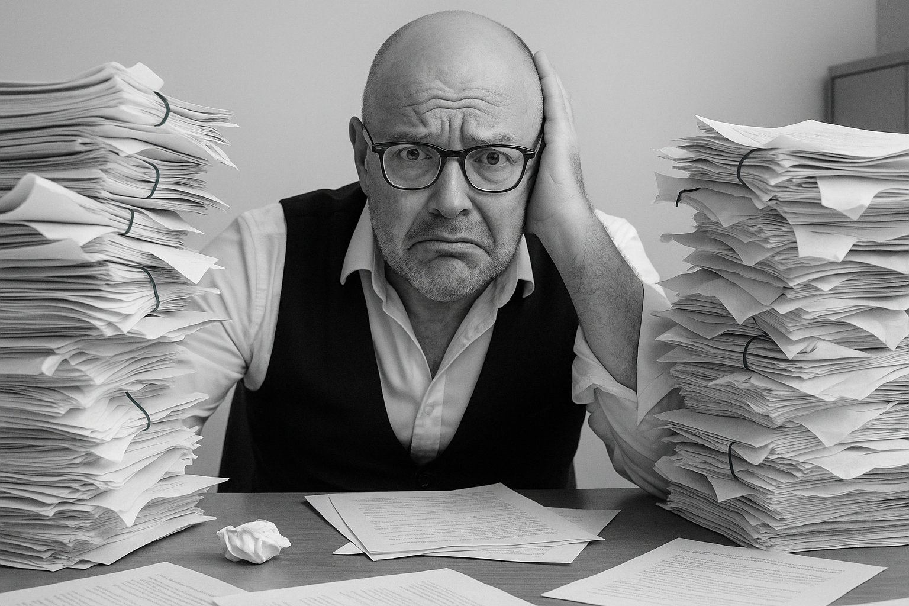


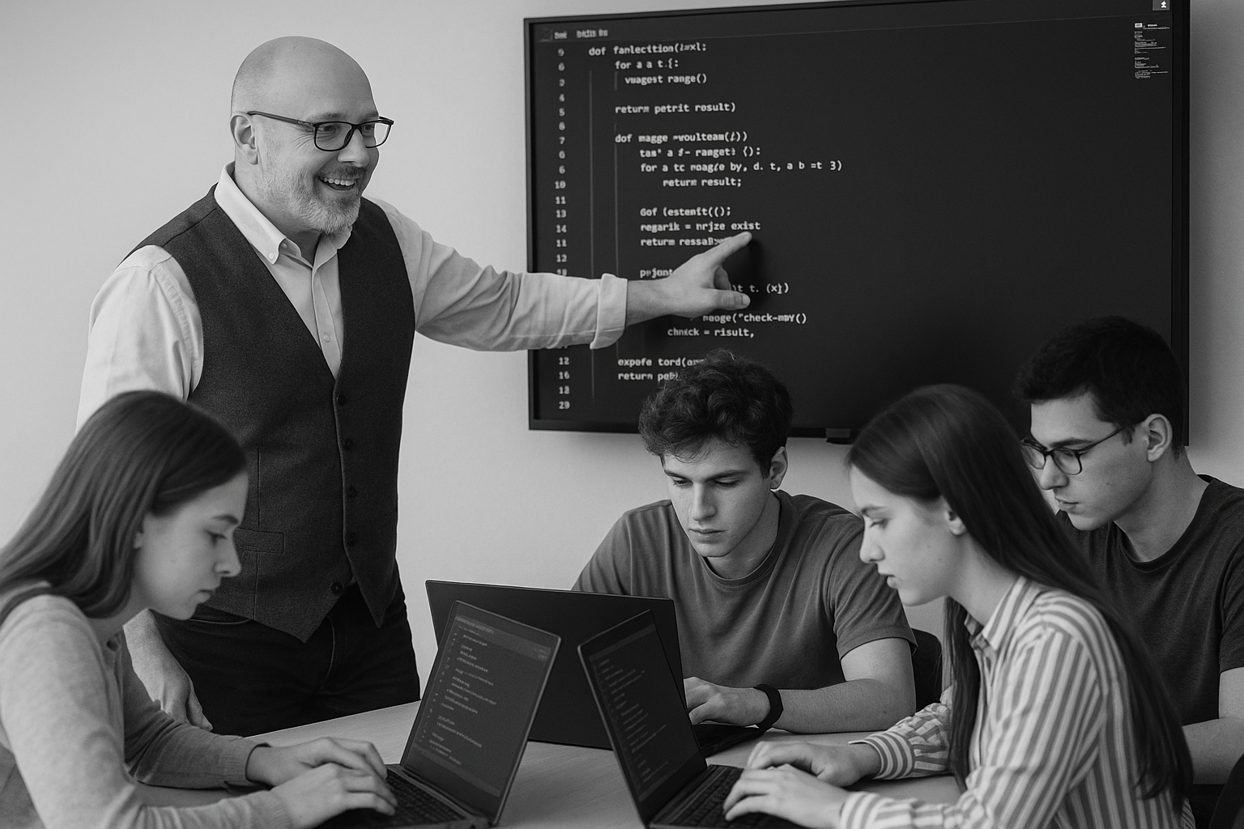
<title>
Note this down
Xmins
Do not delete this slide nor move it from the second last slide in the deck

