Slide 1
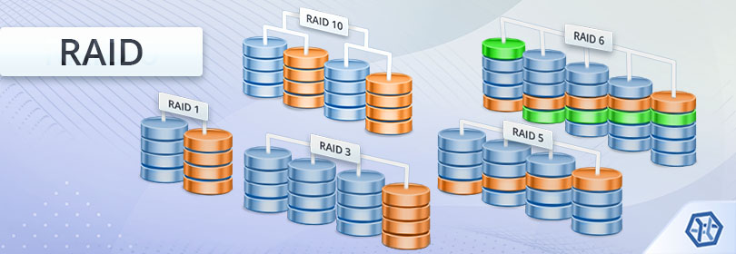
Digital Environments
Lesson 05
Physical Storage

Slide 2
Recall from last lesson
<URL>
An email should by now have arrived with the link attached.

Slide 3
Digital Environments
Lesson 05
Physical Storage

Slide 4
Learning Objectives
Understand how physical data storage and recovery systems work, their features, benefits and drawbacks - including:
  Redundant Array of Independent Disks (RAID)
    RAID 1
    RAID 5
    RAID 10
  Network Attached Storage (NAS)
  Storage Area Network (SAN)

Slide 5

NAS and SAN
Q: Where do you think your phone photos are really stored when you use iCloud, Google Drive, or OneDrive?
A:

Slide 6
Network Attached Storage
Note this down
Definition: A dedicated storage device connected to a network, providing file-level access (like a shared folder).
Access method: Uses protocols like NFS, SMB/CIFS.
Analogy: Like a filing cabinet everyone can access over the network.
Use cases: Small/medium businesses, home backups, file sharing.

Slide 7
Storage Area Network
Note this down
Definition: A high-speed, specialised network that connects storage devices to servers, providing block-level access.
Access method: Servers see SAN storage as local hard drives (protocols like Fibre Channel, iSCSI).
Analogy: Like giving each computer its own private hard drive, but physically they’re all in a central storage room.
Use cases: Large enterprises, databases, virtualisation, high-performance workloads.

Slide 8
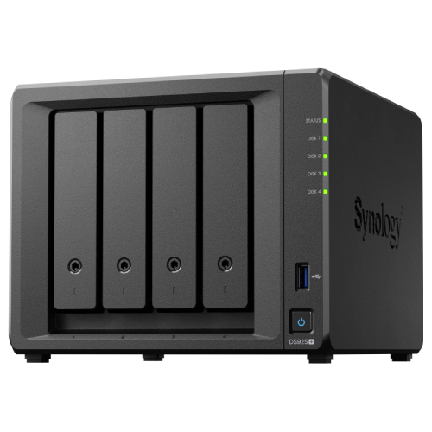
Comparison
Note this down
Feature | NAS | SAN
Access level | File-level | Block-level
Network type | Ethernet (standard LAN) | High-speed network (Fibre Channel, iSCSI)
Ease of setup | Simple, plug & play | Complex, requires specialist skills
Performance | Moderate | Very high
Scalability | Easy to add drives | Highly scalable but costly
Cost | Lower | Higher

Slide 9
Similarities
Note this down
Both provide centralised storage.
Both improve collaboration and data management.
Both can be used with backups, redundancy, and security measures.

Slide 10
In pairs
Which would be more suitable for:
A small business with 20 employees sharing files.
A bank processing millions of secure transactions daily.
Answers
1 = NAS
2 = SAN
3 mins
Why?

Slide 11
Recap
NAS = simple, file-based, cheaper.
SAN = complex, block-based, high-performance.
Final analogy:
NAS = Shared Google Drive folder.
SAN = Each server gets its own “super hard drive” from a central pool.

Slide 12
Starter: Initial Key Terms/Glossary
Disk: A device capable of storing data long term
  e.g. HDD or SSD
Array: An amount of disks connected greater than one
Redundant: A technique which provides more than one copy of data
RAID: Redundant Array of Independent Disks
Read: Transferring data from a disk or RAID to a computer system
Write: Transferring data from a computer system to a disk or RAID

Slide 13
Redundant Array of Independent Disks (RAID): Introduction
RAID is a technology that has been developed and in use for over 30 years
It allows for storage disks (HDDs, SSDs or mixed) to be combined into an array, for either:
  Extended redundancy/backup capability
  Increased speed
  A mixture of the above

Slide 14
RAID: Uses
The main focus of RAID is to increase storage capacity of a system, while maintaining high levels of fault tolerance and reliability
This is the main business case for RAID – preventing expensive data loss – however, the technology can also be leveraged to increase speed of a disk array or simply for the utility of managing several disks as a single entity

Slide 15
RAID: Characteristics
There are three key techniques used on their own, or in combination, when creating a RAID array of disks:
  Striping – Separating a write data flow across all disks
  Mirroring – Copying a write data flow across all disks
  Parity – Error-checking based on the number of 0’s and 1’s in a data block and the block’s checksum

Slide 16
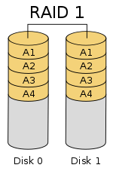
RAID 1
RAID 1 is quite simple: an exact copy – a mirror – of the data write stream is made across all disks within the array
As the data has to be copied to each disk, the total size of the array will be the size of the smallest disk in the array
When writing to the array, the speed will be equal to the write speed of the slowest disk
When reading data from the array, the operation can be split across disks and at maximum read speed can be the total sum read speed of all disks
  When reading A1, part can be taken from Disk 0 and part from A1, up to halving the read time

Slide 17
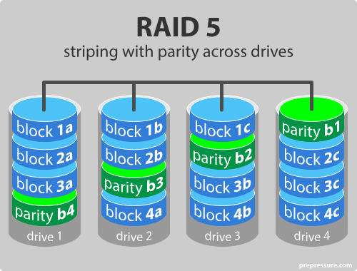
RAID 5
Data is split into blocks and spread ("striped") across multiple disks.
RAID Parity is a mathematical way of protecting data.
  It’s not a full copy of the data, but rather a checksum-like value that allows missing data to be reconstructed if a disk fails.
👉 “If I know all the other pieces of data,
can I figure out the missing one?”

Slide 18
RAID 5: Calculating Parity Checksums
To calculate parity between sets of data, we use the binary exclusive-or logical operation → XOR
XOR takes two inputs, in binary, and will output a ‘1’ if both inputs are different and a ‘0’ if they are not
Input ‘A’ | Input ‘B’ | XOR Result
0 | 0 | 0
0 | 1 | 1
1 | 0 | 1
1 | 1 | 0

Slide 19
RAID 5: Calculating Parity Checksums
We can extend this parity calculation to actual data, for example, calculating the parity between the characters ‘a’ and ‘b’
In binary (through ASCII):
Parity →
 | ASCII | 128 | 64 | 32 | 16 | 8 | 4 | 2 | 1
a | 97 | 0 | 1 | 1 | 0 | 0 | 0 | 0 | 1
b | 98 | 0 | 1 | 1 | 0 | 0 | 0 | 1 | 0
XOR |  | 0 | 0 | 0 | 0 | 0 | 0 | 1 | 1

Slide 20
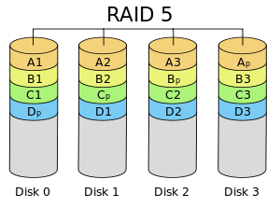
RAID 5: Striping
In RAID 1, all data was copied to all drives – with RAID 5, the data stream is divided by the (number of drives in the array – 1), for example, a four-drive array would see the data stream split into three, this is called striping
The ‘spare’ drive is used to store the parity data between the other drives, although, for each write stream, the disk storing the parity data changes

Slide 21
RAID 5: Redundancy Scenarios
Striping the data with a parity checksum for each write stream means that a whole drive within the array can fail and the data is still entirely protected
In our example we would have stored ‘a’ on Disk 0, ‘b’ on Disk 1 and the Parity Checksum on Disk 2
  If the parity checksum drive failed, we could simply recalculate checksums
  If Disk 0 or Disk 1 failed, we could use the remaining data and the parity checksum to rebuild the lost data

Slide 22
RAID 5: Recovering Data
 | ASCII | 128 | 64 | 32 | 16 | 8 | 4 | 2 | 1
a | 97 | 0 | 1 | 1 | 0 | 0 | 0 | 0 | 1
b | 98 | 0 | 1 | 1 | 0 | 0 | 0 | 1 | 0
XOR |  | 0 | 0 | 0 | 0 | 0 | 0 | 1 | 1
Original data:
Scenario – Disk 1 has failed
Recovery:
 | ASCII | 128 | 64 | 32 | 16 | 8 | 4 | 2 | 1
Disk 0 | 97 | 0 | 1 | 1 | 0 | 0 | 0 | 0 | 1
Parity Disk 2 |  | 0 | 0 | 0 | 0 | 0 | 0 | 1 | 1
Calculated Data | 98 = ‘b’ | 0 | 1 | 1 | 0 | 0 | 0 | 1 | 0

Slide 23
Task
Retrieve the corrupted data:
Explain how the XOR operation is used to calculate a parity checksum
 | 128 | 64 | 32 | 16 | 8 | 4 | 2 | 1
Disk 0 | 0 | 1 | 1 | 0 | 0 | 0 | 0 | 1
Disk 2 Parity | 1 | 1 | 1 | 1 | 0 | 1 | 1 | 0
Recovered Disk 1 Data
XOR Operation

Slide 24
Homework
Deadline:
Midnight before next lesson
A geographical study organisation requires redundant data storage for their 10Tb of mapping data – explain the RAID options available and which they should choose
Research their options and provide a range of costs
Explain the implications and benefits of each RAID option

Slide 25

















<title>
Note this down
Deadline:
Midnight before next lesson
Xmins
In small groups
Working Independently
In pairs
Do not delete this slide nor move it from the second last slide in the deck

