Slide 1

Welcome
You can sit where you like to begin with.
Please log in to your computers, open Teams
and visit this class: Level 2 Coding – Group B or visit:
https://forms.office.com/e/BzTG2CNnyw
and complete a short quiz for me to get to know you.

Slide 2
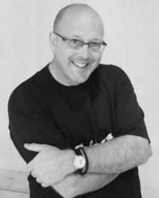

Simon Rundell
I am your teacher for this course.
30+ years experience as a Software Developer

Slide 3
My lessons
Before each lesson I will set a small bit of preparation
  A video to watch
  Something to read
  Something to look up and make some notes
Most lessons will begin with a recall of things we have done in the recent and less recent past
At the end of each lesson I will set a small task
  A video to watch
  Something to look up and make some notes
  A task to undertake

Slide 4
My expectations
That you will do the preparation and be equipped for the lesson
That you will do the set task in time for the next lesson
During the lesson:
  Focus Zone – no phones unless I have specified you to use them
  Listen when I am teaching
    No headphones or earbuds when I am talking
    Engage with the content and the exercises
  Ask relevant questions

Slide 5
My expectations
When working independently:
  Don’t chat with your neighbours – silence is standard
  Headphones/earbuds is a privilege not a right
  Be prepared to stop, turn and listen when I countdown.
  Don’t be distracted by off-topic web browsing, email checking or other time-wasting

Slide 6
You can expect from me
Lessons that are grounded in my experience
Theory and practice
Commitment to teaching and supporting you well
Help as and when you need it – just ask!

Slide 7

Questions on any of that

Slide 8
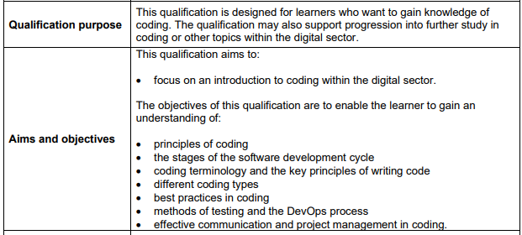
What is this course about?

Slide 9
It is an introduction
The first step towards Software Development.
A solid base for the Level 3 Qualifications in Digital Software Development or Digital Support and Security.

Slide 10
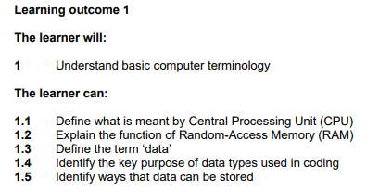
This half term…

Slide 11
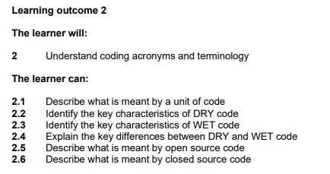
This half term…

Slide 12
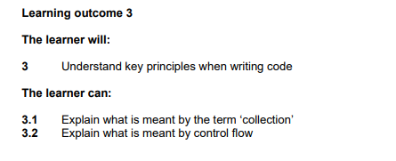
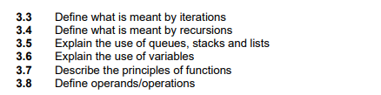
This half term…
The full course specification will be in the Teams Class Folder

Slide 13
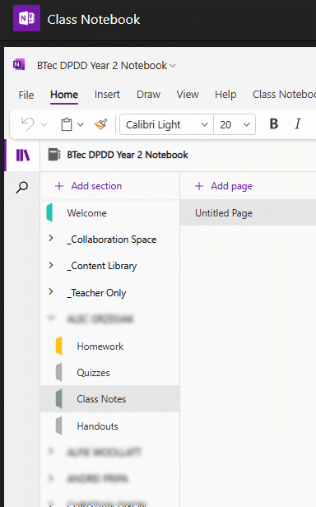
Using the Teams Class Notebook
Teams
Class Notebook
<Your Name>
Class Notes
Create New Page “Basic Computer Terminology”
When you see:
Note this down
This is where I expect you to make notes under the appropriate lesson heading

Slide 14
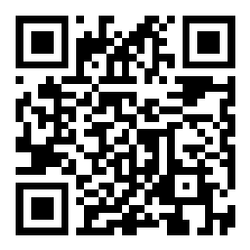
Open
x
Multiple Choice
Word Cloud
Image
Likert Scale
Date and Time
Instructions
www.kallbak.com/q
use code:
What is a Computer?
Create question at kallbak.com or with 'Add Question' from the top menu
To select a question use 'Get Question' from the top menu
Search for the question you want, from either your own or all the public questions
Select it and press 'Insert'
The Question will be inserted into the slide.
Any image will be inserted at full size and you can position it as you wish
Change design and/or fonts to match your/your school's style
Most items are locked, so use 'Arrange' / 'Selection Pane' to free them to be moved around.
You can move anything around but DO NOT delete anything as the system needs it.
Use the 'Control Panel' to start your presentation as it gives you better control over the kallbaks
Use Start and Stop to go live for kallbaks
Summarise will ask Google Gemini AI to create a summary of the responses.
IAV-RJZ
Question #:
35

Slide 15
My definition:
Note this down
A digital machine designed to undertake calculations
A grown-up calculator?

Slide 16
What can you do with these calculations?
Store numbers to undertake Mathematics and Physics
Store text and images as digital information
Manipulate text and images to create documents
Draw images on screen and animate them
Play games with those animated images
Monitor environments and control systems based upon that information
Build systems capable of inferring answers based upon other information (Artificial Intelligence)

Slide 17
A walk around the Motherboard
Note this down

Slide 18
A walk around the Motherboard
Note this down

Slide 19
“Never trust a programmer with a screwdriver”

Slide 20

Homework: label the Motherboard
See the assignment for this lesson.
Create a PowerPoint.
Insert the Motherboard graphic from the Teams Classbook
Label as many of the components as you can using the Callout Shape
Submit via the assignment page

Slide 21
Sample Texts
True / False:
PLEASE LOG IN
PLEASE LOG IN
Do not delete this slide nor move it from the second last slide in the deck

Slide 22
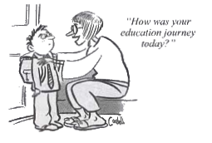











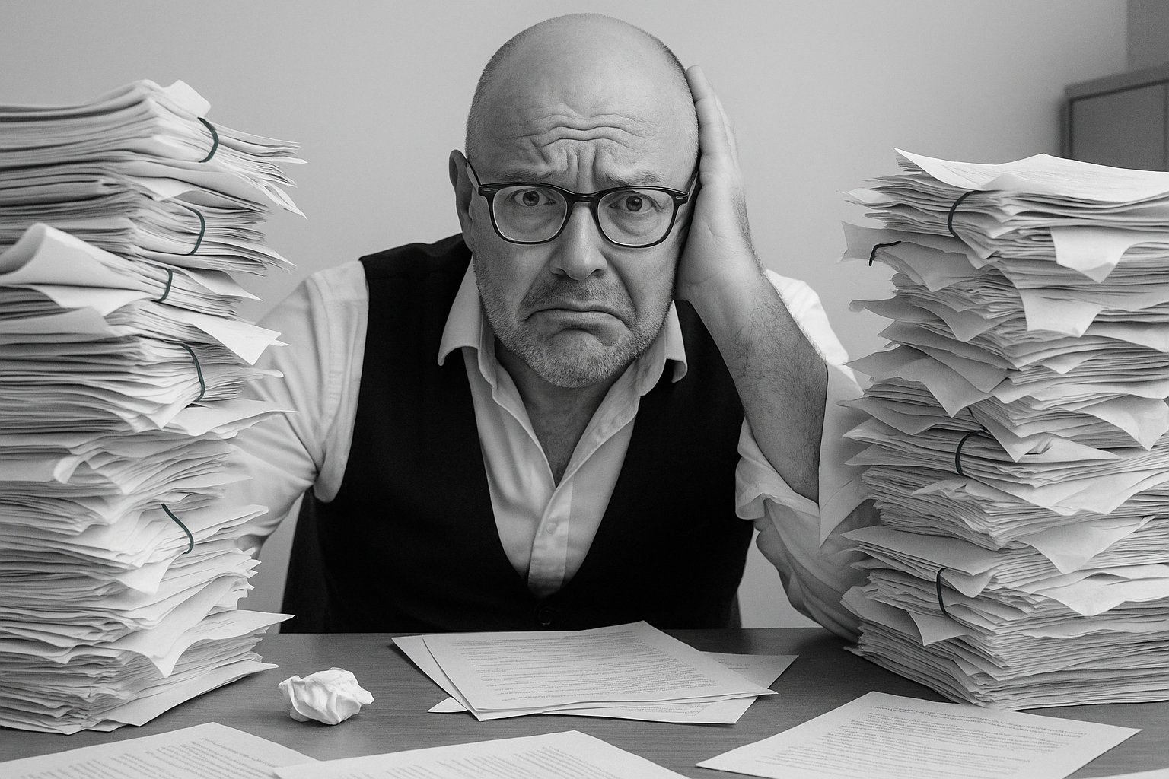


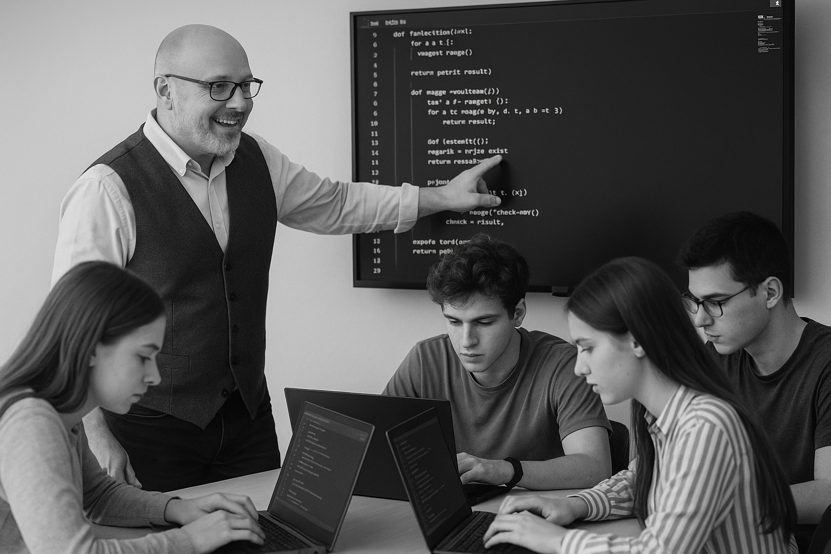
<title>
Note this down
Xmins
Do not delete this slide nor move it from the second last slide in the deck

