Slide 1
Design considerations
UI/UX principles (HIG and Material Design deeper dive)
Navigation, consistency, accessibility, performance trade-offs
Wireframing / storyboarding

Slide 2
Recall from last lesson
https://forms.microsoft.com/e/uLy3eFm4qg
An email should by now have arrived with the link attached.

Slide 3

Design considerations
UI/UX principles (HIG and Material Design deeper dive)
Navigation, consistency, accessibility, performance trade-offs
Wireframing / storyboarding

Slide 4
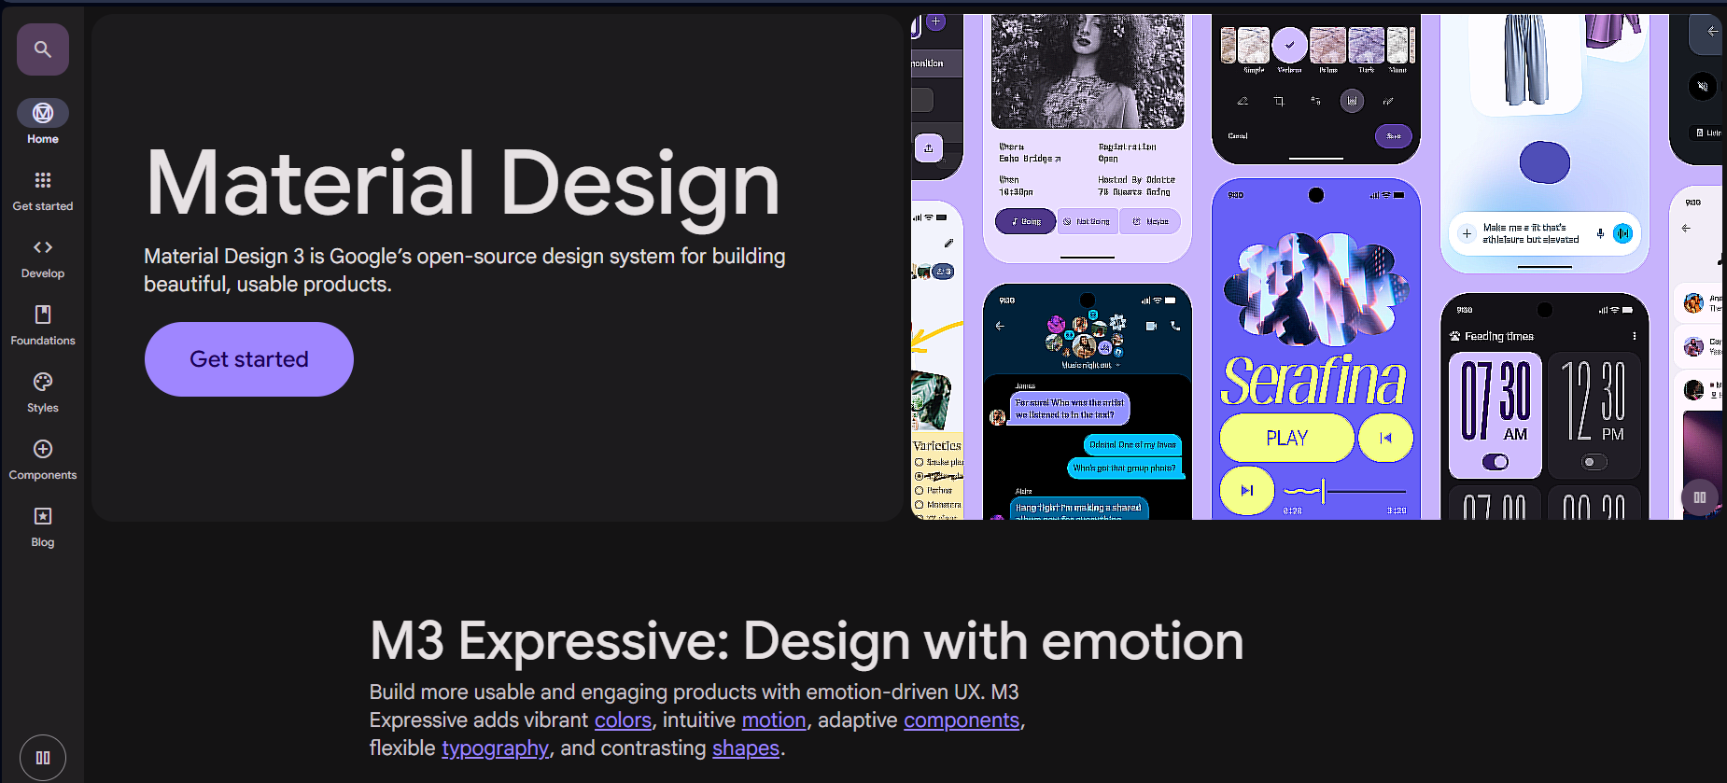
Two key documents
Material Design: https://m3.material.io/ from Google
HIG from Apple (see last week)
As we looked at HIG last week, let us spend 10 minutes on Material
Look through. Do you pick up any key design ideas that differ from the HIG?
10 mins

Slide 5
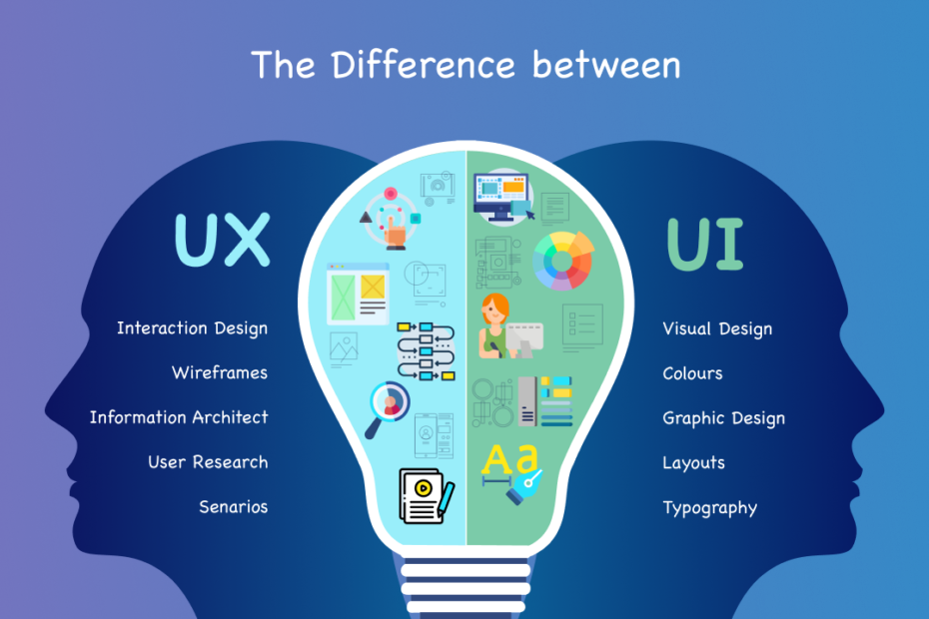
UI vs UX – what’s the difference?

Slide 6
UI – User Interface
What it is: The look and feel of an app
  the visual design, layout, and interactive elements.
Focus: Appearance.
Key elements:
  Colours, fonts, icons, images.
  Buttons, menus, sliders, input fields.
  Screen layout and consistency across pages.
Goal: Make the app attractive and intuitive so users can interact easily.

Slide 7

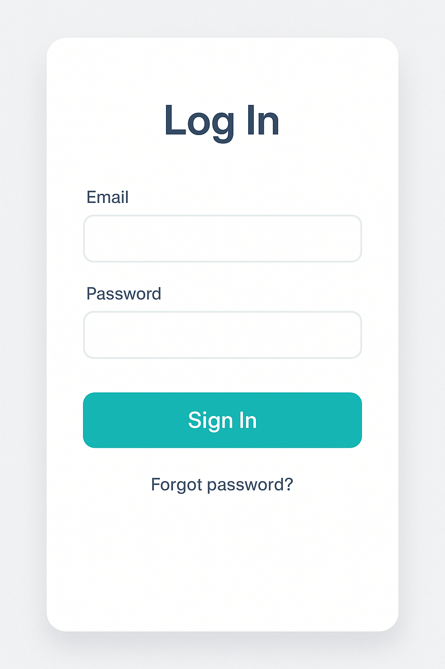
UI Example
Clean
Minimal
Very clear button
Friendly colour scheme

Slide 8
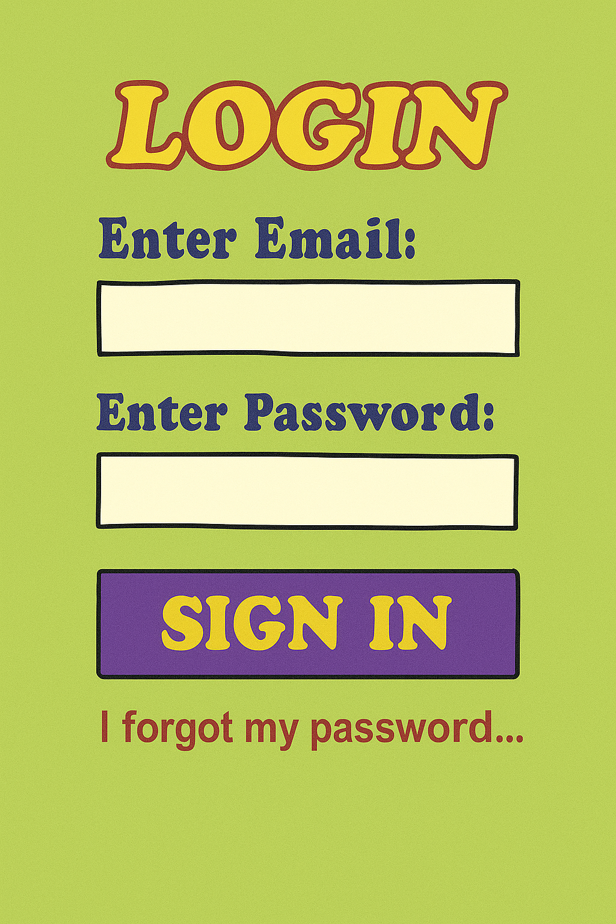
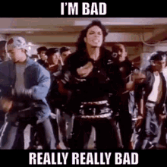
UI Example
Colour scheme
Fonts
Wording
…just NO!

Slide 9
UX – User Experience
What it is: The overall experience a user has while using the app — whether it’s smooth, logical, and enjoyable.
Focus: Functionality and flow.
Key elements:
  Navigation paths (how easy it is to move between screens).
  Accessibility (is it usable by everyone, including those with disabilities?).
  Efficiency (can users achieve their goals quickly?).Error handling and helpful feedback.
Goal: Make the app useful, usable, and satisfying.

Slide 10
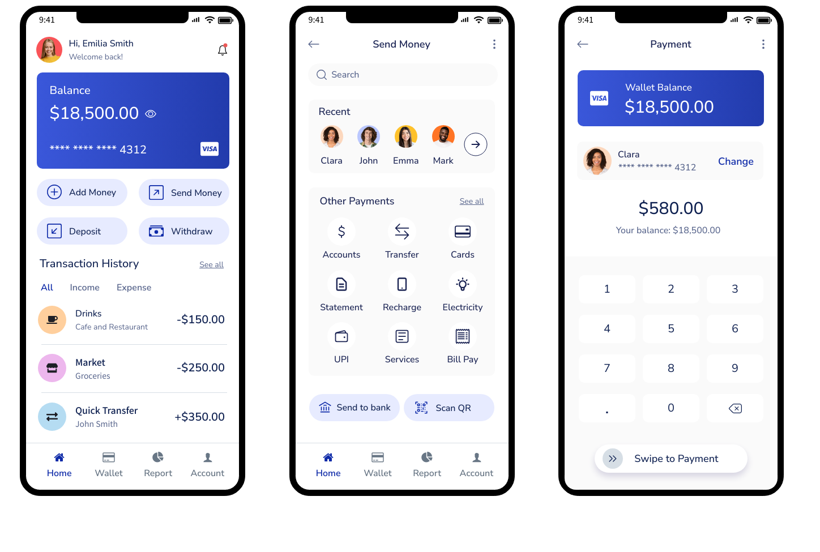
Example
A banking app that lets you transfer money in three steps instead of ten, with clear confirmation messages.

Slide 11
Quick analogy:
Note this down
UI = The car’s dashboard. What the buttons, wheel, and controls look like.
UX = The driving experience. How smooth, safe, and enjoyable the car is to drive.

Slide 12
Summary of UI/UX
A great UI with poor UX → A gorgeous app that frustrates users (pretty, but confusing to use).
A great UX with poor UI → An effective app that works but looks outdated or unattractive.
The best apps combine strong UI + strong UX.

Slide 13
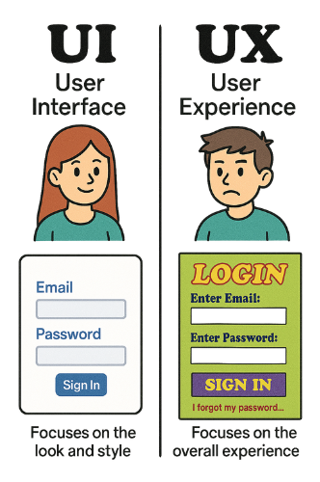
UI/EX Experience Summary

Slide 14
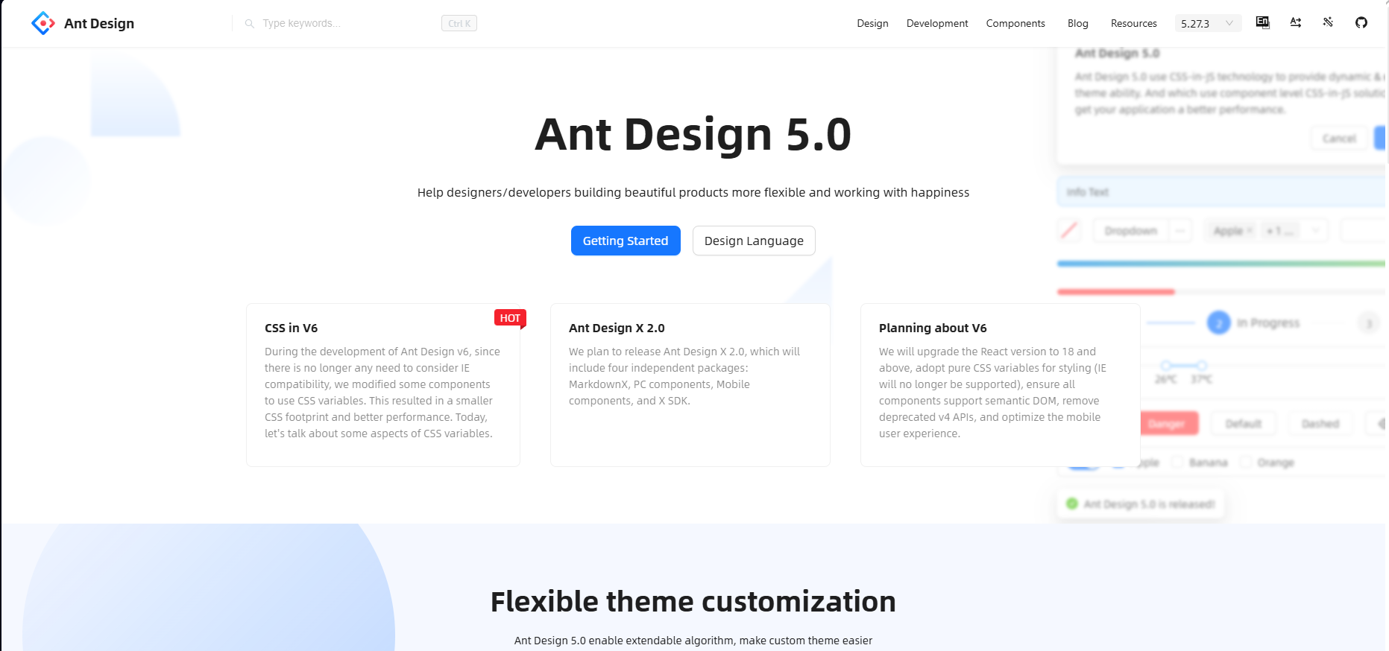
Navigation Styles
One common collection of components using a consistent and effective UI is AntDesign.
Let’s visit: https://ant.design/components/overview
I’m going to talk about things whilst you explore.
Notes:
Tabs – enables multiple pages in one space
Drawers – pop in from one side
Cascader – hierarchical selections
…and any others that catch my eye!

Slide 15
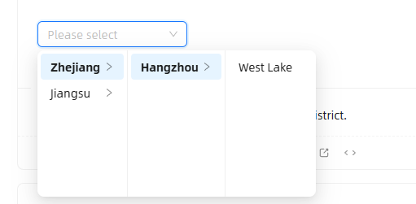
Task
Compile a PowerPoint which explains some of the components that you thought might be interesting
What would you use them for in your project?
Illustrate them with screen shots and add text
When completed, email to me at simonrundell@exe-coll.ac.uk and be prepared to show your colleagues
15 mins

Slide 16
Accessibility and Inclusivity
Colour Contrasts
Font scaling
Haptics
Language and Localisation
Remember these from the HIG, what does Material say about the matter?
10 mins

Slide 17
Performance Trade Offs
Animations vs Speed
Why Animations Matter
Animations can:
  Guide users (e.g., sliding menus, button feedback).
  Make apps feel polished and professional.
  Provide context (showing where content has moved to/from).
Example: A messaging app animating new messages sliding in smoothly.

Slide 18
The Trade Off
Too many animations = slower performance, especially on older devices.
Too little feedback = app feels unresponsive.
Developers must balance visual polish with performance efficiency.

Slide 19
Good Practice
Use animations sparingly and purposefully.
Keep animations short (100–300ms).
Test on real devices, not just emulators.
Provide fallbacks or disable complex animations on low-powered devices.

Slide 20
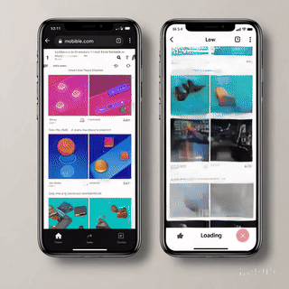
Which would you rather use every day?

Slide 21
Task: Wireframe a simple app idea
In small groups
You can use Pen and Paper, Powerpoint, Publisher, Figma or PenPot or any suitable app to create wireframes of a UI
Your App can be anything you wish
Show me two or three screens based on the good practice we have looked at this lesson
Send to simonrundell@exe-coll.ac.uk
Don’t forget to put the names of the team members in it.
20mins

Slide 22
Homework
Deadline:
Midnight before lesson next Weds
Research a case study of an app with poor design and in three or four paragraphs explain how it failed users.
15 mins

Slide 23











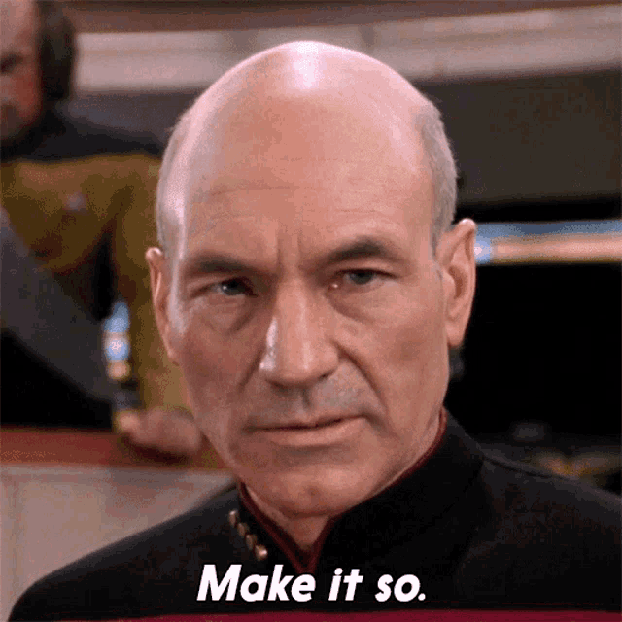
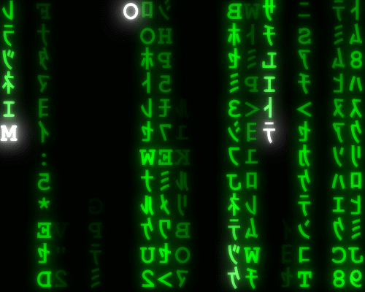
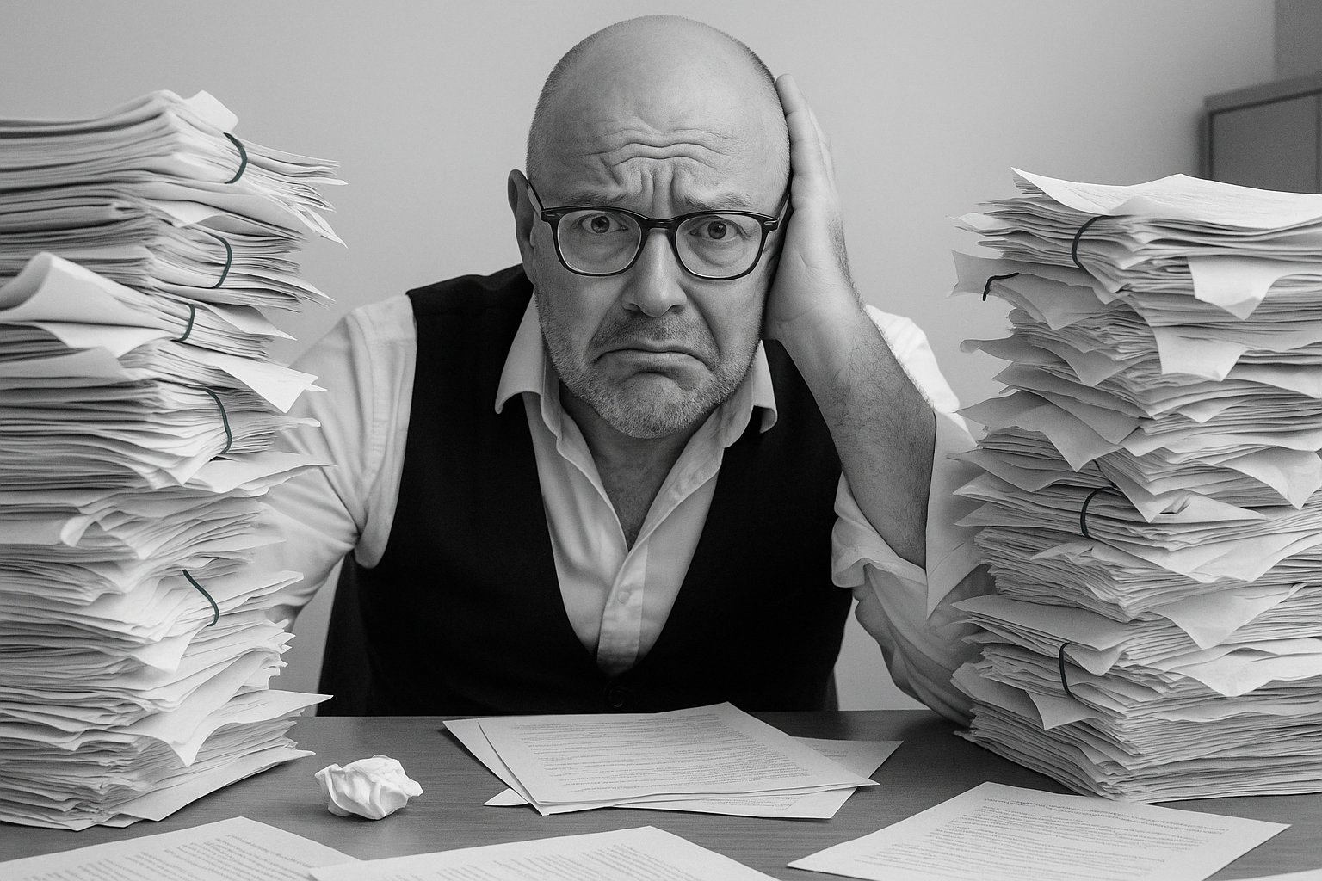
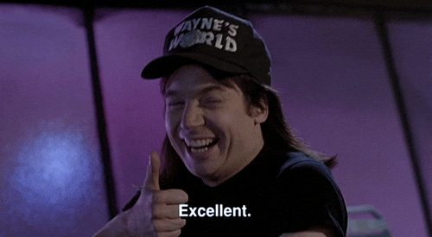

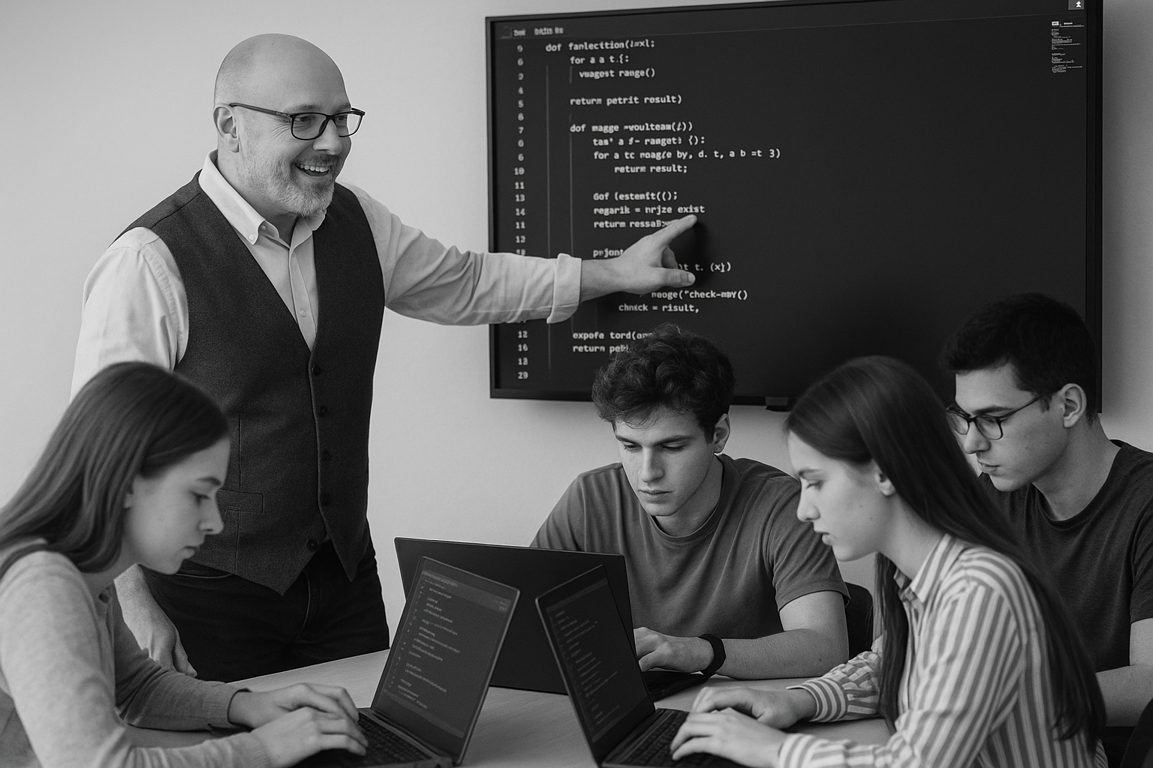
<title>
Note this down
Deadline:
Midnight before next lesson
Xmins
In small groups
Working Independently
In pairs
codeblock
Do not delete this slide nor move it from the second last slide in the deck

