Slide 1
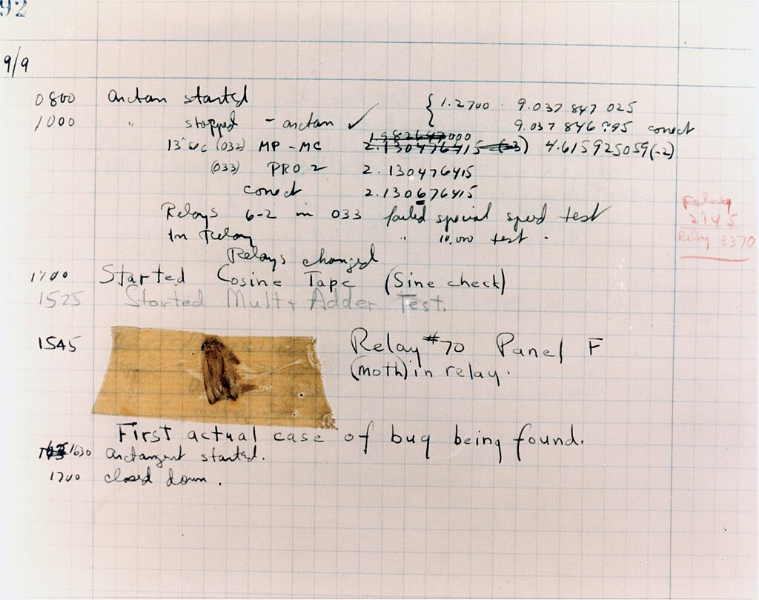
Testing and Deployment Basics
Lesson 6

Slide 2
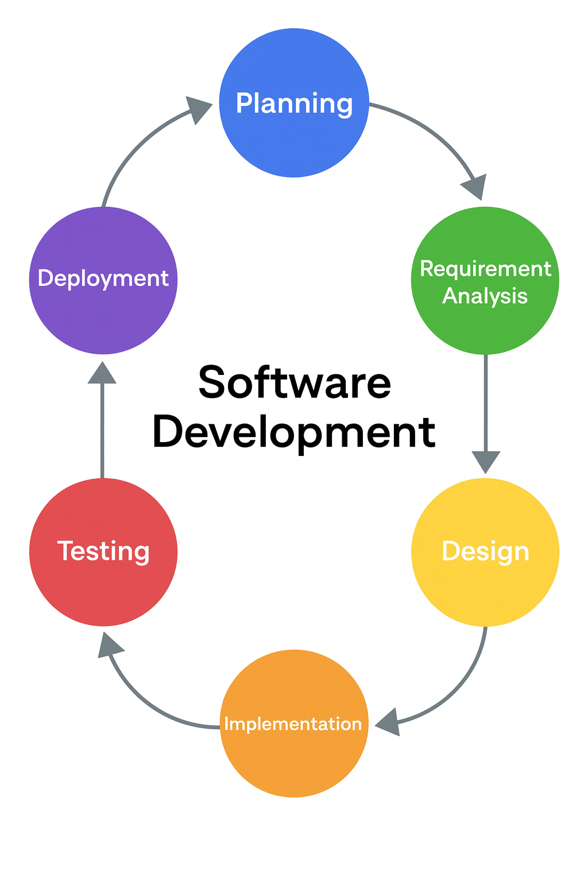
Software Development Life Cycle
Note this down
This is so important

Slide 3

The history of the bug
Note this down
In 1947, a small Moth flew into the large room where the Harvard Mk II, one of the earliest computers was housed.
It landed between two valves and electrocuted itself
It caused a short-circuit which stopped the computer working.
The engineers had to hunt through the thousands of values to find and fix the short-circuit.
Any software error has been called a bug ever since.
Rear Admiral Grace Hopper, US Navy
One of Computing’s pioneers

Slide 4

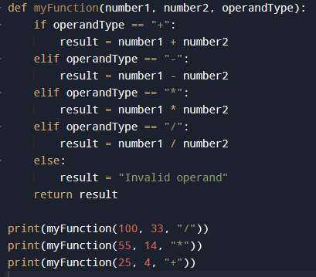
Let’s go on a bug hunt!
print(myFunction(100,33,”/”)
print(myFunction(55, 14, *)
print (myFunction(25, 4, “+”)
def myFunction(number1, number2, operandType):
if operandType==“+”:
result=number1 + number2;
if operandType==“-”:
result=number1 – number
if operandType=“*”:
result=number1 * number2
if operandTyqe=“/”:
result=number1/number2
return result

Slide 5
The importance of Software Testing
See “Programming’s Greatest Mistakes” by Mark Rendel
https://www.youtube.com/watch?v=Y9clBHENy4Q
Link in Teams / Classwork
Software bugs can cause potential monetary and human loss. There are many examples in history that clearly depicts that without the testing phase in software development lot of damage was incurred. Below are some examples:
1994: China Airlines Airbus A300 crashed due to a software bug killing 264 people.
1996: A software bug caused U.S. bank accounts of 823 customers to be credited with 920 million US dollars.
1999: A software bug caused the failure of a $1.2 billion military satellite launch.
1999: Fujitsu’s Horizon IT system caused more than 900 Subpostmasters to be wrongly accused and even prosecuted for theft and fraud, caused by bugs in the system,
2015: A software bug in the F-35 fighter plane resulted in making it unable to detect targets correctly.
2015: Bloomberg terminal in London crashed due to a software bug affecting 300,000 traders on the financial market and forcing the government to postpone the 3bn pound debt sale.
2023: Starbucks was forced to close more than 60% of its outlet in the U.S. and Canada due to a software failure in its POS system.
Which example was worse: financial loss or human loss?

Slide 6
“You do not write code, you debug it”

Slide 7
Different Levels of Software Testing
In Mobile App Testing there are Different Levels of Testing can be classified into 4 levels:
Unit Testing: In this type of testing, errors are detected individually from every component or unit by individually testing the components or units of code to ensure that they are fit for use by the developers. It is the smallest testable part of the software.
Usability Testing → Ensures the app is intuitive and easy to use for real people.
Device Compatibility Testing → Checks the app works across different phones, OS versions, screen sizes.
Acceptance Testing → This is a kind of testing conducted to ensure that the requirements of the users are fulfilled before its delivery.

Slide 8
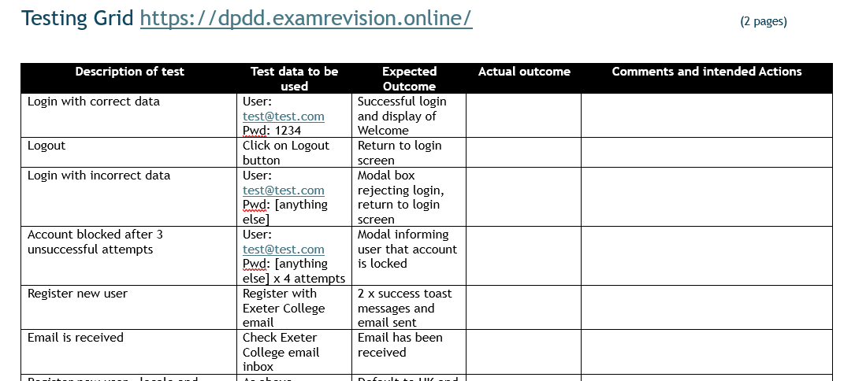
Some real testing based upon a simple login function
This is a web app but the Unit Testing process is the same
Download a copy of the Test Grid from the Teams / Coursework/ Testing folder
Visit: https://dpdd.examrevision.online/
Undertake the tests on the website login function
Attach your test grid to your Class Notes
20 mins

Slide 9
Testing Practice

Slide 10
Common Test Cases specific to Mobile Apps
Performance: Does it load quickly? Does scrolling lag?
Security: Can someone bypass the login screen? Is data encrypted?
Accessibility: Does it support screen readers, colour contrast, large text?
Connectivity: Does the app handle poor/no internet gracefully?
Battery/Resource Use: Does it drain the battery or overuse memory?

Slide 11
Create a test plan for a simple app
The App might be a To-do list or a Calculator
You need to include at least five test cases eg:
  User can add a new item.
  User can delete an item.
  App prevents duplicate entries.
  App works in both portrait and landscape.
  App loads in <2 seconds.
Create a PowerPoint of your test plan and when complete email it to simonrundell@exe-coll.ac.uk
You will then present it to the class
In small groups
30 mins

Slide 12
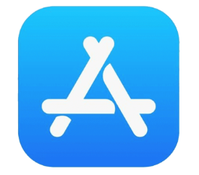
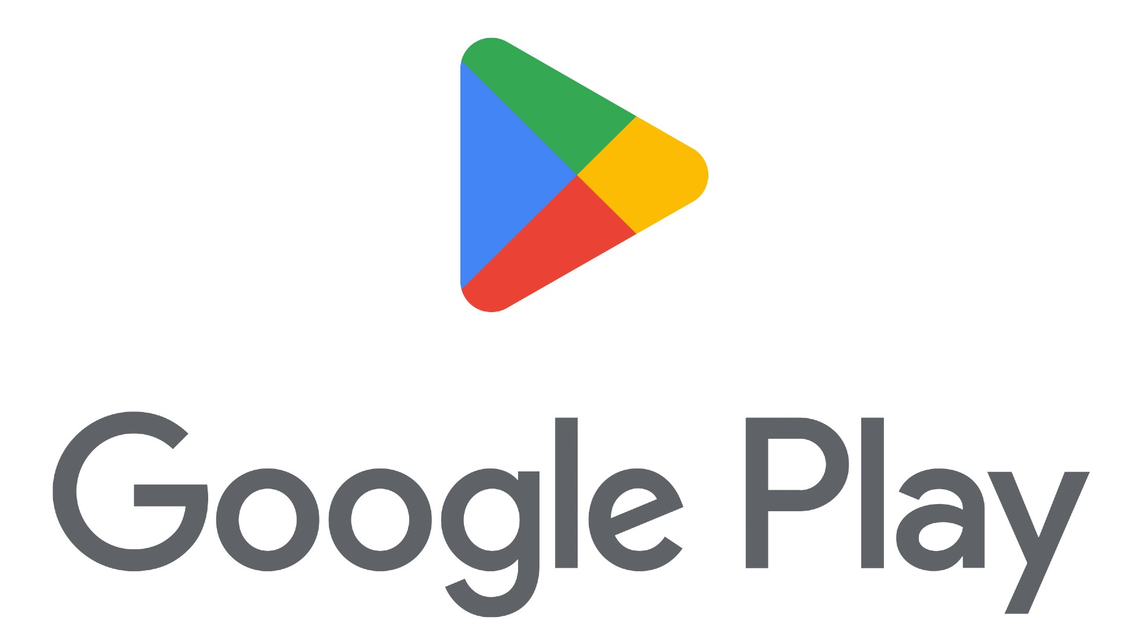
Deployment to App Stores
Apple App Store
  Requires an Apple Developer account (£79/year).
  Apps must pass strict review for security, content, and performance.
Google Play Store
  Developer account is a one-off fee (£25).
  Automated checks + review, generally faster approval.
Common Submission Steps
  Upload app package (.apk/.aab for Android, .ipa for iOS).
  Provide metadata (title, description, screenshots).
  Set price, region availability, and age rating.

Slide 13
Global Deployment Discussion
How might an app work differently in Japan vs the UK?
What challenges are caused by different devices?
Why might legal regulations differ between countries?

Slide 14
Homework
Deadline:
Midnight next Thursday
Research the submission guidelines for either the Apple App Store or Google Play Store.
Summarise the key requirements of that platform
  eg accounts, file formats, review process
Length: 1 page max.

Slide 15
SDLC Methodologies
Most Mobile Apps are developed under an Agile Methodology
  Small, iterative cycles (sprints).
The Scrum framework is one of the most popular:
  Roles include Product Owner,
  Scrum Master,
  Developers.
Frequent testing and feedback → catch bugs early before deployment.

Slide 16
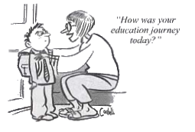

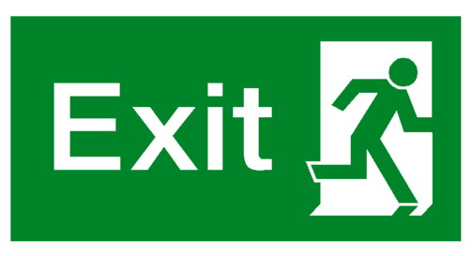


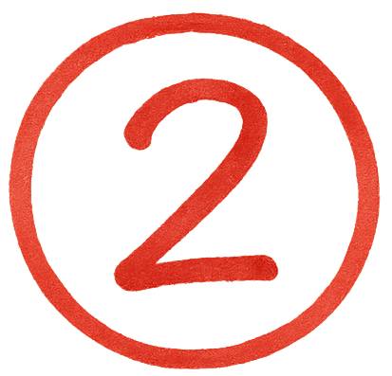
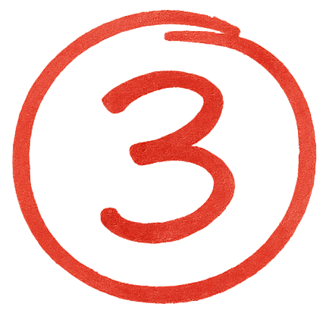




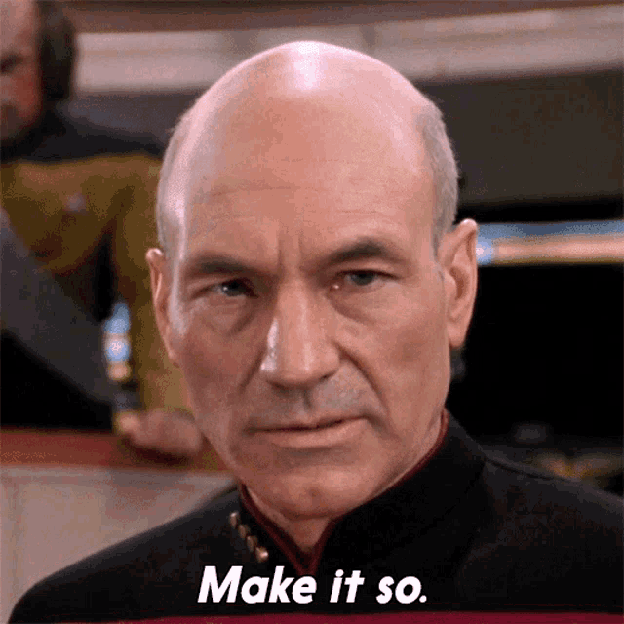
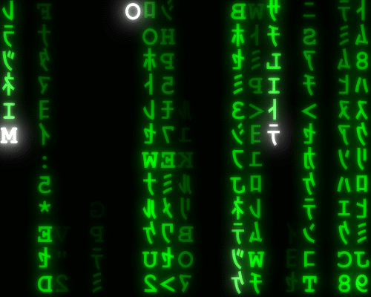
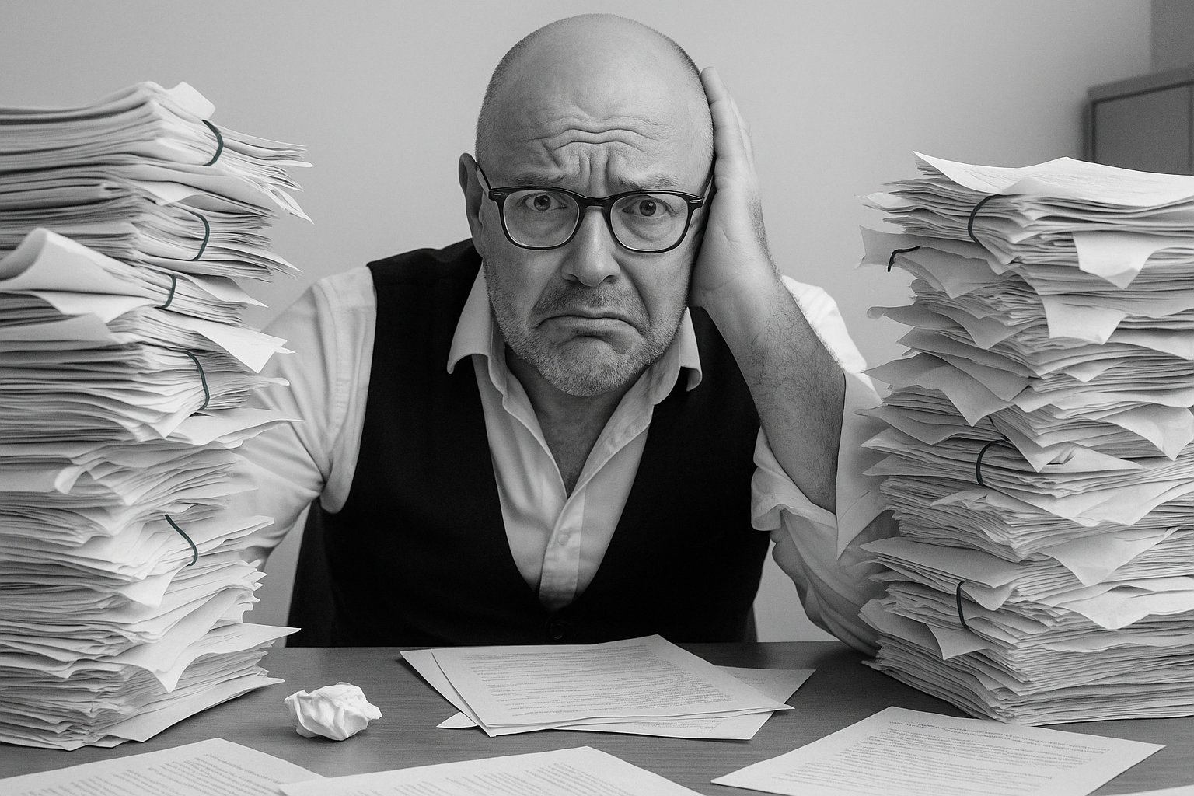
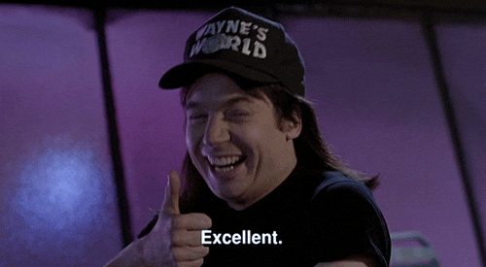

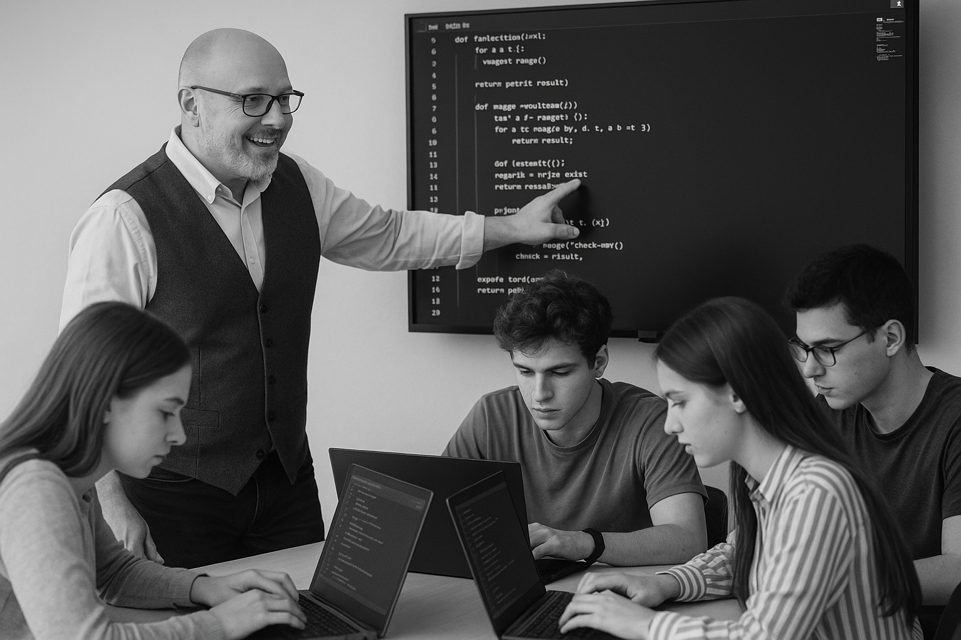
<title>
Note this down
Deadline:
Midnight before next lesson
Xmins
In small groups
Working Independently
In pairs
codeblock
Do not delete this slide nor move it from the second last slide in the deck

