Slide 1
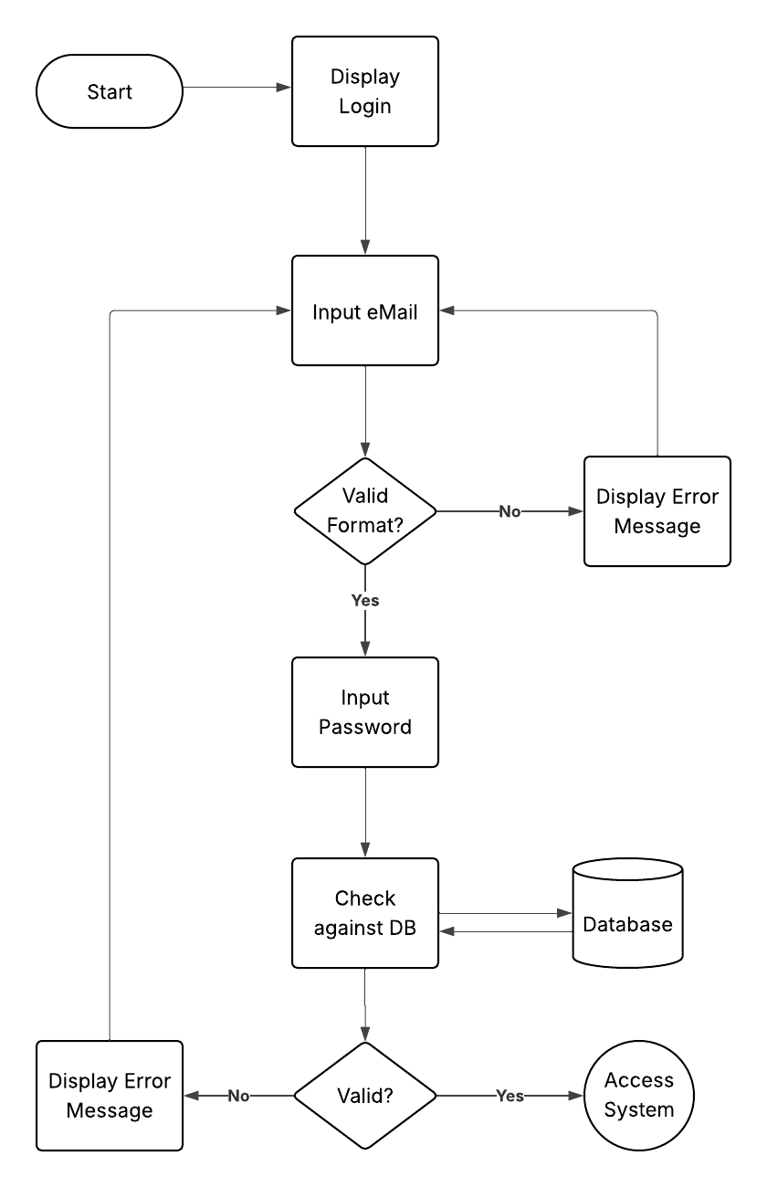
Algorithms, Flow & Validation
Lesson 08

Slide 2
Recall from last lesson
<URL>
An email should by now have arrived with the link attached.

Slide 3
Aims
Designing a mobile app:
algorithms
control structures
validation
embedding testing into design

Slide 4
What happens next?
Here is a simple app task:
“User presses ‘Start Workout’”
Try and predict what the next three steps the app must handle are
Design isn’t just how the screens look, but how the logic flows
Start Workout

Slide 5

Algorithms in Design
Although you will have encountered algorithms in terms of pure programming before…
…we also use algorithms in the design process
particularly in determining the flows of logic, navigation & process

Slide 6
Algorithms in Design
Pseudo code
plain-English steps of an app feature.
Flow diagrams
visualising decisions and branches.
Control structures
sequence
selection (if/else)
iteration (loops).
It is essential to consider data validation as a core part of the design:
“What if a user leaves the field blank?”

Slide 7
Pseudo Code
BEGIN
Display "Login Screen"
INPUT email
IF email format is invalid THEN
Display "Error: Invalid email format"
GOTO INPUT email
ENDIF
INPUT password
CHECK credentials against Database
IF credentials are valid THEN
Access System
ELSE
Display "Error: Invalid email or password"
GOTO INPUT email
ENDIF
END

Slide 8
Your first design algorithm
Working Independently
Chooses one feature from your previous app design
log a workout
submit quiz
upload photo
Write pseudo code for the process, including at least:
Input
Decision/validation
Output
15 mins

Slide 9

Login Flow Chart
The flow diagram shows the logical flow
It also illustrates the place for:
Screen Display
Error Messages
Notice this has no relation to layout

Slide 10
Draw the Flow
Working Independently
Create a flow diagram for the same feature you wrote pseudo code for.
Don’t forget:
Error paths
e.g., invalid input
Use of device functions
e.g., GPS, camera
Loops if needed
e.g., retry password
25 mins

Slide 11
Testing
Remember we did testing earlier?
Here’s how design connects.
Identify one test case for your algorithm
“Enter invalid data → app shows error message”
You see that testing starts at design time

Slide 12
One thing I learned…
Share one way their design handles errors or validation.
The difference between a pretty sketch and a real design:
logic
validation
forward planning

Slide 13
Homework
Deadline:
Midnight Thursday
Expand your pseudocode + flow diagram to cover two features of your app.
Add at least three validation rules for inputs
e.g., must be a number
must not be blank
must be a valid location

Slide 14











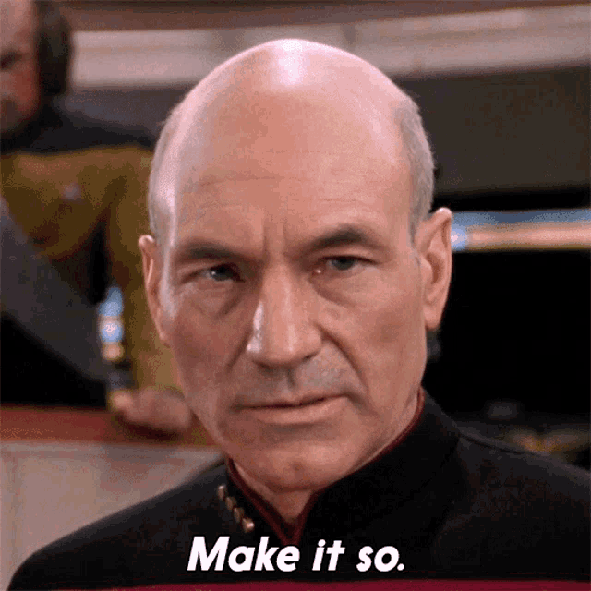





<title>
Note this down
Deadline:
Midnight before next lesson
Xmins
In small groups
Working Independently
In pairs
Do not delete this slide nor move it from the second last slide in the deck

