Slide 1

Bottom-Up and Modular Design
CA1: Problem Solving

Slide 2
Recall Quiz
See Microsoft Forms Quiz
https://forms.cloud.microsoft/e/enHFqH93wr
There should be a scheduled email with the link for this in your inbox.

Slide 3
Learning Outcomes
Explain the features of bottom-up design
Apply bottom-up design.
Discuss the benefits of modular design

Slide 4
Top-Down or Bottom-Up?
Planning a Party
Building something out of lego
Discuss in small groups
Bottom Up
Top Down

Slide 5
Top-Down or Bottom-Up?
Building something out of lego
Planning a Party
Bottom Up
Top Down

Slide 6
Top Down
Note this down
Top down can be effective at identifying the component parts and reverse engineering a challenging question/problem.
But implementation can be limited or flawed – this is because:
It doesn’t detail the specific content of each module
It doesn’t help with specific inputs or outputs for each module or unit
It might not characterise how data or processes are passed between units.
We can end up with a huge level of detail which can be difficult to sort
It is not a method that should be disregarded as it can provide a way to solve a problem, not to fully design a system.

Slide 7
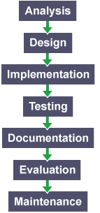
Software Development - Methodology
Note this down
Top down is just one method we can use and is part of a larger design methodology.
The Waterfall method is an example of a methodology to design and implement software solutions from the top down.
Each stage has to be completed before we move onto the next.
It is a linear model, that works well to simplify the development process.

Slide 8
Bottom-Up Design
Note this down
A bottom up design looks at individual component parts and inputs/outputs to a system to work out the individual units (modules).
These Modules are then pieced together to produce more complex systems and we build up the software in this method.
In a bottom-up approach the individual base elements of a new system are first designed in great detail.
These elements are then linked together to form larger subsystems, which then in turn are linked, sometimes in many levels, until a complete top-level system is formed.

Slide 9
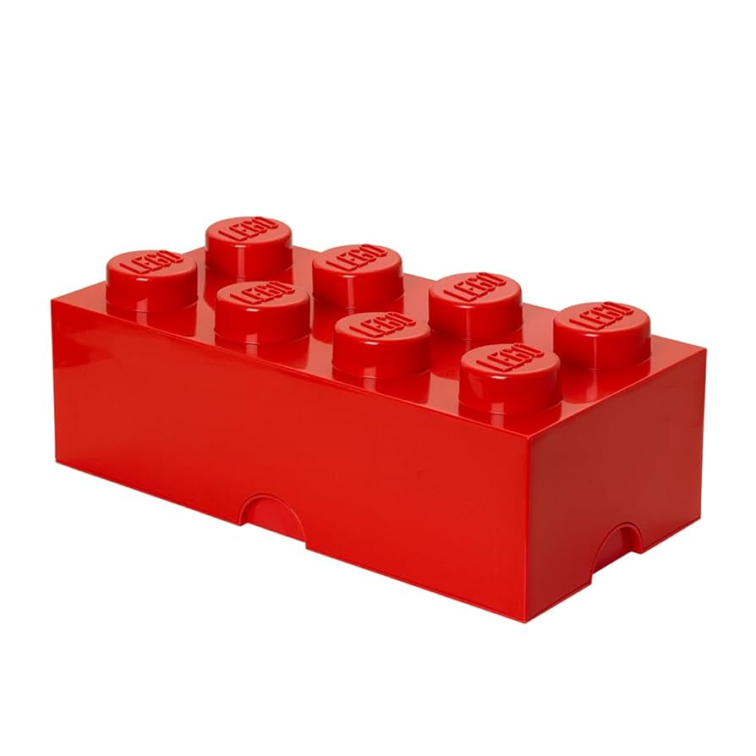
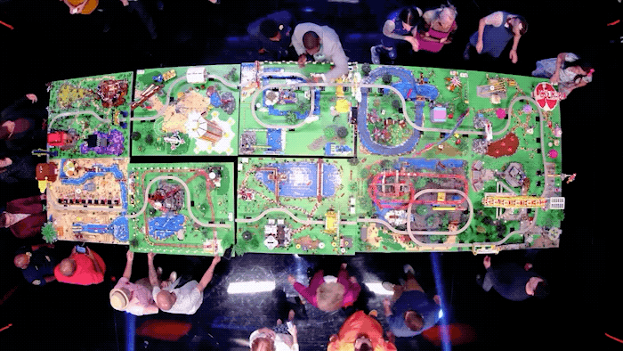
A Bottom-Up approach is like a Lego building block.
On its own it has shape and function…
but
combined
it makes something much bigger and better!

Slide 10
Task
“Your team is asked to design a simple online quiz app.”
Use Bottom-Up thinking to outline key modules
(e.g., questions, scoring, user login, results).
Draw a quick diagram and identify team roles among you (who would build each module).
Each group shares one module idea with the class.
Create a PowerPoint and email it to simonrundell@exe-coll.ac.uk when you are ready to present
In groups of 3–4
25mins

Slide 11
Differences
Note this down
While the top-down approach focuses on breaking down a big problem into smaller and understandable chunks…
The bottom-up approach first focuses on solving the smaller problems at a basic level…
And then building them up to a more complex solution.
We can use the top down to decompose a problem into a more manageable solution
And the bottom-up approach lets us design specific aspects of a program that we design to fit together, so we know how they work.

Slide 12
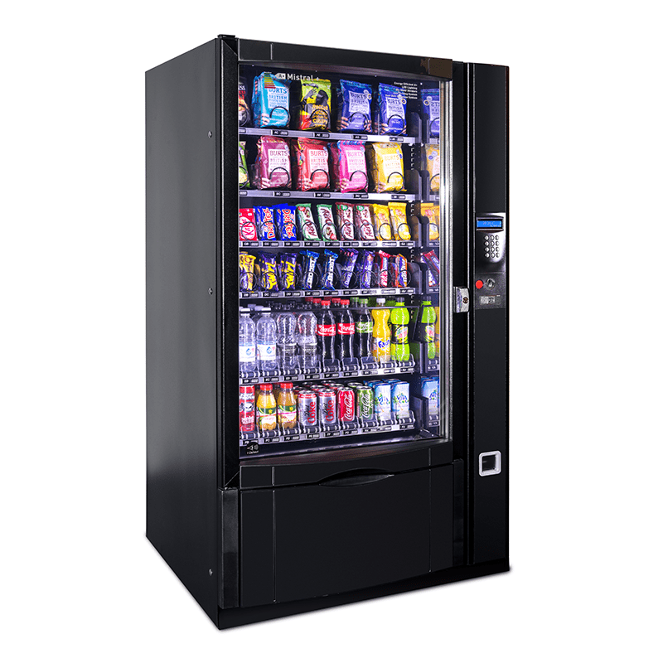
Task
Creating a Vending Machine.
Using a Bottom-Up Approach, create the design tree for a vending machine.
www.draw.io
www.lucid.app ← tell them you’re a student to get extra access
Consider:
Inputs
Outputs
Calculations
Stock Levels
Product range (how many products)
20 mins

Slide 13
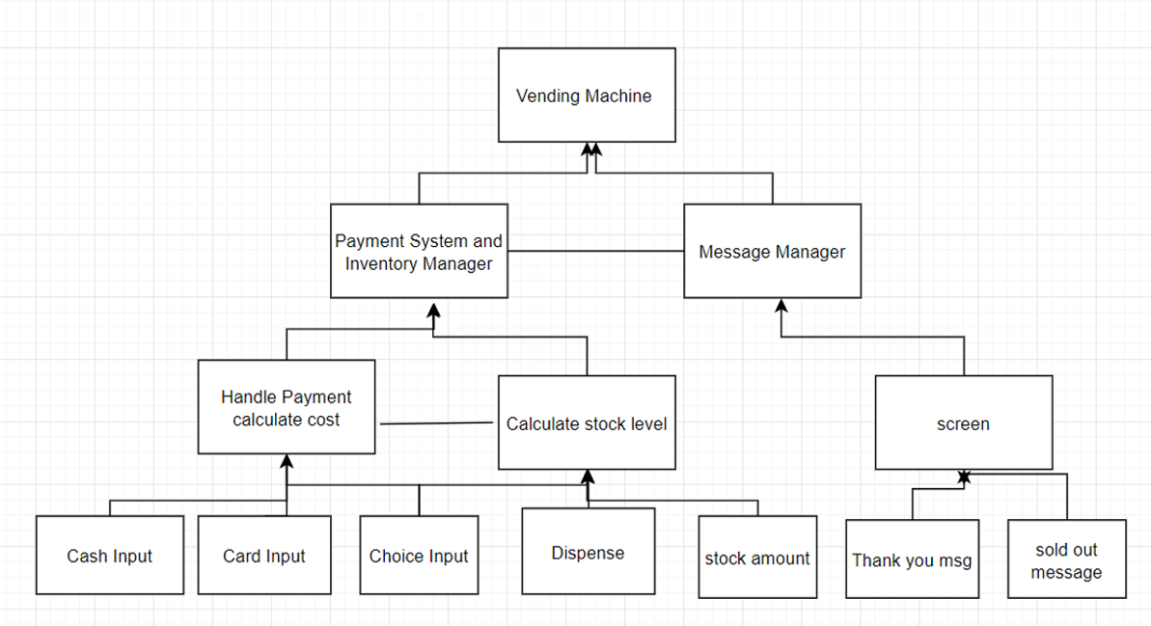

Slide 14
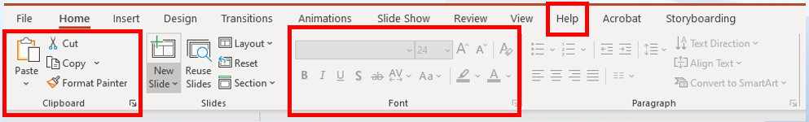
Ultimately, it’s all Modular
Note this down
Ultimately it comes down to modular design.
When we look at software, there are clear modules.
PowerPoint/productivity software has modules, you can see how they are separated out here.
If we were to remove or alter these modules, it might impact the experience of the user, but the software would still work.
It also means I can have a team/person working on each module.

Slide 15

Modular Design and Development
Note this down
Modular design and development allows us to break problems own into manageable solutions.
We can also change the content of modules, or how they handle data, without changing the wider system.
As long as the interfaces between modules are consistent, they integrate seamlessly – like a jigsaw
We can also redesign and redevelop modules to make them more efficient.
The biggest aspect is we can add and refine modules, as the complexity of the system improves.
Modules are often made up of units – individual sections or blocks of code that have a specific task.

Slide 16
Task
15 mins
Describe the benefits of modular design
Why does modular design allow for better team based development?
Using the first link on the next slide, what is the difference between Bottom up and Top Down Design.

Slide 17
Difference between Bottom-Up Model and Top-Down Model
Key | Bottom-Up Model | Top-Down Model
Focus | In Bottom-Up Model, the focus is on identifying and resolving smallest problems and then integrating them together to solve the bigger problem. | In Top-down Model, the focus is on breaking the bigger problem into smaller one and then repeat the process with each problem.
Language | Bottom-Up Model is mainly used by object oriented programming languages like Java, C++, etc. | Top-Down Model is followed by structural programming languages like C, Fortran, etc.
Redundancy | Bottom-Up model is better suited as it ensures minimum data redundancy and focus is on re-usability. | Top-down model has high ratio of redundancy as the size of project increases.
Interaction | Bottom-Up model have high interactivity between various modules. | Top-down model has tight coupling issues and low interactivity between various modules.
Approach | Bottom-up model is based on composition approach. | Top-down model is based on decomposition approach.
Issues | In Bottom-Up, sometimes it is difficult to identify overall functionality of system in initial stages. | In Top-Down, it may not be possible to break the problem into set of smaller problems.
Note this down

Slide 18
Homework
Deadline: Midnight next Sunday
Using either the Bottom Up or Top Down approach (your choice) design:
An online e-commerce system that allows people to order products online (think Amazon)
Create a Word document using a variety of tools, including charting, text, relational

Slide 19
Sample Texts
True / False:
PLEASE LOG IN
PLEASE LOG IN
Do not delete this slide nor move it from the second last slide in the deck

Slide 20











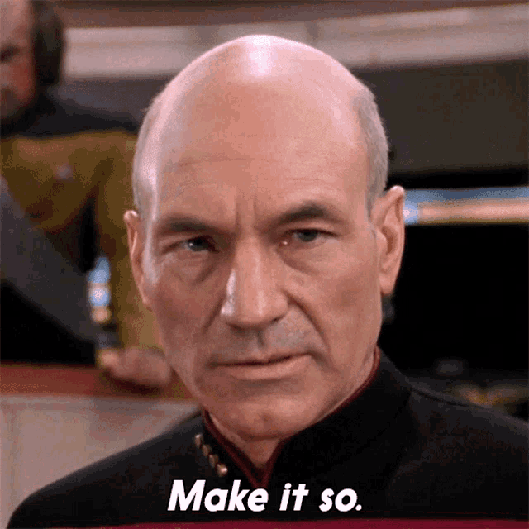
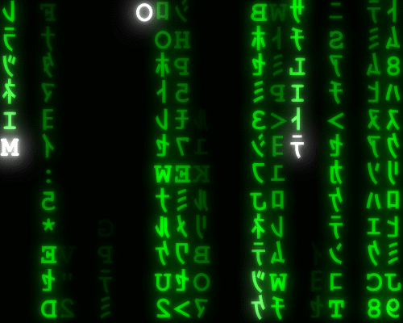




<title>
Note this down
Xmins
Do not delete this slide nor move it from the second last slide in the deck

