Slide 1
Testing Methods and Test Design Techniques
Lesson 2

Slide 2
Recall from last lesson
https://forms.microsoft.com/e/nSFSd1ChAH
An email should by now have arrived with the link attached.

Slide 3
Reflect on this…
Would you rather test a program by running it blindly (no code access) or by seeing its logic line by line?
Black Box Testing
White Box Testing

Slide 4
Task:
Create at least 3 black box test cases and 3 white box test cases
def calculate_grade(score):
if not isinstance(score, (int, float)) or score < 0 or score > 100:
return "Invalid score. Please enter a number between 0 and 100."
if score >= 90:
return "A"
elif score >= 80:
return "B"
elif score >= 70:
return "C"
elif score >= 60:
return "D"
else:
return "F"
def main():
try:
score = float(input("Enter your numeric score (0-100): "))
grade = calculate_grade(score)
print(f"Your letter grade is: {grade}")
except ValueError:
print("Please enter a valid number.")
if __name__ == "__main__":
main()
15 mins

Slide 5
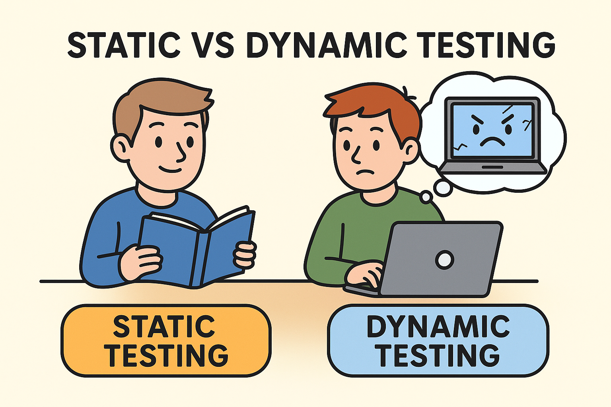
Static vs Dynamic Testing
Static Testing
is proactive, non-execution-based, and focuses on finding defects early through analysis and reviews. It’s cost-effective for early defect detection.
It involves inspections, walkthroughs, code reviews, documentation review.
Dynamic Testing
is reactive, execution-based, and validates the software’s functionality and performance during runtime. It ensures the system behaves correctly under real-life conditions.
It involves running the code and executing test cases.
A combination of both approaches is often used to ensure comprehensive software quality, with static testing catching issues early and dynamic testing verifying runtime behavior.

Slide 6

Boundary Value Analysis
Errors are more likely to occur at the extreme ends of input ranges (just below, on, or just above the boundary)
This is a Black Box testing technique that focuses on the edges/boundaries of input ranges rather than the middle values
How it works:
Identify the input range (valid and invalid).
Choose test cases at the minimum, maximum, and just inside/outside the boundaries.
Test those cases to ensure the system handles them correctly.

Slide 7
Example
Suppose an app requires an age input between 12 and 18 (inclusive).
Valid range: 12 → 18
Invalid values: <12 or >18
Test cases (Boundary Value Analysis):
11 (just below lower bound) – should be rejected ❌
12 (lower bound) – should be accepted ✅
13 (just above lower bound) – should be accepted ✅
17 (just below upper bound) – should be accepted ✅
18 (upper bound) – should be accepted ✅
19 (just above upper bound) – should be rejected ❌
No point testing for 14,15 or 16

Slide 8
Another Example
A password must be between 8 and 16 characters.
Test cases:
7 chars ❌ too short
8 chars ✅ valid
9 chars ✅ valid
15 chars ✅ valid
16 chars ✅ valid
17 chars ❌ too long
In the real world, we probably wouldn’t set such a low password max limit

Slide 9
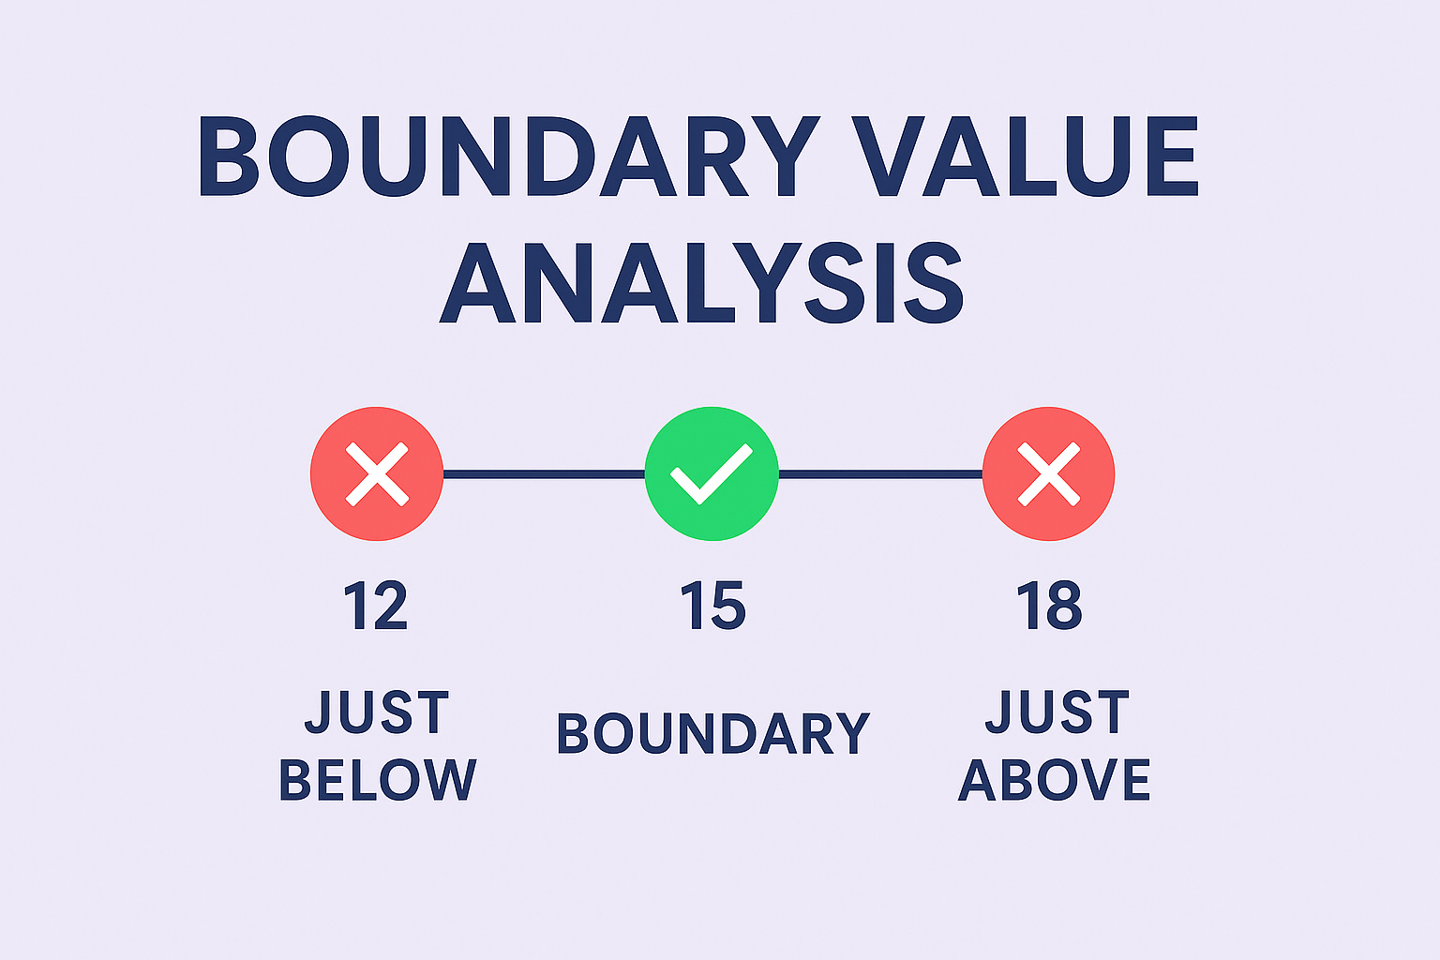
Why it’s useful
Efficient: tests fewer cases than trying every possible input.
Effective: catches common off-by-one errors
(e.g. <= vs < mistakes).

Slide 10
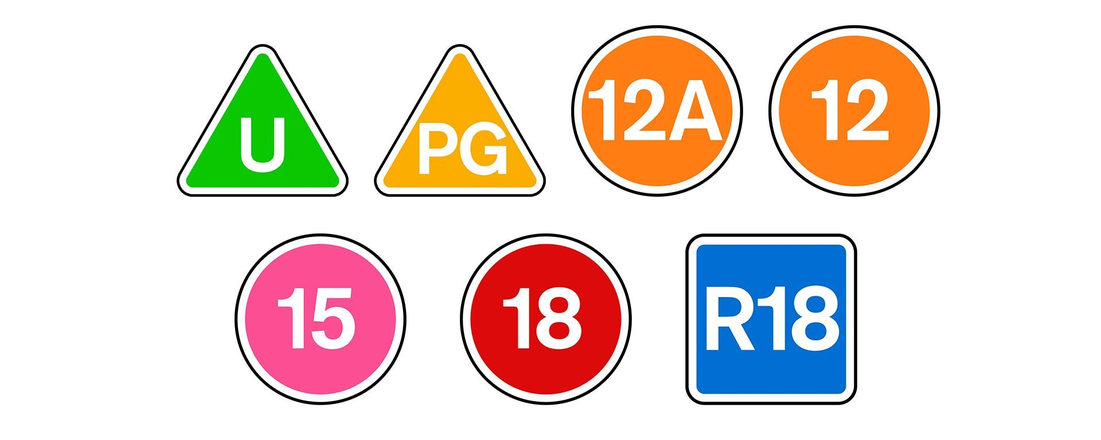

Task: Movie classification
We have the BBFC Ratings:
Identify which boundary values should be tested when a user inputs an age
Write some code (in a language of your choice) to do this
Apply your boundary tests and report your findings
You could use www.programiz.com
if stuck for an environment
(select a language then ‘Online Compiler’)
20 mins

Slide 11
Decision Table Testing
This is a black box test design technique that uses a table of conditions and actions to represent complex business rules and logic.
It’s especially useful when there are multiple inputs or conditions that can combine in different ways.
Sometimes called Cause–Effect Testing.
Why Use It?
Complex rules can be difficult to cover exhaustively if you only think about test cases informally.
Decision tables make you systematically list all possible combinations.
Helps ensure no rules are missed.

Slide 12
Structure of a Decision Table
Conditions | Rule 1 | Rule 2 | Rule 3 | Rule 4
Condition 1 | T | T | F | F
Condition 2 | T | F | T | F
Actions
Action 1 | ✓ |  | ✓
Action 2 |  | ✓ |  | ✓
T/F = True/False for each condition.
✓ = Which actions are triggered under that rule

Slide 13
Example: Online Shopping Discount
How to read this:
Rule 1: Member + order > £50 → gets 10% discount + free delivery
Rule 2: Member + order ≤ £50 → gets 10% discount only
Rule 3: Not member + order > £50 → gets free delivery only
Rule 4: Not member + order ≤ £50 → gets no benefits
Suppose an online shop gives discounts based on:
Condition 1: Is the customer a member?
Condition 2: Has the order value > £50?
Conditions | Rule 1 | Rule 2 | Rule 3 | Rule 4
Customer is a member | T | T | F | F
Order value > £50 | T | F | T | F
Actions
10% discount | ✓ | ✓
Free delivery | ✓ |  | ✓

Slide 14
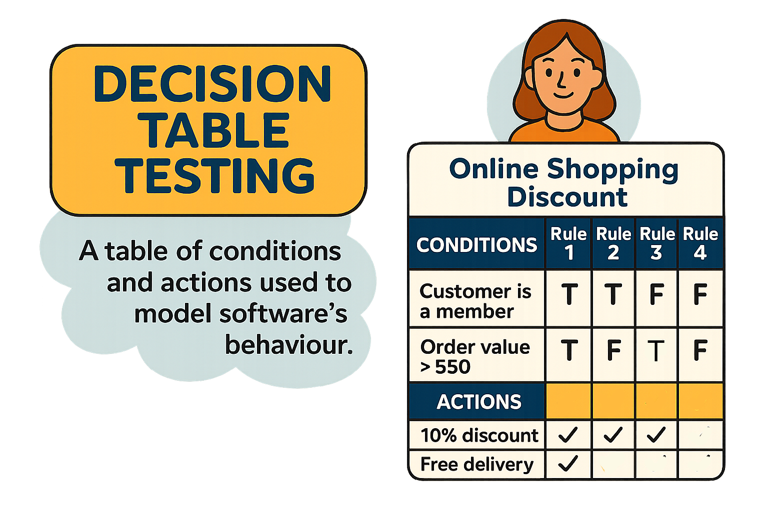
Activity: Cinema Booking System
Condition 1: Is the customer a student
Condition 2: Is it before 5pm
Actions: Discounted Price, Free Popcorn (your choice)
How might you fill in a decision table and derive the test cases?

Slide 15
Summary
Each rule = one test case.
Decision tables are best for situations with clear conditions and business rules.
They reduce errors by making all combinations explicit.

Slide 16
State Transition Testing
State Transition Testing (STT) is another core black-box test design technique, often used alongside Boundary Value Analysis and Decision Tables.
It is a black-box testing technique where test cases are designed based on the states a system can be in, and the transitions (changes) between those states caused by events or inputs.
It is especially useful when software behaviour depends on the history of what has happened before, not just the current input.
👉 Think of it as: “If the system is in State A and I give it Input X, it should move to State B and produce Output Y.”

Slide 17
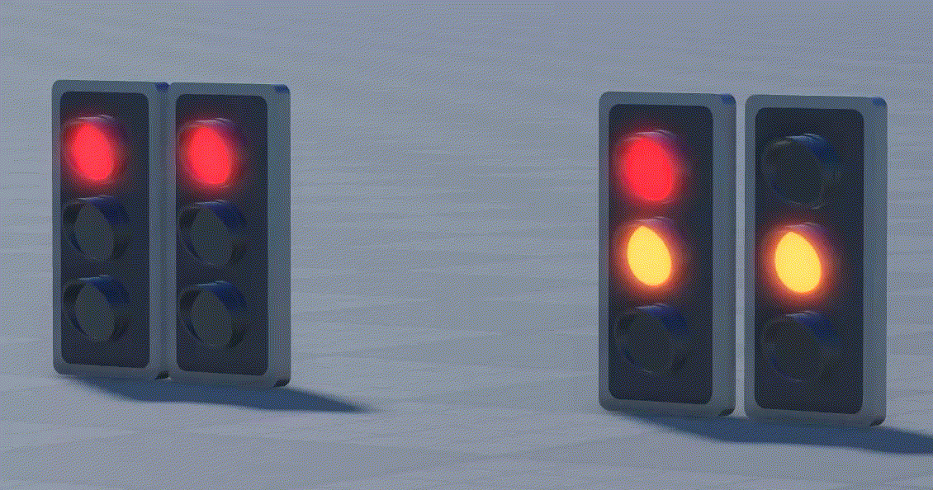
When is STT useful?
Systems with sequential operations.
Programs where behaviour depends on previous events (not just current input).
Examples:
Login systems (lock after 3 wrong attempts).
ATMs (different states for idle, card inserted, pin entered, transaction).
Traffic lights (state changes with timer or sensors).

Slide 18
Key Concepts of STT
States – distinct modes of the system (e.g., “Locked”, “Unlocked”).
Events/Inputs – what triggers a change (e.g., “Enter correct PIN”).
Transitions – rules that define movement from one state to another (e.g., from “Locked” → “Unlocked”).
Invalid Transitions – when an event is not allowed in a given state (e.g., pressing “Withdraw” without inserting a card).

Slide 19
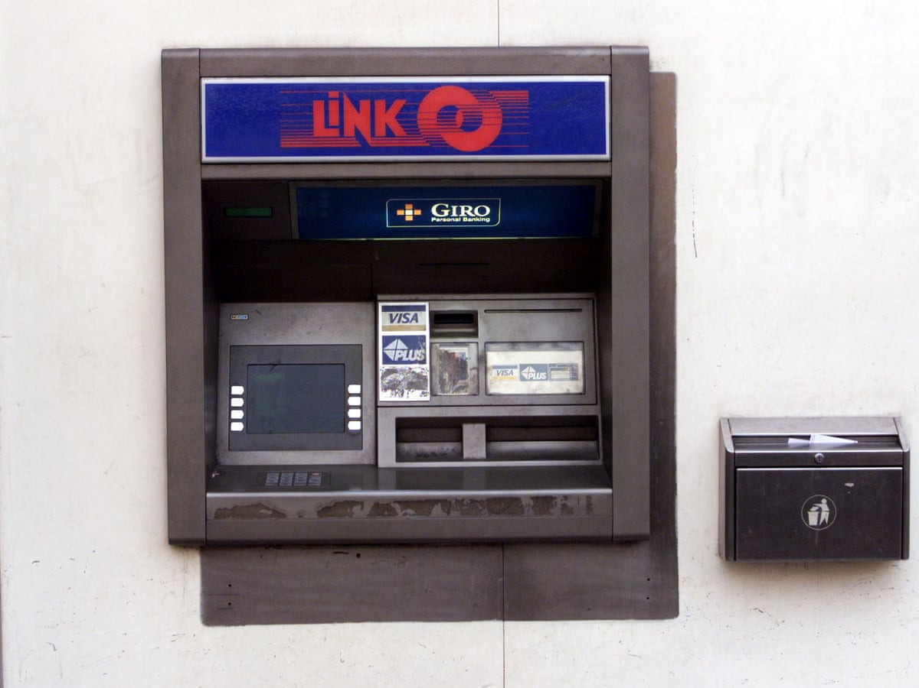
Example: ATM Login
States: Locked, Logged In Inputs: Correct PIN, Wrong PIN (3 attempts), Logout
Current State | Input | Next State | Output/Action
Locked | Correct PIN | Logged In | Access granted ✅
Locked | Wrong PIN (x3) | Locked | Account locked ❌
Logged In | Logout | Locked | Session ended 🔒
Ensures coverage of all valid and invalid transitions.
Helps identify unhandled conditions (places the system could get “stuck”).
Especially good for workflow-driven systems
BUT can get complex if a system has many states and transitions.
Works best when states are well-defined.

Slide 20
Why might automated testing be more reliable than manual testing? Why might it not be?
Notes:
Why Automated Testing Might Be More Reliable Than Manual Testing
Consistency and Repeatability: Automated tests execute the same steps precisely every time, eliminating human error due to fatigue, oversight, or inconsistency. They follow predefined scripts, ensuring consistent test conditions and results.
Speed and Efficiency: Automated tests can run much faster than manual tests, allowing for frequent and rapid execution across multiple scenarios, environments, or datasets. This enables more thorough testing in less time.
Coverage: Automated testing can cover a larger number of test cases, including edge cases, in a shorter period. It can simulate thousands of user interactions or data combinations that would be impractical for manual testing.
Reusability: Once created, automated test scripts can be reused across different versions of the software, reducing the effort needed for regression testing and ensuring consistent validation over time.
Data Accuracy: Automated tests can handle complex calculations, data comparisons, and validations with high precision, reducing the likelihood of errors in evaluating test outcomes.
Scalability: Automated testing scales well for large applications, multiple platforms, or continuous integration pipelines, where manual testing would be too resource-intensive.
Elimination of Human Bias: Automated tests are not influenced by tester assumptions, mood, or experience level, leading to objective and reproducible results.
Why Automated Testing Might Not Be More Reliable Than Manual Testing
Limited Contextual Understanding: Automated tests lack human intuition and cannot interpret context or subtle usability issues (e.g., poor UI design, confusing workflows) that a manual tester might notice.
Incomplete Test Coverage: Automated tests only verify what they are programmed to check. If the test scripts are poorly designed or miss critical scenarios, they may fail to detect defects that a manual tester could identify through exploratory testing.
Initial Setup and Maintenance: Writing and maintaining automated test scripts requires significant upfront effort and technical expertise. Bugs in the test scripts themselves or outdated tests can lead to false positives or negatives, reducing reliability.
Inability to Handle Dynamic or Unpredictable Scenarios: Automated tests struggle with scenarios that involve unpredictable user behavior, dynamic content (e.g., CAPTCHA), or complex visual validation, where human judgment excels.
High Dependency on Environment Stability: Automated tests can fail due to environmental issues (e.g., network latency, UI changes, or test data inconsistencies) that a manual tester might adapt to or overlook.
False Sense of Security: Over-reliance on automated tests can lead teams to assume the software is defect-free, even when untested areas or edge cases exist that require manual validation.
Cost of Tools and Expertise: Automated testing often requires investment in tools, frameworks, and skilled personnel. If not properly implemented, the resulting tests may be less reliable than manual efforts by experienced testers.
Summary
Automated testing is generally more reliable for repetitive, well-defined, and data-driven tasks due to its consistency, speed, and scalability. However, it may fall short in scenarios requiring human intuition, adaptability, or complex qualitative assessments, where manual testing excels. A balanced approach combining both methods often yields the best results, leveraging automation for efficiency and manual testing for exploratory and context-sensitive validation.

Slide 21

Automated vs Manual Testing
Consistency and Speed
Automated testing provides consistent results and executes tests much faster than manual testing, reducing human error.
Human Insight and Flexibility
Manual testing allows detection of user experience and visual issues that automated tools may miss, offering greater flexibility.
Investment and Adaptability
Automation requires significant initial setup and is less adaptable to unexpected changes compared to manual testing.
Notes:
Why Automated Testing Might Be More Reliable Than Manual Testing
Consistency and Repeatability: Automated tests execute the same steps precisely every time, eliminating human error due to fatigue, oversight, or inconsistency. They follow predefined scripts, ensuring consistent test conditions and results.
Speed and Efficiency: Automated tests can run much faster than manual tests, allowing for frequent and rapid execution across multiple scenarios, environments, or datasets. This enables more thorough testing in less time.
Coverage: Automated testing can cover a larger number of test cases, including edge cases, in a shorter period. It can simulate thousands of user interactions or data combinations that would be impractical for manual testing.
Reusability: Once created, automated test scripts can be reused across different versions of the software, reducing the effort needed for regression testing and ensuring consistent validation over time.
Data Accuracy: Automated tests can handle complex calculations, data comparisons, and validations with high precision, reducing the likelihood of errors in evaluating test outcomes.
Scalability: Automated testing scales well for large applications, multiple platforms, or continuous integration pipelines, where manual testing would be too resource-intensive.
Elimination of Human Bias: Automated tests are not influenced by tester assumptions, mood, or experience level, leading to objective and reproducible results.
Why Automated Testing Might Not Be More Reliable Than Manual Testing
Limited Contextual Understanding: Automated tests lack human intuition and cannot interpret context or subtle usability issues (e.g., poor UI design, confusing workflows) that a manual tester might notice.
Incomplete Test Coverage: Automated tests only verify what they are programmed to check. If the test scripts are poorly designed or miss critical scenarios, they may fail to detect defects that a manual tester could identify through exploratory testing.
Initial Setup and Maintenance: Writing and maintaining automated test scripts requires significant upfront effort and technical expertise. Bugs in the test scripts themselves or outdated tests can lead to false positives or negatives, reducing reliability.
Inability to Handle Dynamic or Unpredictable Scenarios: Automated tests struggle with scenarios that involve unpredictable user behavior, dynamic content (e.g., CAPTCHA), or complex visual validation, where human judgment excels.
High Dependency on Environment Stability: Automated tests can fail due to environmental issues (e.g., network latency, UI changes, or test data inconsistencies) that a manual tester might adapt to or overlook.
False Sense of Security: Over-reliance on automated tests can lead teams to assume the software is defect-free, even when untested areas or edge cases exist that require manual validation.
Cost of Tools and Expertise: Automated testing often requires investment in tools, frameworks, and skilled personnel. If not properly implemented, the resulting tests may be less reliable than manual efforts by experienced testers.
Summary
Automated testing is generally more reliable for repetitive, well-defined, and data-driven tasks due to its consistency, speed, and scalability. However, it may fall short in scenarios requiring human intuition, adaptability, or complex qualitative assessments, where manual testing excels. A balanced approach combining both methods often yields the best results, leveraging automation for efficiency and manual testing for exploratory and context-sensitive validation.

Slide 22
Homework
Deadline:
Midnight before next lesson
Step 1: Read the code and identify the states
Step 2: Create a state transition table or diagram for the system.
Step 3: Write 5 test cases to cover important transitions, e.g.:
Locked → enter correct code → Unlocked.
Locked → 3 wrong attempts → Blocked.
Unlocked → lock() → Locked.
Blocked → enter code → Still Blocked.
Locked → 2 wrong codes + correct code → Unlocked.

