Slide 1

Security Testing
Testing Lesson 03

Slide 2
Recall from last lesson
https://forms.microsoft.com/e/PggtVxCYLE
An email should by now have arrived with the link attached.

Slide 3
Learning Objectives
By the end of the lesson, you will be able to:
Define what security testing is and explain why it is essential in digital projects.
Identify common security risks and vulnerabilities in digital systems.
Apply and evaluate simple security test methods
  e.g., input validation, SQL injection examples.
Recognise the role of online tools and ethical considerations in security testing.

Slide 4
Important
Never attempt any of this on real production systems or systems you don’t have permission to test
Keep tests non-destructive: prefer read-only checks and reasoning.
Capture evidence (screenshots, Network request bodies, server logs) and report findings responsibly.
The purpose is defensive: to learn how to secure systems.
Doing this on any other system outside this teaching environment is an offence under the Computer Misuse Act (1990) and you could be jailed and/or fined.

Slide 5


The CIA triad model

Slide 6
The CIA triad model
“triad” means three
Confidentiality
Integrity
Availability

Slide 7
Ensuring confidentiality
Access Control
Authentication
Encryption

Slide 8
Establishing integrity
Checksums
Digital Signatures

Slide 9
Maintaining availability
Backups
Redundancy
Denial of Service (DoS) prevention

Slide 10
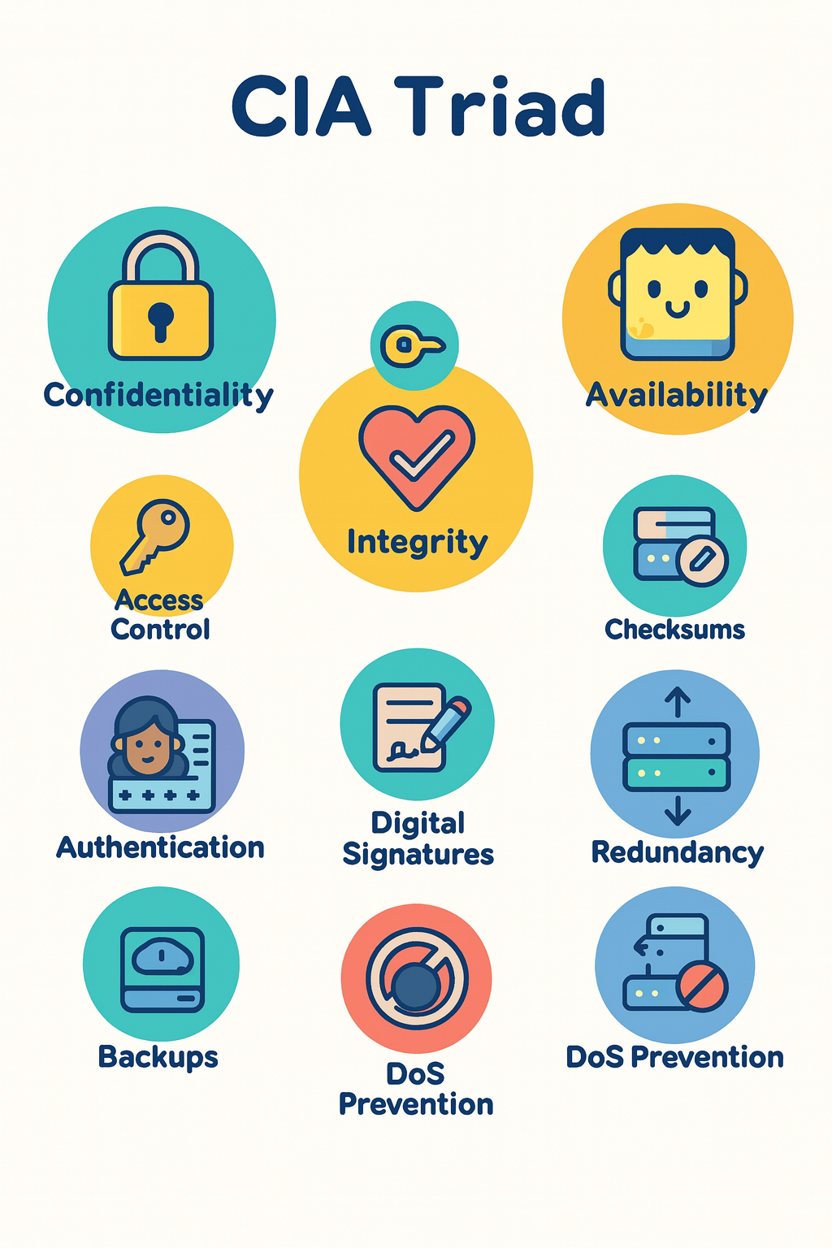
The CIA triad model core features
Access Control
Authentication
Encryption
Checksums
Digital Signatures
Backups
Redundancy
DoS Prevention

Slide 11
Types of Security Tests
Vulnerability scanning
Penetration testing (Pen Testing)
Input validation testing
Authentication and authorisation checks

Slide 12
SQL Injection
I am going to demonstrate a SQL injection (aka a SQLi)
This is dangerous because it opens up the whole database to being destroyed or worse, compromised by a bad actor.
From this we will learn how to mitigate against SQLi attacks.

Slide 13
A simulation of SQLi
Visit: https://security.examrevision.online
Enter test inputs (e.g., ' OR '1'='1) and press Log in (simulate)
Inspect the constructed SQL (simulated), request body and server log areas

Slide 14
Activity: Input Validation
See Worksheet Activity A for grid
Goal:
  produce 8 test cases for a small form and run two safe tests (or reason through if no lab).
Deliverable:
  completed test table (worksheet) with at least two executed tests (screenshots).
Step-by-step:
  Choose fields to test (username, password, bio, age, file upload).
  For each field write: valid case, boundary (min/max), invalid type, encoding/escape case, long string.
  Run two tests using the HTML demo or a safe lab page. Capture Network → Request Body and paste a screenshot in the worksheet.
In pairs
20 mins

Slide 15
Input Validation Checks
See Worksheet Activity A for grid
Boundary tests: empty, min, max length
  e.g., 0, 1, 64, 256 chars length inputs
Invalid types
  letters in numeric fields, long strings, strange encodings
XSS examples:
  <script>alert(1)</script>
  must be escaped/encoded
20 mins

Slide 16
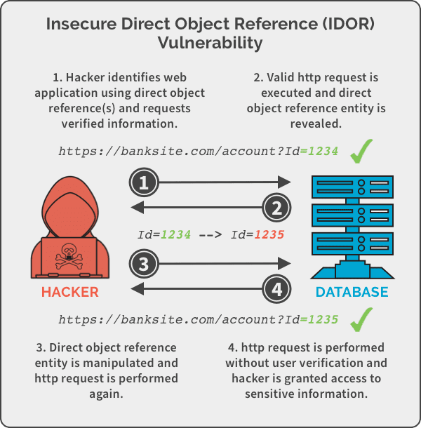
IDOR
IDOR stands for Insecure Direct Object Reference.
It’s a type of security vulnerability where an application exposes a reference (like a file name, database ID, or account number) directly to the user, and the application doesn’t properly check whether that user is authorised to access the referenced object.
Example:
  A banking website shows your statement at:
  https://bank.com/statements?account=123
If you change 123 to 124, and the system shows someone else’s statement without checking permissions, that’s an IDOR vulnerability.

Slide 17
Activity: Authentication & Authorisation Checks
See Worksheet Activity B for info
Goal:
  check basic auth policies and perform forced-browsing and IDOR checks (non-destructive).
Deliverable:
  one evidence screenshot per pair and notes in worksheet.
Step-by-step:
1. Authentication checks: try a weak password registration (if permitted) or inspect password policy on the registration form; try several failed logins and note whether the app blocks or shows a delay message.
2. Cookie inspection:
  DevTools → Application → Cookies: check flags (HttpOnly, Secure, SameSite).
3. Forced browsing: attempt to open /admin or /orders/999 (replace numeric id) while logged in as a low-privileged account; note the status code and capture a screenshot.
4. IDOR check: change an object id in a URL and record whether access is granted incorrectly (if so, stop and record evidence).
In pairs
20 mins

Slide 18
Auth & Authorisation Checks
See Worksheet Activity B for info
Authentication
  failed-login lockout, password policy, MFA check
Authorisation
  forced browsing, IDOR (direct object reference) tests
Session & cookie checks
  HttpOnly, Secure, SameSite flags
20 mins

Slide 19
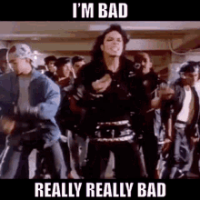
SQLi Vulnerability
If the code uses an insecure login such as:
An attacker can change the code contained in user_input to something dangerous
query = "SELECT * FROM users WHERE username = '" + user_input + "' AND password = '" + pass_input + "'";
‘; DELETE * FROM Products;’

Slide 20
Preventing SQLi attacks
The main defence again SQLi is with parameterised inputs which are bound to the query rather than being simply created by adding plain text.
Example in PHP:
#PHP
$query = "SELECT * FROM tbluser WHERE email = ? AND passwordHash = ? AND useremailvalidated=1";
$stmt = $mysqli->prepare($query);
if (!$stmt) {
send_response("Prepare failed: " . $mysqli->error, 500);
}
$stmt->bind_param("ss", $receivedData['email'], $receivedData['passwordHash']);
if (!$stmt->execute()) {
send_response("Execute failed: " . $stmt->error, 500);
}

Slide 21
Preventing SQLi attacks
Example in NodeJS:
const sql = `SELECT * FROM tbluser
WHERE email = ? AND passwordHash = ? AND useremailvalidated = 1
`;
let rows;
try {
const [result] = await connection.execute(sql, [
receivedData.email,
receivedData.passwordHash,
]);
rows = result;
} catch (err) {
sendResponse(`Query failed: ${err.message}`, 500);
} finally {
await connection.end();
}

Slide 22
Preventing SQLi attacks
Example in Python:
query = (
"SELECT * FROM tbluser "
"WHERE email = %s AND passwordHash = %s AND useremailvalidated = 1"
)
with conn.cursor(dictionary=True) as cursor:
cursor.execute(query, (received_data["email"], received_data["passwordHash"]))
return cursor.fetchall()

Slide 23
Preventing SQLi attacks
In all languages:
  Validate and sanitise input; enforce strict types and lengths
  Use hashing and salting for passwords (never store plaintext)
  Use least-privileged DB accounts
    restrict the backend to an account that has limited CRUD permissions
    Do not actually delete accounts or products but use a flag to make them unused and restrict the site account to just CRU
  Use Transactions where possible
    This means the data can be rolled back much more easily.
  Add logging and monitoring of all failed logins

Slide 24
Homework
Deadline:
Midnight before next testing lesson
Write a 300-word summary: pick one check from your test plan, describe a likely failure mode, and give three developer recommendations to fix it
  e.g., parameterised queries, input sanitisation, server-side role checks.

Slide 25
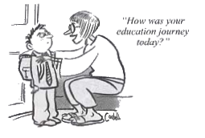
















<title>
Note this down
Deadline:
Midnight before next lesson
Xmins
In small groups
Working Independently
In pairs
Do not delete this slide nor move it from the second last slide in the deck

