Slide 1
Development Approaches & Tools
Lesson 5

Slide 2
Recall from last lesson
https://forms.microsoft.com/e/4UL9aAaLtV
An email should by now have arrived with the link attached.

Slide 3
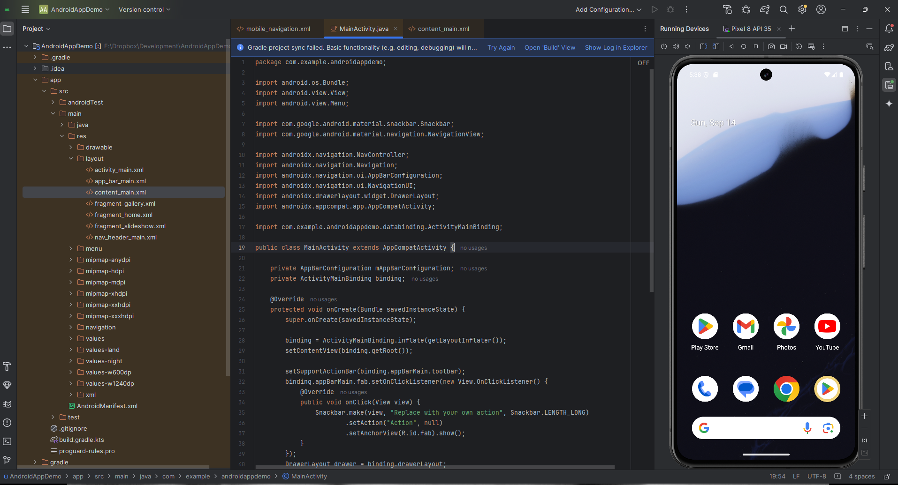
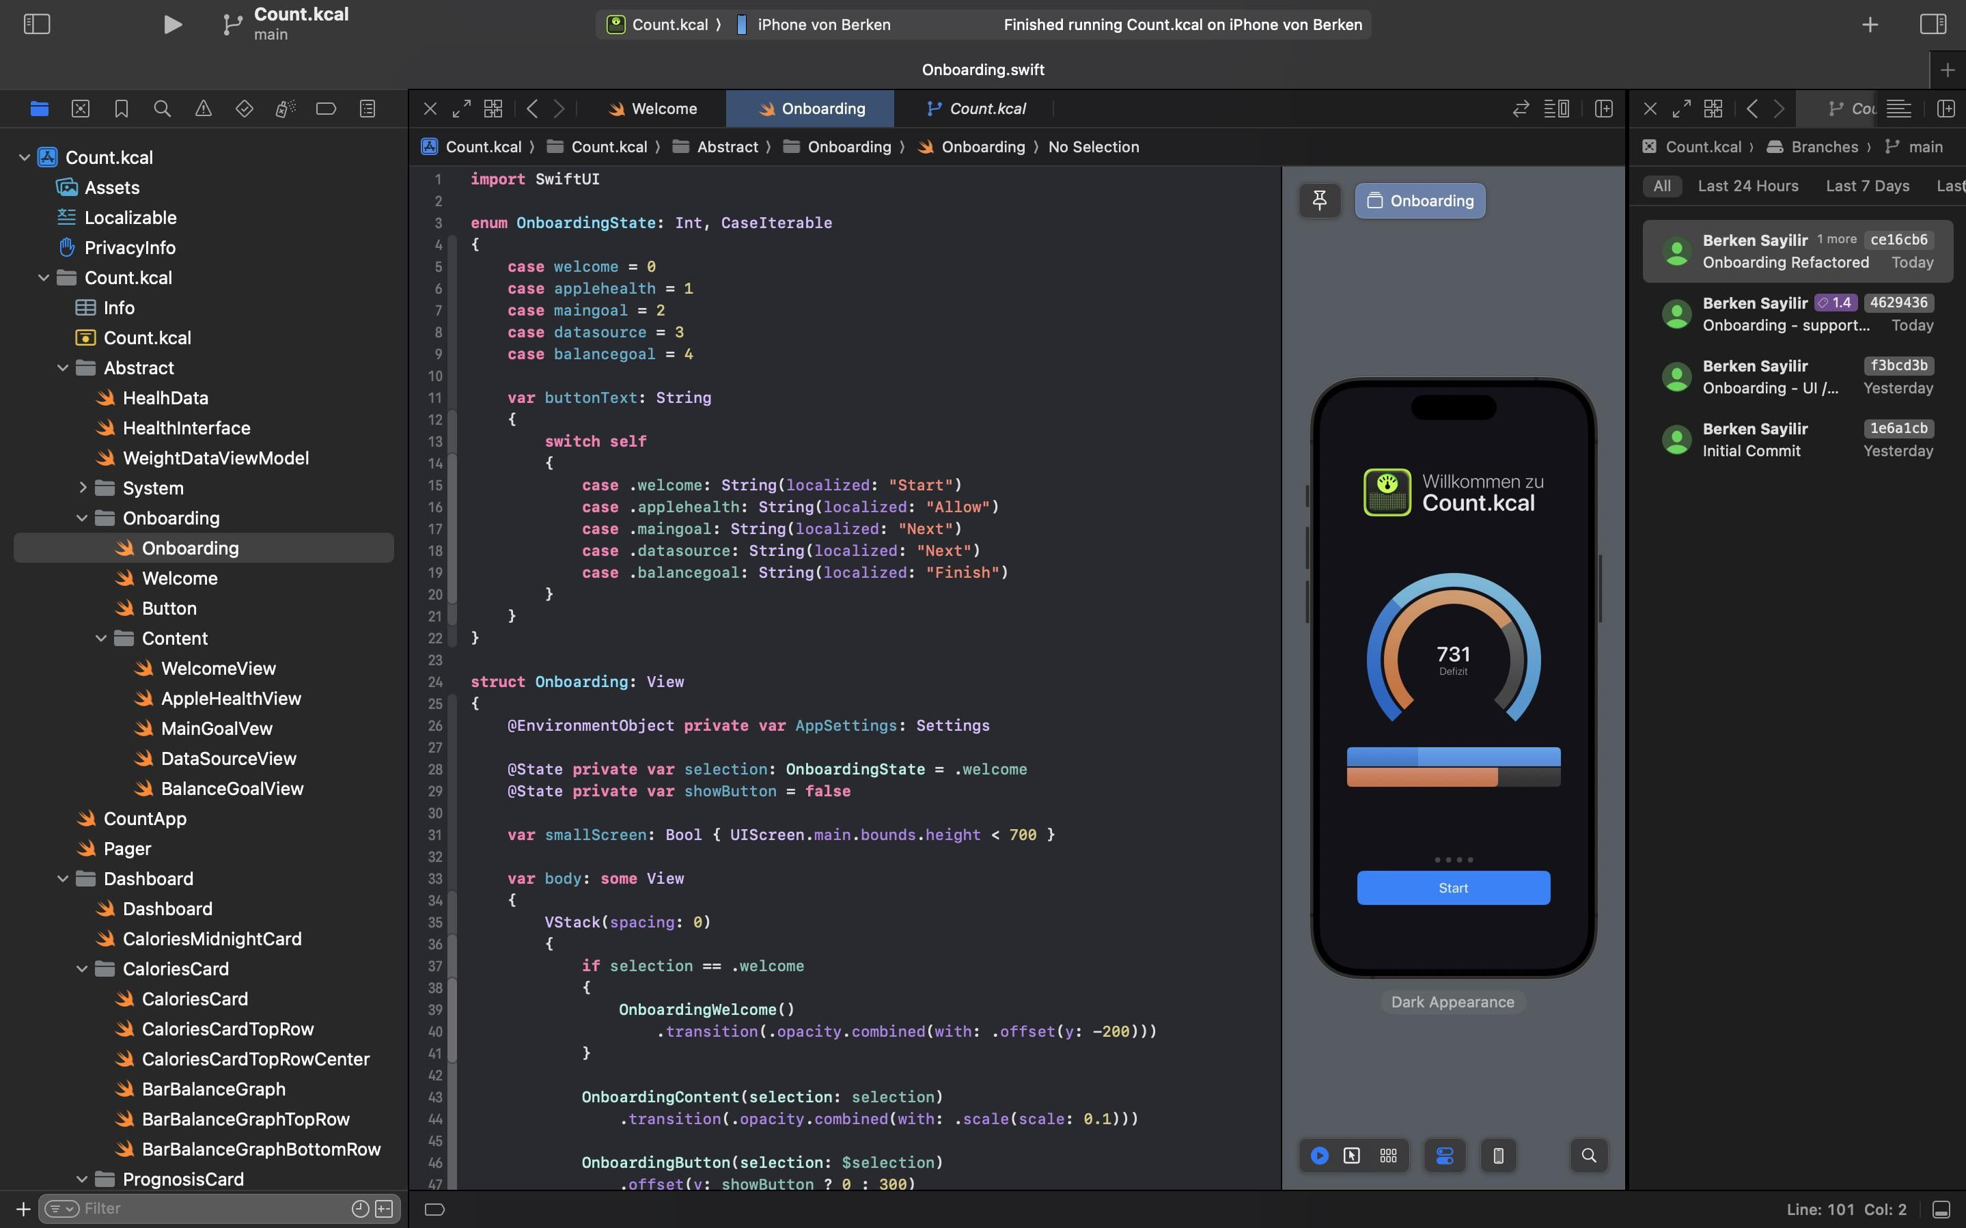
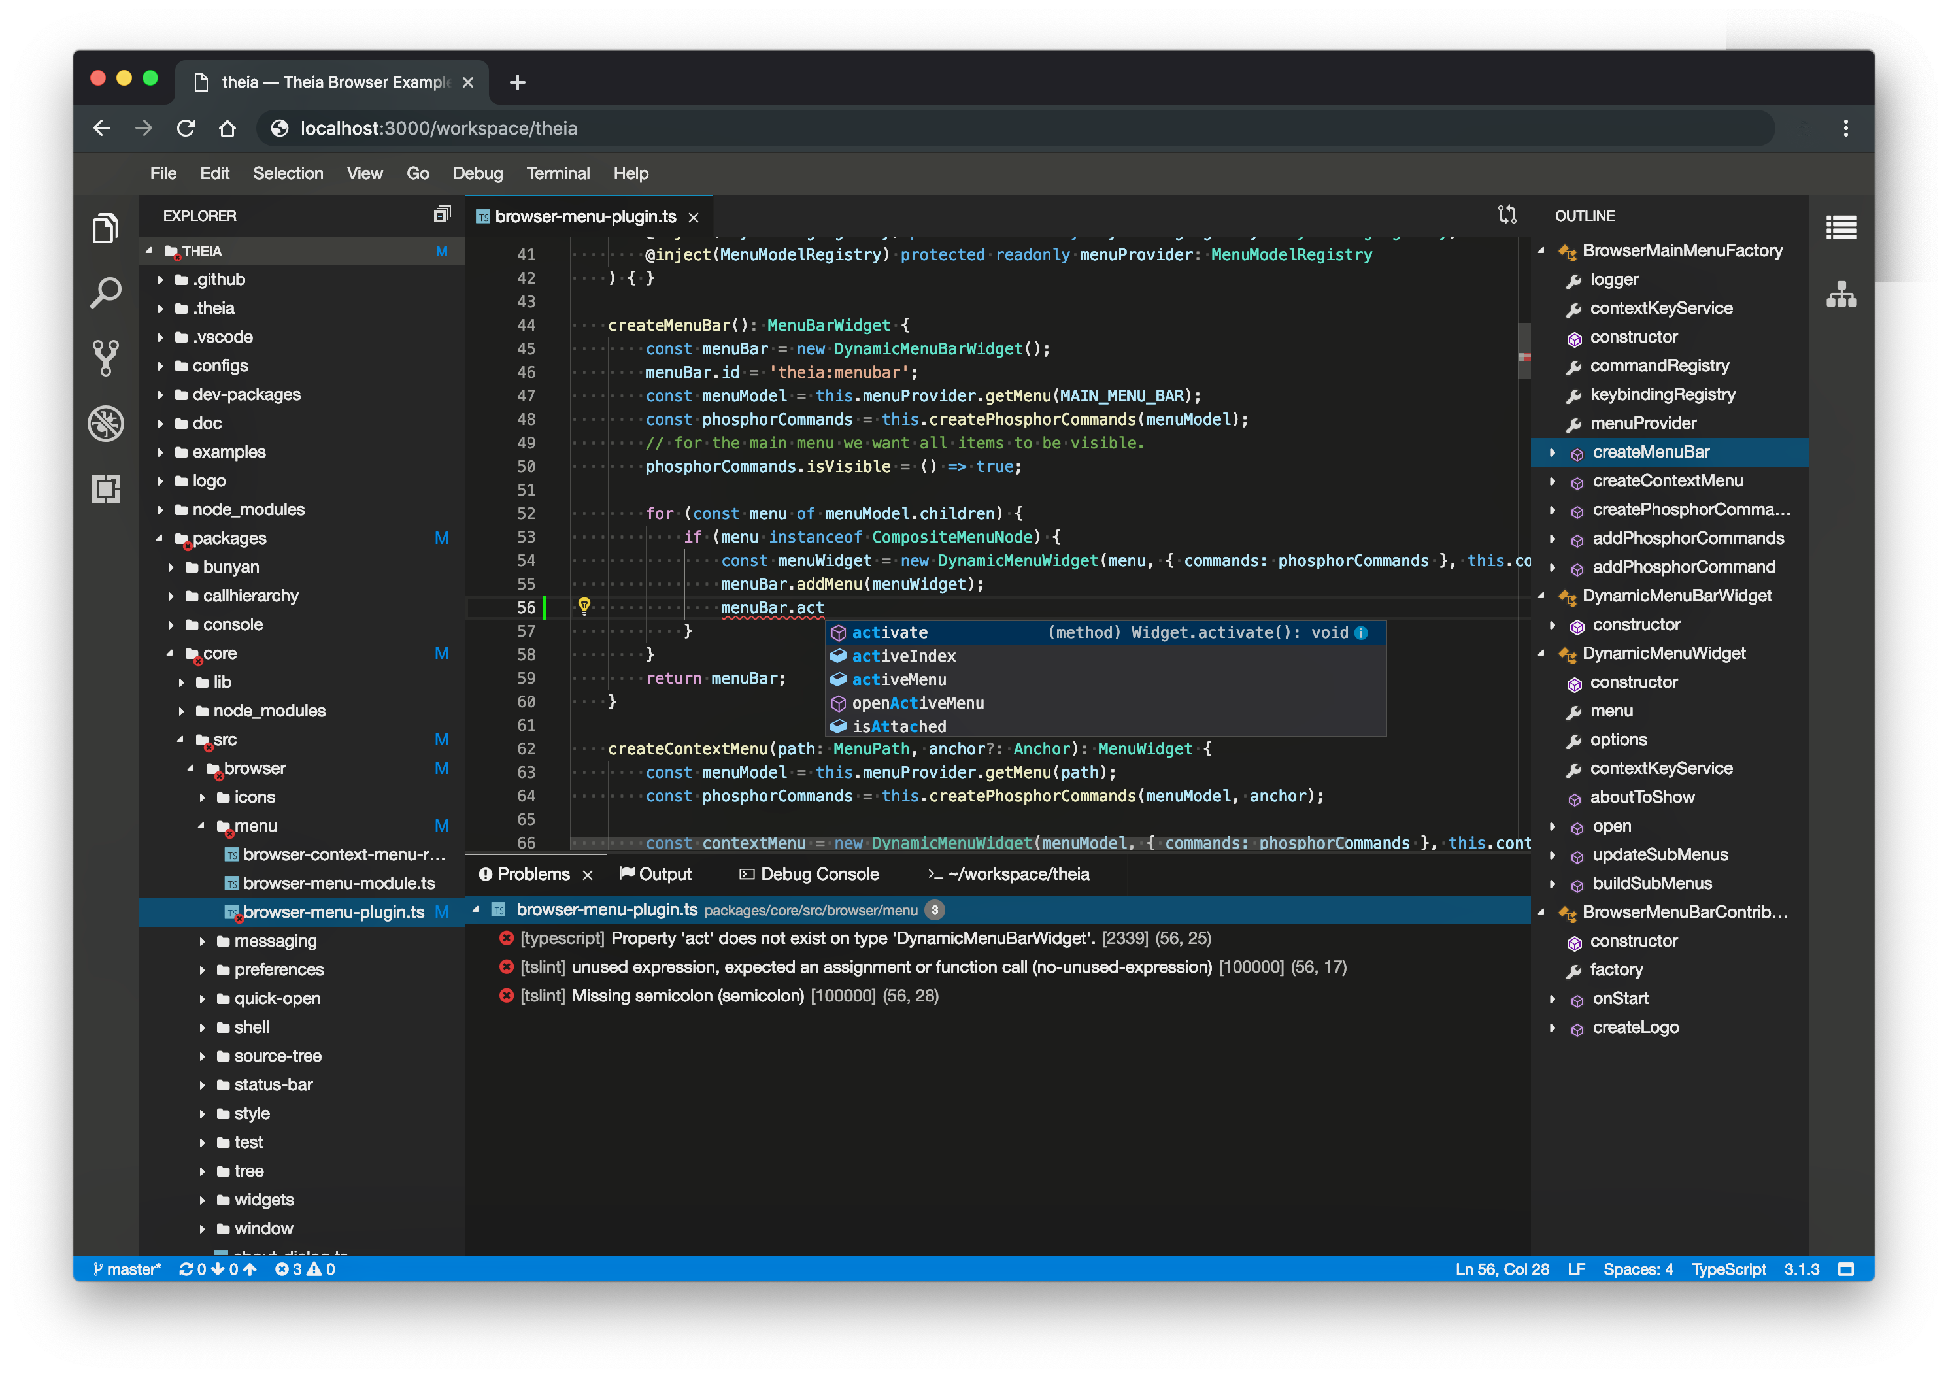
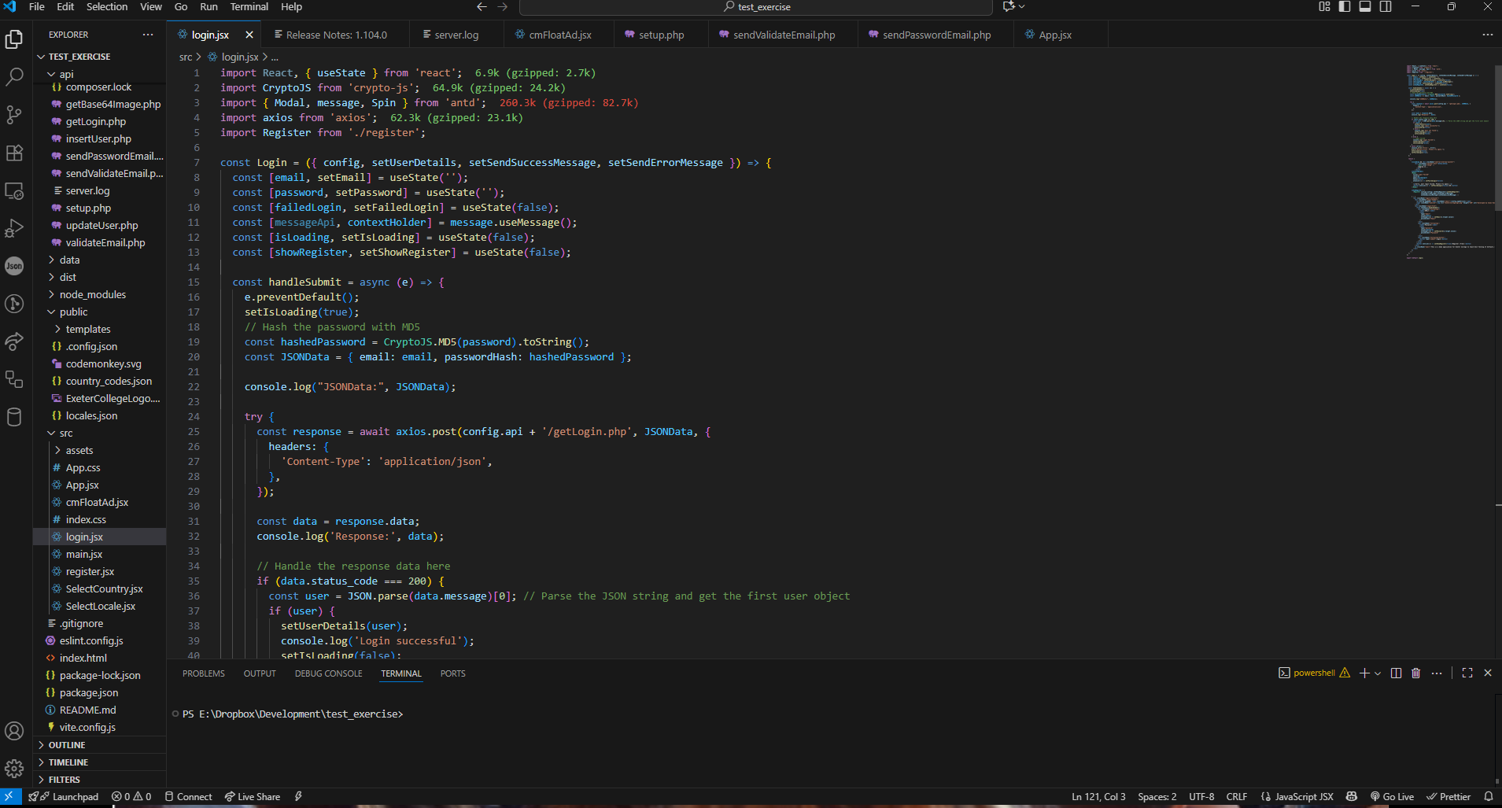
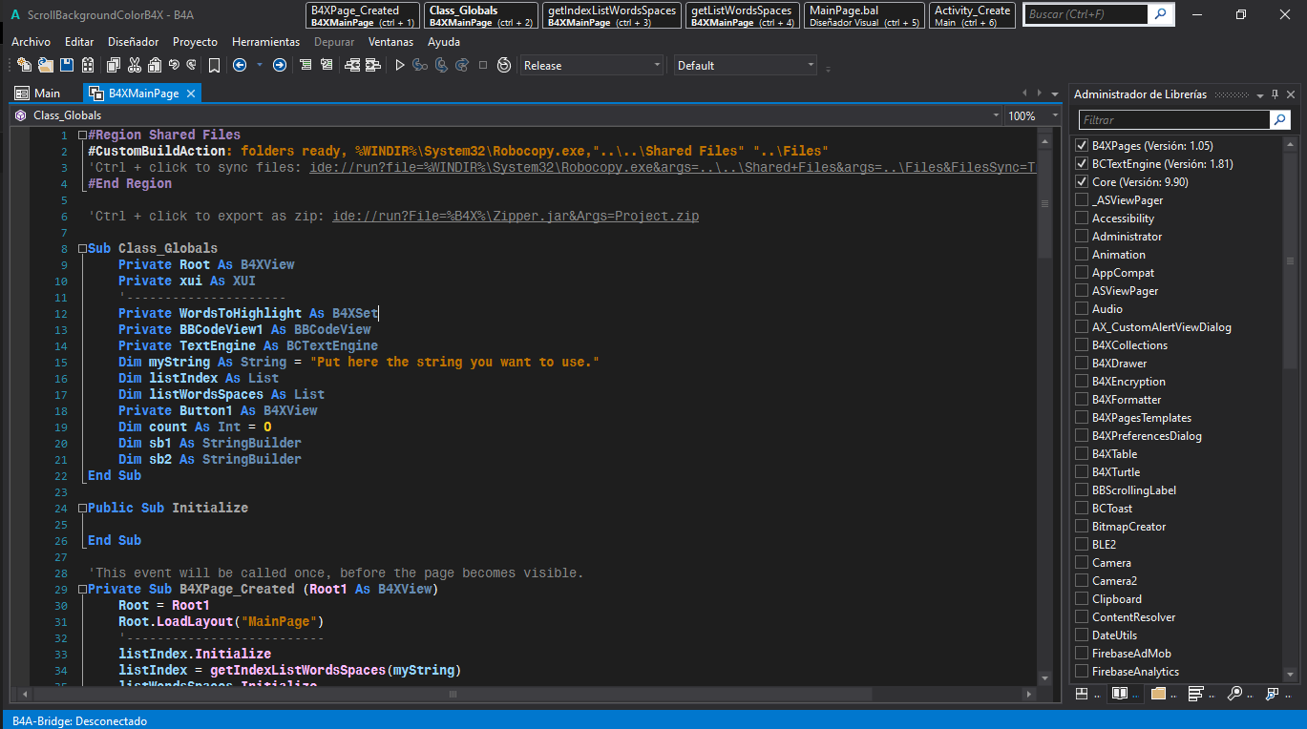
Spot the Tool
Answers:
Android Studio
Xcode (iOS)
Eclipse (Java)
VSCode (Multi)
B4x (Multi)
1
2
3
4
5

Slide 4
IDEs (Integrated Development Environments)
Android Studio
Official IDE for Android.
Built on IntelliJ IDEA.
Provides layout editors, emulators, debugging tools, and direct connection to Google Play SDKs.

Slide 5
IDEs (Integrated Development Environments)
Xcode
Apple’s IDE for iOS/macOS development.
Supports Swift and Objective-C.
Comes with Interface Builder (drag-and-drop UI).
Required for App Store deployment.

Slide 6
IDEs (Integrated Development Environments)
VSCode
Lightweight, cross-platform code editor.
Flutter (Dart) and React Native (JavaScript) plugins allow cross-platform development.
Popular with web developers moving into mobile.

Slide 7
👉 Android Studio and Xcode = platform-specific. 👉 Flutter/React Native in VS Code = cross-platform.

Slide 8
SDKs and APIs
SDK (Software Development Kit): Tools + libraries that allow you to build for a platform.
Example: Android SDK (emulators, compilers, debugging tools).
APIs (Application Programming Interfaces): Connect apps to external services or device features.
Google Maps API → Embed maps and geolocation.
Firebase → Authentication, real-time database, analytics, push notifications.
👉 SDKs = build the app. 👉 APIs = extend the app.
I want us to spend some time on APIs next week

Slide 9
Simulators / Emulators vs Physical Devices
Simulators / Emulators
Run apps virtually on your PC.
Faster to test on multiple devices/screen sizes.
Don’t always replicate hardware features well
(e.g., GPS, accelerometer).
Physical Devices
Essential for real-world testing.
Reveal performance issues, battery drain, network latency.
Best Practice:
Test on both emulators (for variety) and at least one physical device (for reality).

Slide 10

Debugging Basics
Debugging tools in IDEs let you:
Step through code line-by-line.
Inspect variable values.
Catch crashes and error messages.
Version Control (Git):
Tracks changes in code.
Allows multiple developers to collaborate safely.
Roll back to earlier versions if mistakes are made.
GitHub/GitLab are popular platforms.

Slide 11
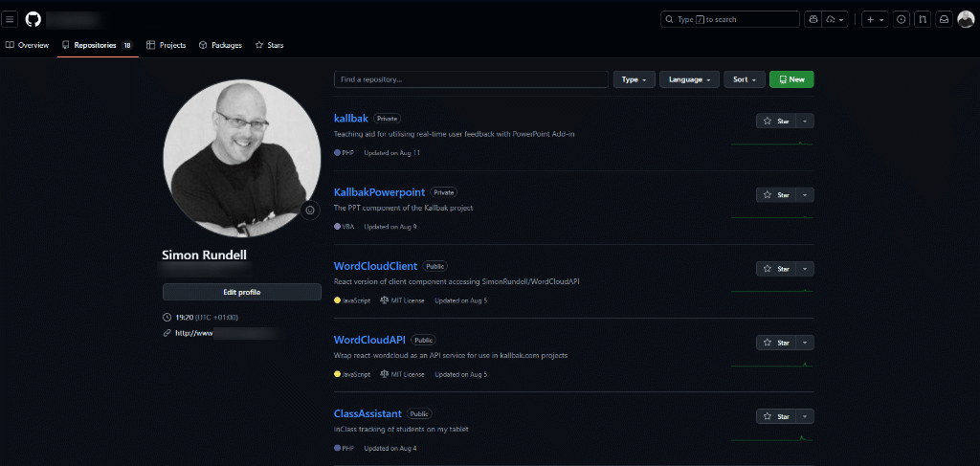
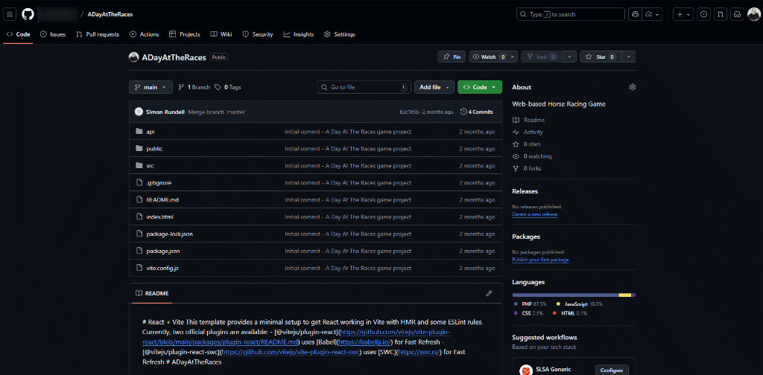

Slide 12


Slide 13
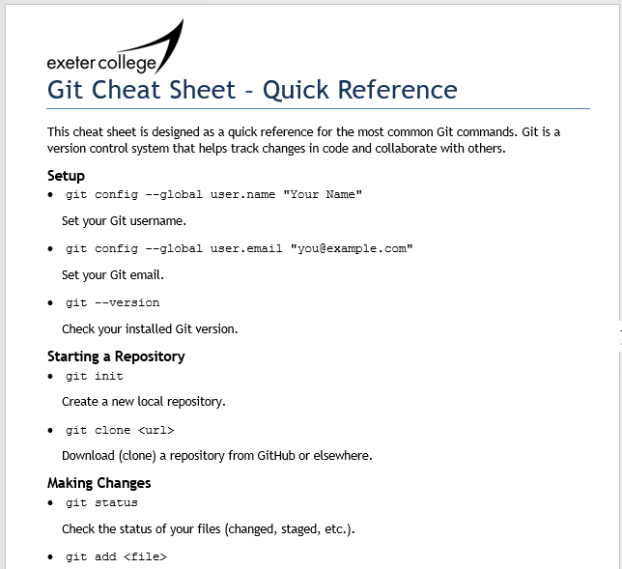
Git Hub Cheat Sheet in the Classwork Folder

Slide 14
Git Simulation
Each person has a role
Coder → makes changes.
Stager → stages changes.
Committer → commits changes.
Pusher/Puller → syncs with the “remote repo”
I am the “remote repo”
You have some cards representing some files.
In small teams of 3-4

Slide 15
Stage 1: Making Changes
The Coder writes a simple change on the file File1.txt
ie “Added a new function” or “Changed colour to blue”
The file is unstaged at this point
The command is given
So… what’s changed?
git status

Slide 16
Stage 2: Staging and Commiting
The Stager takes the file card and puts it in a “staging area”
The command is given
The Committer writes a short commit message on the back of the card recording what the change was
ie “Changed header colour”
The command is given
Now the file is officially part of the local repo.
git add <file>
git commit –m “Changed header colour”

Slide 17
Stage 3: Pushing to Remote
The Pusher takes the committed file and hands it to the “Remote Repo” (me)
The command is given
You can all see that the master copy has been updated
git push

Slide 18
Stage 4: Pulling Updates
One of the teams wants the latest copy of the file
The command is given
They now have the same updated version.
git pull

Slide 19
Stage 5: Merge Conflict
git status
git add File2.txt
Two Coders all write something different on File2.txt
ie one writes “Red” and the other “Blue”
Both commit and try to push.
Conflict! Two versions can’t be merged automatically.
So you have to negotiate which version to keep or combine them
Then the Maintainer can issue
git commit –m <whatever>
git push
git merge <branch>

Slide 20
What did you notice?
Git tracks changes step by step.
You can roll back or merge.
Collaboration needs communication.
There are visual versions of Git available and some IDEs like VSCode can do much of the work, but to really understand it you have to learn it on the command line.
If ever I get confused, I usually ask a LLM to clarify it so I don’t mess up my codebase.

Slide 21
Which tool for the job?
Working Independently
Here are some project scenarios:
“I want to build an iOS-only app”
“I want the same app on iOS and Android”
“I’m learning coding for the first time”
Decide which tool/framework you would choose and why?
Feedback to the class, justifying your decision.
10 mins

Slide 22
Homework
Deadline:
Midnight before next Friday
Short Write-Up (200 words): "Which mobile development environment do you think is best for beginners, and why?"
Compare Android Studio, Xcode, and VS Code with Flutter/React Native.
Mention at least one advantage and one drawback of the chosen environment.

Slide 23

















<title>
Note this down
Deadline:
Midnight before next lesson
Xmins
In small groups
Working Independently
In pairs
codeblock
Do not delete this slide nor move it from the second last slide in the deck

