Slide 1

CodeMonkey
This template and PowerPoint Extensions created by
Where the magic happens
CodeMonkey Design
www.codemonkey.design
simon@codemonkey.design
+44 7976 802123

Slide 2
Mobile Apps Development
Lesson 1

Slide 3

Welcome
You can sit where you like to begin with.
Please log in to your computers, open Teams
and visit this class: BTec IT Year 2 Group B or visit:
https://forms.office.com/e/BzTG2CNnyw
and complete a short quiz for me to get to know you.

Slide 4


Simon Rundell
I am your teacher for this course.
30+ years experience as a Software Developer

Slide 5
My lessons
Before each lesson I will set a small bit of preparation
A video to watch
Something to read
Something to look up and make some notes
Most lessons will begin with a recall of things we have done in the recent and less recent past
At the end of each lesson I will set a small task
A video to watch
Something to look up and make some notes
A task to undertake

Slide 6
My expectations
That you will do the preparation and be equipped for the lesson
That you will do the set task in time for the next lesson
During the lesson:
Focus Zone – no phones unless I have specified you to use them
Listen when I am teaching
No headphones or earbuds when I am talking
Engage with the content and the exercises
Ask relevant questions

Slide 7
My expectations
When working:
Don’t chat with your neighbours – silence is standard
Headphones/earbuds is a privilege not a right
Be prepared to stop, turn and listen when I countdown.
Don’t be distracted by off-topic web browsing, email checking or other time-wasting

Slide 8
You can expect from me
Lessons that are grounded in my experience
Theory and practice
Commitment to teaching and supporting you well
Help as and when you need it – just ask!

Slide 9

Questions on any of that

Slide 10

App Development
A1 Types of Mobile Apps

Slide 11
Introduction to the unit
Assignment 1 – Analyse Mobile Apps
Assignment 2 – Design, build and evaluate a mobile app to a given brief.

Slide 12
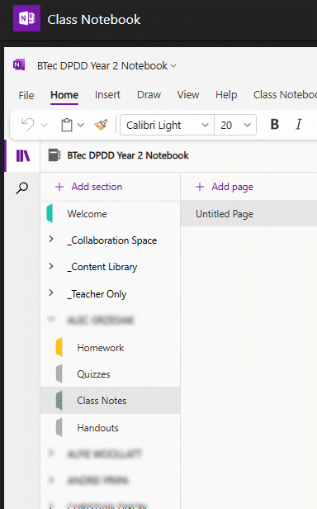
Using the Teams Class Notebook
Teams
Class Notebook
<Your Name>
Class Notes
Create New Page “A1 Types of Mobile App”
When you see:
Note this down
This is where I expect you to make notes under the appropriate lesson heading

Slide 13
What is an App?
There are different approaches to building apps.
Discuss these terms, what do they mean?
Native
Web-app
Discuss in pairs
Hybrid
Cross-platform

Slide 14
Native
Web-app
Hybrid
Cross-platform

Slide 15

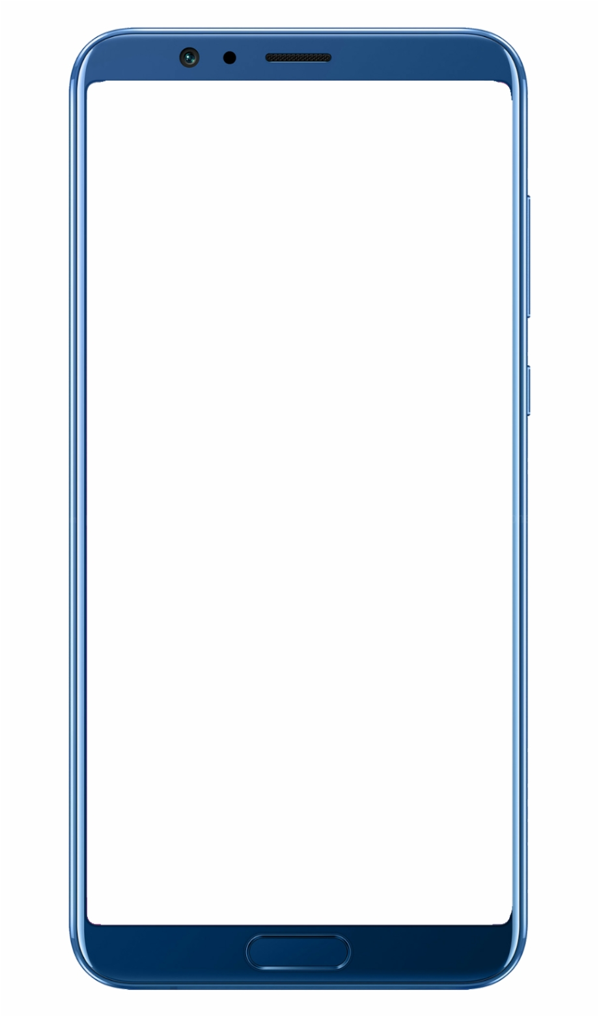
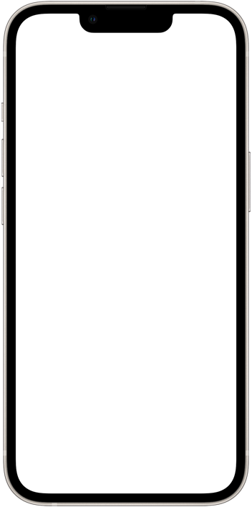

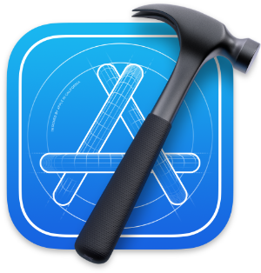

Native
Using platform specific tools to create a singular app for a specific platform.
eg Creating an iPhone app using Apple's Xcode SDK and Swift language.
Some companies will have an iOS team and an Android team working on 2 versions of the same app.
iPhone
Android
Xcode
Note this down

Slide 16
Native
Research and list some apps that are built Natively.
(Try and find an app you use regularly).

Slide 17
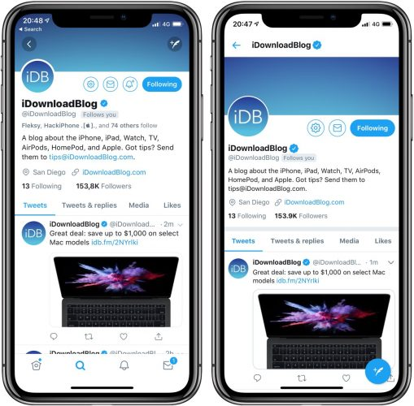
Web App
Note this down
Web apps access content using a browser and the internet.
Modern web apps can be made to look almost identical to native apps.

Slide 18
Web Apps
Research and list some apps that are Web Apps.
(Try and find an app you use regularly).

Slide 19
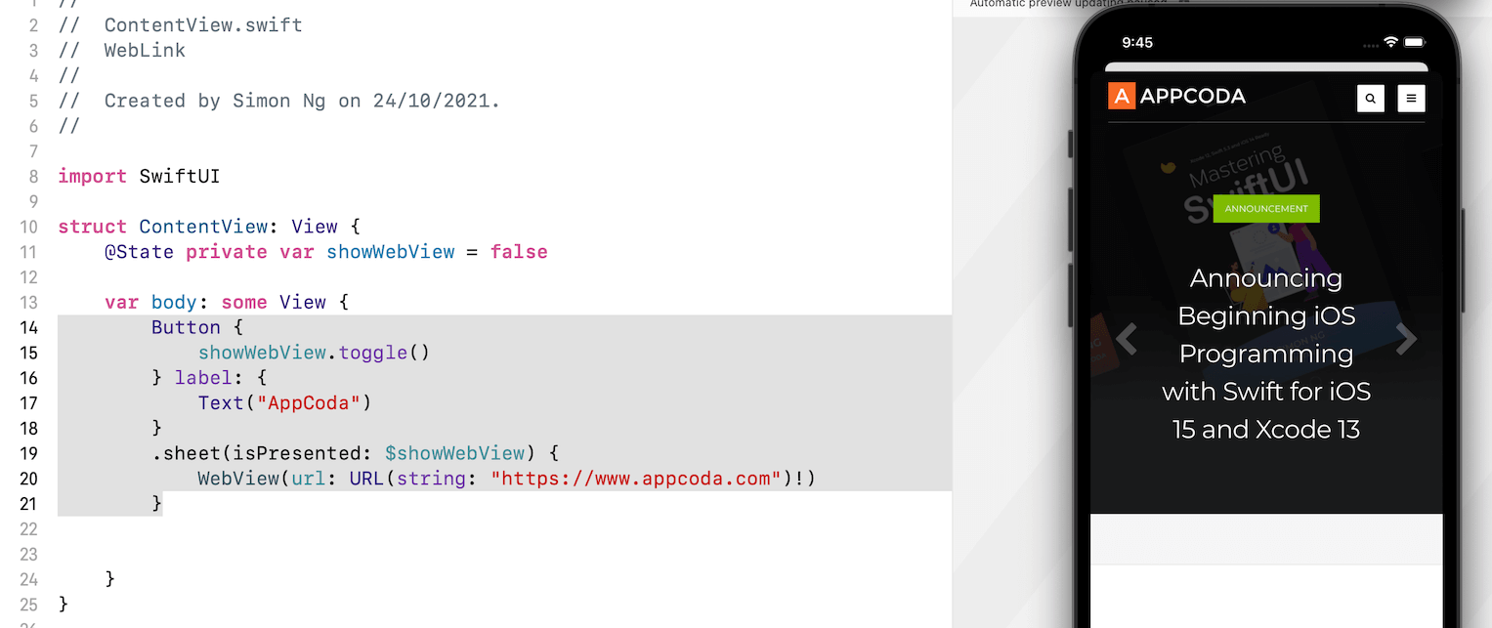
Hybrid
Hybrid apps are a combination of Native and Web app elements. They use the internet and a web-browser 'view' to display content. These can be packaged into a traditional app you would download from a store. You can embed a 'WebView' into your app and specify the webpage to load.
Note this down
Web View embedded into an app.
Native Content

Slide 20
Hybrid
Research and list some apps that are Hybrid Apps.
(Try and find an app you use regularly).

Slide 21



Cross-Platform
Note this down
Develop a single version of the app (single codebase). Then deploy to multiple platforms such as iOS, Android and even Windows.
React Native (JavaScript)
Flutter (Dart – Google)
Microsoft .Net MAUI (C# and Xaml (like HTML))

Slide 22
React Native
Let's try out React Native.
Go here: https://snack.expo.dev/
Don't bother creating an account yet.
Hit iOS or Android in the simulator and 'Tap to Play'.
Look through the code and see if you can:
Change the app background to red. (#ff0000)
Add text under the image (below the card).
Apply paragraph styling to the Text.
React Native allows developers to create mobile apps using JavaScript and a set of components that map directly to Native mobile UI components on both iOS and Android platforms. When you use React Native, the code is translated into native code for the respective platform. All about React Native - How does it work and when to use it (clouddevs.com)

Slide 23
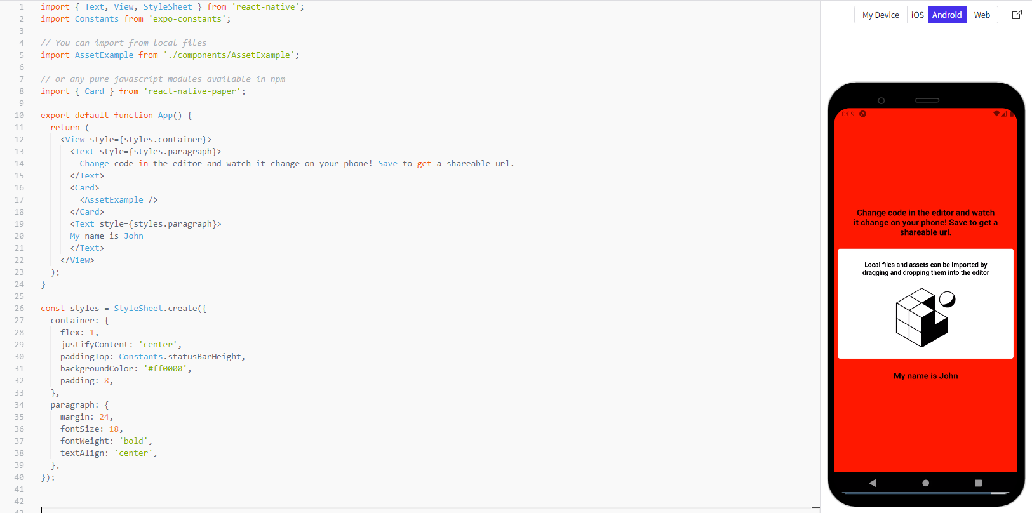

Slide 24
React Native
Research and list some apps that are built using React Native
(be careful - they say Facebook is built with React Native, but it isn't, what they mean is specific parts of it is such as the Desktop Messenger app).
(Try and find an app you use regularly).

Slide 25
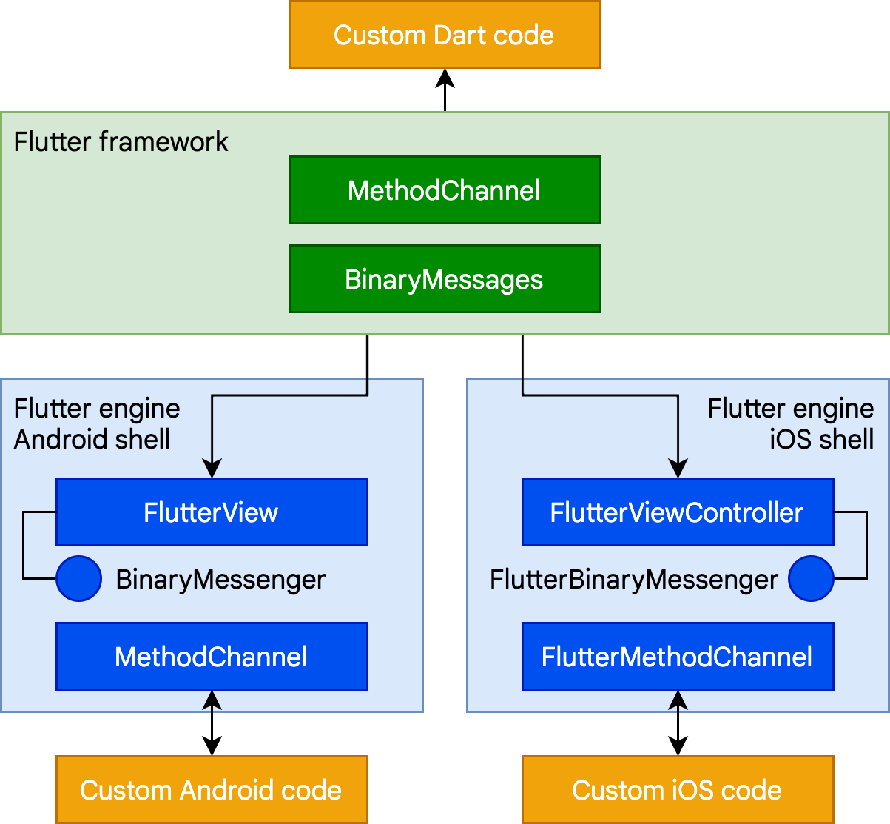
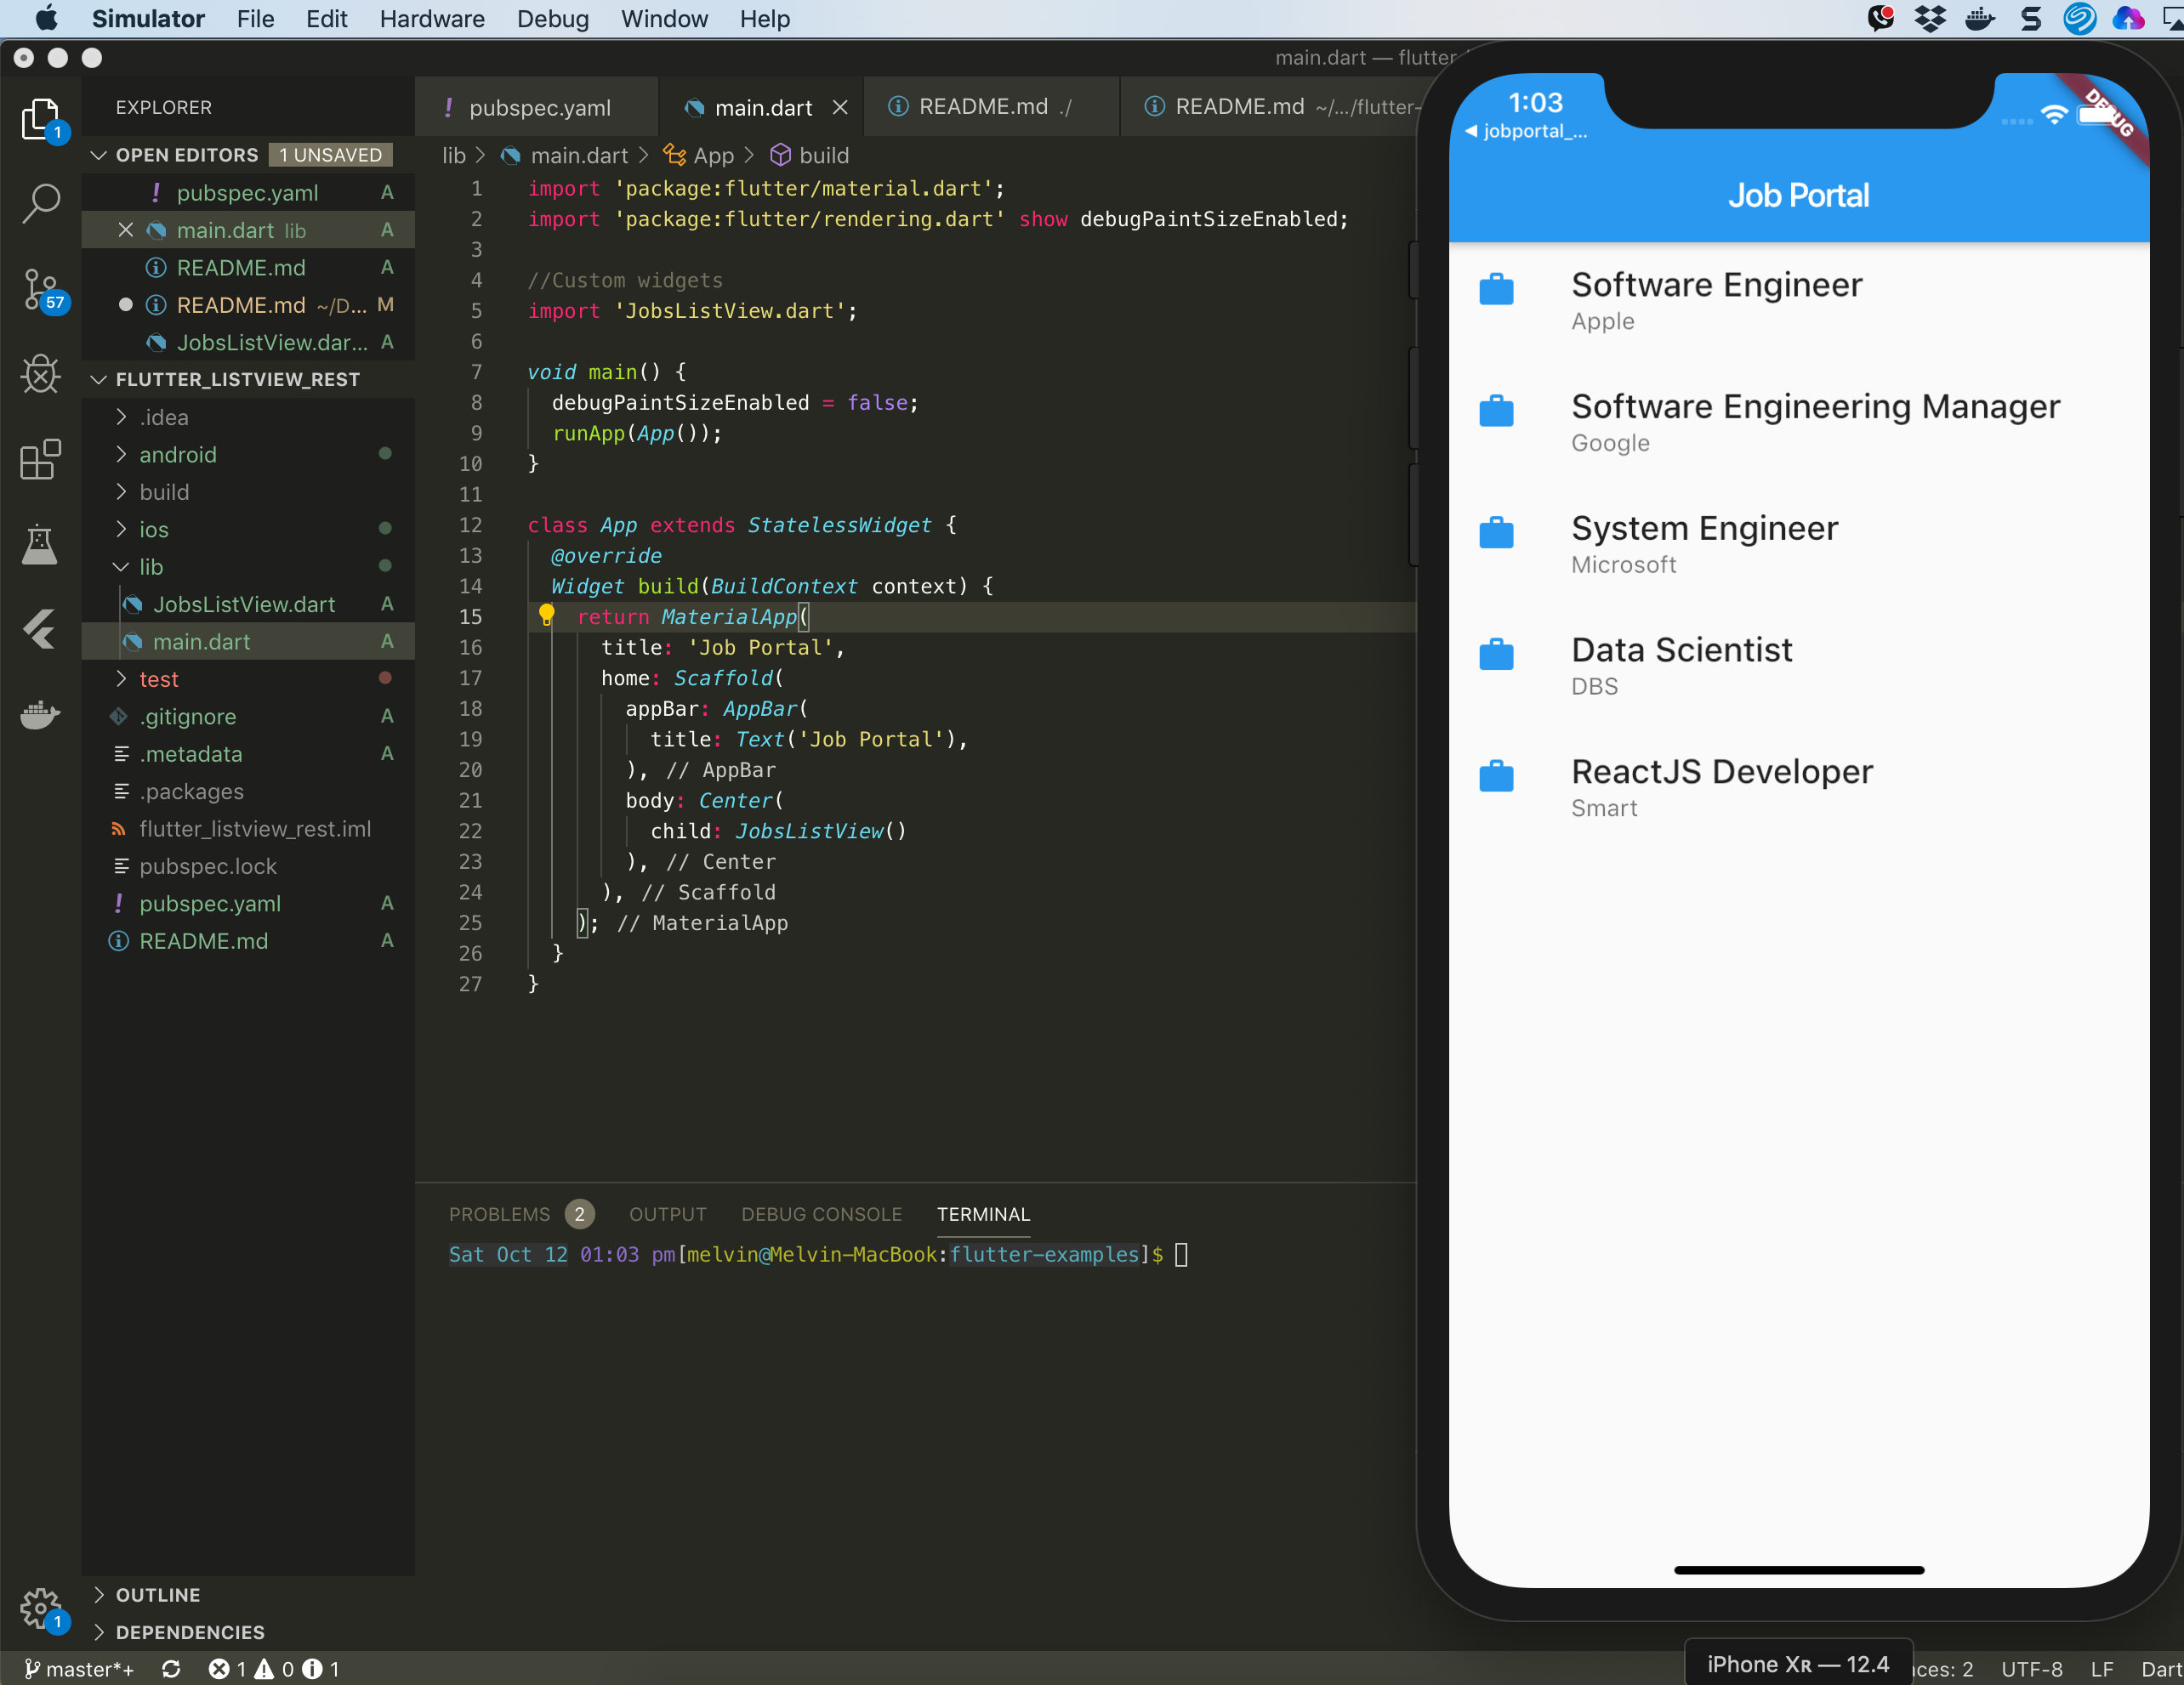
Flutter
Note this down
Like React Native, Google's Flutter enables you to create cross-platform applications using a single codebase.

Slide 26
Flutter
Research and list some apps that are built using Flutter.
(Try and find an app you use regularly).

Slide 27
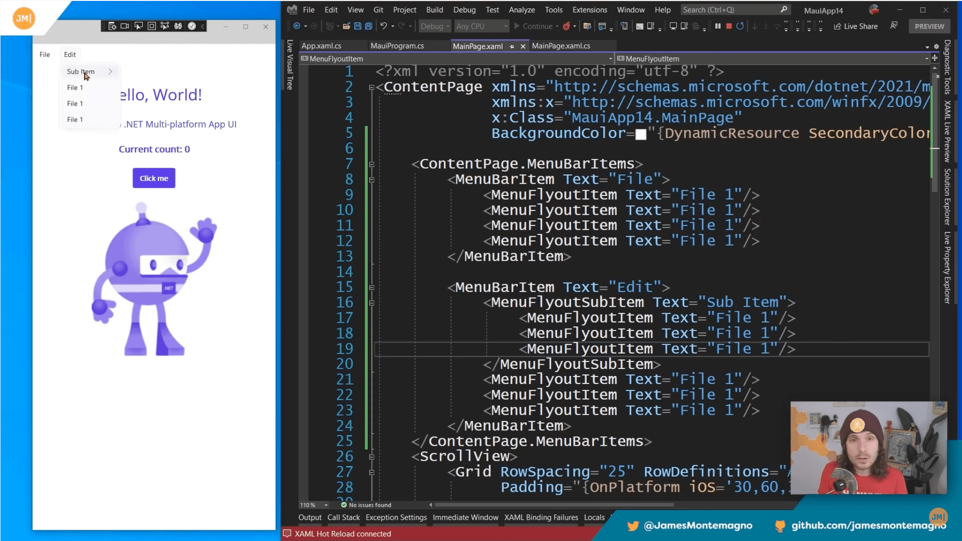
Microsoft .Net MAUI
Note this down
MAUI = Multiplatform Application UI.
Develop in Visual Studio.
Uses XAML for UI.
C# for functional code.
Deploy on iOS, Android, Windows and Mac OS!
eXtensible Application Markup Language

Slide 28
.Net MAUI
Research and list some apps that are built using MAUI.
(Try and find an app you use regularly).

Slide 29
Homework
Deadline:
Midnight Tuesday
Research the pros and cons of different app dev approaches.
Create a Word document and submit it as the Assignment.
 | Pros | Cons
Native
Web App
Hybrid
Cross-Platform

Slide 30
Sample Texts
True / False:
PLEASE LOG IN
PLEASE LOG IN
Do not delete this slide nor move it from the second last slide in the deck

Slide 31

















<title>
Note this down
Xmins
Do not delete this slide nor move it from the second last slide in the deck

