Slide 1

App Development
A2a Context of Mobile Apps

Slide 2
Recall
Answer the five questions on last lesson at:
https://forms.microsoft.com/e/svAf3HYNwi

Slide 3
Human Interface Guidelines
Throughout these sessions research aspects of mobile app development using Apple's amazing design and development guide found here:
https://developer.apple.com/design/human-interface-guidelines/
TASK: Quickly explore the HIG and find something interesting / new to you to report back to the class.
Link is in Class Teams
10 mins

Slide 4
Features
Let’s Mind Map the features of Mobile Apps to see how it impacts the design, development and use of them…
You can use paper, or any charting tool you like.
If you haven’t ever tried a charting tool, try LucidChart (Tell them you’re a student and they will give you an educational account)

Slide 5

Features – Accessibility
Research at least 3 accessibility features you can build into mobile apps and how they help people:
https://developer.apple.com/design/human-interface-guidelines/accessibility
Why is this important?
10 mins
Remember this is in the Classwork folder of Teams
Add to your Mind Map
Notes:
Light / Dark mode - Bool
Username - String
High score – Int / Double.
Theme colour - String
Last login date – Date (could use a String if Date is not available).
The SwiftUI example demonstrates saving a 'username' in long term memory.

Slide 6
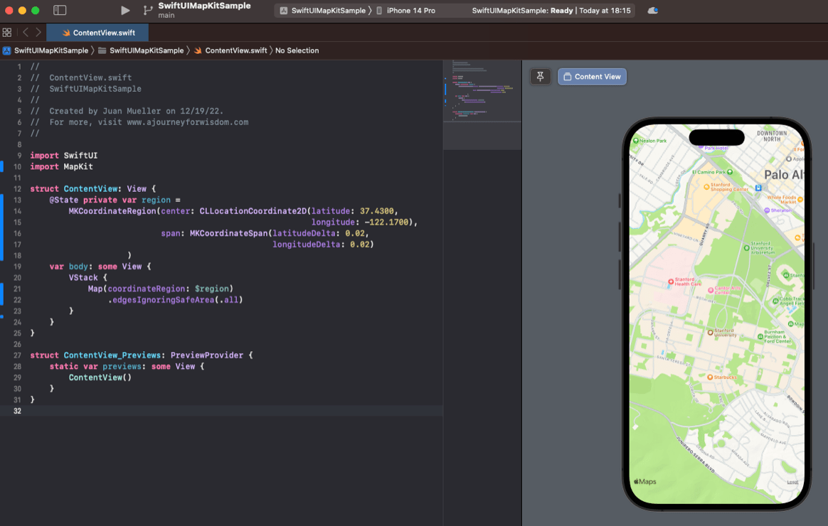
Features - Maps
10 mins
Research examples of apps that use interactive maps.
What is the purpose of the map?
Add to your Mind Map

Slide 7
Features - Locale
You can also access the Phone's 'Locale' info.
The SwiftUI code above formats the totalPerPerson amount in a Text view using the currency symbol for the phone's region setting.
( ?? "USD" ) provides a default value – this technique is called 'nil coalescing'.
eg: the Text view will update dynamically:
Set the phone region to America = $100
Set the phone region to U.K. = £100.
What type of customer might this be useful for?
Add to your Mind Map

Slide 8
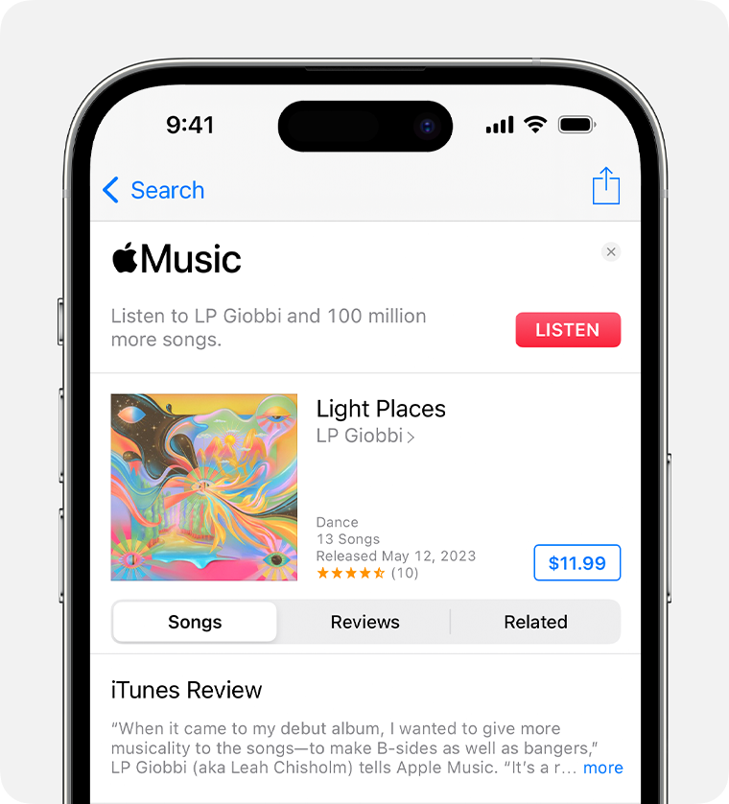

Features – Sound / Music
10 mins
Consider apps which require sound / music and why.
Research best practices for playing audio on the HIG.
Research Haptics on the HIG.
Add to your Mind Map
Notes:
Light / Dark mode - Bool
Username - String
High score – Int / Double.
Theme colour - String
Last login date – Date (could use a String if Date is not available).
The SwiftUI example demonstrates saving a 'username' in long term memory.

Slide 9
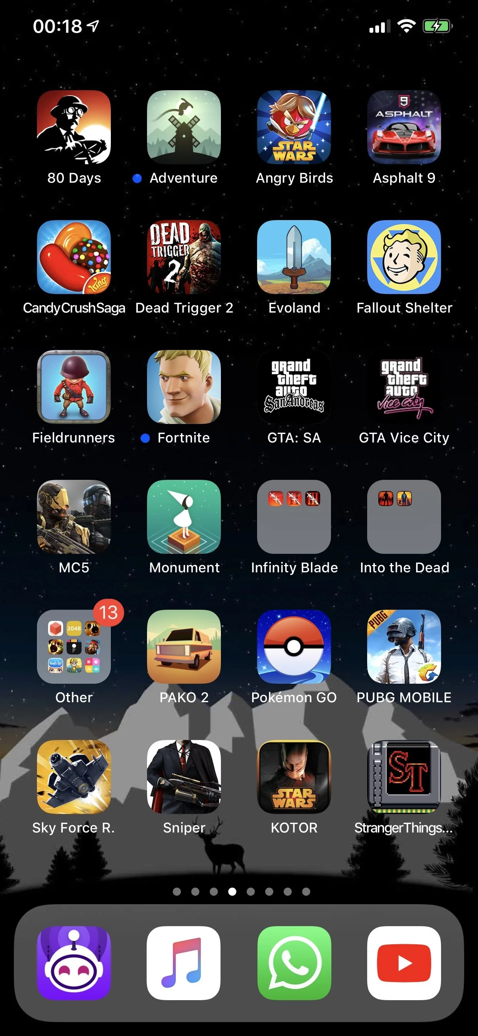
Features – Games
Add to your Mind Map
Platforms such as iOS have dedicated frameworks for game development. Apple has a 2D framework called SpriteKit and 3D framework called SceneKit which can also be used for Augmented Reality apps. There is also a low-level framework called 'Metal'.
What design choices do you need to consider when developing a game for mobile app development?
What games have you seen work really well on mobile devices and why?
Notes:
Light / Dark mode - Bool
Username - String
High score – Int / Double.
Theme colour - String
Last login date – Date (could use a String if Date is not available).
The SwiftUI example demonstrates saving a 'username' in long term memory.

Slide 10

Features – Productivity
Explore productivity apps on your phone (word, PPT, Outlook etc.).
How are they different to the desktop versions and why?
Design
Functionality
Add to your Mind Map
Notes:
Light / Dark mode - Bool
Username - String
High score – Int / Double.
Theme colour - String
Last login date – Date (could use a String if Date is not available).
The SwiftUI example demonstrates saving a 'username' in long term memory.

Slide 11
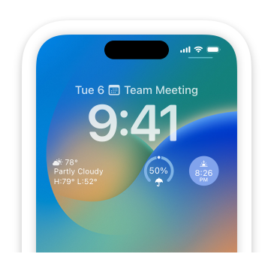
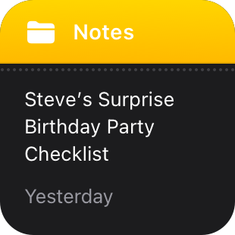
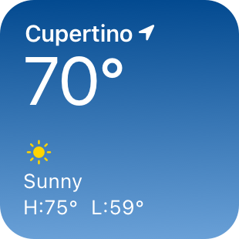
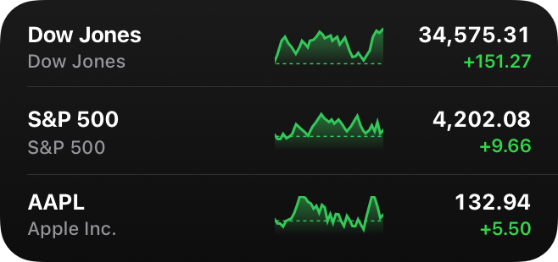
Features – Widgets
10 mins
Research the definition of a widget.
There are good design approaches for widgets here:
https://developer.apple.com/design/human-interface-guidelines/widgets
Add to your Mind Map
Notes:
Light / Dark mode - Bool
Username - String
High score – Int / Double.
Theme colour - String
Last login date – Date (could use a String if Date is not available).
The SwiftUI example demonstrates saving a 'username' in long term memory.

Slide 12
New Features – AR
Device technology:
Why is LiDAR important for accurate AR?
Why do you need accelerometer and gyroscope info?
What is world tracking?
https://developer.apple.com/augmented-reality/arkit/
https://developer.apple.com/documentation/visionos/tracking-points-in-world-space
https://developer.apple.com/design/human-interface-guidelines/augmented-reality
10 mins
Add to your Mind Map
Notes:
Light / Dark mode - Bool
Username - String
High score – Int / Double.
Theme colour - String
Last login date – Date (could use a String if Date is not available).
The SwiftUI example demonstrates saving a 'username' in long term memory.

Slide 13
New Features
Discuss:
As a developer, why is it important to stay up to date with technological change?
Notes:
Light / Dark mode - Bool
Username - String
High score – Int / Double.
Theme colour - String
Last login date – Date (could use a String if Date is not available).
The SwiftUI example demonstrates saving a 'username' in long term memory.

Slide 14
Homework
1. Research (10 minutes) Choose one feature from the list below:
Accessibility
Maps
Locale (region & currency)
Sound/Music/Haptics
Games
Productivity
Widgets
Augmented Reality (AR)
Find one real-world mobile app that uses this feature. Write a short paragraph (4–5 sentences) explaining:
The app name.
How it uses the feature.
Why this improves the user experience.
2. Reflection (5 minutes) Answer this question in 2–3 sentences:
Why is it important for app developers to stay up to date with new features and technologies?

Slide 15
Sample Texts
True / False:
PLEASE LOG IN
PLEASE LOG IN
Do not delete this slide nor move it from the second last slide in the deck

Slide 16

















<title>
Note this down
Xmins
Do not delete this slide nor move it from the second last slide in the deck

