Slide 1

App Development
A2b Context of Mobile Apps

Slide 2
Recall
Answer the five questions on last lesson at:
https://forms.microsoft.com/e/WuC9ZD3PWh
Also set as an assignment.

Slide 3
Data Persistence

Slide 4
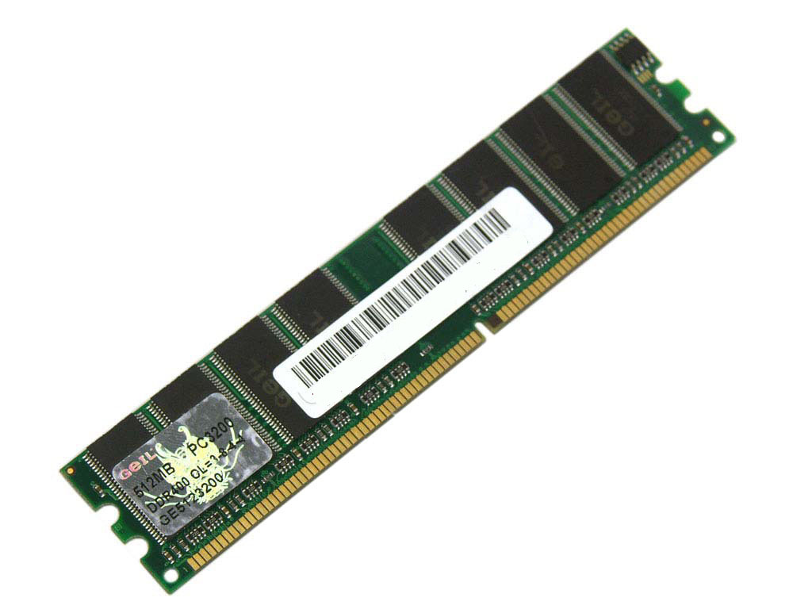
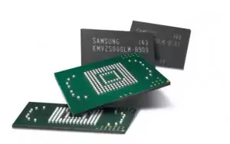
What is Persistence?
When you create constants and variables they are stored in RAM. So, when the app or device is closed your app's data is gone.
Therefore, we need a way to 'persist' data in long term memory on the device.

Slide 5
Features - Utility
Some Data Persistence Methods:
Preferences / @AppStorage (small key/value persistence)
File Manager (local persistence).
Database / Core Data (local persistence).
Cloud storage (Firebase / Realm)

Slide 6
Features – Preferences / @AppStorage
Used to store small pieces of data (Int, String, Bool, Doubles) in a dictionary key / value pair structure.
Often this data is loaded when the app is loaded, therefore you should keep this data small to ensure your app loads quickly.
Use this for user settings. What data types would these settings be:
Light / Dark mode
Username
High score
Theme colour
Last login date
Boolean
String
Integer
Tuple for RGB/HSL or String for Hex values
Date/Time
Notes:
Light / Dark mode - Bool
Username - String
High score – Int / Double.
Theme colour - String
Last login date – Date (could use a String if Date is not available).

Slide 7
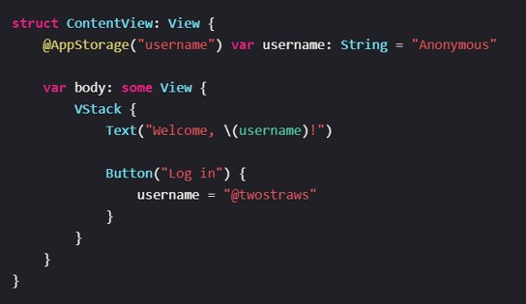
Features – Preferences / @AppStorage
Here is an example of @AppStorage used in SwiftUI.
We can persist a username string using the @AppStorage property wrapper and the username key in the phone's memory for quick recall when the app loads.

Slide 8
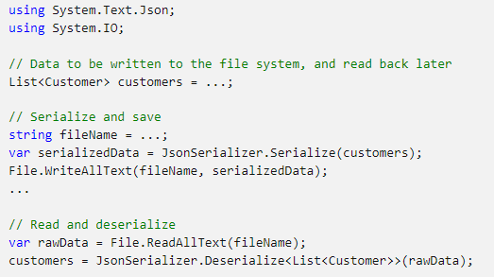
Features – File Manager
File Manager enables us to create and edit data as JSON, and to use this data in our apps. It’s a simpler way of creating, updating and persisting data than creating a Database or using Core Data.
The example on the right demonstrates an example in .Net C# of how:
Data is serialized (converted) into JSON.
Data is deserialized back into C#.
Similar approaches are taken in other frameworks. For instance in Swift we use the terms Codable and Decodable.
Notes:
Light / Dark mode - Bool
Username - String
High score – Int / Double.
Theme colour - String
Last login date – Date (could use a String if Date is not available).
The SwiftUI example demonstrates saving a 'username' in long term memory.

Slide 9
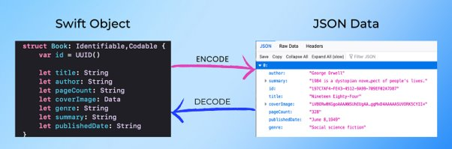
Features – File Manager
Here is an example of Swift code on the left which can be 'encoded' into a JSON file which can be persisted. It can then be decoded when we need to access / change the data.
Notes:
Light / Dark mode - Bool
Username - String
High score – Int / Double.
Theme colour - String
Last login date – Date (could use a String if Date is not available).
The SwiftUI example demonstrates saving a 'username' in long term memory.

Slide 10
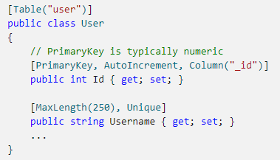
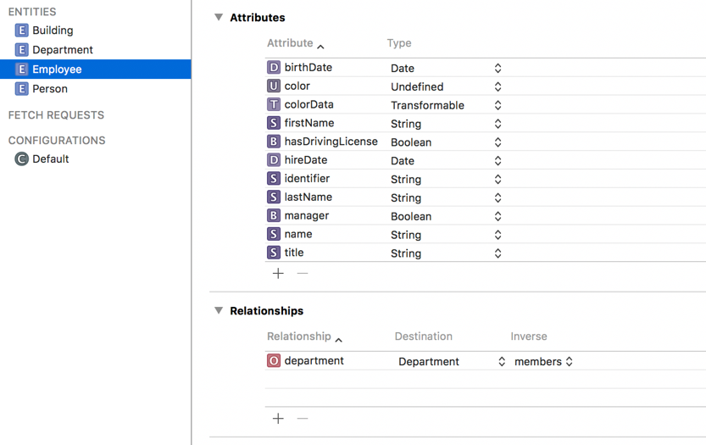
Features – Database / Core Data
Required for more complex data structures and relational data.
.Net (left) and Xcode Core Data (right) both use SQLite to store data.
Remember, this is still local persistence, saved to the device.
Notes:
Light / Dark mode - Bool
Username - String
High score – Int / Double.
Theme colour - String
Last login date – Date (could use a String if Date is not available).
The SwiftUI example demonstrates saving a 'username' in long term memory.

Slide 11

Features – Cloud Storage
Research Google Firebase.
What can it do?
Why would you use it?
What sort of data can you store on it?
What are the security advantages?
How many monthly users can you have on the free plan?
Can you think of an app idea that would require a Cloud System like this?
Research some apps that use Firebase or Realm.
10 mins

Slide 12
CRUD
What is CRUD?

Slide 13
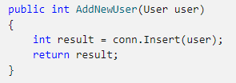
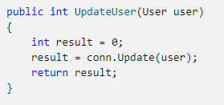
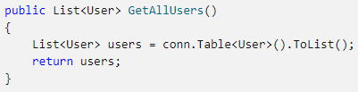
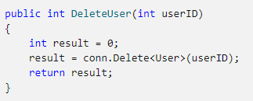
Create, Read, Update, Delete
All Apps that use data generally need to be able to do CRUD tasks to manage data, no matter how you store it.
Research and discuss an app that does this.
5 mins
Create
Update
Here is an example in C# .Net MAUI of how we could complete CRUD tasks on users.
(conn refers to a connection to an SQLite Database.
Read
Delete

Slide 14
Sample Texts
True / False:
PLEASE LOG IN
PLEASE LOG IN
Do not delete this slide nor move it from the second last slide in the deck

Slide 15













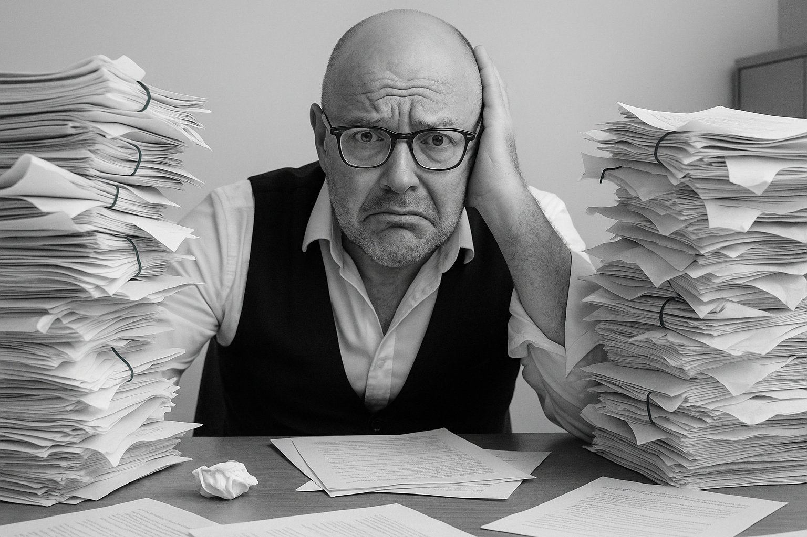



<title>
Note this down
Xmins
Do not delete this slide nor move it from the second last slide in the deck

