Slide 1
Problem Solving
Lesson 1

Slide 2
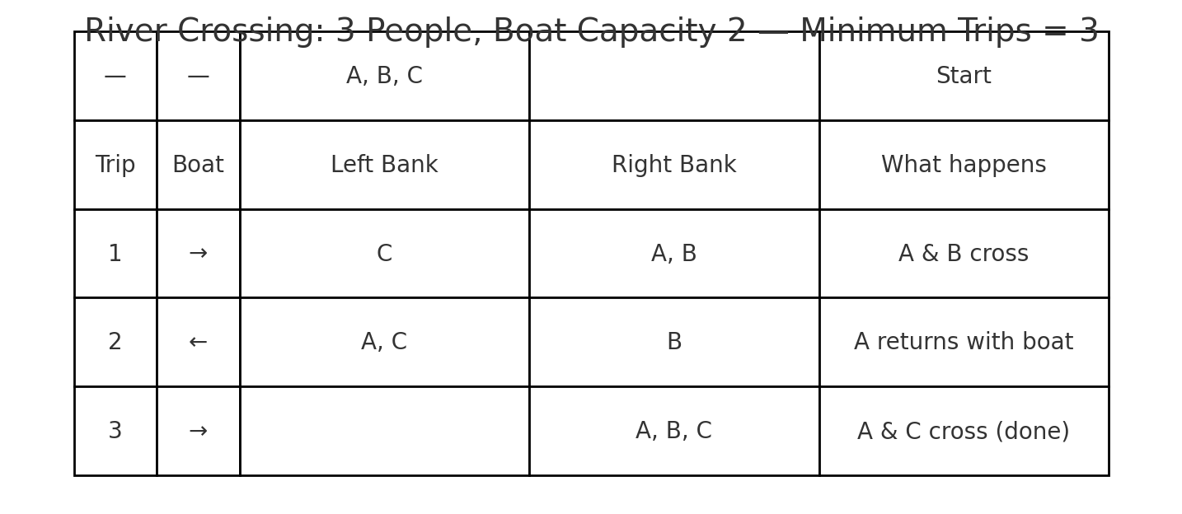
Starter
Solve these riddles:
River Riddle: Three people need to cross a river. The boat can only carry two at a time. How many trips does it take for all three to get across?
Answer: 3 trips
The Farmer’s Riddle: A farmer has a fox, a chicken, and a bag of grain. He must cross a river with only one item at a time in his boat. If left together, the fox will eat the chicken, and the chicken will eat the grain. How does he get them all safely across?
Answer: Take chicken first, return alone, take fox, bring chicken back, take grain, return alone, finally take chicken.
The Riddle Riddle: The more you take away from me, the bigger I get. What am I?
Answer: A hole

Slide 3
Solving a riddle requires you to think about a solution.
That’s what Problem Solving is all about

Slide 4
Do you recall from this morning’s lesson how we described a computer?

Slide 5
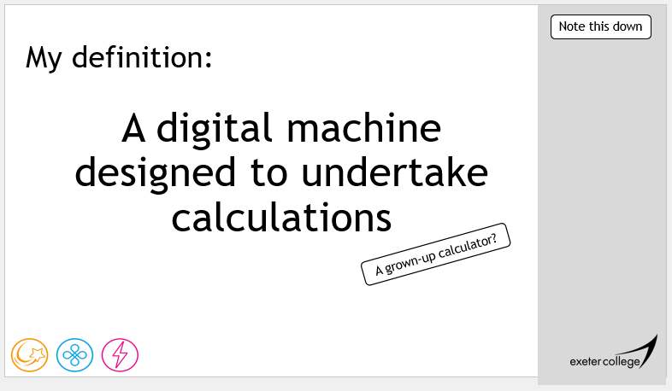
Do you recall from this morning’s lesson how we described a computer?

Slide 6
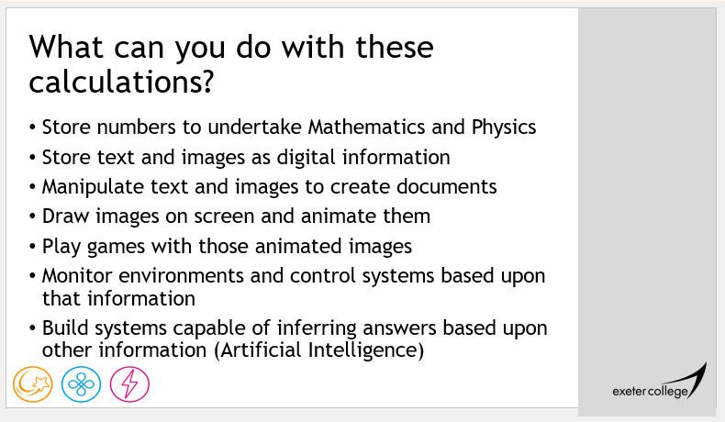
…but how do we get to do this?

Slide 7
Problem Solving!
Over this course we will be looking at the ways that we understand problems and design solutions so a computer can address them.

Slide 8
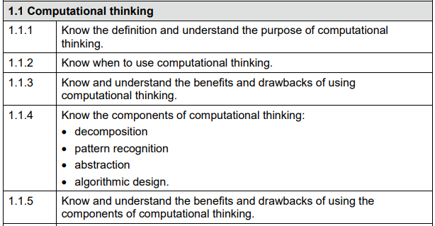
p10

Slide 9
Computational Thinking
Note this down
Computers are used to solve problems using software and communications.
Although they are powerful, there are still things that computers cannot effectively do, such as solve problems to new, and unknown situations.
This requires humans, and computational thinking, to review all the facets of a situation and develop a solution.

Slide 10
Computational Thinking
Note this down
This unit is developed to improve application of computational thinking for problem solving.
There are four key areas:
  Decomposition
  Abstraction
  Pattern recognition
  Algorithms
Make notes on the following video:

Slide 11
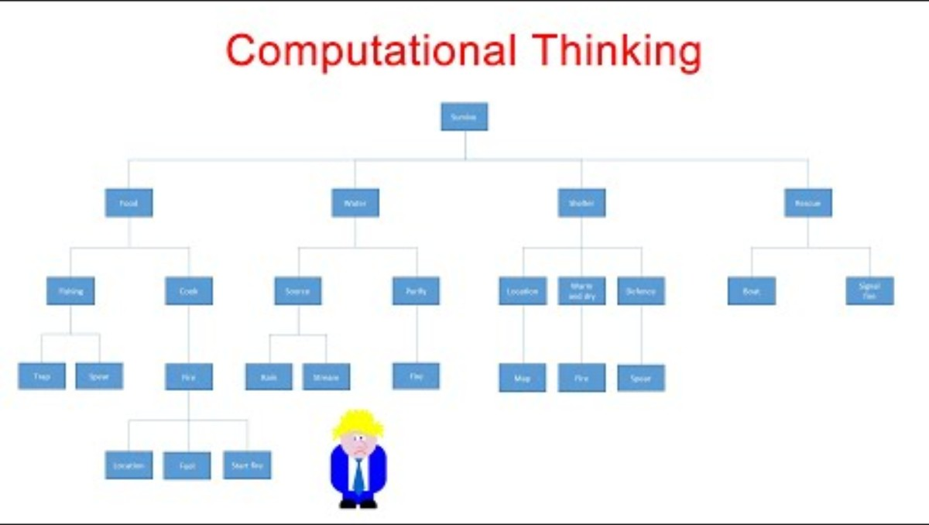

Slide 12
Task: Planning a College Trip
Groups of Three
Scenario:
You have been asked to help plan a trip for 60 students and 5 staff members to a museum in another city. There are hundreds of details to think about: names of students, which bus company to use, what time to leave, dietary requirements, who sits where on the coach, what the weather might be, and more.
Activity:
Write down all the details you think could be involved in planning the trip.
Now apply abstraction: remove the unnecessary detail and identify the core elements of the problem that must be considered in order to plan a successful trip.
  For example, instead of listing every student, you might just need the number of students.
  Instead of worrying about the exact weather, you might just need a decision about whether the trip can go ahead indoors or outdoors.

Slide 13

Program Design
Note this down
Program design is the process of converting a set of requirements/needs into a collection of instructions for a computer system to carry out.
A program is a series of instructions that the computer executes in order to perform some meaningful work.
Not all of these commands work at the same time or are even fully used, Microsoft Word for example was developed because the problem was the world needed a reliable, but functional and aesthetically pleasing word processor.
It has a bunch of features that can be removed or replaced that many users wouldn’t notice, but they all solve a problem.
80/20 rule

Slide 14
Program Design
Note this down
Program design is an integral part of developing a solution to a problem, and requires the full range of computational thinking.
  Translating what the program needs to do and translating that into general operations or commands.
  Identifying important characteristics of the commands and grouping them.
  Establishing an order and relationships between the groups, where they should go, when they should be used.
There are two main approaches to this.
  Top Down Program Design
  Bottom Up program Design (which we will cover next lesson)

Slide 15
Top Down Approach
Note this down
Top down program design is an approach to program design that starts with the General Concept or Big Idea/Big Problem and repeatedly breaks it down into its component parts.
It starts with the abstract and continually breaks it down until it reaches the specific.
We look at the overall project and start to break it down into smaller and smaller processes.

Slide 16
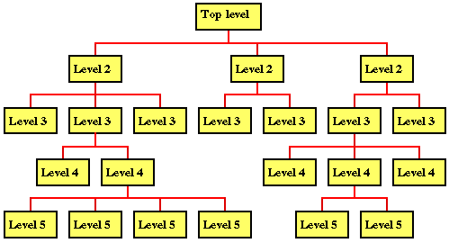
Top down and Black Boxes
Note this down
Top Down uses levels, to show the increasing breaking down of systems into subsystems, this is called our analysis tree
Level 4, is much more specific in its function than level 2, for example.
The boxes are called “black boxes”, at this stage the actual inner workings isn’t too much of a concern, its more about what they do, than how they do it.

Slide 17
Task: Top Down - Design a Car Functionality (for a Game)
Independent
Work
Going down 3-4 levels, use Top Down analysis to consider the functionality of a car, and what needs to happen in order to build one for a Racing Simulation.
Consider:
  What a car can do
  How a car behaves
  The way a car is interacted with.
15 mins

Slide 18
Summary
Note this down
Top down is a problem solving technique where a problem is continually broken down into smaller and smaller sub-problems or operations until we have found a set of easily programmable or achievable tasks.
Each level gets further from the main system, but is still useful or beneficial to overall functionality of the total system (or big picture)
Using this method, it is possible to achieve a generally detailed breakdown of a big issue into more manageable chunks.
However, this is just one tool in our toolbox, it’s aim is not to use the technique but to map a more detailed design or a set of implementation statements.

Slide 19

Homework – See Team Assignments
Resources:
Internet
Books
Remember to cite your sources
Evaluate the benefits and weaknesses to problem solving using the Top Down approach.
What are the risks in designing solutions, what are the benefits?
What can be missed when designing with this method?
Write a couple of paragraphs in a Word document and submit
Deadline: Midnight before next lesson

Slide 20
Sample Texts
True / False:
PLEASE LOG IN
PLEASE LOG IN
Do not delete this slide nor move it from the second last slide in the deck

Slide 21
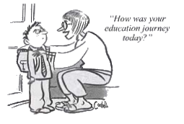










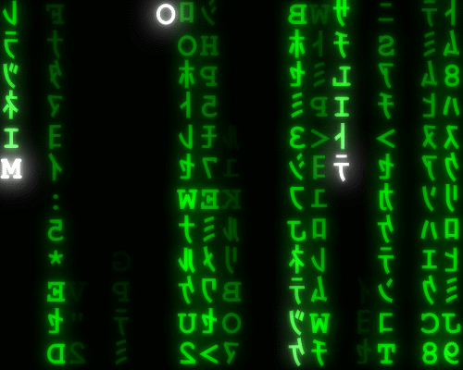


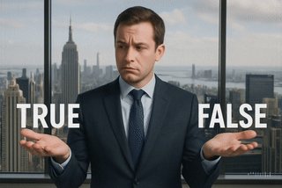

<title>
Note this down
Xmins
Do not delete this slide nor move it from the second last slide in the deck

