Slide 1
Decomposition
Lesson 3

Slide 2
Recall from last lesson
https://forms.microsoft.com/e/fkyj9ydBGt
An email should by now have arrived with the link attached.

Slide 3
Aims for this lesson
Explain the purpose of decomposition.
Discuss the needs for requirements.
Decompose a complex scenario into a requirements list.

Slide 4
Decomposition
Decomposition is just the breaking down of a complex problem or situation into more manageable units, or requirements.
We have already been decomposing problems with both the vending machine task, and the e-commerce task.
Bottom Up and Top Down are just methods we use to decompose the complex into the manageable.
The main goal of decomposition is to identify the individual aspects of the software and what parts will interact closely, or be more cohesive

Slide 5

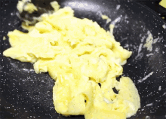
Let’s decompose…
Buying a Game on Steam/PSN/XBL
Sign in
Open Store
Choose/search Game
Select 'buy'/add to cart
Checkout
Fill in card form
Complete/download
Making Delicious Scrambled Eggs
Crack eggs
Add butter
Whisk
Cook on low while adding more butter
Remove from heat, at mid point
Continue to stir slowly

Slide 6
What are Requirements?
Requirements are the functionalities that the program will have.
It will consider
Inputs
Outputs
Processes
Users that will interact with it
What data or information is stored
Larger systems will have larger requirements and will have a greater range of users with different administrative access and permissions.
This would need to be factored into the design process.

Slide 7
Modularity
The design stage includes working out what the modules of code will be and what they will do.
As we add more modules, we can continue to go back and check against the original designs, review, maintain, and continue to build.
Over time, the form of the software application will take shape and allow us to meet the requirements of the clients needs.
During design stages, we continually look back over the requirements against the modules we design to ensure they meet the needs of the software.
This prevents feature creep beyond the scope of the project

Slide 8

Scenario – Picture Frames
DECOMPOSITION QUESTIONS
What are the inputs?
What are the outputs?
What information is stored within the system?
Who are the users that will interact with the system?
What processes happen between inputs and outputs?
How do parts of the system interact – one module with another?
Picture Frames is a franchise that offers bespoke photo printing of many sizes, frames, canvases, and large prints.
They need a way to manage stock as currently they just order something when they run out which causes a delay and means some customers have to wait for new stock to come in.
Their till system is also paper based and continues to use handwritten receipts which is causing problems for new staff.
Ideally the till system will calculate cost of goods and factor this into an inventory system that can provide reminders to order new stock.
Customer data is also not tracked, nor is customer trends, and this could be factored in in some way.
Working Independently
20 mins

Slide 9
Answers – What are the Requirements?
The solution must:
Stock Management
Log all stock coming in
Add new items to stock
Categorise stock inventory
Tracks Stock and triggers stock warning
Identifies popular stock
Till system
Add up costs of items
Barcode to input items to till system
Record payment details/date/payment type
Customer Data – Capture Customer Details – address
Purchase frequency
Customer engagement system - emails

Slide 10
From Requirements to Design
Working Independently
Using http://draw.io or www.lucid.app let’s use our requirements to create a diagram to show how the system will operate?
Remember, the design diagram shows the modules, and you can break down these modules into sections as you need to.
Export your design to PDF and email to me at simonrundell@exe-coll.ac.uk and then insert into your Class Notebook as a record
15 mins

Slide 11

Homework
JimAir is a budget airline that flies all over Europe, they want to move into a digital booking system that handles booking of flights and management of accounts.
Users should be able to use their booking reference to review their flights and pay for seats, as well as look up any changes or amend their details.
They also need to be able to be either a corporate customer for businesses or the private customer for normal bookings.
When they register then need to supply name, email address and address, as well as card details.
You need an account to view your flight details as well as make amendments. Reminders will be sent out a week and day before travel via email or telephone.
Deadline:
Midnight before next lesson
Use decomposition to identify user requirements then create a diagram to show your functional design

Slide 12

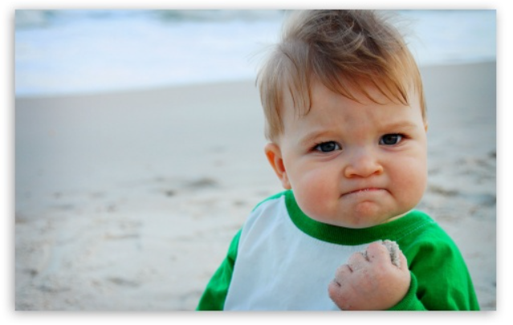









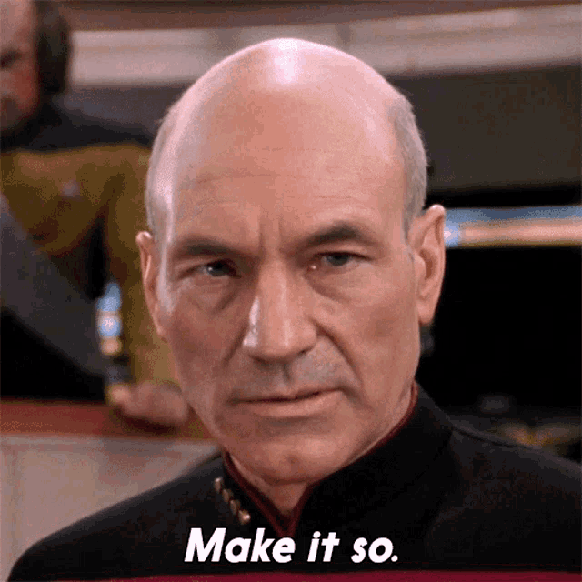
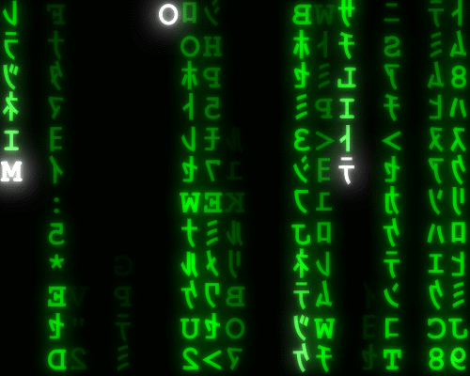

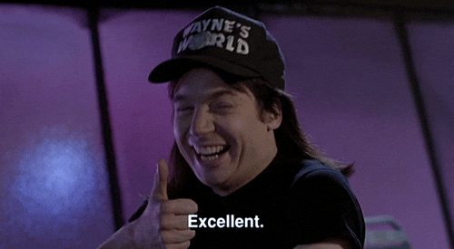

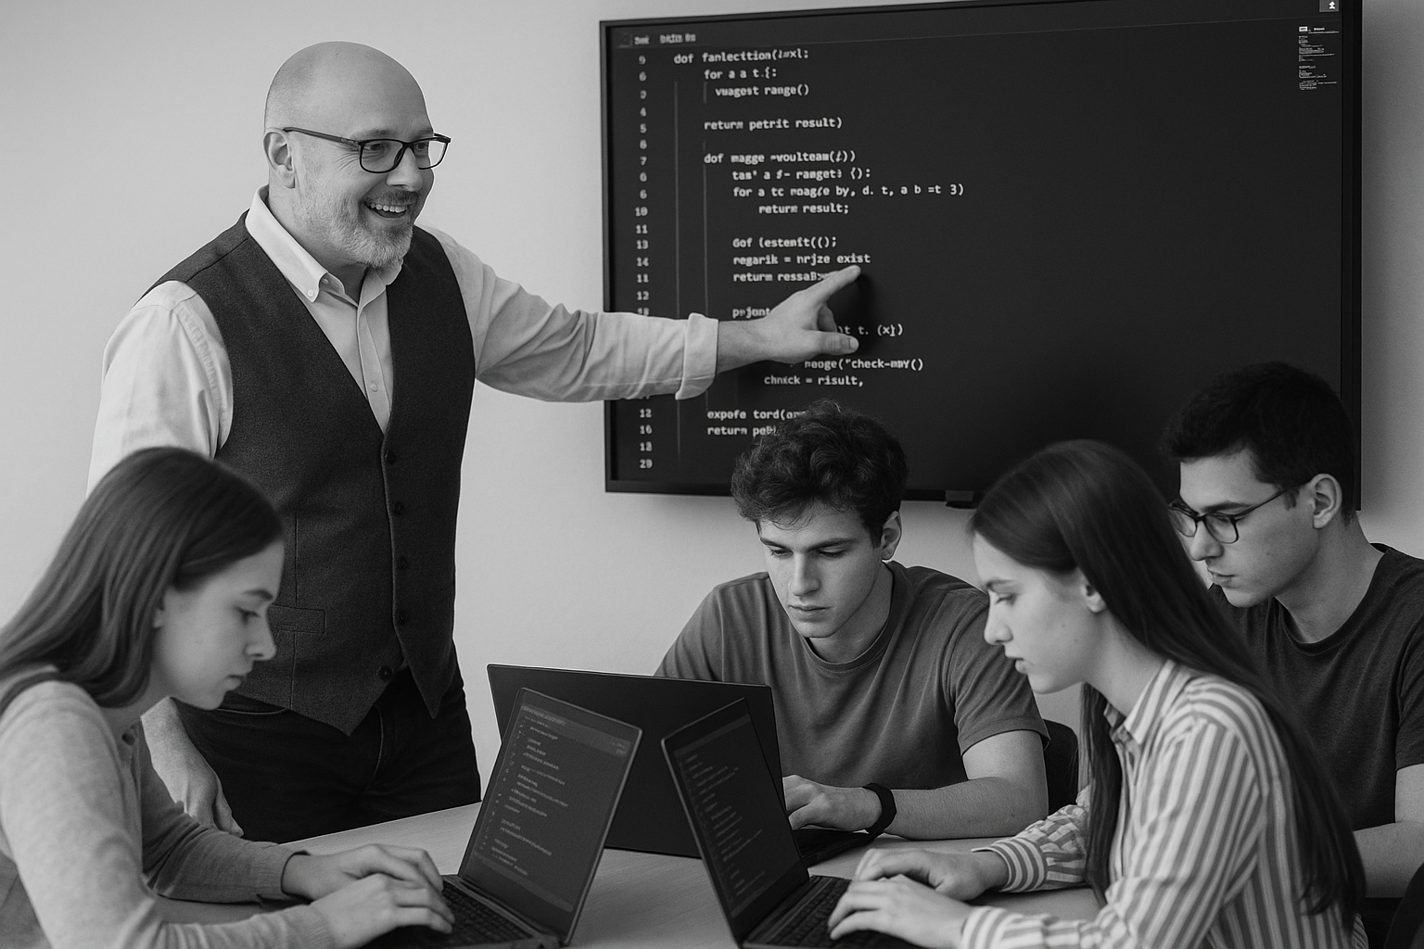
<title>
Note this down
Deadline:
Midnight before next lesson
Xmins
In small groups
Working Independently
In pairs
codeblock
Do not delete this slide nor move it from the second last slide in the deck

