Slide 1

Pattern Recognition
Lesson 4

Slide 2
Recall from last lesson
https://forms.microsoft.com/e/E7mjhezqMT
An email should by now have arrived with the link attached.

Slide 3
Pattern Recognition
Lesson 4

Slide 4
Recap
Define Decomposition:
The art of taking apart a more complex situation in order to simplify the problem.

Slide 5
What are the patterns?
🔺🔺⬜🔺🔺⬜ ?
2, 4, 8, 16, ?
😀 😃 😄 😁 ?
How do you know?

Slide 6

Task – Decompose!
In small groups
JimAir is a budget airline that flies all over Europe, they want to move into a digital booking system that handles booking of flights and management of accounts.
Users should be able to use their booking reference to review their flights and pay for seats, as well as look up any changes or amend their details.
They also need to be able to be either a corporate customer for businesses or the private customer for normal bookings.
When they register then need to supply name, email address and address, as well as card details.
You need an account to view your flight details as well as make amendments. Reminders will be sent out a week and day before travel via email or telephone.
10 mins

Slide 7
Requirements:
Users must be able to review flight details
Secure – encrypted customer data
Generate appropriate random booking number
Store User accounts – customer data – flight miles – type of customer
Alert/calendar system for reminders – repeated over time frame
Store Departure Information
Booking system to link customer profile with seat and plane
Input form/input method for customer data

Slide 8
Pattern Recognition
A key aspect of computational thinking is being able to recognise and identify patterns and recurring features.
By recognising repeated instructions or themes, we can save time and design more efficient systems.
We can also break down more complex instructions into simple repeated ones.
Pattern Recognition is based on these key areas:
Identifying Common Elements
Identifying Common Factors
Identifying Behaviour Patterns

Slide 9
Identifying Common Elements
Once you identify a common pattern, there is more than likely going to be an existing solution to the problem.
For example, you might want to search for repeated elements or instructions.
When instructions or commands tend to be repeated, we can re-use those components.
Searching and sorting, for example, do not need to be programmed again and again, we just sort by different criteria using the same ‘search’ instruction.

Slide 10
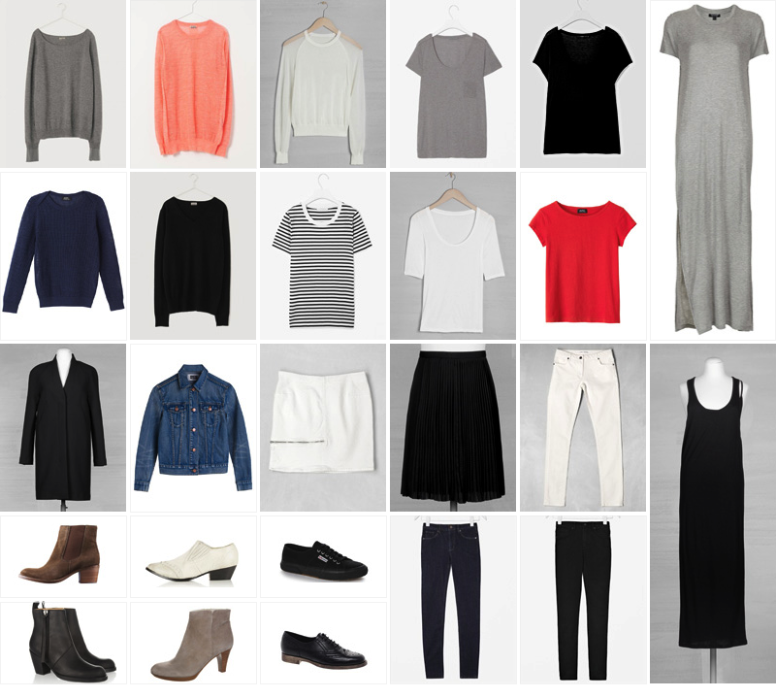
In small groups
What patterns do you see here?

Slide 11
Identifying the Common Factors
Within these elements, we might identify specific factors we want to record and use.
Within the JimAIR example, we have common elements, such as bookings, flight times, and dates.
Within those common elements we might further consider common factors – each customer will use a name, email and address.
They might be either a business customer or a private customer, but ultimately they are still paying for a service.

Slide 12
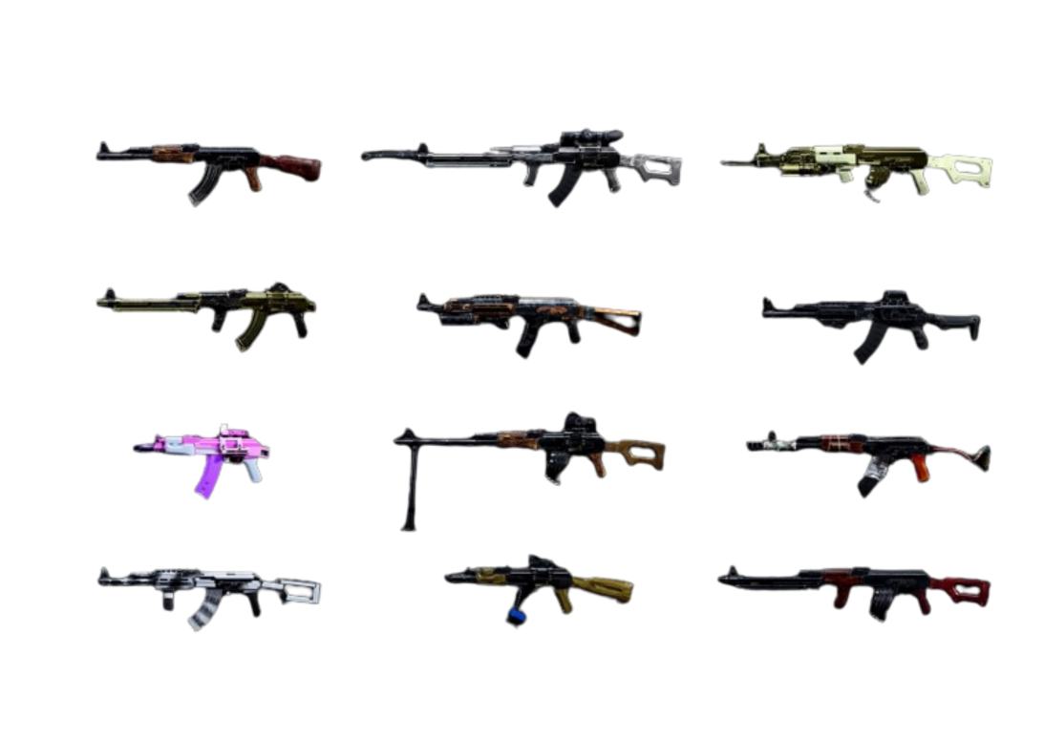
What are the common factors
In small groups
What do all of these weapons from a game have?
15 mins
Notes:
In small groups, ask:
What do they all have in common? (damage, ammo, type).
How could a program store these shared properties?
Link back to: “Recognising patterns lets us avoid rewriting code for every weapon.”

Slide 13
Recognising patterns lets us avoid rewriting code for every weapon.

Slide 14
Identify Behaviour Patterns
These design patterns are specifically concerned with communication between objects.
Systems and modules communicate, many will communicate in similar ways.
Passing strings around are very similar across programs, when we use a print statement, the pattern is always the same, and this makes it easier for us to learn.

Slide 15
Applications
Program design is about recognising patterns, in program structure, the way in which functions are used, and how the real world works in comparison.
Code breaking is operated using patterns, the Enigma code was broken by looking for the repeated patterns.
AI and Machine Learning uses patterns in big data or images in order to learn and improve accuracy, look at cancer research using AI.
Effective and efficient program design is created through effective pattern recognition.

Slide 17
Pattern Task
In pairs/threes
Think all about the different types of vehicles in the world.
Break them down into types.
Recognise the patterns, what characteristics do they all share
What groups are emerging of similar types that share characteristics?
15 mins

Slide 18
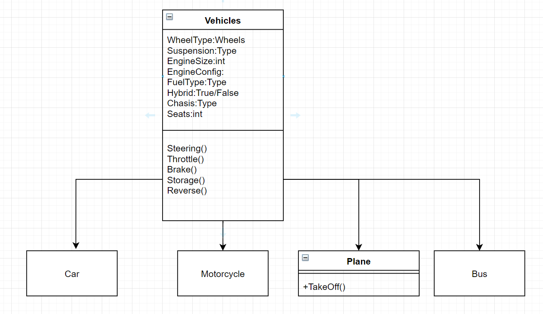

Slide 19
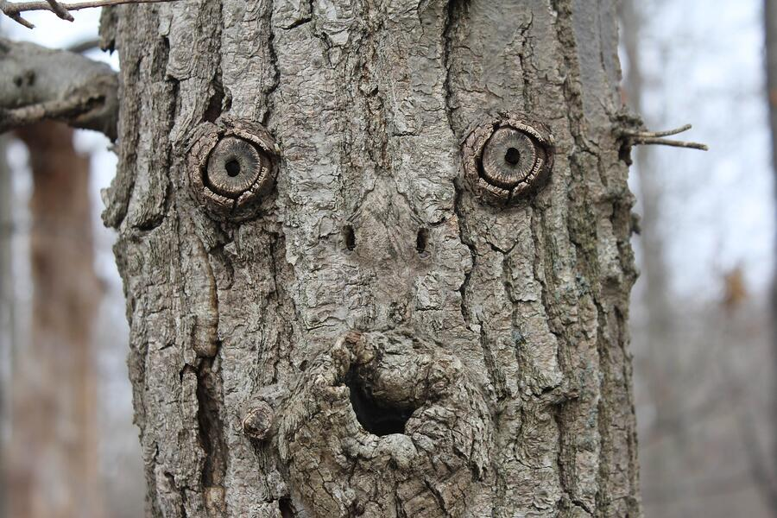
Pareidolia
Human brains are always seeking meanings even from natural objects
That is why you can often see faces in the clouds or trees
Computers do not have the neural capacity for this, which is why Captcha often uses visual tests to exclude bots.

Slide 20
Homework Task
Deadline:
Midnight before next lesson
You are designing a Zoo Tycoon type game/simulator.
From a software perspective you need to design the structure of the program that handles the animals.
What are the patterns that occur in groups of animals, such as mammals, birds, reptiles, etc.
What patterns/similarities are found between these animals, and how would you group them?

Slide 21
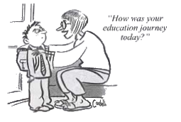












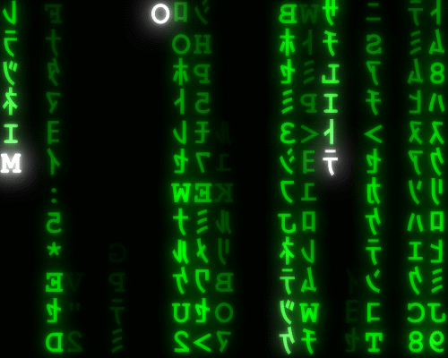









<title>
Note this down
In pairs
Working Independently
In small groups
Deadline:
Midnight before next lesson
Xmins
Do not delete this slide nor move it from the last slide in the deck

