Slide 1

Problem Solving: Algorithms
Lesson 3

Slide 2
Recall from last lesson
<URL>
An email should by now have arrived with the link attached.

Slide 3
Problem Solving: Algorithms
Lesson 3

Slide 4
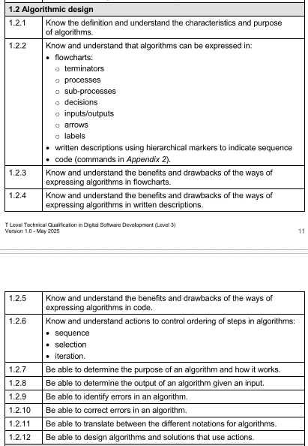
Aim:
By the end of the lesson, students will be able to:
Define what an algorithm is and explain its importance in problem solving.
Interpret basic algorithm representations (pseudocode & flow diagrams).
Construct simple flow diagrams for basic algorithms (sequence, selection, iteration).

Slide 5


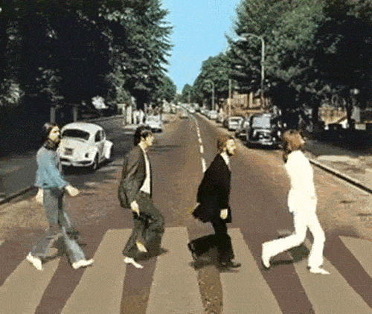
Everyday actions
Making a cup of tea
Logging into a phone
Crossing the road
Identify the Steps
In small groups
5 mins

Slide 6

These are all algorithms
Note this down
Precise step-by-step instructions to solve a problem

Slide 7
What is an algorithm
Note this down
An algorithm is a precise, step-by-step set of instructions designed to solve a problem or complete a task.
In computing, algorithms are written in a way that a machine (or a human) can follow without ambiguity.
They are the foundation of all computer programs
before writing code, we design the algorithm.

Slide 8
Examples
Note this down
boil kettle
add tea bag
pour water
add milk/sugar
enter PIN
check correct?
if yes, unlock
if no, try again

Slide 9
Key Qualities of an Algorithm
Note this down
Finite
It must end after a certain number of steps.
An algorithm that runs forever (e.g., an infinite loop) isn’t valid unless that’s the intended purpose.
Definite (Unambiguous)
Each step must be clear and precise.
There should be no confusion about what to do at each stage.
Effective
Every step must be simple enough to be carried out (by a person or a machine).
Instructions should be basic actions, not vague descriptions.
Input
An algorithm should specify what information it needs to begin.
Example: “Enter two numbers” before calculating a sum.
Output
It should clearly define the result it will produce.
Example: “The total is 42.”

Slide 10
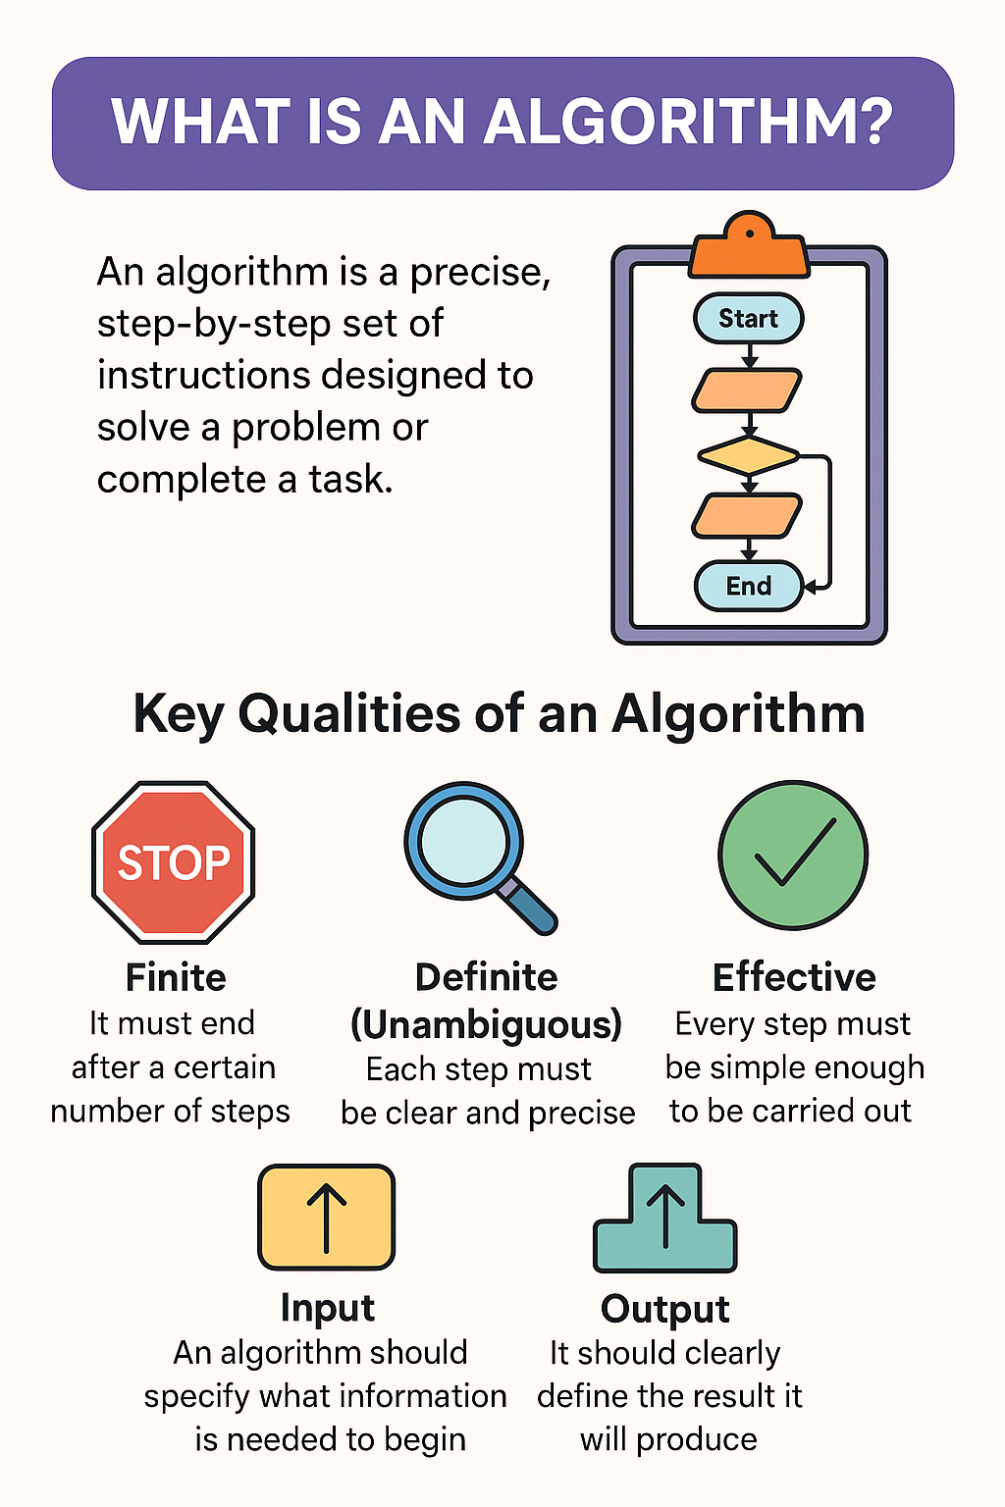
Why Algorithms matter
Note this down
They help break complex problems into manageable steps.
They can be represented in different forms (pseudocode, flow diagrams, written steps).
Well-designed algorithms save time, reduce errors, and make coding much easier.

Slide 11
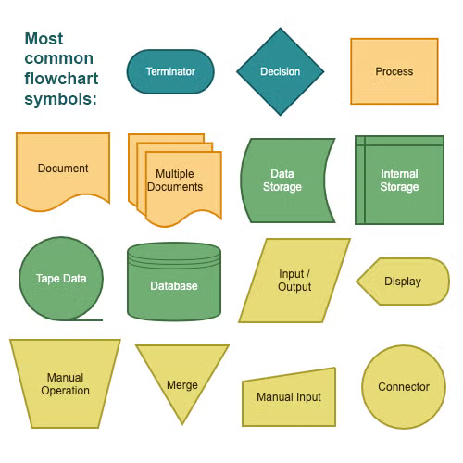
Flow Diagram Symbols

Slide 12

Making a Jam Sandwich
I’m going to use www.lucid.app

Slide 13
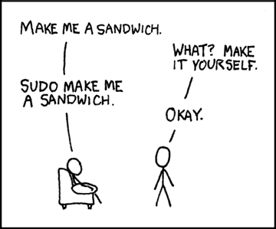

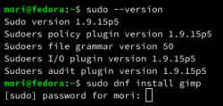

Slide 14
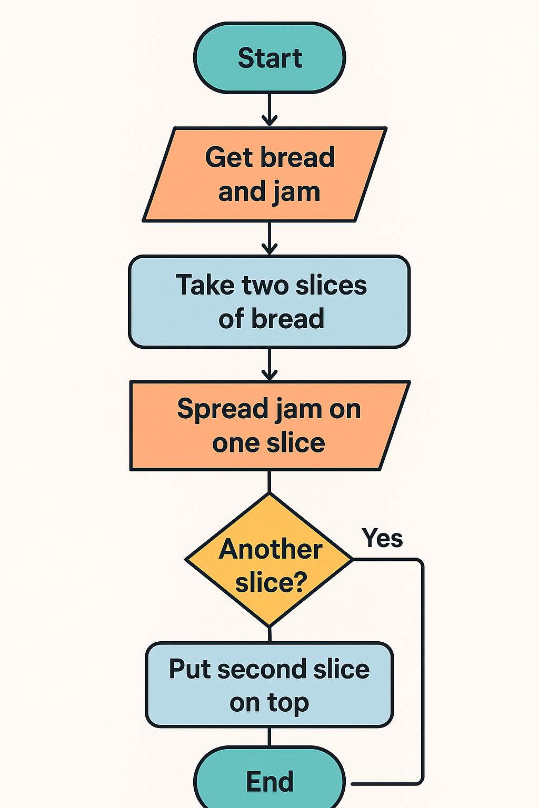

Slide 15
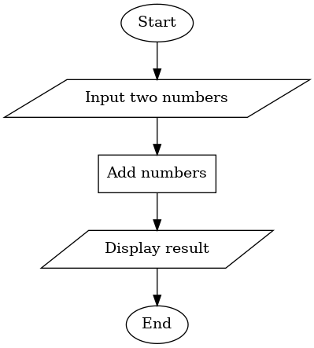
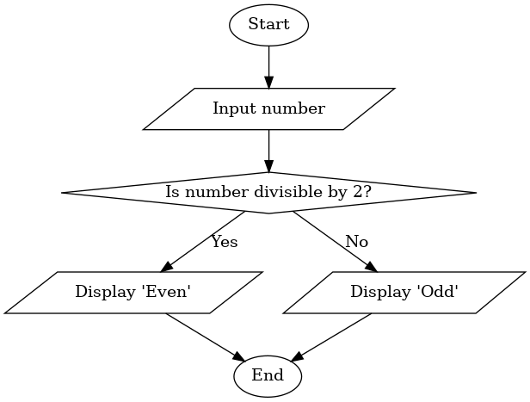
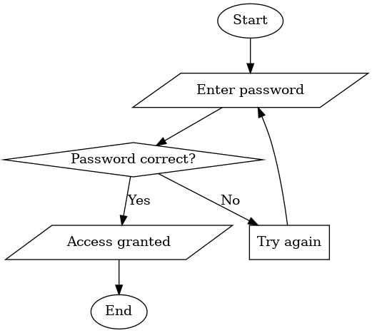
Task
Working Independently
Interpret these flow diagrams
Explain what they do in plain English
15 mins
Use worksheet

Slide 16
Create a flow diagram for one of the following:
Working Independently
An ATM machine that lets you withdraw money if PIN is correct.
A traffic light sequence.
A basic quiz question
input answer → check correct → give feedback
Use www.lucid.app or www.draw.io to create them
Screenshot into your Class Notebook
20 mins

Slide 17
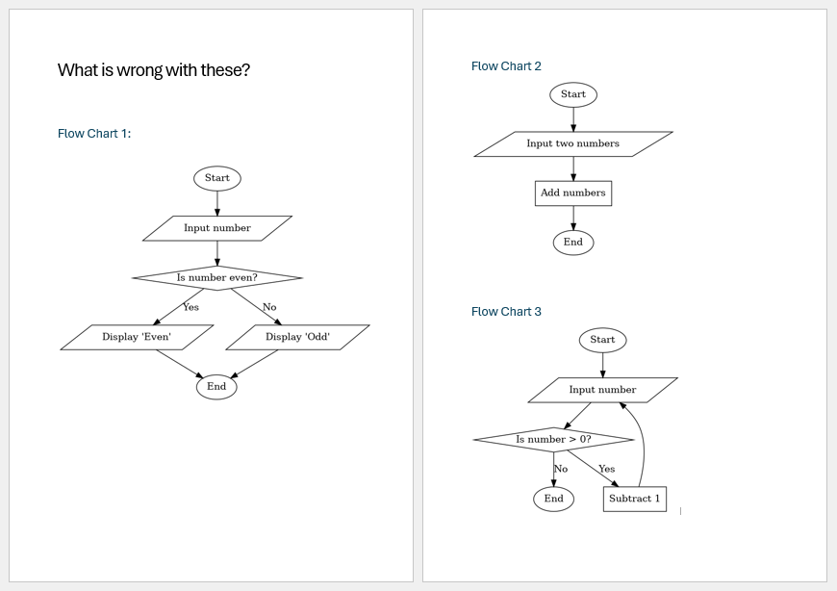
What is wrong with these?

Slide 18
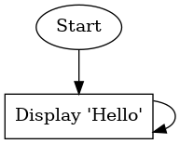
Debug this Algorithm
Infinite Loop

Slide 19
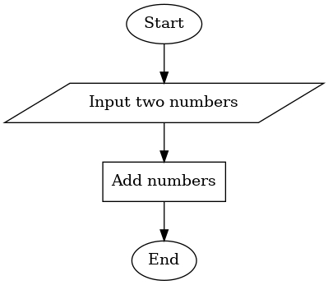
Debug this Algorithm
Missing Output

Slide 20
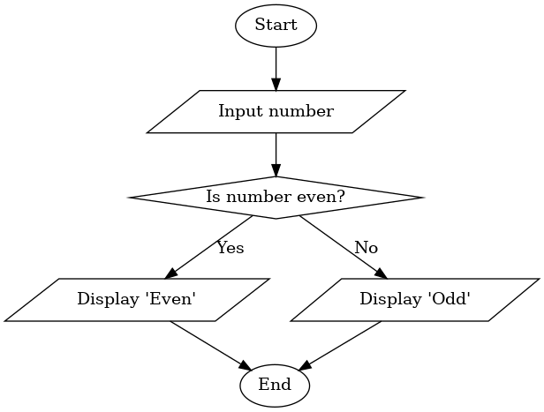
Debug this Algorithm
Wrong Branch

Slide 21
Independent Challenge
Working Independently
Design a flow diagram for:
“Find the largest of three numbers”
10 mins

Slide 22
Homework
Create a flow diagram for “Designing a vending machine algorithm to dispense drinks.”
Design it in your chosen charting program
Recommended: www.lucid.app or www.draw.io
Export to PDF and submit to Assignment
Deadline:
Midnight before next Problem Solving Lesson

Slide 23

















<title>
Note this down
Deadline:
Midnight before next lesson
Xmins
In small groups
Working Independently
In pairs
codeblock
Do not delete this slide nor move it from the second last slide in the deck

