Slide 1

CodeMonkey
This template and PowerPoint Extensions created by
Where the magic happens
CodeMonkey Design
www.codemonkey.design
simon@codemonkey.design
+44 7976 802123

Slide 2
User Requirements
Lesson 1

Slide 3
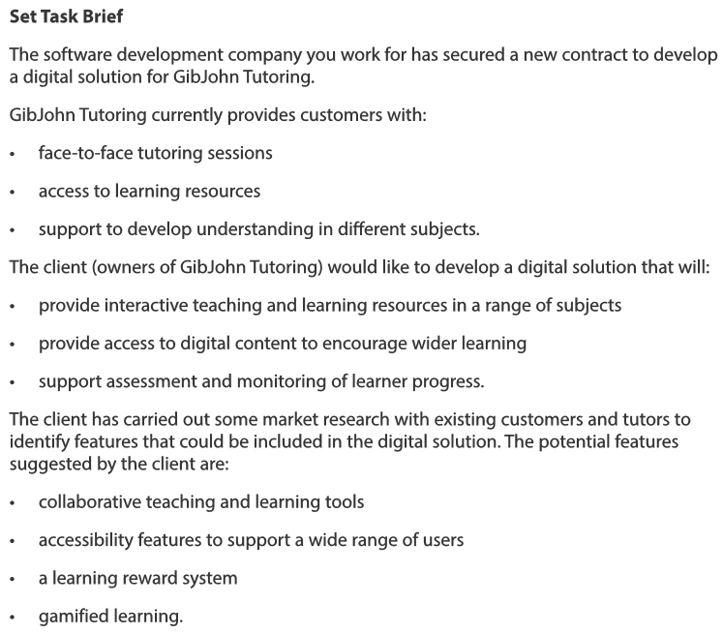
The project brief
We only looks at this last lesson so it should be familiar to you
One of the key initial activities of the SDLC is user analysis
In the real-world users often don’t really know what they want or can’t express it
That’s where your expertise comes in!

Slide 4
Performing a user analysis
There are several business analysis models to help us understand the user’s needs:
user stories
activity diagrams
mind maps
product road maps
process diagrams
entity relationship diagrams.
Over the next couple of lessons, we will explore these and practice using them.
Not every model is right for every case, but you should know all of them
Note this down

Slide 5
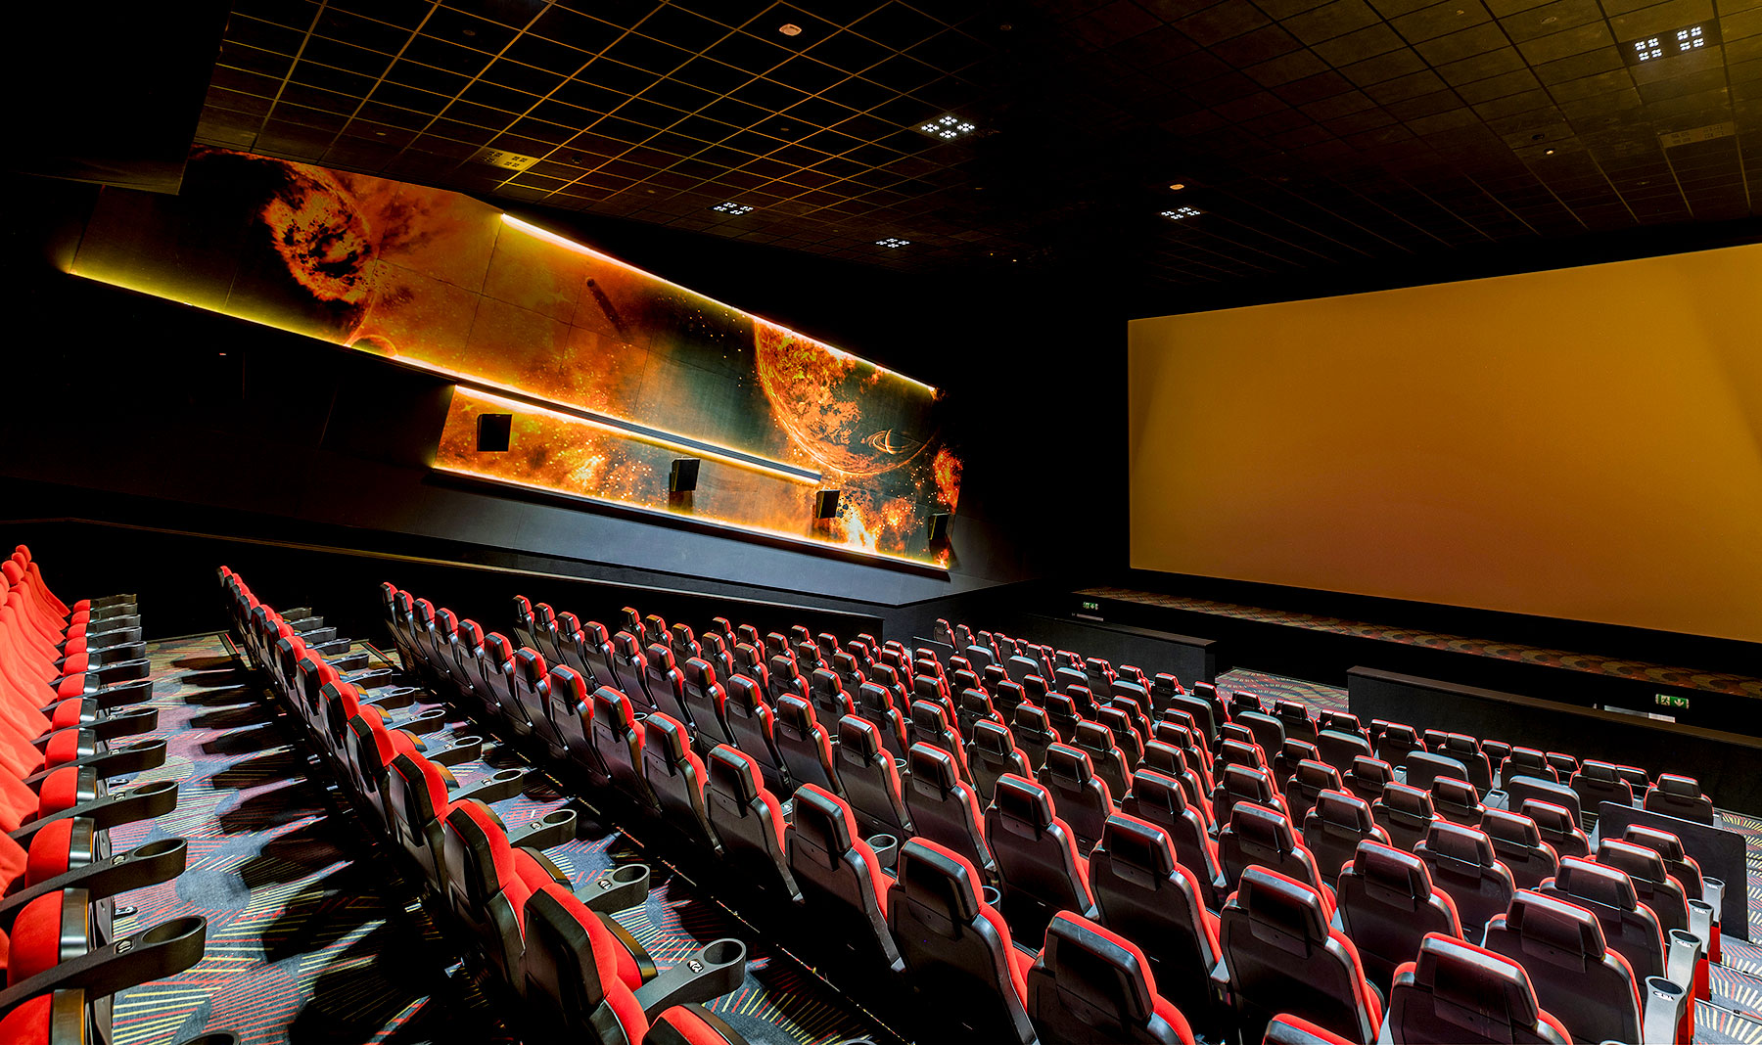
User Stories
An online cinema ticket booking system
What do you think users of this system
will want to be able to do?

Slide 6
An online cinema ticket booking system

Slide 7
User Stories
Note this down
User Stories are a key element of the Agile Methodology
They look at the business operation as a narrative
Examples:
“As a student I want to log in with my Google account so that I don’t have remember another password”
“As a teacher, I want to generate a class progress report so that I can track student performance”
As a [role] I want [feature] so that [benefit]

Slide 8
“As a student I want to log in with my Google account so that I don’t have remember another password”
Note this down
BDD / Gherkin Style
GIVEN
WHEN
THEN
AND
GIVEN I am on the login page
WHEN the page loads
THEN I should see a button labelled "Log in with Google"
AND the button should be clearly visible and clickable
These statements lead directly to making testing better
GIVEN I have previously logged in with Google
WHEN I log in again using the same Google account
THEN I should be redirected to my existing profile
AND no duplicate accounts should be created

Slide 9
Good user stories…
Note this down
works stand alone
I
N
V
E
S
T
ndependent
egotiable
aluable
stimable
mall
estable
based upon interaction with users
should be useful to the user
developers will understand how long it will take to deliver this
Notice how this work at the beginning is closely liked to testing at the end
small enough to be delivered in one sprint
can be evaluated by pass/fail testing

Slide 10
Activity: Writing user stories
15 mins
In your Teams Notebook:
Write about 3 – 4 user stories using the correct format
Remember that your user stories should be INVESTed
GIVEN
WHEN
THEN
AND
INDEPENDENT
NEGOTIABLE
VALUABLE
ESTIMABLE
SMALL
TESTABLE
A mobile app for ordering food from a College canteen

Slide 11
Share

Slide 12


Slide 13
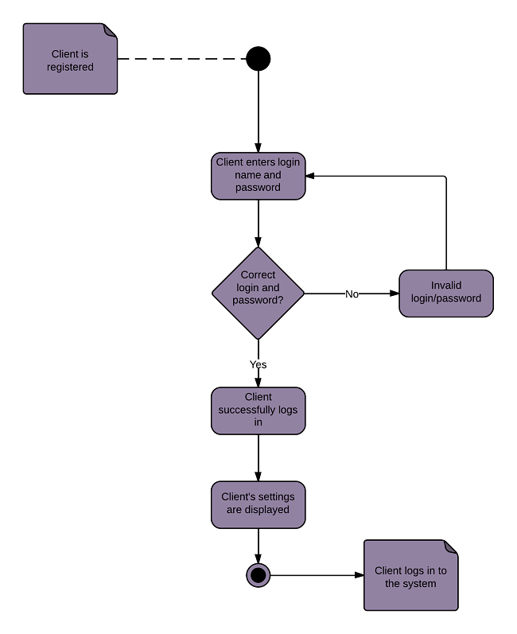
From stories to diagrams
Note this down
Textual user stories are helpful but can be hard to visualise.
UML Activity Diagrams help model the workflow of user interactions.

Slide 14
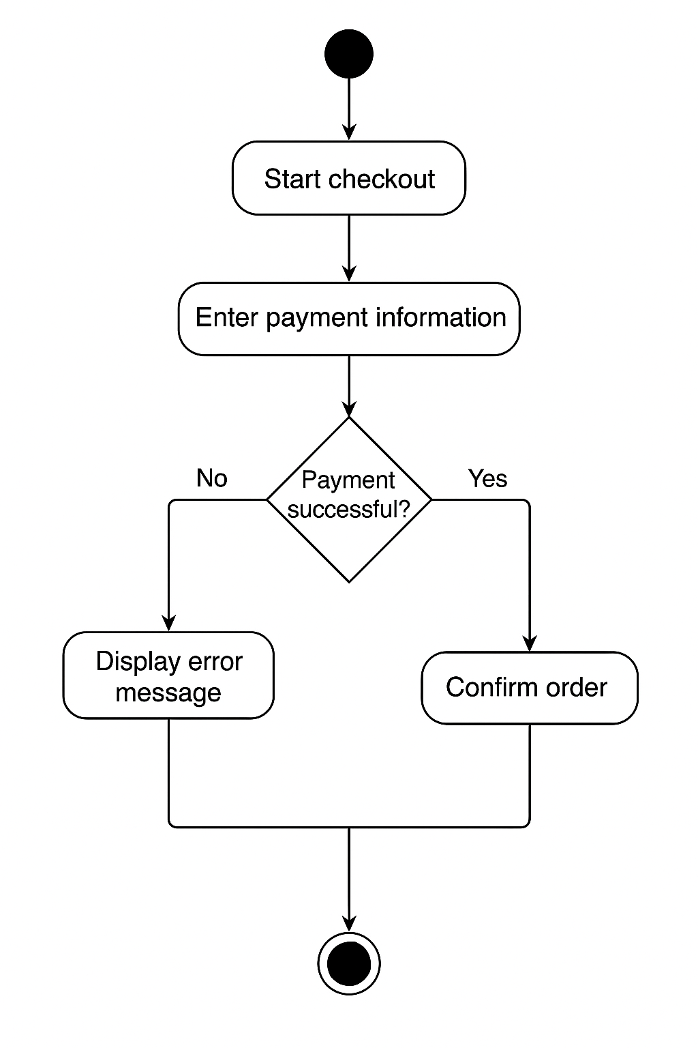
"As a customer, I want to pay online so that my order is confirmed immediately"
Note this down
Activity Diagrams are described in UML (Unified Modelling Language)
Nodes are where things happen
Edges are what connect nodes

Slide 15
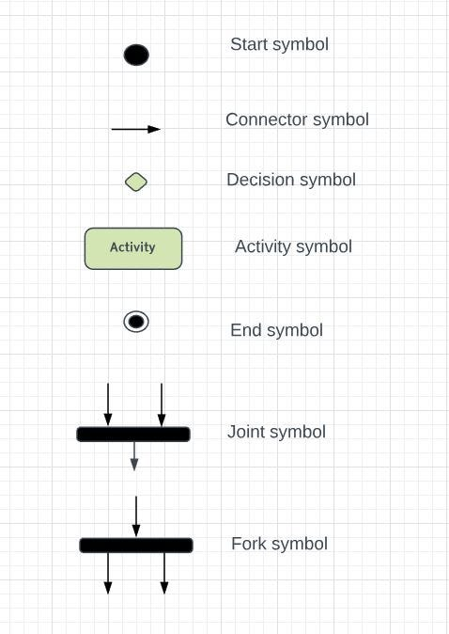
UML Activity Diagram Symbols
Note this down

Slide 17


Visit https://lucid.app
Lucid is great for all kinds of diagramming beyond just this course.
It also meets some of the Course criteria 1.6, 3.1, 5.1, 5.2
Create a free account for LucidChart
use your College email, but do not sign in with “Microsoft”
Confirm your email from your inbox with the authorisation code. Say you are a Student in Higher Education and they will upgrade your account for free
Create a new “Flow Diagram” from Blank
Although there is a Chart marked UML Diagram, the Flow Diagram is better for our purposes now.
We use for “Start” and “End” in Lucid

Slide 18
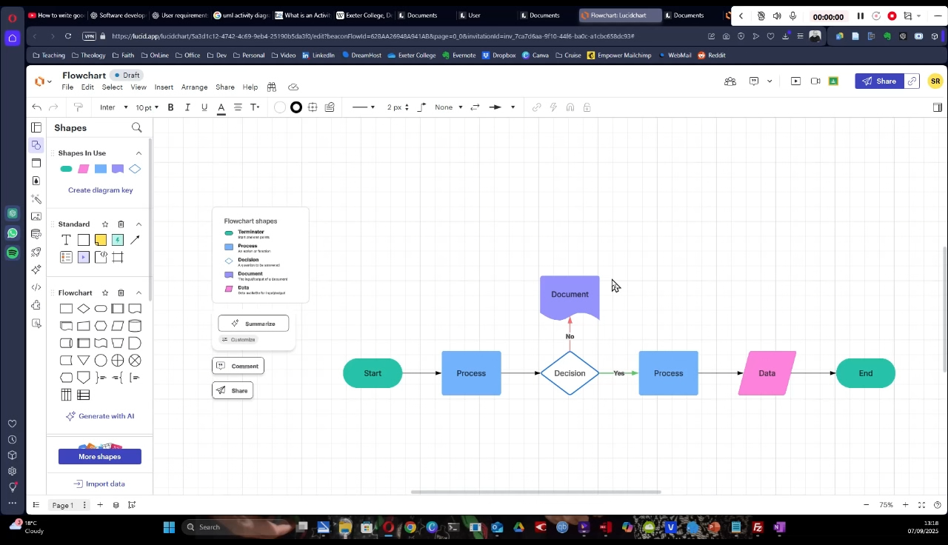
Activity: creating activity diagrams
20 mins
Take your earlier user stories and create them as a UML activity diagrams
Screenshot them and add them to your Teams OneNote

Slide 19
Share diagrams

Slide 20
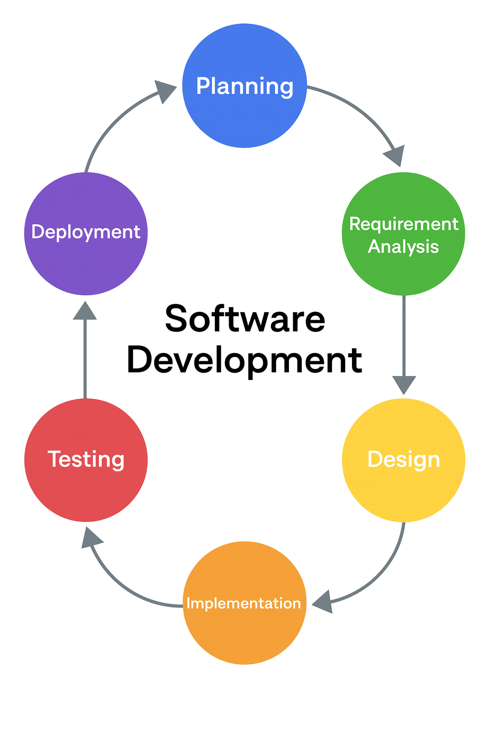
Recap
Note this down
User stories capture what the user wants
Activity diagrams visualise how that need is met
This links back to the SDC

Slide 21
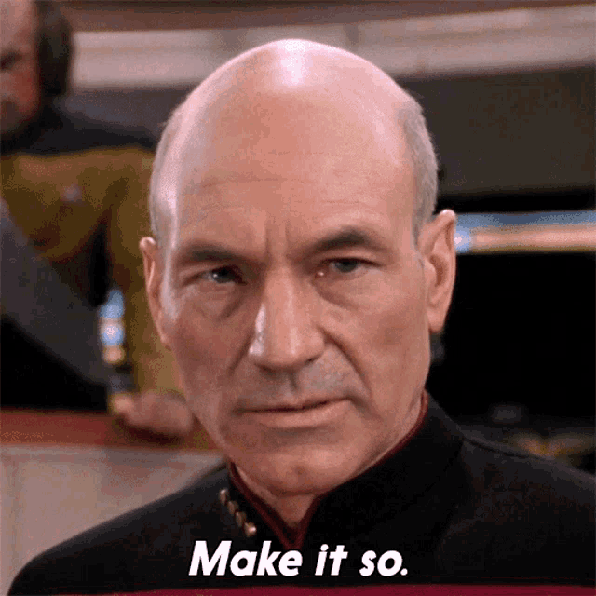
Homework
Deadline: Midnight Monday
Think up another two user stories
Include branching/decisions in them
Write them up in a Word Document
Draw them in LucidChart
Cut and paste into your word document
Submit as an assignment

Slide 22
Sample Texts
True / False:
PLEASE LOG IN
PLEASE LOG IN
Do not delete this slide nor move it from the second last slide in the deck

Slide 23











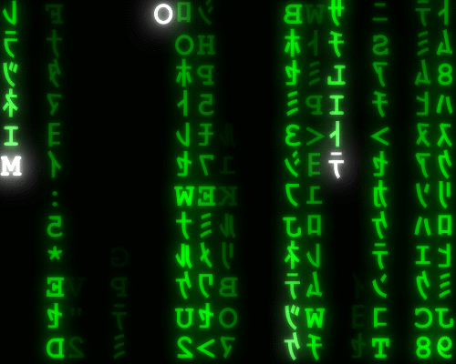




<title>
Note this down
Xmins
Do not delete this slide nor move it from the second last slide in the deck

