Slide 1
User Requirements
Lesson 2

Slide 2
Recall Quiz
You should have a scheduled email link by now
or the URL is:
https://forms.cloud.microsoft/e/0iexLbDAaw

Slide 3
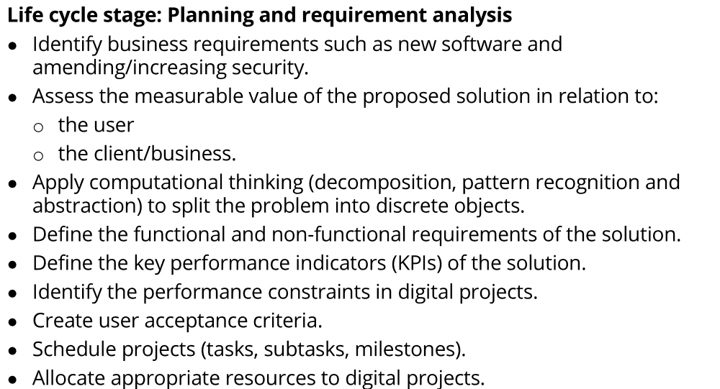
Specification

Slide 4
So… by applying decomposition to this area of learning, today we will focus on:
Define functional and non-functional requirements.
Understand KPIs (Key Performance Indicators) and performance constraints.
Create user acceptance criteria.

Slide 5
Two briefs for you to consider
In the Design Classwork folder as well
Brief A: College Attendance App
The college wants a simple mobile app that tutors can use to record student attendance.
Tutors should be able to mark students present, late, or absent.
Students should be able to view their own attendance history.
The app should be quick to load during busy classroom periods.
Attendance data must sync securely with the college database.
The app should work on both Android and iOS phones.
Brief B: Online Shop
A small clothing company wants an online shop to sell T-shirts and hoodies.
Customers should be able to browse items and add them to a shopping basket.
Customers must be able to pay by debit card, credit card, or PayPal.
Orders should trigger an automated confirmation email to the customer.
The website should be available 24/7 with minimal downtime.
Pages should load in under 3 seconds, even at peak times.
In pairs:
list 3 things the system must do (functional
3 things that would make it better/ easier/ faster (non-functional)
5 mins
Functional = core behaviour; Non-functional = quality, constraints, standards
Notes:
“Work with your partner. For each brief, underline or list 3 functional requirements (what the system must do) and 3 non-functional requirements (how the system should perform or behave). Be ready to share back.”

Slide 6
Functional vs Non-Functional Client Brief A
System should record attendance
Students should be able to view their own attendance history
Data must be secure
App should work on both Android and Apple Phones
The app should be quick to load during busy classroom periods.

Slide 7
Functional vs Non-Functional Client Brief B
Customers should be able to browse items and add them to a shopping basket.
Customers must be able to pay by debit card, credit card, or PayPal.
Orders should trigger an automated confirmation email to the customer.
Pages should load in under 3 seconds, even at peak times.
The website should be available 24/7 with minimal downtime.

Slide 8
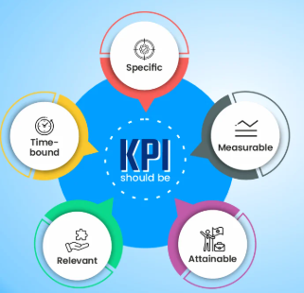
Key Performance Indicators
These are measurable ways to assess success
95% uptime
Average page load < 2s
KPIs should be:
Specific
Measurable
Attainable
Relevent
Time-bound

Slide 9
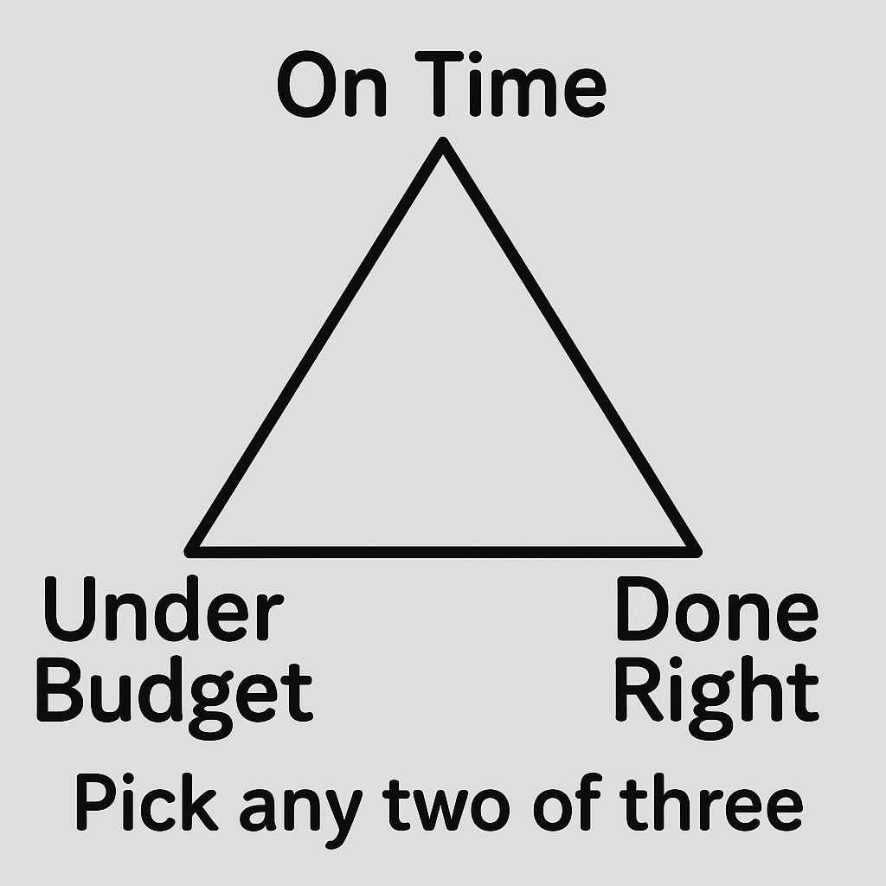
Performance Constraints
These are things that we have to deal with
They may be technical, organisational or legal
Examples:
limits on time
budget
tech limitations like bandwidth
security concerns
GDPR

Slide 10
Activity
In small groups
There is a new Cinema Online Booking Service
Create 3 KPIs for the project
Identify some Constraints that might have an impact on this project
Be prepared to share some of your ideas.
15 mins

Slide 11

User Acceptance Criteria
UACs are measurable checks to prove that requirements have been met
Requirement: “System must allow online payments.”
Acceptance Criteria: “Users can pay with debit, credit, or PayPal, and receive confirmation email within 5 minutes.”

Slide 12
Task:
Write 3 UACs each for the two briefs we have just used
Working Independently
Brief A: College Attendance App
The college wants a simple mobile app that tutors can use to record student attendance.
Tutors should be able to mark students present, late, or absent.
Students should be able to view their own attendance history.
The app should be quick to load during busy classroom periods.
Attendance data must sync securely with the college database.
The app should work on both Android and iOS phones.
Brief B: Online Shop
A small clothing company wants an online shop to sell T-shirts and hoodies.
Customers should be able to browse items and add them to a shopping basket.
Customers must be able to pay by debit card, credit card, or PayPal.
Orders should trigger an automated confirmation email to the customer.
The website should be available 24/7 with minimal downtime.
Pages should load in under 3 seconds, even at peak times.
15 mins

Slide 13
Application Activity
Working Independently
A college wants a homework submission portal
Independently:
List 3 functional requirements.
List 2 non-functional requirements.
Suggest 2 KPIs.
Write 2 user acceptance criteria.
20 mins

Slide 14
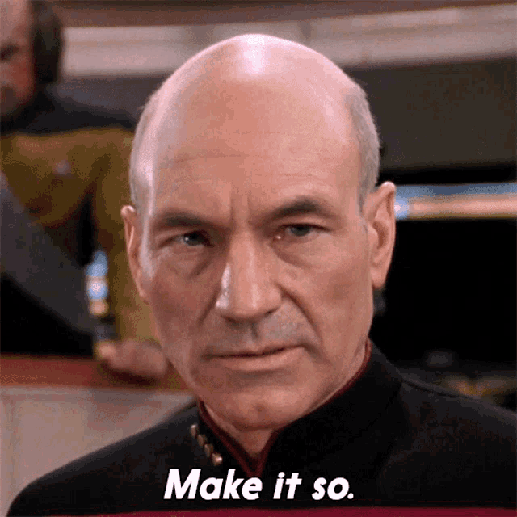
Homework
Deadline:
Midnight before next lesson
Create and submit a Word document which is a short requirement specification for a mobile food delivery app
Include:
3 functional requirements
2 non-functional requirements
2 KPIs
2 user acceptance criteria

Slide 15
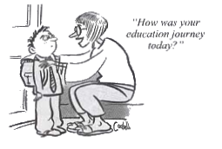











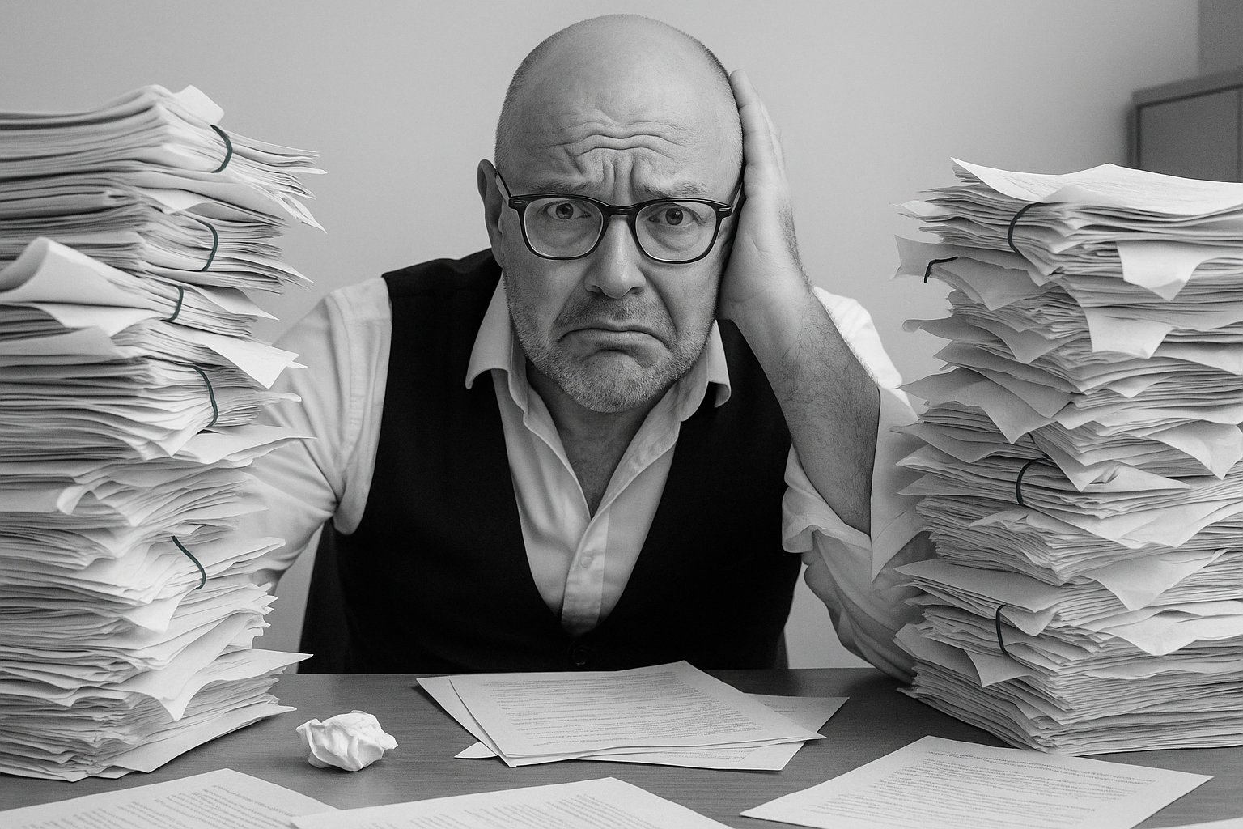


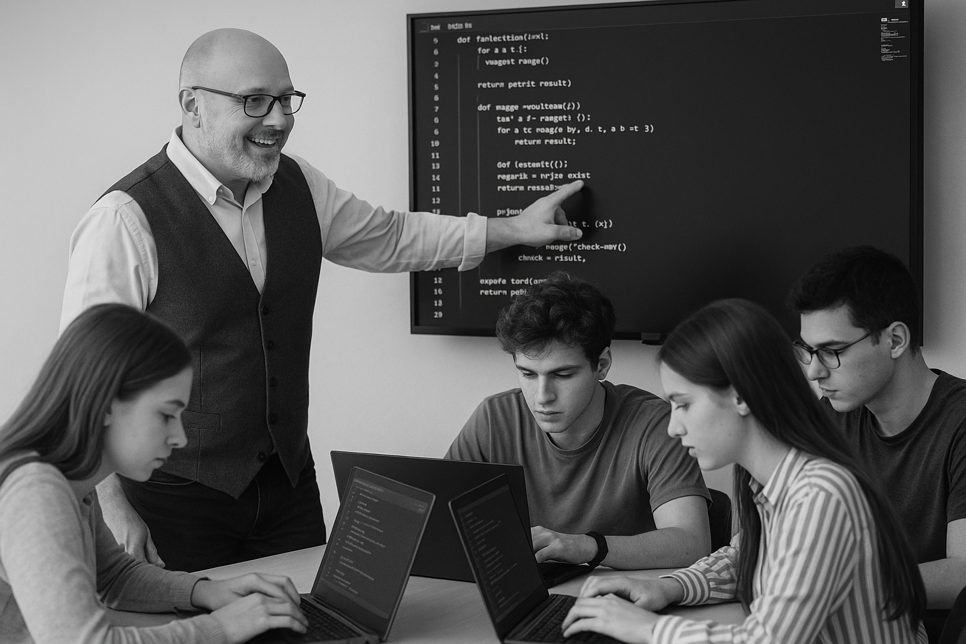
<title>
Note this down
Xmins
In small groups
Working Independently
In pairs
codeblock
Do not delete this slide nor move it from the second last slide in the deck

