Slide 1
User Requirements - Lesson 3
Gathering, Prioritising, and Validating Requirements

Slide 2
Recall from last lesson
https://forms.microsoft.com/e/GKsfeuzcFE
An email should by now have arrived with the link attached.

Slide 3
Lesson 3 Focus
Techniques for Gathering Requirements
Methods for Prioritising Requirements
Validating Requirements to avoid mistakes

Slide 4
How do we gather Requirements?
Note this down
Surveys and Questionnaires
Interviews with stakeholders
Observation of users
Document analysis (existing workflows, policies)
Workshops and brainstorming sessions

Slide 5
Activity: Gathering Requirements
In pairs
One of you thinks of a business and its requirements for an App, but assume you know nothing about the technical aspects of a solution
The acts as the analyst, the other as the client
Conduct a short interview (10 mins) to capture system requirements
Swap roles and repeat
20mins

Slide 6

Prioritising Requirements
Not all requirements can be delivered immediately
Prioritising helps focus on what is most important
Prevents scope creep and wasted effort

Slide 7
MoSCoW Prioritisation
Note this down
Must have – essential requirements
Should have – important but not vital
Could have – nice to include if time allows
Won’t have – not planned for this release

Slide 8
Activity: Prioritisation
In pairs
The brief is an Online Food Ordering App
List the requirements
Categorise them using the MoSCoW method
15mins

Slide 9
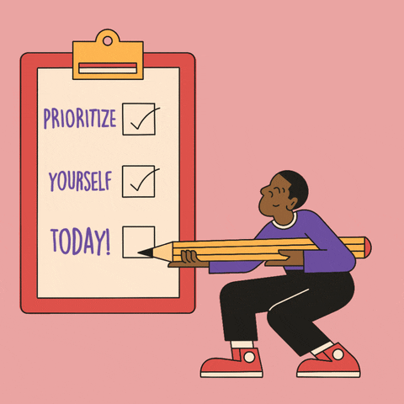
Validating Requirements
Ensures requirements are correct and clear
Prevents misunderstandings between client and developer
Helps confirm that goals are realistic and testable

Slide 10

Validation Techniques
Requirements reviews and walkthroughs
Prototyping to show users early versions
Stakeholder workshops
Cross-checking against acceptance criteria

Slide 11
Activity: Spot Issues
Look at a sample requirement list on the next slide
Identify anything unclear or conflicting
Suggest improvements
Decide how you would validate them

Slide 12
Sample Requirements List for an Online Library App
Functional Requirements
The app must allow users to search for books by title, author, or ISBN.
The app should be really fast and nice to use.
Users must be able to borrow e-books and return them within 14 days.
The system must allow teachers to add new books to the library database.
The app will sometimes let users share books with their friends.
Non-Functional Requirements
The app must load all pages in under 3 seconds.
The app should be user-friendly.
The system must comply with GDPR regulations for storing user data.
The app should work on all devices ever made.
The app must be available 24/7 with at least 99% uptime.
Working Independently
10 mins
Identify anything unclear or conflicting
Suggest improvements
Decide how you would validate them

Slide 13
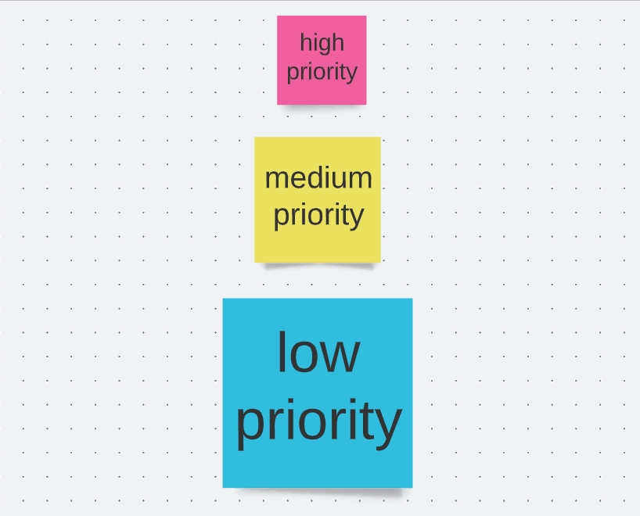
Plenary
What could go wrong if we don’t gather requirements properly?
Why is prioritisation important for project success?
How does validation save time and money?

Slide 14
Homework
Write a short requirements specification for a mobile learning app
Include 3 functional requirements
Include 2 non-functional requirements
Categorise them using MoSCoW
Suggest how you would validate them
Deadline:
Midnight before lesson next week

Slide 15
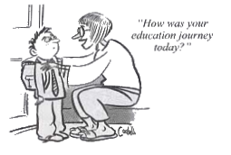







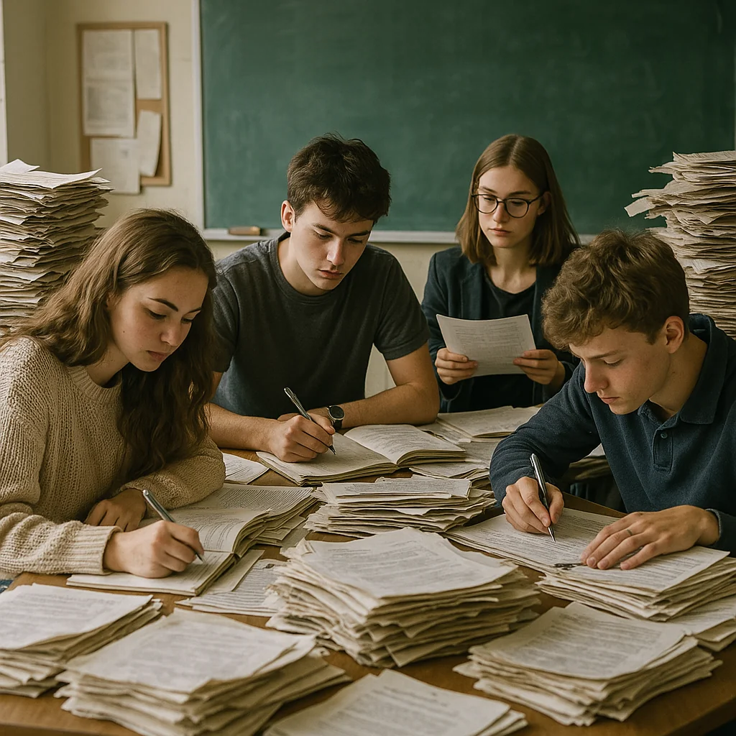


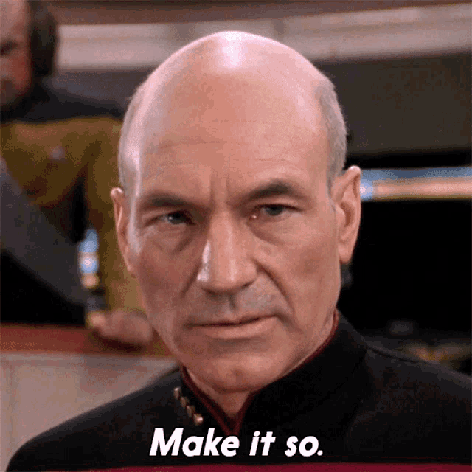

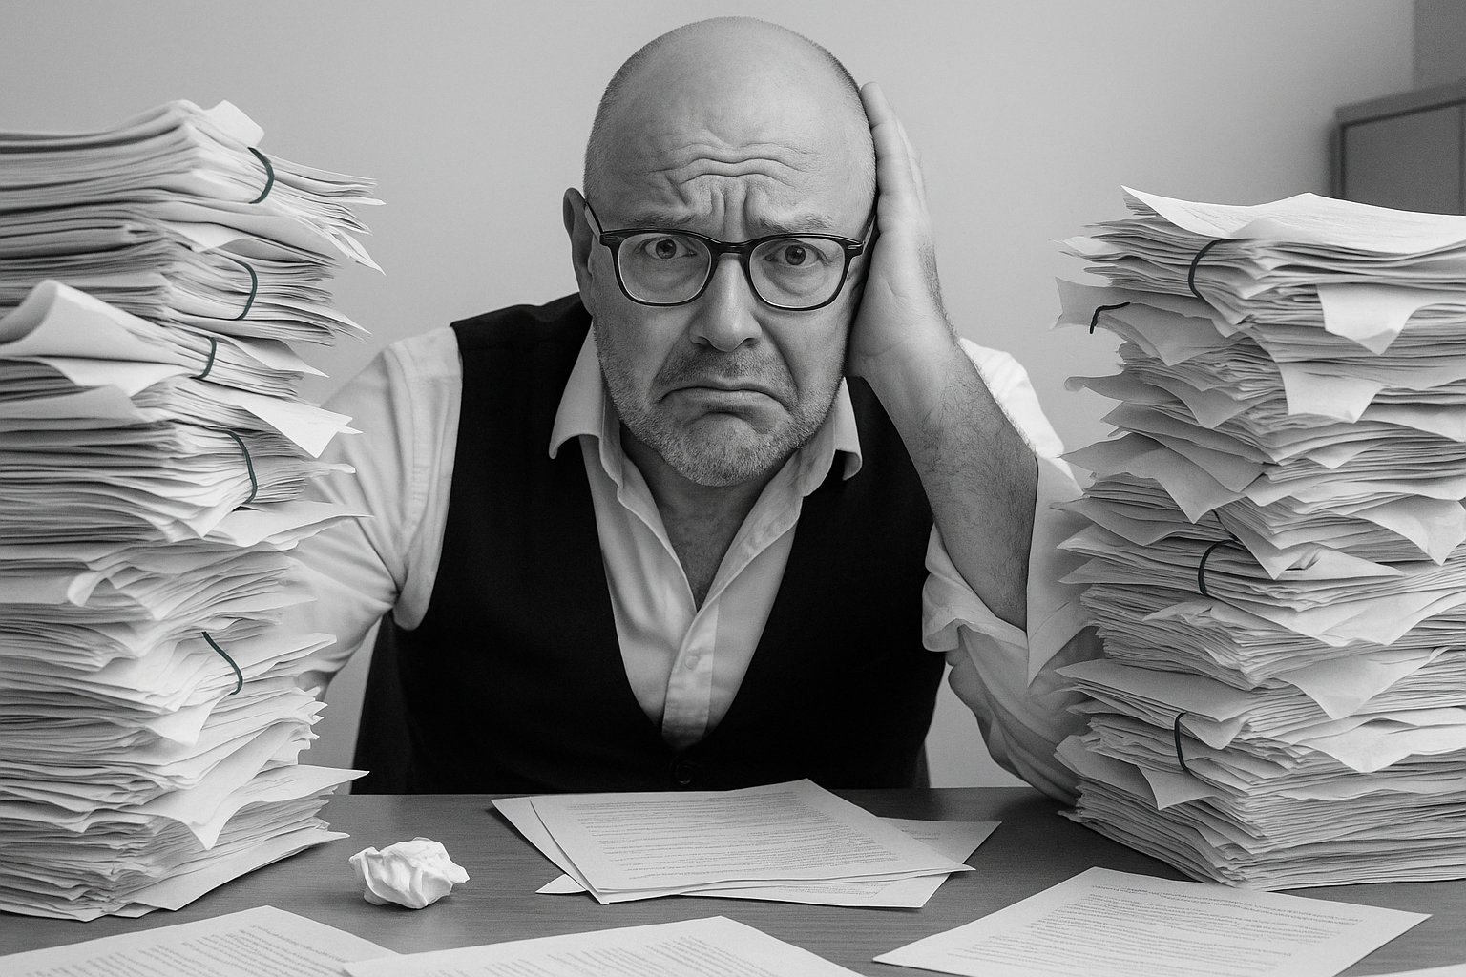
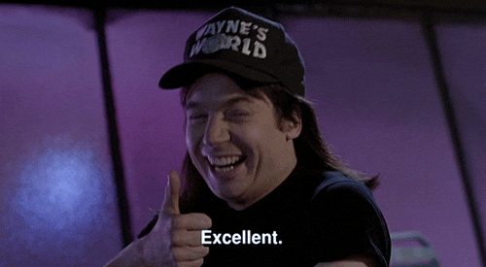


<title>
Note this down
Deadline:
Midnight before next lesson
Xmins
In small groups
Working Independently
In pairs
Do not delete this slide nor move it from the second last slide in the deck

