Slide 1

Networks
Lesson 8

Slide 2
Phones
a small reminder…
once you have authenticated phones should be in the pockets on the wall

Slide 3
Networks
Lesson 8

Slide 4
Learning Objectives
By the end of the lesson, students will be able to:
Define a Wide Area Network (WAN) and explain how it differs from a Local Area Network (LAN).
Describe the purpose of Networks in connecting geographically separated networks.
Identify and explain common Network topologies:
bus
star
full mesh
partial mesh
Analyse advantages and disadvantages of different Network topologies.

Slide 5



LAN vs WAN Quickfire
Usually covers a single building or campus
May connect computers across different cities or countries
Can use wired or wireless connections
Is normally owned and managed by one organization
Uses routers to move data between networks
Provides communication between two or more LANs.
Extension: “If Exeter College opened a new campus in Plymouth, how would you link the two LANs?”

Slide 6
Wide Area Networks
Note this down
Wide Area Network (WAN): A network that spans a large geographical area and connects multiple Local Area Networks (LANs) together using public or private telecommunication links.
Organisations use WANs to link offices, campuses, or branches located far apart.
The internet itself is the largest example of a WAN.
WANs often rely on service providers (ISPs or carriers) to supply the underlying connection.

Slide 7

“Why can’t a business just extend its LAN cable 100 miles between offices?”

Slide 8
WAN vs LAN Comparison Table
Note this down
Feature | LAN | WAN
Geographical area | Limited (building or campus) | Wide (city, country, global)
Ownership | Owned and managed internally | Uses external telecoms infrastructure
Speed | Typically faster (1 Gbps +) | Typically slower (10 Mbps – 100 Mbps)
Reliability | Easier to control | Depends on third-party providers
Cost | Lower setup cost | Higher, ongoing lease or ISP costs
Examples | College network, home Wi-Fi | Internet, corporate VPNs, MPLS links
Which of these factors would most concern a company connecting a remote warehouse?

Slide 9
Public vs Private WANs
Note this down
Private
Public
Owned or leased exclusively by one organisation
e.g. MPLS circuit, leased line.
Secure and predictable but expensive.
Analogy: hiring a private chauffeur
Uses the public internet or shared carrier networks.
Cost-effective but requires VPN encryption to maintain privacy.
Analogy: using the bus but locking your briefcase

Slide 10
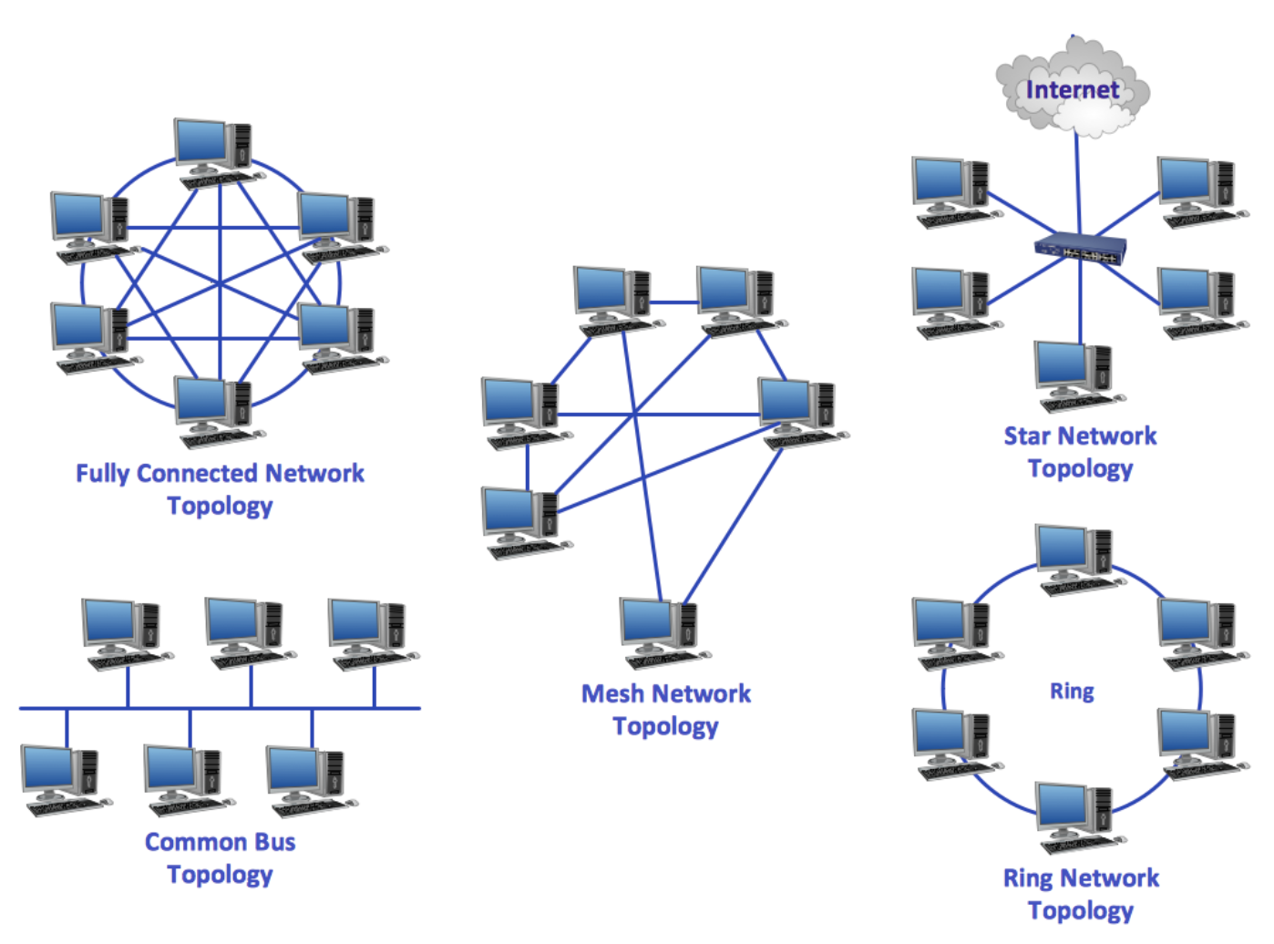
Network Topologies
Note this down

Slide 11
Logical vs Physical Topology
Note this down
Aspect | Physical | Logical
Definition | The actual layout of cables and devices | The flow of data within the network
Example | Star layout of routers | Hub-and-spoke logical connections over the Internet
If the physical layout is a mesh but the data only passes through one hub, which logical topology is that?
Star
Even though the physical cabling forms a mesh (many possible connections between nodes), if all the data traffic actually passes through a single central device, then the logical behaviour is that of a star — because the hub (or router/switch) controls all communication paths.

Slide 12
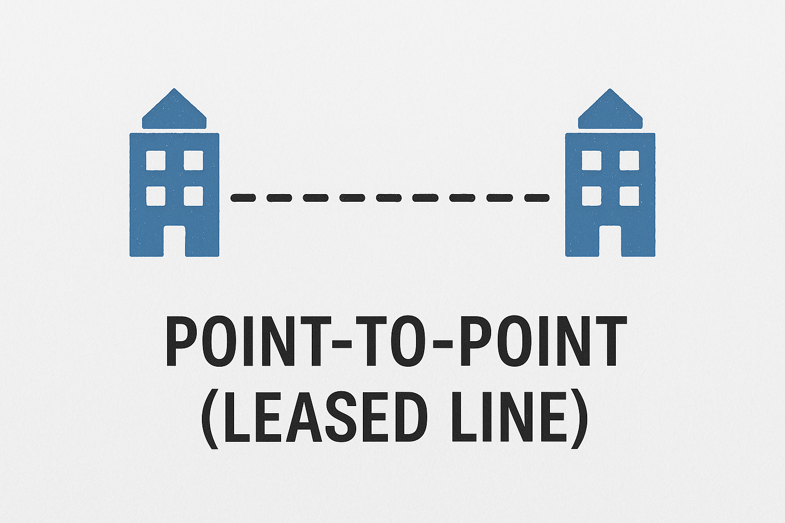
Common Topologies
Note this down
Point to Point (Leased Line)
Two sites are directly linked by a dedicated line.
💡 Example: HQ ↔ Data Centre
✅ Reliable, secure
❌ Costly, limited scalability

Slide 13
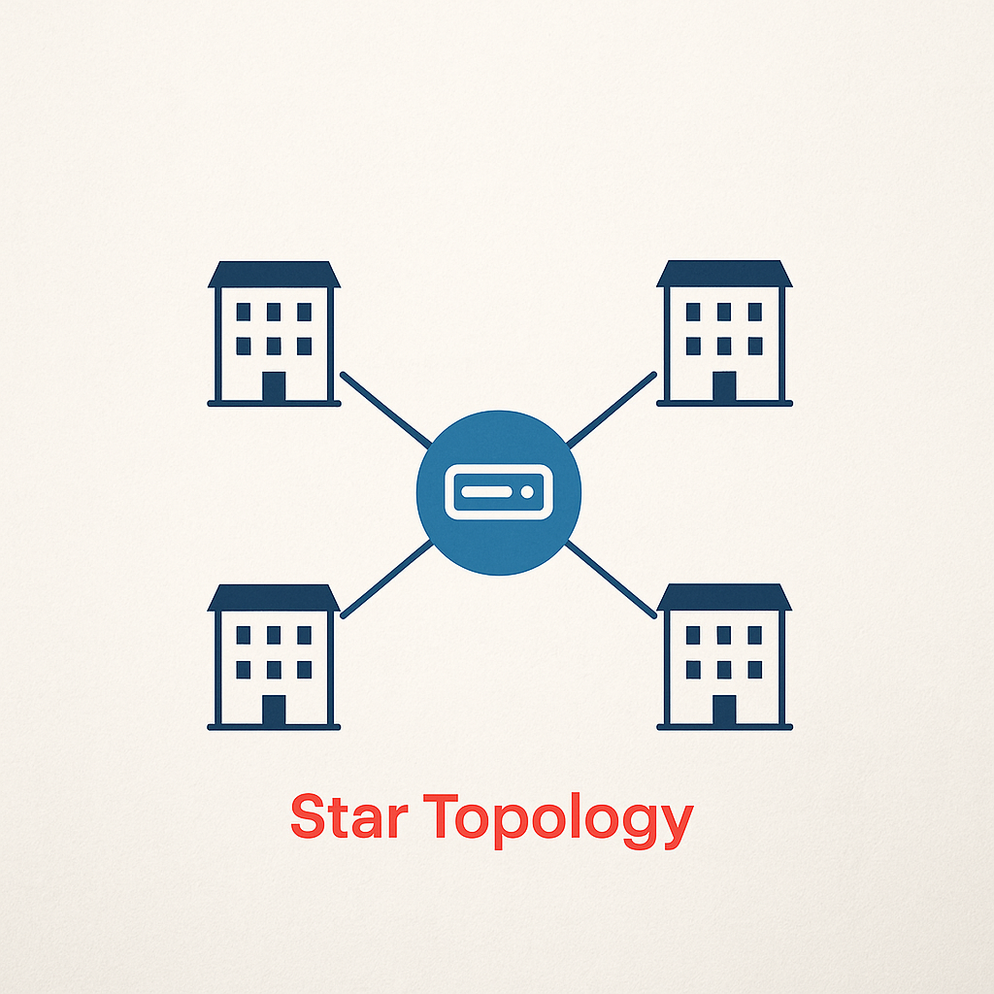
Common Topologies
Note this down
Star (Hub & Spoke)
Central router (hub) connects to several branch routers (spokes).
💡 Example: Bank branches connected to head office.
✅ Easy management
❌ Traffic bottlenecks at hub

Slide 14
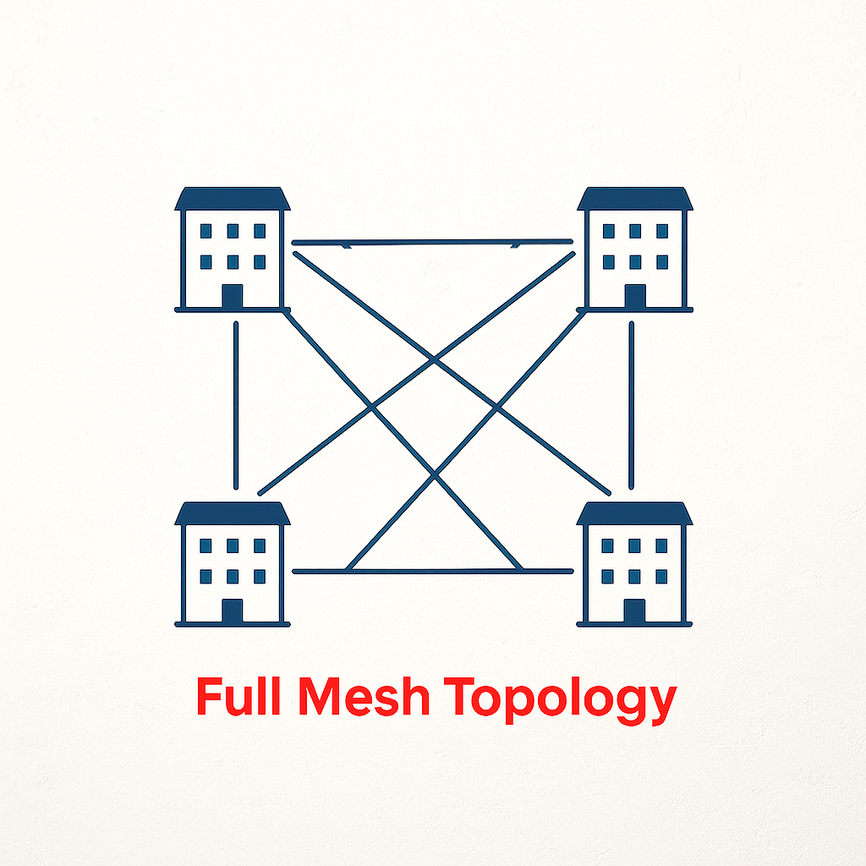
Common Topologies
Note this down
Full Mesh
Every site connects to every other site.
💡 Example: Real-time trading
network
✅ High redundancy
❌ Complex and expensive

Slide 15
Common Topologies
Note this down
Partial Mesh
Only key sites fully interconnected.
💡 Example: Military network – critical operations fully redundant, mobile ops not
✅ Balance between redundancy and cost

Slide 16
So…
Note this down
Which topology provides the best resilience?
Which would be cheapest to implement?

Slide 17
Case Example
A logistics firm has depots in London, Bristol, and Glasgow. Each needs constant access to the head-office database in London.
Which topology fits best?
How would reliability differ if they added a new depot in Belfast?
In small groups
5 mins

Slide 18
Summary
Note this down
WANs link multiple LANs across distances.
They can be private or public and adopt different topologies for cost vs redundancy.
Understanding these helps us choose the right design for business needs.

Slide 19
Activity: Design your own network
In small groups
The House of Retail is a store chain with an HQ in London and stores in Manchester, Cardiff and Belfast
Choose the most suitable topology
Illustrate it and label key links
Use lucid.app, chart.io or Cisco Packet Tracer
Create in a PowerPoint a short business case as to why this is the right choice on both business and technology grounds
Use your network diagram imported into the PPT
Be prepared to discuss
Cost implications
Reliability and Redundancy
Ease of adding new sites
25 mins
if Cisco Packet Tracer is on your machine
5-minute presentation to class
email presentation to simonrundell@exe-coll.ac.uk

Slide 20
Homework
Deadline:
Midnight before next lesson
Draw your own network diagram for a fictional company with 5 sites. Label the topology, and write 3 bullet points explaining why you chose that layout
Extension: Explain one risk and one advantage of using a public WAN (e.g. Internet) instead of a private leased line.

Slide 21























<title>
Note this down
In pairs
Working Independently
In small groups
Deadline:
Midnight before next lesson
Xmins
Do not delete this slide nor move it from the last slide in the deck

