Slide 1
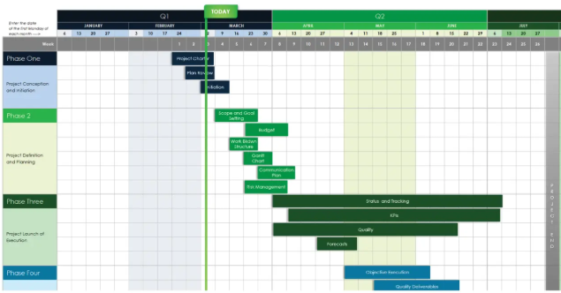
Revisiting Some Planning and Methodology Topics
Week 8

Slide 2
Reflection on the Past Paper
https://forms.microsoft.com/e/wRKkzzRWX2
An email should by now have arrived with the link attached.

Slide 3
Phones
a small reminder…
once you have authenticated phones should be in the pockets on the wall

Slide 4
Revisiting Some Planning and Methodology Topics
Week 8

Slide 5


The most common software methodology I saw implemented for this project was…?
Waterfall?
Agile?
Scrum?
JFDI
“Just flipping do it!”

Slide 6
The impact of JFDI
Impossible to finalise
Because you don’t set the outcome targets
Scope Creep
Because you allow late additions or distractions
Missed or nearly missed deadlines
Because there can be no milestones
Wasted time and resources
Because unplanned development is wasted with a rage quit

Slide 7
Lesson Aims
By the end of the lesson, students will be able to:
Describe the purpose of the SDLC and typical stages.
Identify key team roles in software projects and their responsibilities.
Explain why different projects may require different approaches.
Understand the main reason for establishing milestones in a project

Slide 8
Knowledge Recall
https://forms.microsoft.com/e/G1UA6sk8js
I will post this link in Teams for you now.

Slide 9
Draw a house
Paper and Pens
Team A
Team B
You get to draw a house according to the blueprint I am going to give you
Draw a house
Without a clear plan (methodology), even a simple task leads to inconsistent outcomes and confusion.

Slide 10
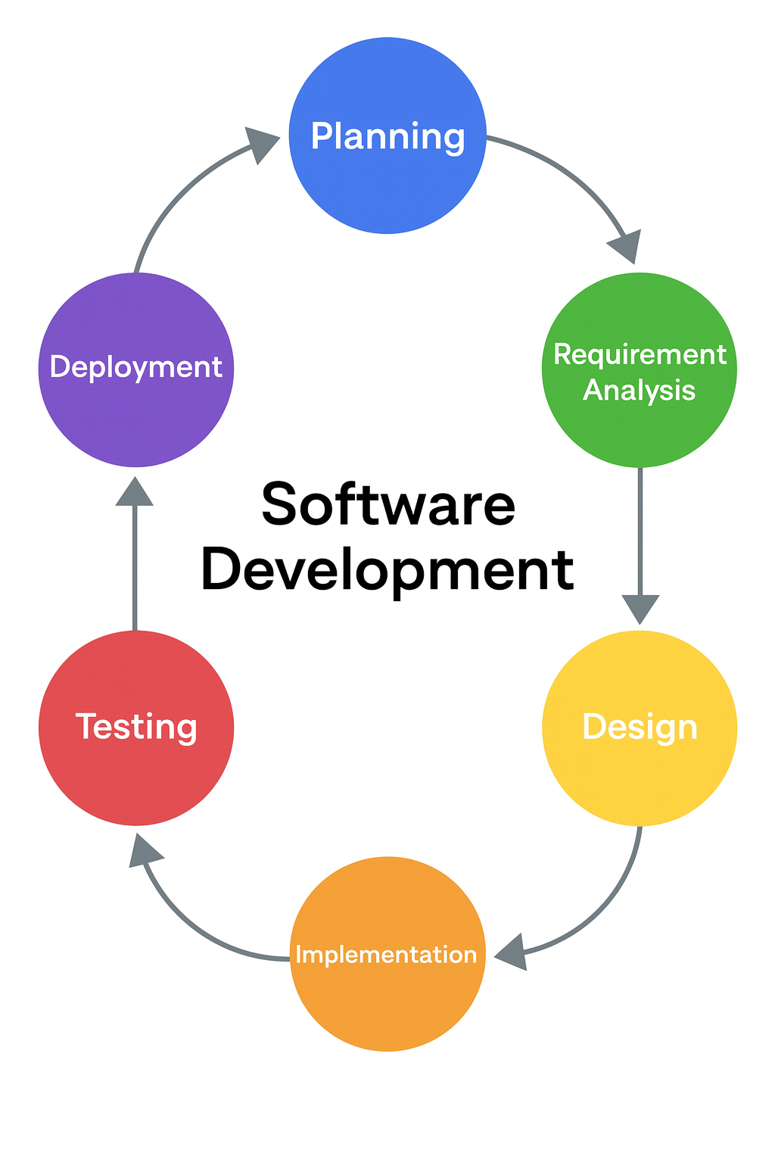
Software Development Life Cycle
Planning
Requirement Analysis
Design
Implementation
Testing
Deployment
Lower –scoring projects seemed to enter at this point
Notes:
Planning
Requirement Analysis
Design
Implementation
Testing
Deployment
Then graphic
Then arrow → lower scoring projects seemed to enter at this point

Slide 11
Why is Planning important in a Project?
To establish what the client wants
In our case: to understand the Brief thoroughly
To understand the constraints on the project
In our case:
What other projects am I working on?
Am I going to be out of the country?
How will my part-time job affect this project?
To establish milestones along the duration of the project
In the real world this might involve sign-off from the client at various key stages (and part-payment!)

Slide 12
Why is Requirement Analysis important to a project?
To understand the business environment for which the project is designed
To establish a clear understanding of the user’s functional and non-functional requirements often with user stories.
To research into potential technical and operational solutions to the project
including analysis of rival or comparative products already on the market
To be able to cost out resources for the project
Programmer hours, Deployment & Maintenance Costs
Functional Requirements
What the app needs to do
Non-Functional:
Speed, Capacity, Availability

Slide 13
Why is Design important in a project?
To establish a clear UI / UX which can be applied consistently across the project
To systematically design data structures for best efficiency (and therefore speed)
To establish algorithms for functional operation
To effectively modularise functionality
To design Tests to meet user acceptance criteria
To enable the most efficient use of the most expensive resource in the project:
Programmer Hours!

Slide 14
Why is Implementation important in a project?
To build the project efficiently
To pass the tests within minimal difficulty
Any test detected outside of Alpha Testing involves a delay while it is fixed and rebuilt, thus delaying the project
To build what is requested at this stage of the project
No more. No less.

Slide 15
Why is Testing important in a project?
Beta testing is testing outside the development team
Passing Beta and then the User Acceptance Criteria is the key target of the project
It is usually one of the key triggers for payment.

Slide 16
Why is Deployment important in a project
A good project poorly implemented might as well be a bad project
This might involve user training or user documentation
It naturally leads into the maintenance phase which is a key to getting paid for the long term.
Keeping clients happy keeps the money rolling in with minimal work.

Slide 17
Sequence the SDLC

Slide 18
Team Roles
Product Owner
Scrum Master/Project Manager
Developer
Tester/QA
UX/UI Designer
Business Analyst

Slide 19






The Team

Slide 20
Product Owner
Defines the product vision and goals aligned with business needs.
Prioritises the product backlog and manages requirements.
Acts as the voice of the customer, ensuring the product delivers value.
Works closely with the team to clarify and refine user stories.

Slide 21
Scrum Master / Project Manager
Facilitates the Agile process and removes obstacles for the team.
Ensures communication and collaboration between all stakeholders.
Helps the team stay focused, organised, and aligned with sprint goals.
Tracks progress and manages timelines and deliverables.

Slide 22
Developer
Writes, tests, and maintains the source code that makes up the product.
Works closely with designers, testers, and analysts to meet requirements.
Participates in code reviews and continuous integration.
Ensures scalability, performance, and maintainability of the solution

Slide 23
Tester / Quality Assurance
Designs and executes tests to ensure software quality.
Identifies bugs and works with developers to resolve them.
Verifies that the software meets both functional and non-functional requirements.
Helps maintain documentation of testing processes and outcomes.

Slide 24
UX/UI Designer
Designs user interfaces that are intuitive, accessible, and visually appealing.
Conducts user research and testing to improve usability.
Collaborates with developers to ensure design fidelity in implementation.
Focuses on creating a seamless, engaging user experience.

Slide 25
Business Analyst
Bridges the gap between business needs and technical solutions.
Gathers, documents, and analyses requirements.
Helps define scope, objectives, and key success criteria for projects.
Supports decision-making through data and process analysis.

Slide 26
Team Role Recall

Slide 27
Case Study
A College wants a simple room‑booking feature added to an existing site
Which SDLC stages are most critical?
Which roles are essential?

Slide 28
Exit Ticket
https://forms.microsoft.com/e/tSL2bRUiwF
I will post this link in Teams for you now.

Slide 29












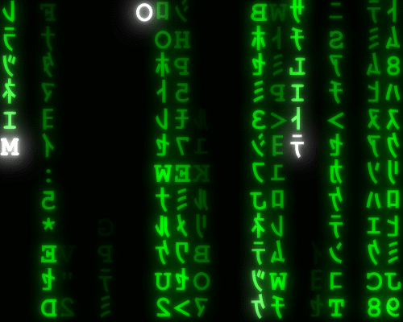

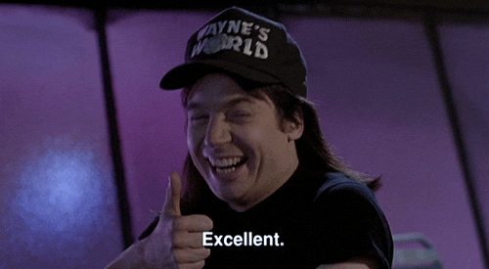
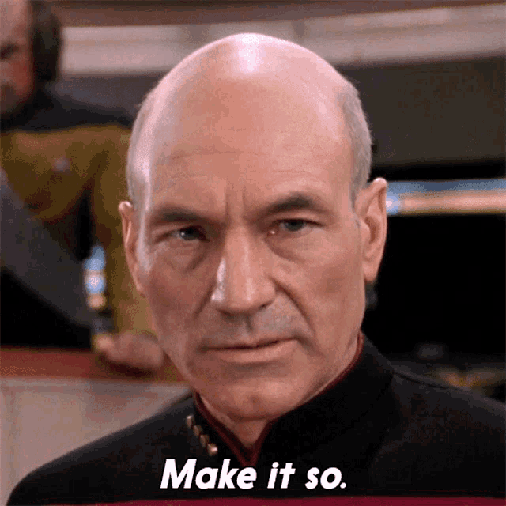





<title>
Note this down
In pairs
Working Independently
In small groups
Deadline:
Midnight before next lesson
Xmins
Do not delete this slide nor move it from the last slide in the deck

