Slide 1

CodeMonkey
This template and PowerPoint Extensions created by
Where the magic happens
CodeMonkey Design
www.codemonkey.design
simon@codemonkey.design
+44 7976 802123

Slide 2
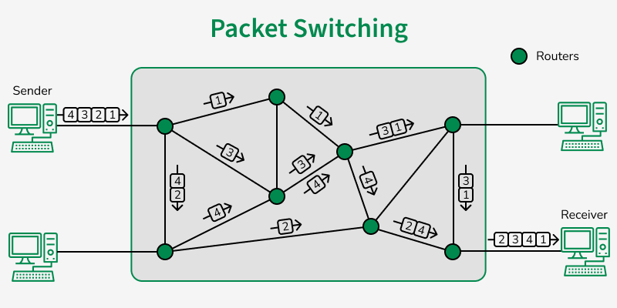
Packet-Switched WAN Options
Lesson 10

Slide 3
Recall from last lesson
https://forms.microsoft.com/e/Xt4jE3xfUh
An email should by now have arrived with the link attached.

Slide 4
Phones
a small reminder…
once you have authenticated phones should be in the pockets on the wall

Slide 5
Packet-Switched WAN Options
Lesson 10

Slide 6
Lesson Objectives
By the end of this session, students will be able to:
Explain what packet switching is and how it differs from circuit switching.
Describe how Frame Relay, X.25, and ATM operate within packet-switched WANs.
Distinguish between switching and multiplexing in data transmission.
Evaluate the advantages and disadvantages of packet-switched WANs.
Compare packet-switched technologies in terms of latency, cost, reliability, and scalability.

Slide 7
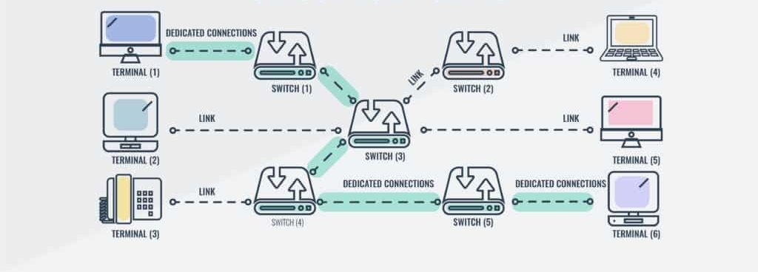
Last lesson we looked at Circuit Switching…

Slide 8

Why might circuit switching be inefficient for the internet?

Slide 9

Packet Switching
using Cat Memes
(no cats will be harmed in this analogy)

Slide 10


Slide 11

2
4
1
3
5
7
6

Slide 12
Note this down

Slide 13
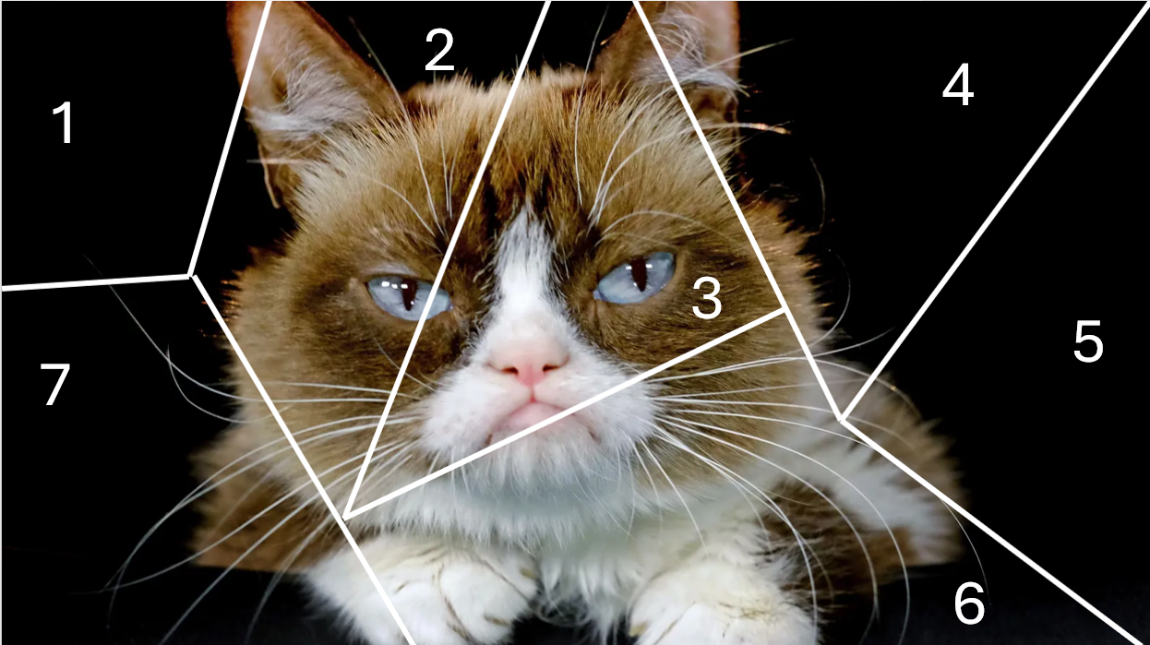

Slide 15
Reflect
How did this represent packet switching?
What could cause delays or missing packets?
Could two packets take different routes?
What might happen if packets arrive out of order?

Slide 16
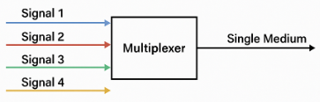
Multiplexing
Multiple signals are combined for transmission over a single medium
Analogy: merging several lanes of traffic into one big motorway
Multiple signals share the same medium which increases efficiency and reduces costs
Fibre Optic has so much more capacity ‘bandwidth’ than copper wire

Slide 17
What’s in the packet?
Note this down
Each packet contains:
Header → the delivery information (like an envelope)
Payload → the actual data (like the letter inside)
Trailer → extra info for checking errors
Just like the postal system, every packet must carry the information needed to reach its destination, even if it’s part of a bigger message
Analogy: the digital postal service
Concept | Postal Analogy | Networking Example
Header | Address on the envelope | Source IP, destination IP, protocol
Payload | The letter inside | Your email text, image, or web data
Trailer | Return receipt or seal | Error-checking bits (CRC, checksum)

Slide 18
Example
Note this down
Field | Description | Example
Source Address | Where it came from | 192.168.1.10
Destination Address | Where it’s going | 8.8.8.8
Protocol | What rules to use | TCP / UDP
Packet Number | Order of packets | #3 of 10
Checksum | Error detection | Confirms no data loss

Slide 19
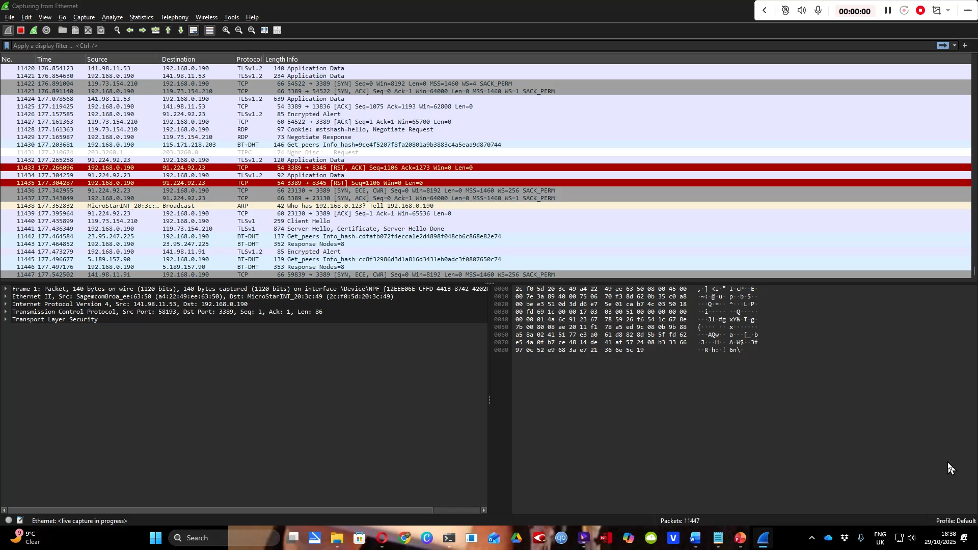
In practice: WireShark

Slide 20
Connectionless vs Connection-Oriented Services
Note this down
Where might you have heard TCP before?
Term | Meaning | Example Protocol | Analogy
Connection-Oriented | A logical connection is established before data is sent. The sender and receiver maintain this connection for the session. Packets are acknowledged and retransmitted if lost. | TCP (Transmission Control Protocol) | Like making a phone call – you establish the line, then talk in order.
Connectionless | Data is sent without first establishing a connection. Packets are routed individually and may take different paths. No delivery guarantees. | UDP (User Datagram Protocol) | Like posting letters – each one travels separately, and some could arrive late or not at all.
TCP/IP

Slide 21
Packet Switching Theory
Note this down
Packet switching is the method of delivery — how data moves through a network.
TCP and UDP are transport layer protocols that use packet switching differently:
TCP (connection-oriented) adds reliability and order.
UDP (connectionless) sacrifices reliability for speed.

Slide 22
Packet-Switched Technologies
Frame Relay
X.25
ATM (Asynchronous Transfer Mode)

Slide 23
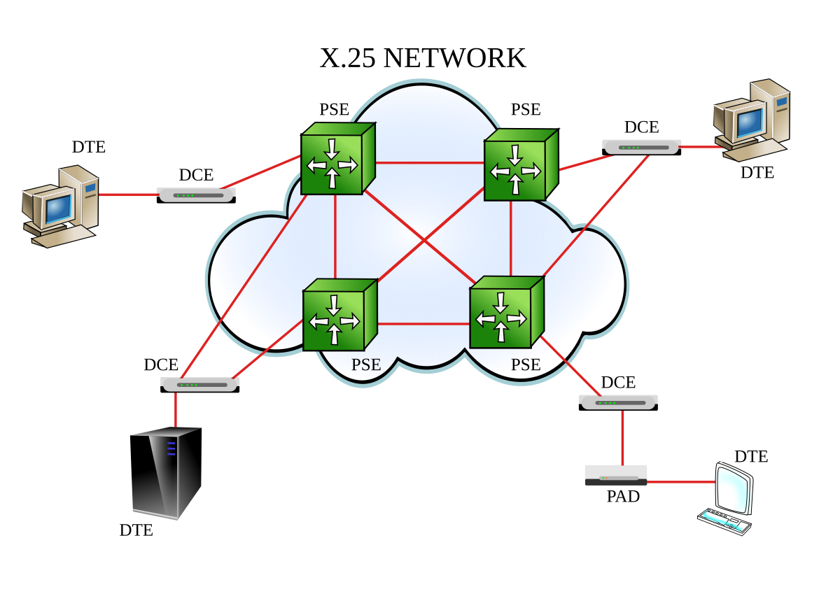
X.25 – The Grandparent of Packet Switching
Note this down
Origins:
Developed in the 1970s by the International Telecommunication Union (ITU) for use on the public data networks (before the Internet).
How it works:
Provides reliable, connection-oriented packet delivery.
Performs error checking and correction at each network node.
Each node confirms successful delivery before forwarding packets to the next hop.
Advantages:
Extremely reliable and robust; good for noisy or unstable lines.
Limitations:
High overhead, slower speeds, and inefficient for modern traffic.
Typical Use:
Early bank ATM machines, mainframe connections, early business WANs.
Analogy:
Like a cautious courier who phones you after delivering every single parcel.
Notes:
DTE – Data Terminal Equipment – ie the terminal
DCE – Data Ciruit Terminating Equipment – what connects this network to the carrier network (a bit like a router)
PSE – Packet Switching Exchange – on the network moves packets around

Slide 24
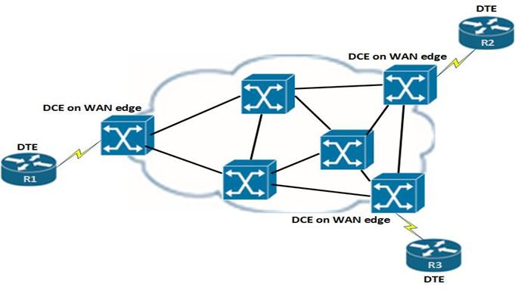
Frame Relay – The Streamlined Successor
Note this down
Origins:
Developed in the 1980s to improve on X.25 as line quality improved.
How it works:
Simplifies packet handling — relies on error checking at endpoints instead of every hop.
Provides virtual circuits (PVCs or SVCs) between locations — logical paths set up across the WAN.
Supports multiple connections over one physical line, improving cost efficiency.
Advantages:
Faster, cheaper, and simpler than X.25.
Limitations:
Less reliable — assumes physical networks are mostly error-free.
Typical Use:
Private business WANs connecting branches before widespread broadband or MPLS.
Analogy:
Like a trusted courier network that assumes good roads — no need to check every mile.
Notes:
DTE – Data Terminal Equipment – ie the terminal
DCE – Data Ciruit Terminating Equipment – what connects this network to the carrier network (a bit like a router)
PSE – Packet Switching Exchange – on the network moves packets around

Slide 25
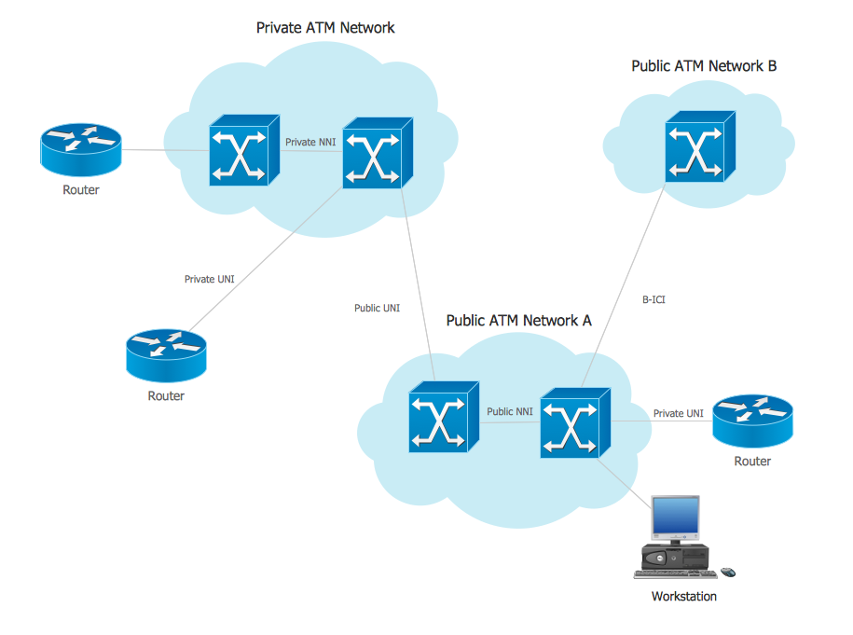
ATM (Asynchronous Transfer Mode) – The Speed-Focused Hybrid
Note this down
Origins:
1990s technology designed for voice, video, and data — used heavily by telecoms providers.
How it works:
Data is split into fixed-size 53-byte cells (48 bytes of data + 5 bytes header).
Provides constant, predictable performance — ideal for multimedia.
Uses virtual paths and channels for quality-of-service (QoS) guarantees.
Advantages:
Very fast and reliable; handles voice, video, and data equally well.
Limitations:
Complex, expensive, and eventually replaced by IP-based systems.
Typical Use:
Backbone networks in ISPs and telecom carriers (e.g., BT, AT&T).
Analogy:
Like a high-speed train where every carriage is exactly the same size — easy to schedule and control.

Slide 26
Comparison
Note this down
Technology | Era | Speed | Error Handling | Reliability | Cost | Typical Use
X.25 | 1970s | Slow (up to 64 Kbps) | At every node | Very high | High | Early bank & business networks
Frame Relay | 1980s–2000s | Medium (64 Kbps–45 Mbps) | At endpoints | Good | Medium | Business WANs, branch connections
ATM | 1990s–2010s | High (155 Mbps+) | Managed QoS | Excellent | High | Telecom backbones, video traffic

Slide 27
Reflect
Why did each newer technology drop some features of the older one?
What improvements made error correction at every node unnecessary?
Why is ATM’s fixed cell size useful for voice and video traffic?
Which do you think would work best for today’s broadband infrastructure?”

Slide 28
Worksheet
Working Independently
See Teams / <location> / Lesson 10 Worksheet Packet Switched WAN Technologies
25 mins

Slide 29
Plenary
What is packet switching?
How does Frame Relay differ from X.25?
Which technology uses fixed-length cells?
Define multiplexing.
Give one advantage and disadvantage of packet switching.

Slide 30
Homework
Deadline:
Midnight 6 days time
Compare two packet-switched WANs
eg: Frame Relay vs ATM in a table showing latency, cost, reliability, scalability.
Extension: Recommend which is better for a high-traffic business.

Slide 31























<title>
Note this down
In pairs
Working Independently
In small groups
Deadline:
Midnight before next lesson
Xmins
Do not delete this slide nor move it from the last slide in the deck

