Slide 1
Decisions, decisions…
Lesson 7

Slide 2
Recall from last lesson
https://forms.cloud.microsoft/e/UD1JGZBqQL
An email should by now have arrived with the link attached.

Slide 3


True or False?
7 is greater than 10.
The average age of this class is 15.9 years.
I am now holding up my left hand
My name is “Chris”
Notice how all the answers can be given as either
or

Slide 4
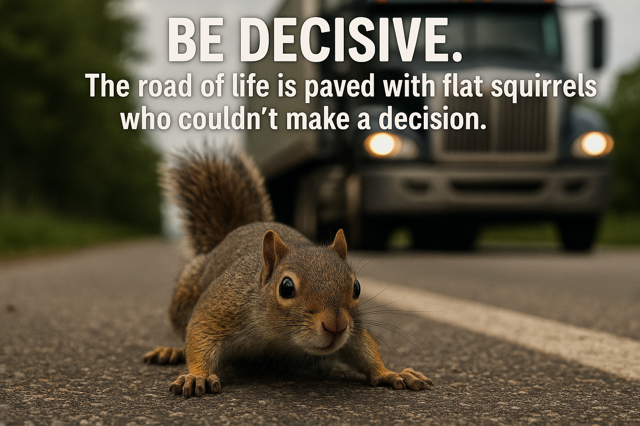

Slide 5
More on operators
So far we have only touched on Mathematical Operators ( +, -, *, / )
Now we get to learn about Logical Operators
  ==
  !=
  > and <
  <= and >=
equals (we use = just to assign values)
is not equal to
is greater or less than
is greater or equal to or less than or equal to

Slide 6
So…
7 > 10
average_age < 15.9
hand_up = “Left”
my_name != “Chris”

Slide 7
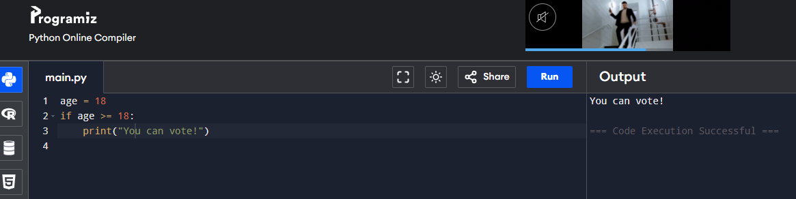
The if statement
age = 18
if age >= 18:
print("You can vote!")
Note the indentation after the : just like in a function
Let’s try that ourselves in Programiz!
https://www.programiz.com

Slide 8
The else statement
age = 15
if age >= 18:
print("You can vote!")
else:
print("You are too young to vote.")
Use else when there are two either/or options

Slide 9
More than 2 options? Use elif
score = 72
if score >= 90:
print("Grade A")
elif score >= 70:
print("Grade B")
else:
print("Grade C or below")
Note that we use >= so that a score right on the boundary does not fall through this test
else catches what falls out the bottom.

Slide 10
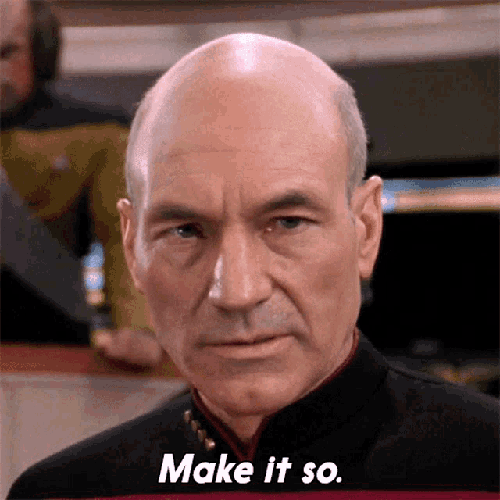
Task
There is another operator to introduce to you: % which returns the number left over when a number is divided, so:
7 % 2 (we say ‘seven mod two’) is 1, because when you divide 7 by 2, there is 1 left over. This is a good way of working out if a number is odd or even.
6 % 2 is 0 because it divides equally.
15 % 3 is 0 because it divides equally.
Hint:
Assign a variable
Use mod (%)
Use if/else
Use print() to give your result on the screen
So, knowing this, can you write me a program which checks if a number is even or odd
What about a program that takes in an input() from the user and works on that?
15 mins

Slide 11
Another Task
25 mins
We use input() to gather information from the user, and assign it to a variable with =
So:
my_variable = input(“Enter your name: “)
Would show the prompt, gather the info and store it in my_variable
Create a program to gather in a password and check if it matches a correct password “letmein”
Display a text menu, ask the user to make a choice
  If they choose option 1 then reply with “Hello”
  If they choose option 2 then reply with “Goodbye”
  If they choose anything else tell them it is an invalid choice
Create a grading system with 5 categories: (A,B,C,D, Fail)
Menu:
Say Hello
Say Goodbye
Choose option:

Slide 12
A newer Python feature is match/case
choice = input("Choose option: ")
match choice:
case "1":
print("Hello!")
case "2":
print("Goodbye!")
case _:
print("Invalid choice")
You don’t need to know this at Level 2, but it’s cool to know

Slide 13
Summary Questions
What keyword starts a branch in Python?
What does elif mean?
Why is indentation important?
What is the difference between if and else?

Slide 14
Homework
Deadline:
Midnight before next lesson
Continue using Programiz to:
Write a program that asks the user for their favourite colour.
If it is “blue”, print “That’s my favourite too!”
Else, print “Nice choice.”
Screenshot code + output and upload.

Slide 15
Sample Texts
True / False:
PLEASE LOG IN
PLEASE LOG IN
Do not delete this slide nor move it from the second last slide in the deck

Slide 16
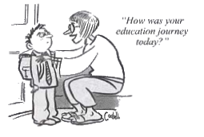










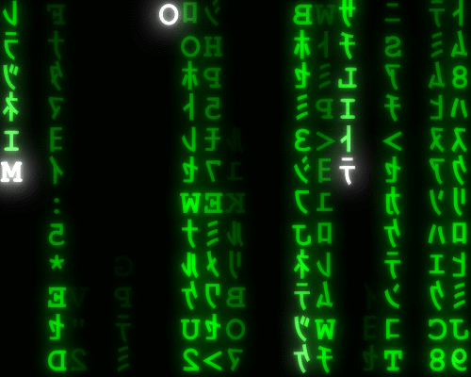



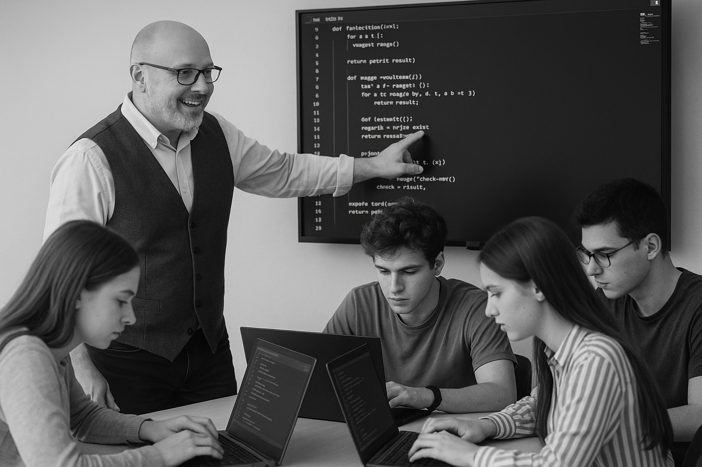
<title>
Note this down
Deadline:
Midnight before next lesson
Xmins
In small groups
Working Independently
In pairs
codeblock
Do not delete this slide nor move it from the second last slide in the deck

