Slide 1
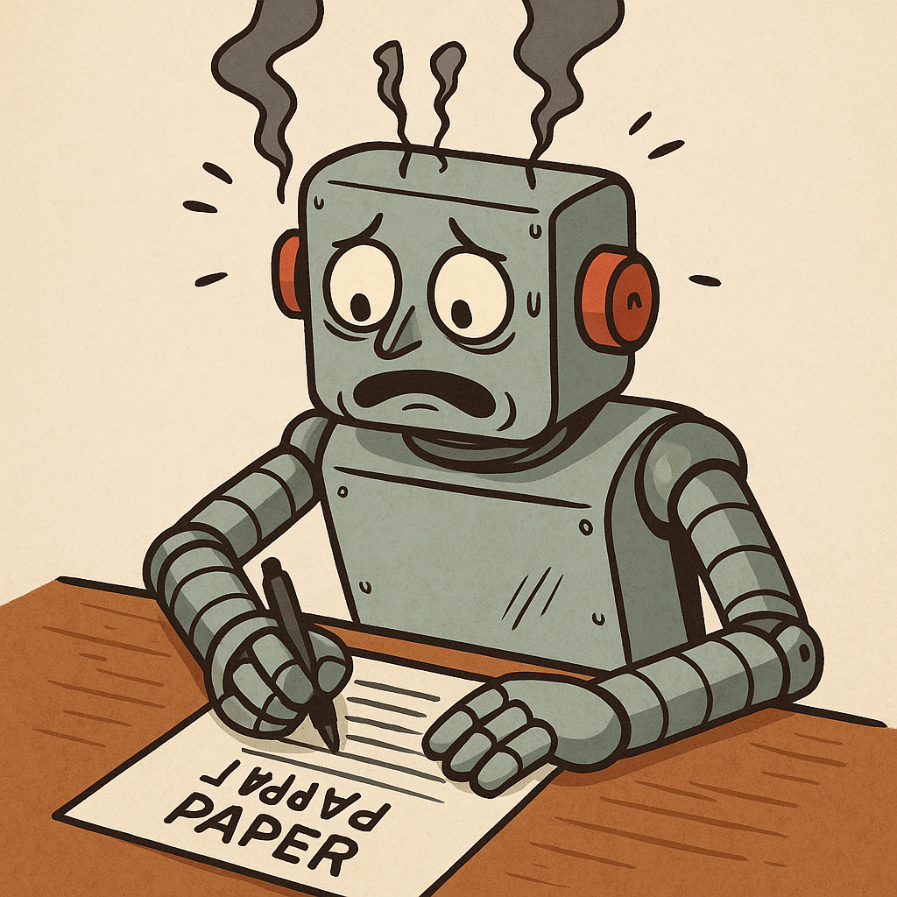
How I know it’s AI
Why you shouldn’t use ChatGPT to write your assessments

Slide 2
You think you might get away with it…
ChatGPT is not 100% accurate and so can make some serious errors that you might not notice.
It has been known to make stuff up.
ChatGPT writes in a way which is usually very different from the way you normally write.
Getting ChatGPT to write your work for you means you never get to learn it, so you will never progress.
There is a place for ChatGPT:
To check your grammar and spelling
To identify missing bits of information
But do not accept its offer to re-write it for you
Write it in your own words

Slide 3
Academic Malpractice
IMPORTANT
Using Generative AI to write your essays is serious academic malpractice
It is the same as cheating
You understand the penalties for cheating?
Failure of that piece of coursework
Possible failure of the course
Your place at College in jeopardy.
Use ChatGPT as an assistant, not a replacement.

Slide 4
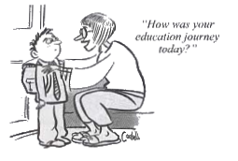








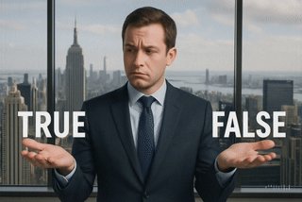
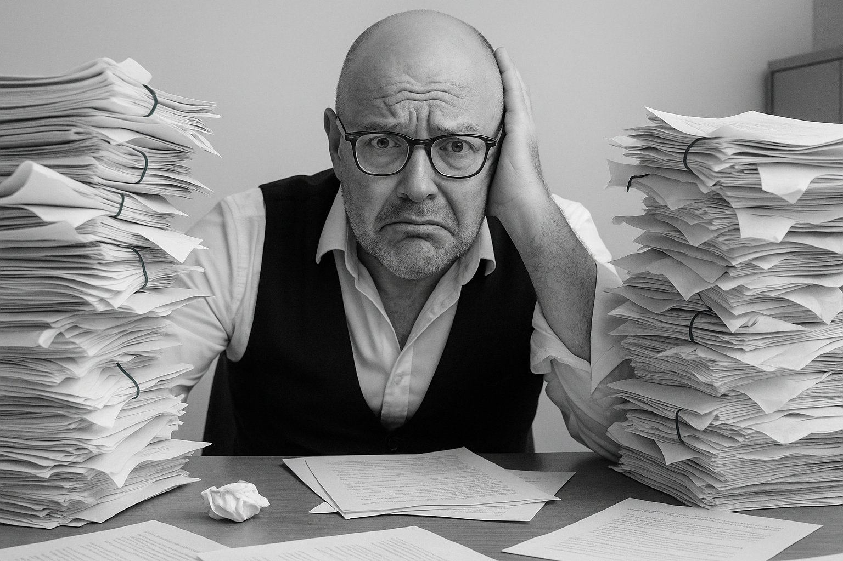


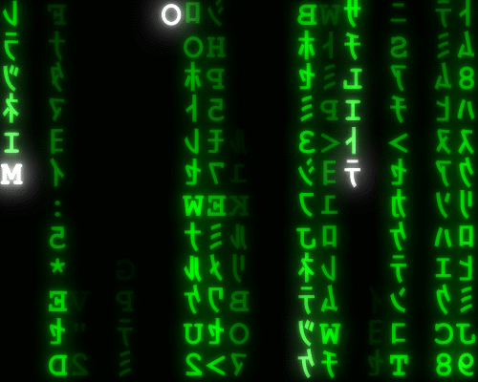
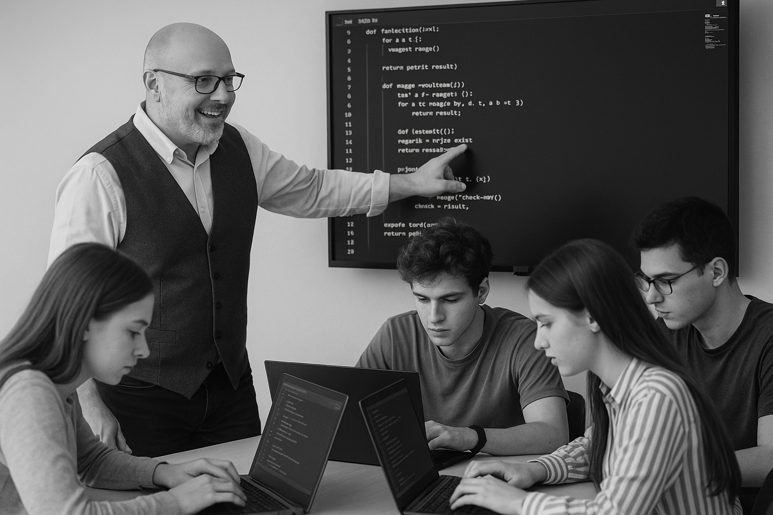
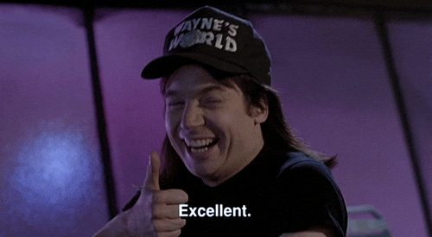





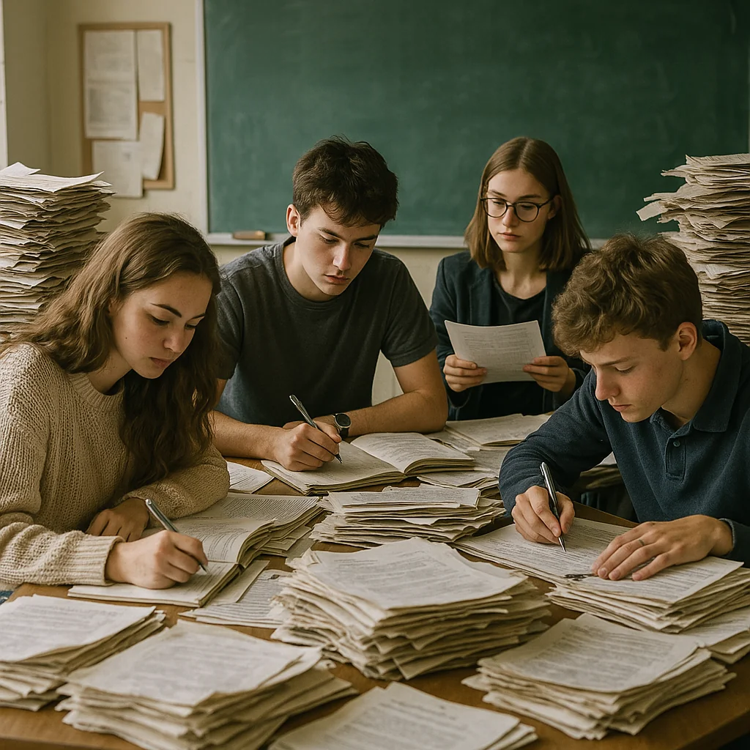

<title>
Note this down
In pairs
Working Independently
In small groups
Deadline:
Midnight before next lesson
Xmins
Do not delete this slide nor move it from the last slide in the deck

