Slide 1
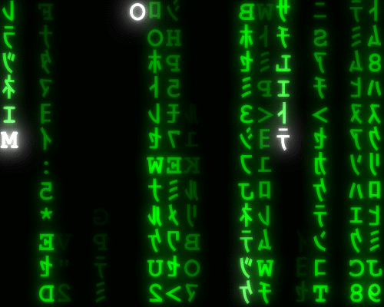
Data:
Data types & Data Storage
Lesson 02

Slide 2
Recall Quiz
https://forms.office.com/e/4NyCpYHDBA

Slide 3
Data:
Data types & Data Storage
Lesson 02

Slide 4
What elements of data do you think your smartphone collected about you before you came to class today?
Talk to your neighbour
Share some examples
Why might companies want this data?

Slide 5
Data is everywhere & everything
Note this down
The main purpose of computing is:
  To gather data
  To manipulate data
  To store data
  To retrieve data
  To report on data
By itself data is useless

Slide 6
Data vs Information
Here is some data about me:
  74
  David
  161787401
  6818
This raw data is not that useful is it?
Numbers in my Postcode

Slide 7
Data vs Information
Here is some data about me:
  74
  David
  161787401
  6818
This raw data is not that useful is it?
My Grandson’s name

Slide 8
Data vs Information
Here is some data about me:
  74
  David
  161787401
  6818
This raw data is not that useful is it?
The login of a chat app from the 1990s which closed years ago

Slide 9
Data vs Information
Here is some data about me:
  74
  David
  161787401
  6818
This raw data is not that useful is it?
The number of steps I’ve taken today

Slide 10
The most important Computer Science formula you will ever learn:
data + context = information
Note this down

Slide 11
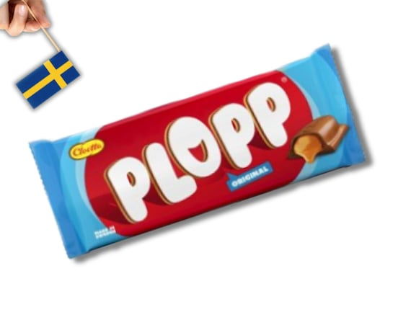
Data
is just raw numbers or letters
It requires some context to make it meaningful.
Even words are just symbols
They mean different things to different people, cultures, languages….
This is the name of a real Swedish chocolate bar

Slide 12


Context
Adds meaning
If I asked for someone to build me something 2m high…
But if they built it 2cm high…

Slide 13
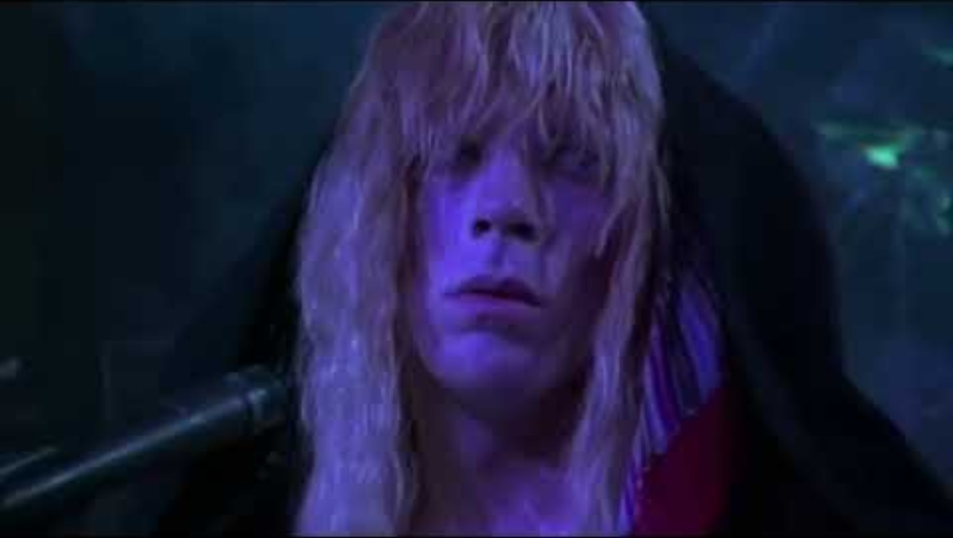

Slide 14
Context
Note this down
Context is comprised of structure and meaning
Think about dates…
01/09/2025
  In the UK this means 1st September 2025
  In the USA it means 9th January 2025
  In Japan you would write 2025-09-01
dd/mm/yyyy
mm/dd/yyyy
yyyy-mm-dd

Slide 15
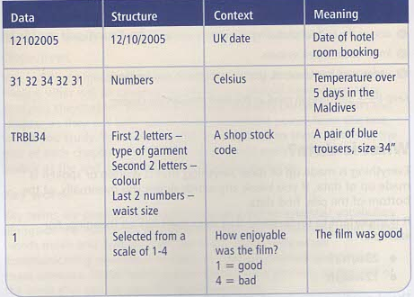
Making meaning…
Note this down

Slide 16
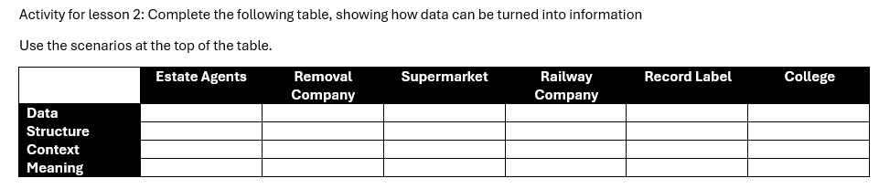
Activity
This is found in the Class Teams / Principles of Coding / Lesson 2 Activity

Slide 17
Data types
Note this down
There are FIVE key data types:
  Integer
  Floating Point (aka Real)
  String (aka Text)
  Date/Time
  Boolean

Slide 18
Note this down

Slide 19
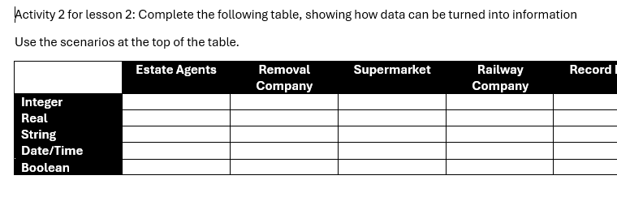
Activity 2

Slide 20
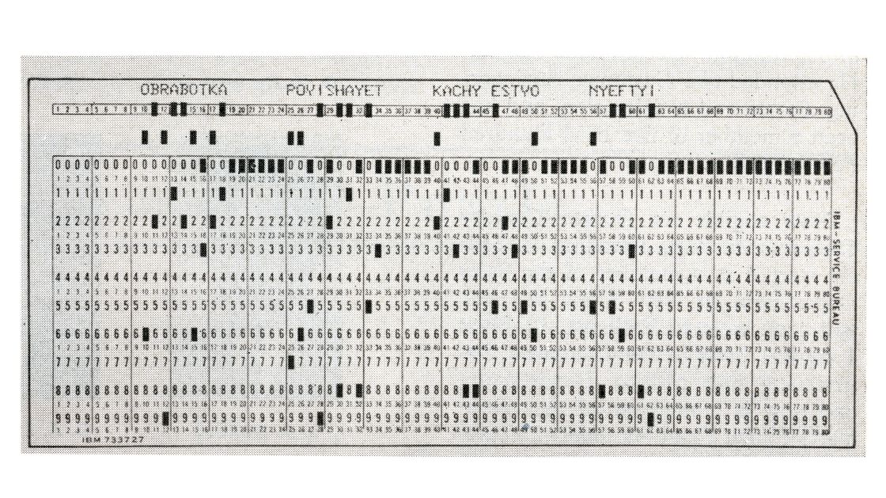
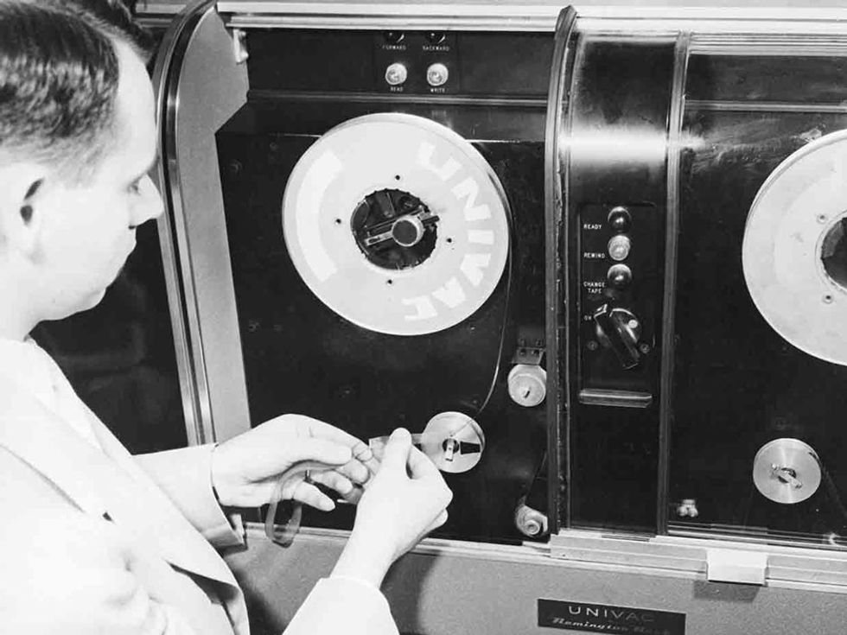
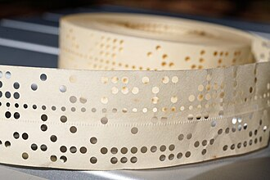
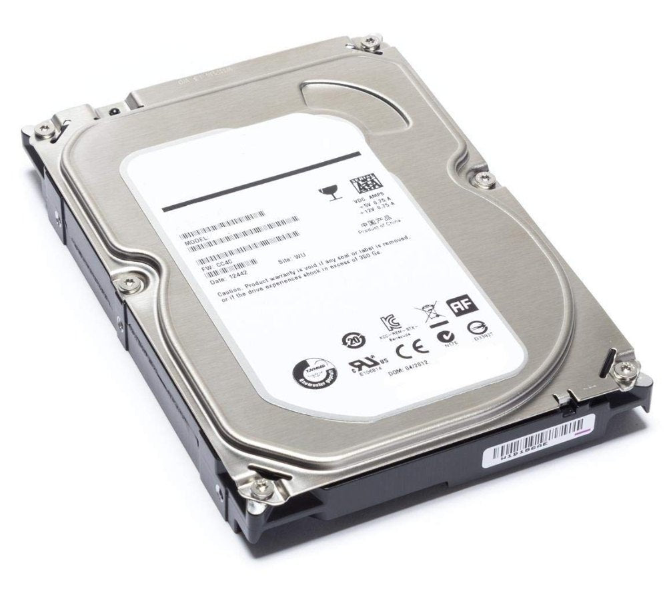
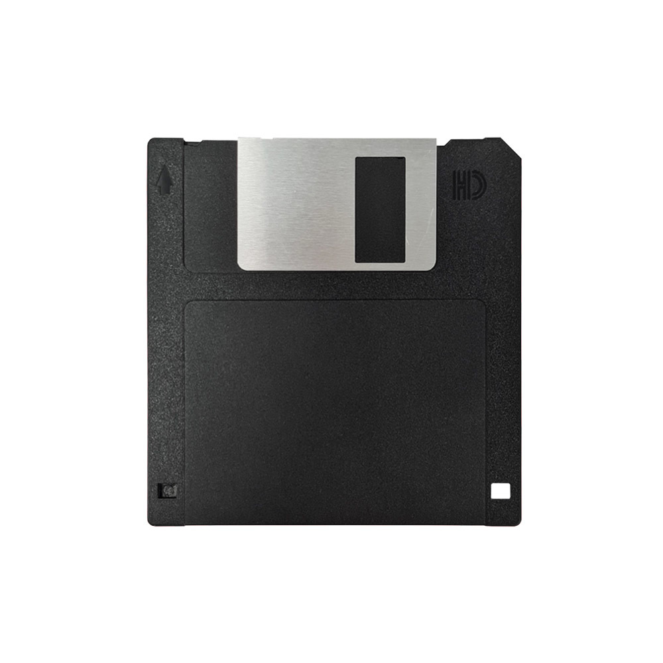
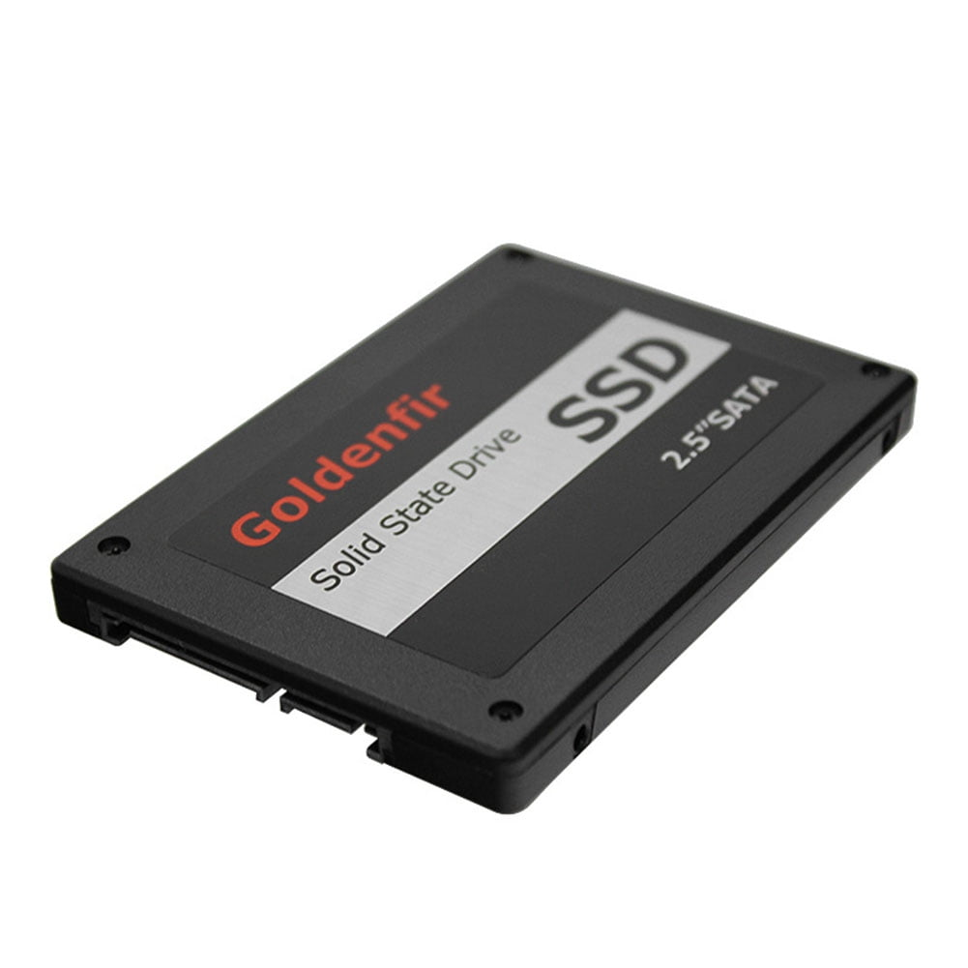
Data Storage
Some examples…
Examine these artifacts.
Think about some of their advantages and disadvantages

Slide 21
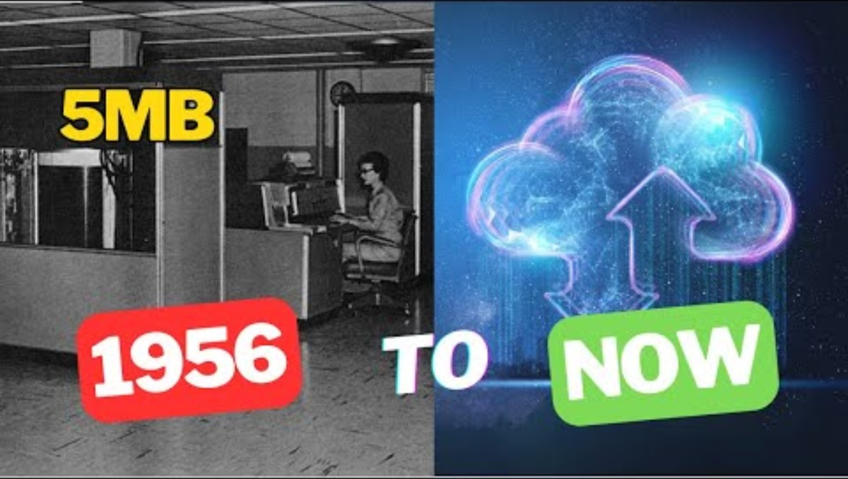

Slide 22
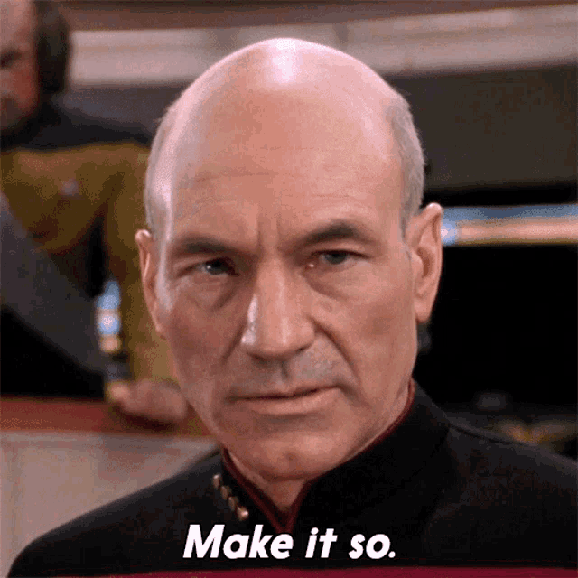
Homework
See the assignment for lesson 2 in the Class Teams
It’s a 1hr video talk, but it’s entertaining
Watch it before Midnight Friday Night
Deadline: Midnight Thursday

Slide 23
Sample Texts
True / False:
PLEASE LOG IN
PLEASE LOG IN
Do not delete this slide nor move it from the second last slide in the deck

Slide 24
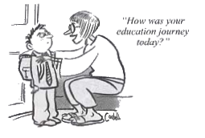










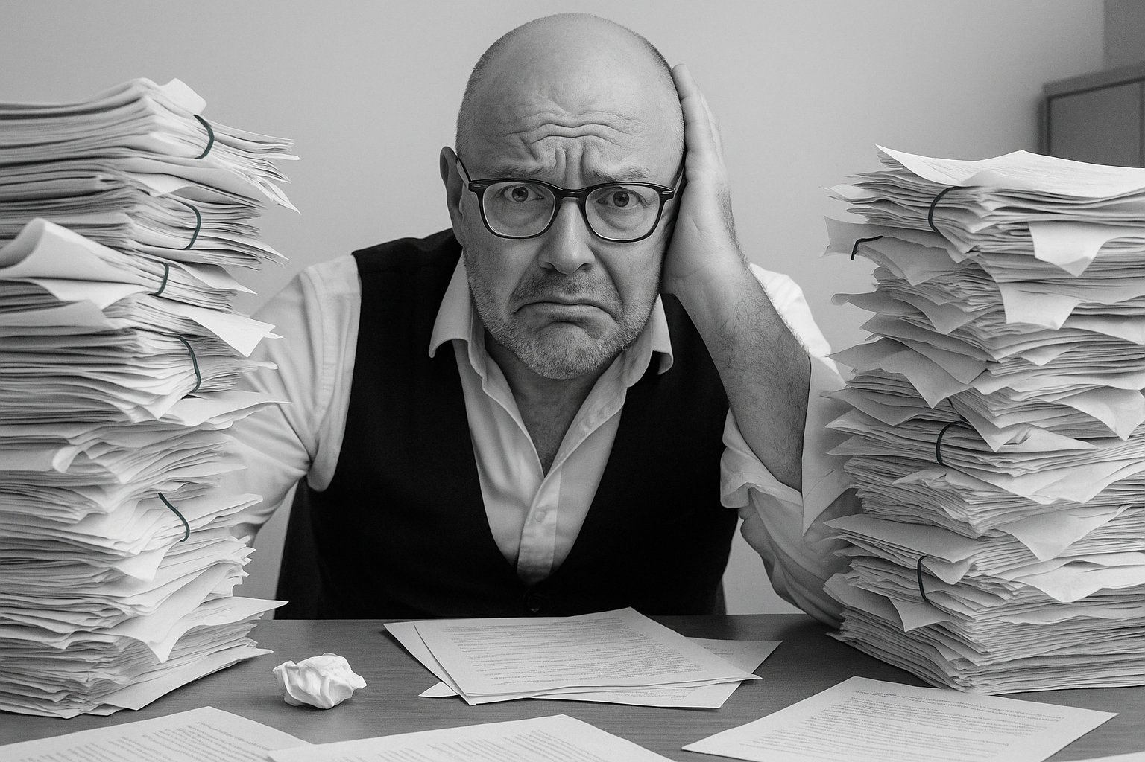

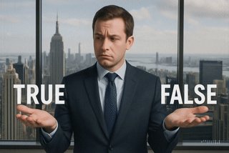

<title>
Note this down
Xmins
Do not delete this slide nor move it from the second last slide in the deck

