Slide 1

CodeMonkey
This template and PowerPoint Extensions created by
Where the magic happens
CodeMonkey Design
www.codemonkey.design
simon@codemonkey.design
+44 7976 802123

Slide 2
Understanding coding acronyms and terminology
Lesson 3

Slide 3
Recall
Visit:
https://forms.microsoft.com/e/K73QrEvkDD
to see what you remember from last lesson

Slide 4
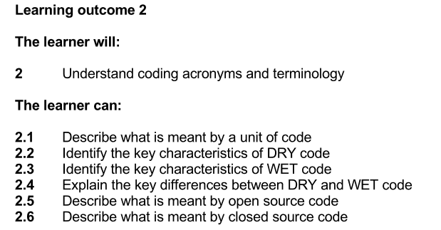

Slide 5
Acronyms and Terminology
Note this down
In IT we love our acronyms and stupid names
We especially love our acronyms which make stupid names
TWAIN: Toolkit Without An Interesting Name
GNU: GNU’s Not Unix
CPU: Central Processing Unit
RAM: Random Access Memory
Scanner drivers
This is especially special because it is recursive

Slide 6
What is meant by a unit of code?
Note this down
A unit of code is the smallest piece of code that performs a specific function.
It could be a line of code, a function, or a module depending on the context.
Think of it as a building block in a bigger program.

Slide 7
What’s the smallest “unit” in a recipe, a car, or a song?
Talk in pairs
Now share

Slide 8


A unit of code is like a Lego building block.
On its own it has shape and function…
combined
it makes something much bigger and better!

Slide 9
In your Teams Class Notebook
Note down the definition of a unit of code.
Can you think of a different analogy to illustrate it?
Write this

Slide 10
DRY Code
Note this down
Don’t
Repeat
Yourself
Key characteristics:
Reusable
Efficient
Easier to maintain
Written once, used many times

Slide 11

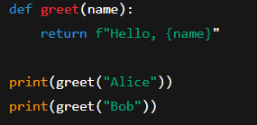
What would be wrong with this?
Note this down
vs

Slide 12
WET Code
Note this down
We
Enjoy
Typing
Key characteristics:
Repetitive
Harder to maintain
More chance of errors

Slide 13
What happens if I want to change “Hello” to “Hi”?
Note this down
You only have to change it once
Clearly:
DRY is better than WET
You’d have to change it everywhere for each line

Slide 14
Key differences between DRY and WET code
DRY code saves time, avoids duplication, and makes programs easier to update.
WET code is repetitive, wastes time, and makes maintenance harder.

Slide 15
Task: Experience the difference between DRY and WET code
In your Teams Class Notebooks:
Type “Welcome to WET Coding” down ten times
Type “Welcome to DRY Coding” and now copy and paste it ten times.
Which one was easier?
Do not use cut and paste, type it out ten whole times!

Slide 16
DRY vs WET
Note this down
Which task took longer?
Which was easier to change? (What if the phrase changed to “Hello Coders!”?)
Which was more error-prone?
DRY | WET

Slide 17
In your Teams Class Notebooks
Answer:
“What is the difference between DRY and WET Code?”
Class Notebooks
5 mins

Slide 18
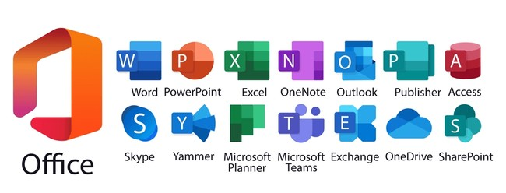

Closed Source Code
Note this down
If you weren’t at College, would Microsoft Office be free for you to use?
It is a commercial, paid product
In fact: even if you have paid money for it, you don’t own it
You only own a licence to be able to use it
This is Closed Source Code
Why might a company want to keep its code closed?
Good job the College pays for you to have a Microsoft Office licence whilst you study here!

Slide 19
But there are other forms of Licence:
Note this down
Open Source Code makes the code available to the public
Sometimes that is completely without limit
Sometimes there are limits and expectations that if you modify the code, you share it with the software community.
Good examples are:
The Linux Operating System
The Python Programming Language
VLC Media Player
GNU is an example
MIT, Apache licenses

Slide 20

Open Source
Note this down
Open Source can be changed by anybody for their own use
People work on this often for their own enjoyment
They can submit their work to the maintainers of the code who can approve it to become part of the main software
Maintainers do it for nothing in their own spare time, so changes can be slow in being released
There is no commercial pressure to innovate.

Slide 21
Research and Homework
Deadline:
Midnight Tuesday
Create a Word document and research and answer these five questions:
What is a unit of code?
Which is better for maintainability: DRY or WET code? Why?
Give an example of a DRY coding practice.
What is the main difference between open source and closed source software?
Give one example of open source software and one of closed source software.

Slide 22
Sample Texts
True / False:
PLEASE LOG IN
PLEASE LOG IN
Do not delete this slide nor move it from the second last slide in the deck

Slide 23













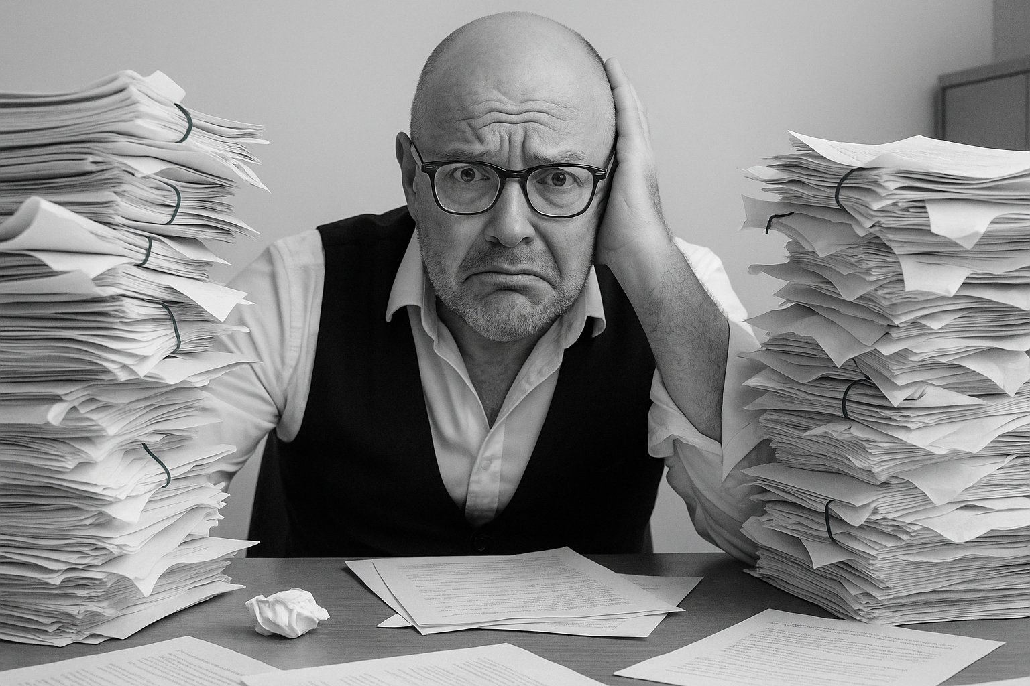



<title>
Note this down
Xmins
Do not delete this slide nor move it from the second last slide in the deck

