Slide 1
Core Coding Concepts
Lesson 5

Slide 2
Recall Quiz
Microsoft Forms Quiz:
https://forms.microsoft.com/e/b0MSFvvNA5
Also an assignment…

Slide 3
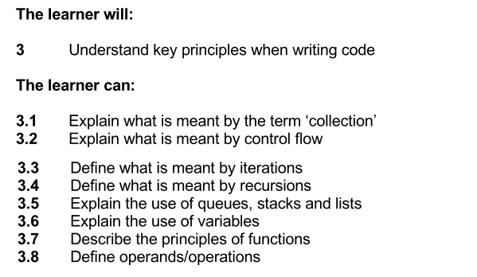
I’m not going to approach these in order, but from a more logical ground-up approach

Slide 4
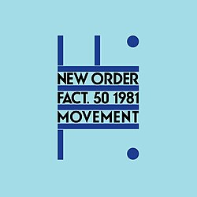
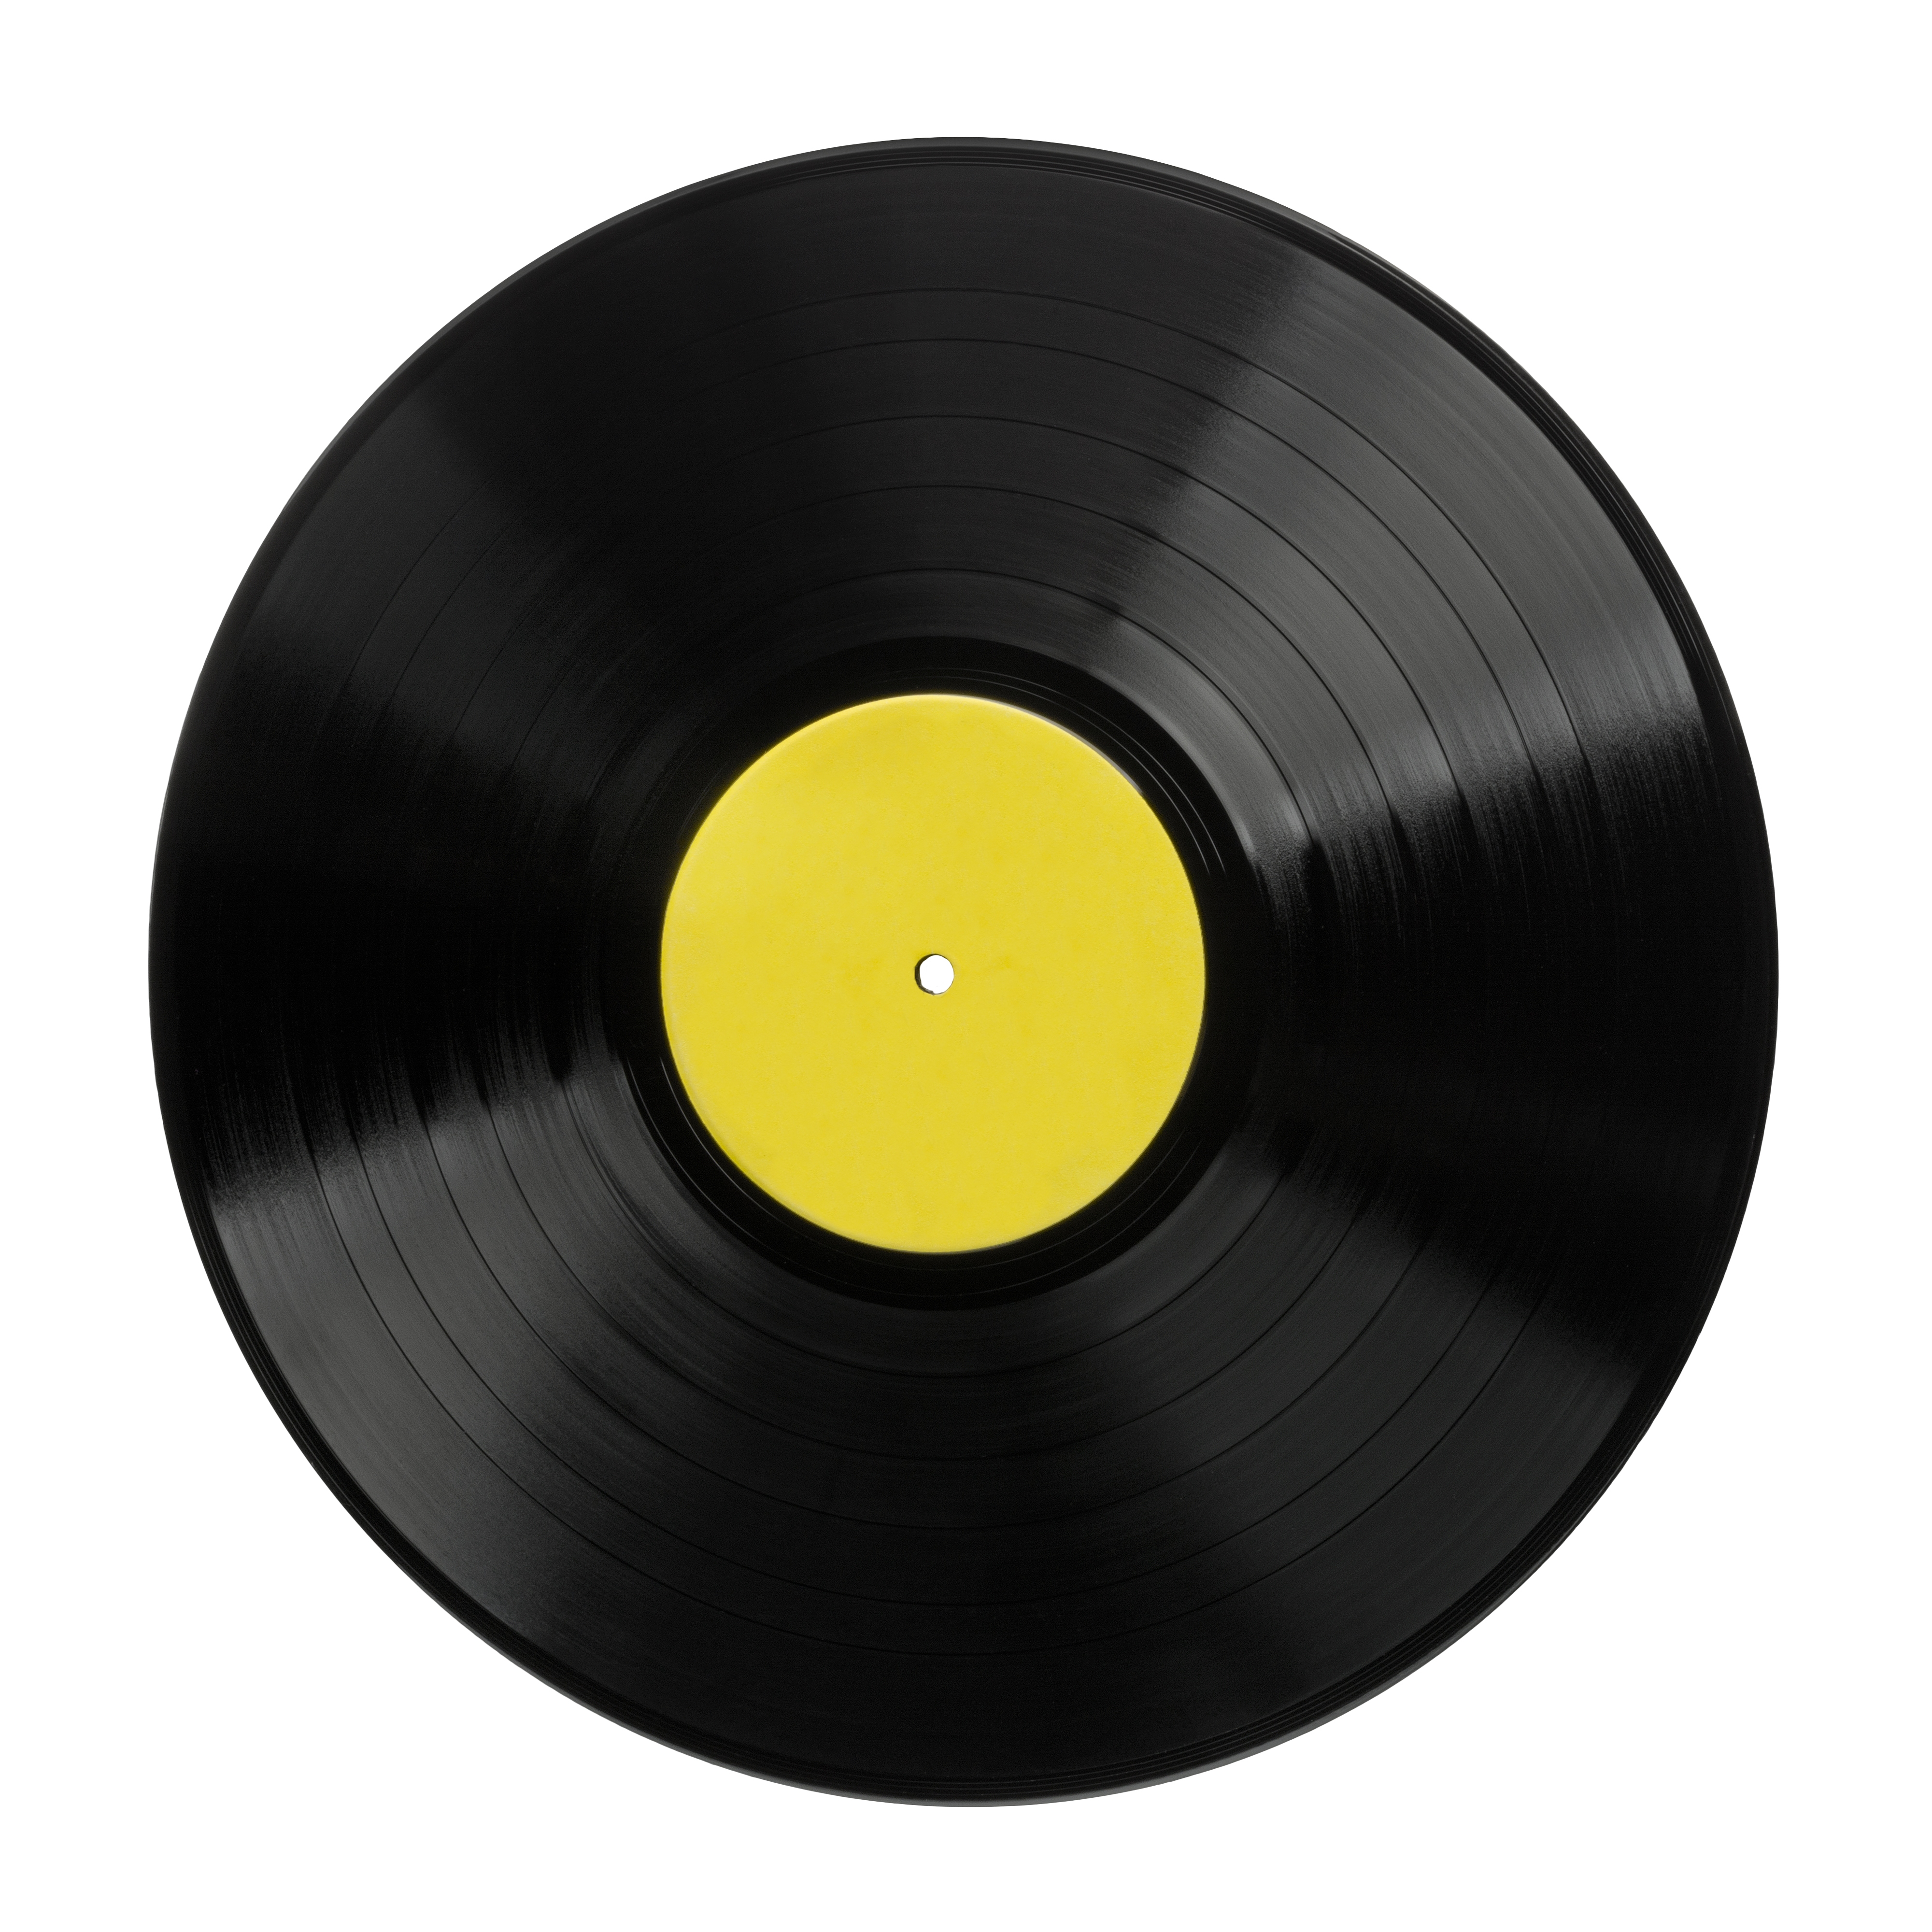
A New Order
Variables (3.6)
  Foundation of all coding — storing single pieces of data.
Operands/Operations (3.8)
  Once you can store values, you need to do something with them (maths, logic, string operations).
Functions (3.7)
  How operations and variables can be grouped into reusable blocks.
  Introduces the idea of parameters and return values.
Control Flow (3.2)
  If/Else decisions show how a program changes its path depending on conditions.
  Leads naturally into loops.
Iterations (3.3)
  Students already understand control flow; now they can loop through repeated code.
Recursion (3.4)
  A Special type of iteration using self-calling functions.
Collections (3.1)
  Arrays and lists that are “many variables in one place.”
Queues, Stacks, Lists (3.5)
  Specialised forms of collections with rules.
Notes:
Variables (3.6)
Foundation of all coding — storing single pieces of data.
Students need this before they can see why collections matter.
Operands/Operations (3.8)
Once they can store values, they need to do something with them (maths, logic, string operations).
Functions (3.7)
Show how operations and variables can be grouped into reusable blocks.
Introduces the idea of parameters and return values.
Control Flow (3.2)
If/Else decisions show how a program changes its path depending on conditions.
Leads naturally into loops.
Iterations (3.3)
Students already understand control flow; now they can loop through repeated code.
Recursion (3.4)
Special type of iteration using self-calling functions.
Best introduced after standard loops.
Collections (3.1)
Now that learners can handle variables, loops, and functions, it makes sense to group data.
Introduce arrays/lists as “many variables in one place.”
Queues, Stacks, Lists (3.5)
Specialised forms of collections with rules.
Can be linked to real-world analogies (queues at the shop, stack of plates, to-do lists).

Slide 5
Variables
Note this down
What can a Variable do?
It can vary!

Slide 6
So…
A variable is a piece of memory that the program allocates a value to.
Its value can be altered
The contents of the variable can be gathered from input
The contents of the variable can be output to the screen

Slide 7
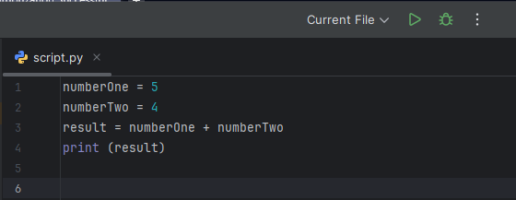
Let’s do some actual coding…
We will cover this using the Python programming language
We will use an online Python editor called Programiz
Go to https://www.programiz.com

Slide 8
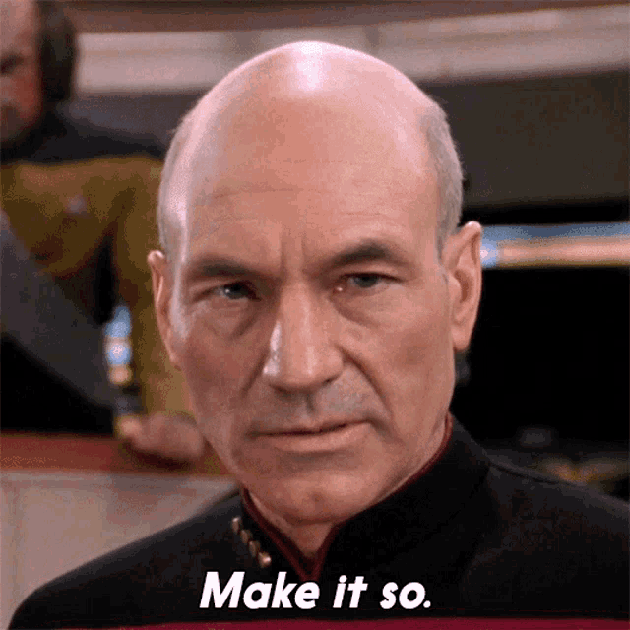
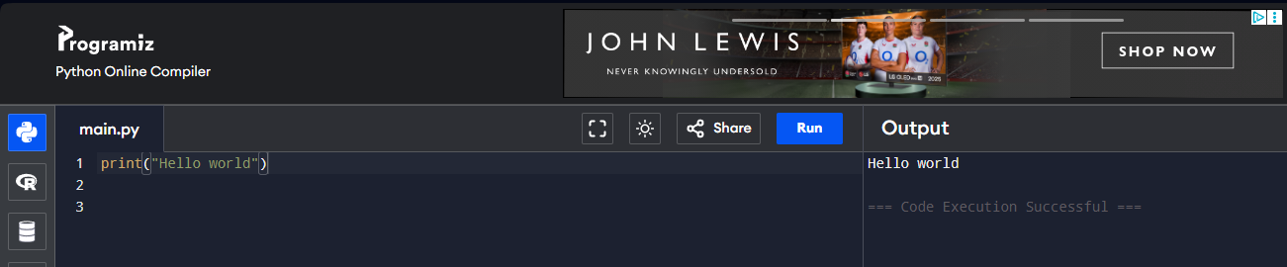
Run button
Take a screenshot and put in in your Notes. You can mark this “My First Program”

Slide 9
Data types of Variables
Note this down
There are FIVE key data types:
Variable Type | Used for | Examples
Integer | Whole numbers | 42 123001
Floating Point aka Real | Numbers with decimal points | 3.14 25.724
String aka Text | Letters and words | “Simon” “42”
DateTime | A date (optionally with time) | 15/09/2025 10:45am
Boolean | Yes/No or True/False | 0 1
Strings are always marked in “quotes”

Slide 10
Operators “Things we do to variables”
Note this down
Plus, Minus, Multiply, Divide - +-*/ all apply to numbers
We can also do some operations on Strings
“Hello” + “Simon”
…would give us “HelloSimon”
We need a space, so “Hello” + “ ” + “Simon”
This is called concatenation

Slide 11
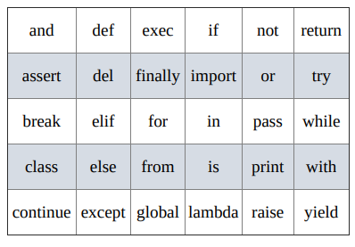
There are some words you can’t use…
…because they are reserved words for certain Python commands

Slide 12
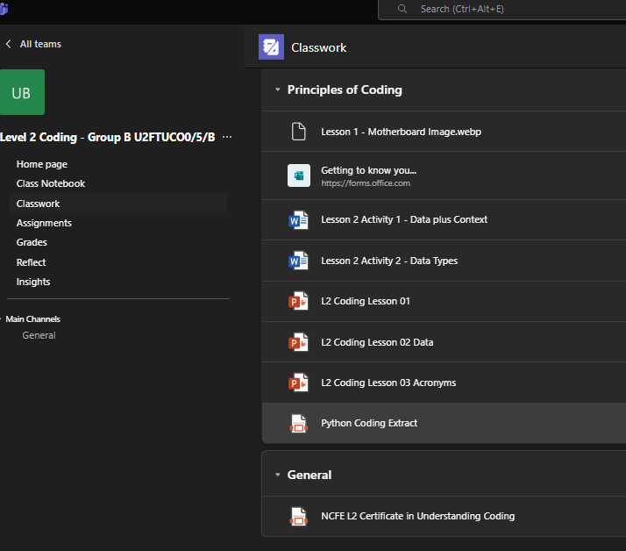
There is a resource for you
The pages from this eBook can be used to remind you

Slide 13
Two really important statements
We use these two statements a lot when doing command line coding in Python
There are similar ones in many other languages
print() ← you can tell it’s a statement because of the ()
  This prints whatever is inside the brackets to the screen
input()
  This shows what is inside the brackets as a prompt and gets input from the user’s keyboard
  We always immediately assign it to a variable
age = input(“Enter your age: “)
print(age)

Slide 14
Task
Create some programs which undertake some simple Maths operations such as addition, subtraction, multiplication and division
After each one runs correctly, take a screen shot of your source code and/or cut and paste the source code in your notebook.
You can play around with it at home or in College (Programiz is free and runs in your browser)

Slide 15
Homework
Write a Word document that outlines:
  What variables are
  How they should be named (from previous lessons)
  What operations do to those variables
  Recount the main types of variable and what they are used for
Include some screenshots of code examples if you can

Slide 16
Sample Texts
True / False:
PLEASE LOG IN
PLEASE LOG IN
Do not delete this slide nor move it from the second last slide in the deck

Slide 17
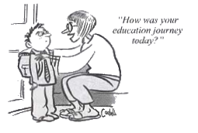







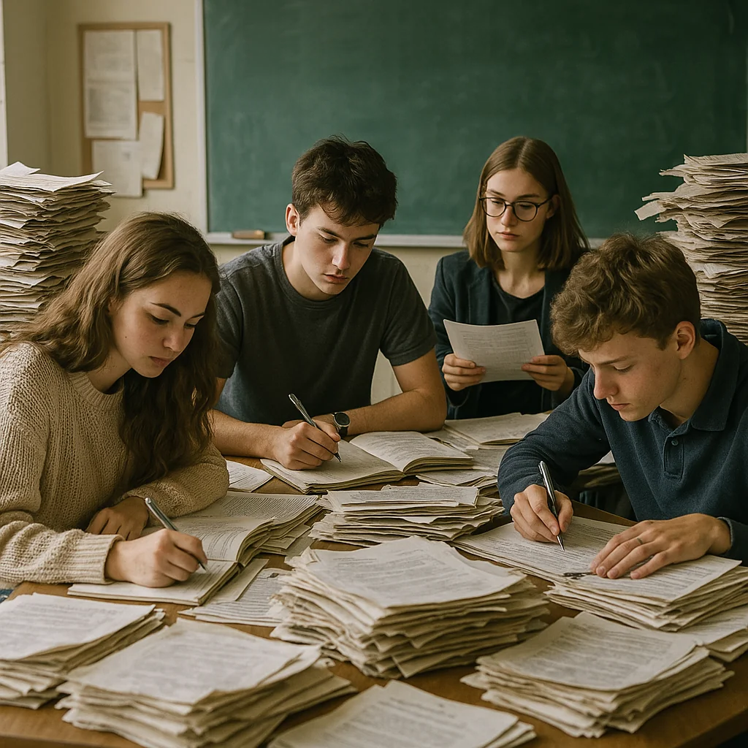


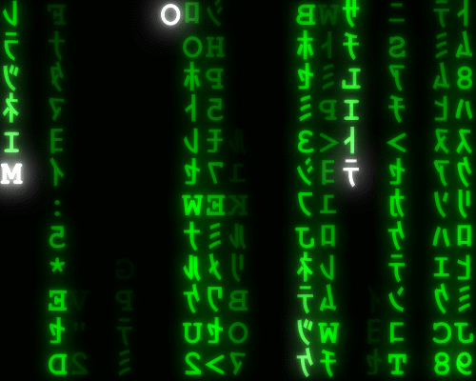
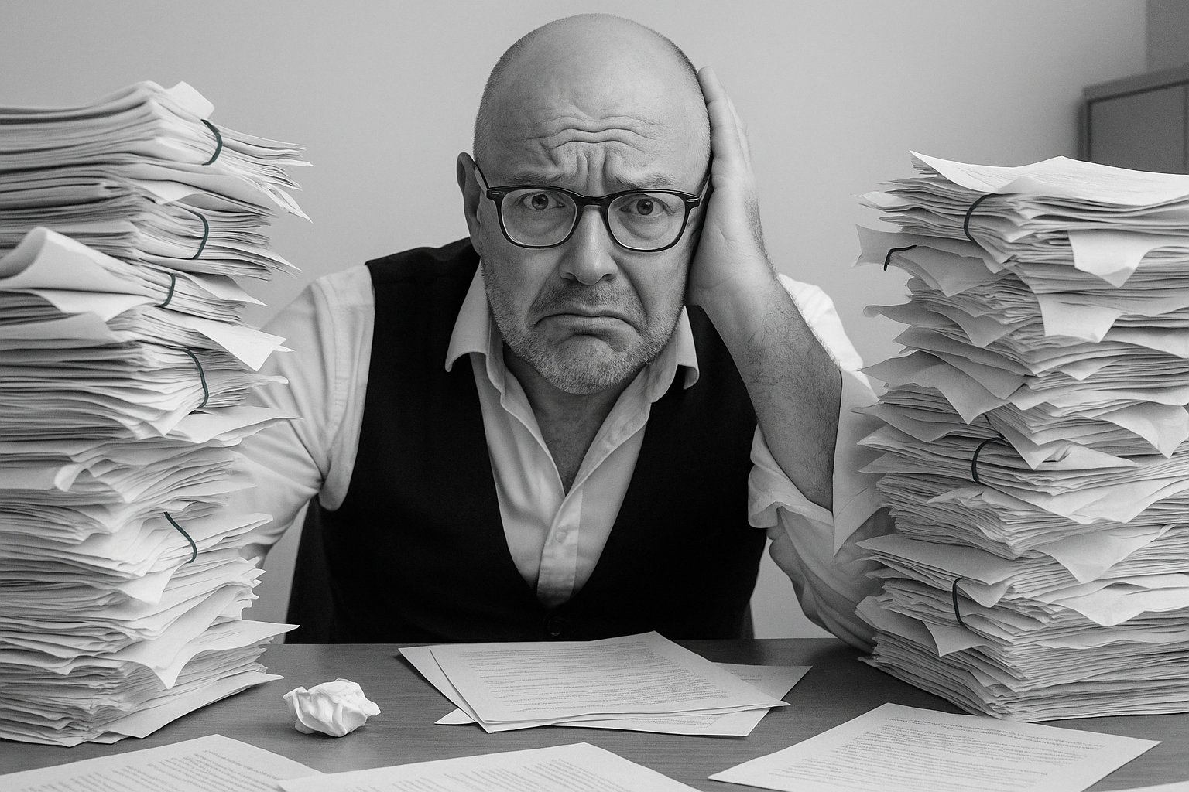

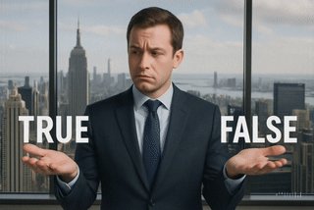
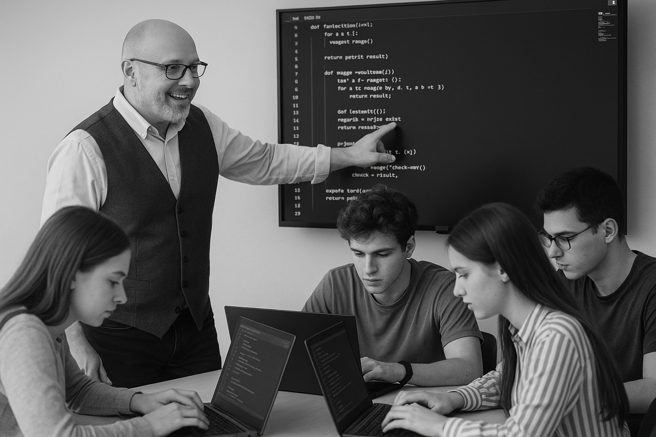
<title>
Note this down
Deadline:
Midnight before next lesson
Xmins
In small groups
Working Independently
In pairs
codeblock
Do not delete this slide nor move it from the second last slide in the deck

