Slide 1
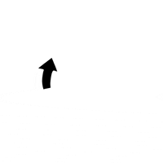
Do it again…
Lesson 8 Iterations

Slide 2
Recall from last lesson
https://forms.microsoft.com/e/eKTVrSd66R
An email should by now have arrived with the link attached.

Slide 3
Do it again…
Lesson 8 Iterations

Slide 4

Pass the handclap
Notice that this is a loop and it continues until I stop you doing it.
Let’s stand in a circle

Slide 5
So in programming…
There are lots of things that we need to do repeatedly
Sometimes that will be infinite
  Until something stops it (a condition is met)
Sometimes that will be for a set number of times
  “Repeat this 5 times”
The word Iteration means “doing it again”
Definite iteration
Indefinite iteration

Slide 6
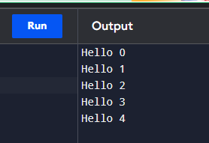
Definite iteration: the for loop
for i in range(5):
print("Hello", i)
This code prints “Hello” 5 times, numbering them 0 to 4
  …because we start counting at 0 which is a bit weird
Let’s go to programiz.com and try this code out!

Slide 7
Task
See if you can:
  Print your name out 20 times (without the number after)
  Print the numbers 1 to 20
  Print the even numbers 2 to 20
    There are a couple of ways of doing this
    One way involves changing the way the loop works (better)
    The other way involves working through all the numbers and only printing the odd numbers (slower)
Working Independently
20 mins

Slide 8


Even numbers solution
This is the slower solution:
This is the better solution:

Slide 9
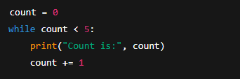
Indefinite iteration: the while loop
Let’s go to programiz.com and try this code out!
The while loop continues as long as a condition is true
You need to make sure that you update count, otherwise the loop runs forever.

Slide 10
Task
Keep asking the user for their favourite colour until they type “blue”.
Create a countdown from 10 to 1, then print “Blast off!”.

Slide 11
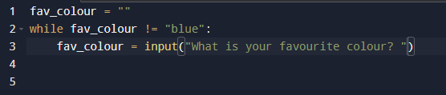
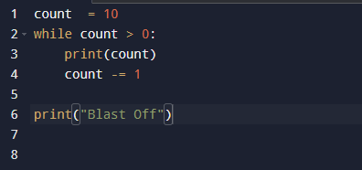
Solutions
Favourite Colour:
Countdown:

Slide 12
Which loop?
In pairs
Should this be a for or a while?
  Print the numbers 1–100.
  Keep rolling a dice until you get a 6.
  Ask the user for their password until it matches “letmein”.
  Print “Coding is fun!” 7 times.
Discuss in pairs, then code the solution in Programiz
15 mins

Slide 13
Task
Working Independently
Choose two challenges to attempt:
Print the 12 times table.
Write a guessing game: program chooses a number (use secret = 7), user keeps guessing until they get it right.
Write a program that prints all odd numbers between 1 and 50.
Write a program that asks the user to enter a password. Keep asking until they type “python”.
20 mins

Slide 14
Review
What’s the difference between for and while?
What is an infinite loop?
When would you use a for vs a while?

Slide 15
Homework
On Programiz, write and screenshot the following:
  A program that prints a multiplication table (x1–x10) for a number the user enters.
  A program that keeps asking “Do you want to quit? (y/n)” until the user enters y.
Upload screenshots of code + output.
Deadline:
Midnight before lesson next week

Slide 16
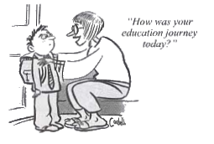







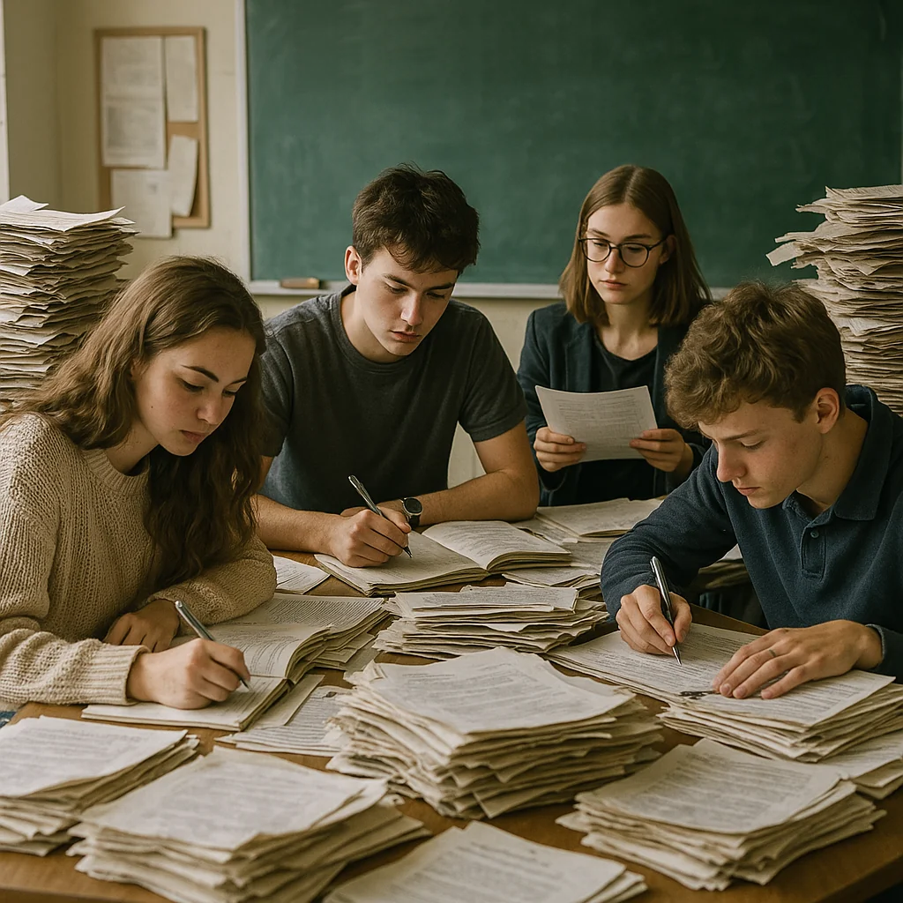


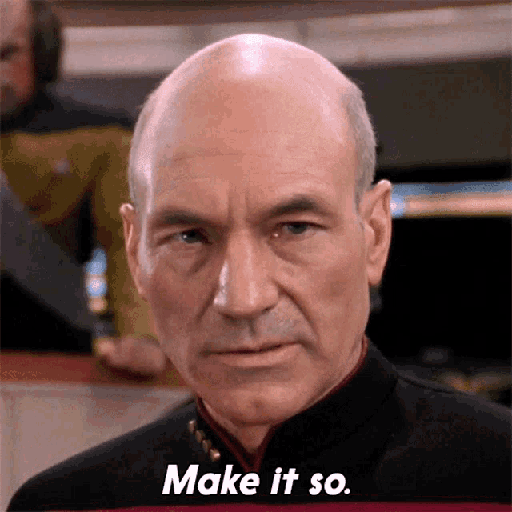
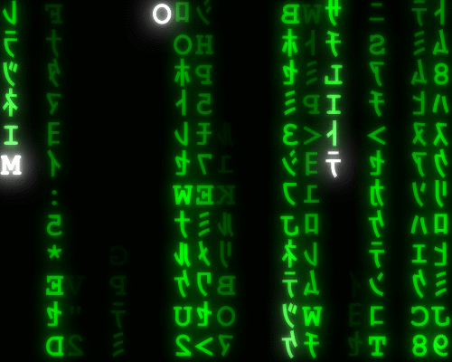
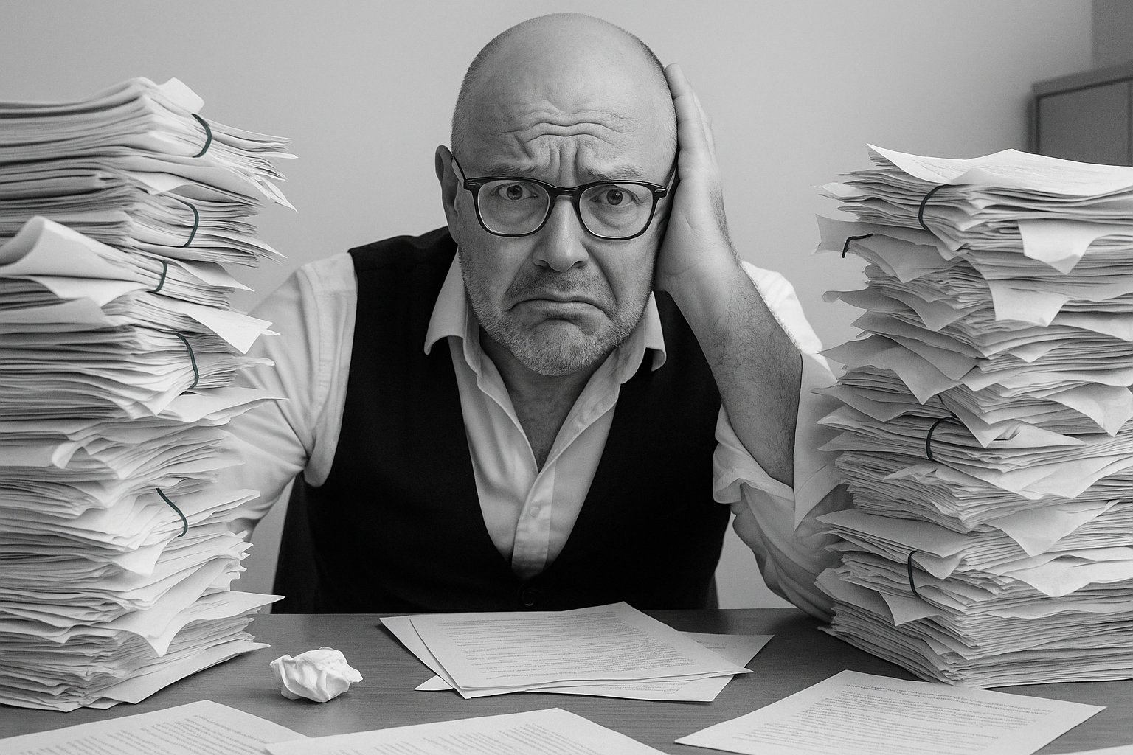
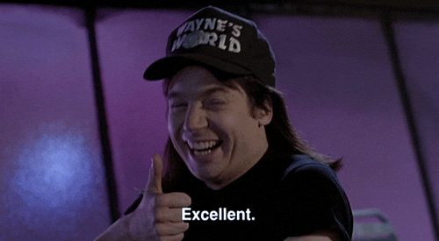
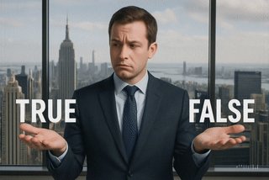
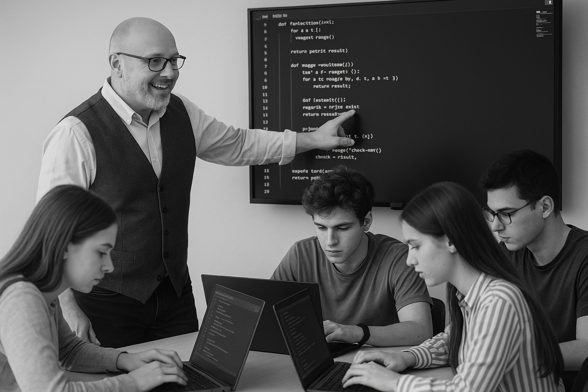
<title>
Note this down
Deadline:
Midnight before next lesson
Xmins
In small groups
Working Independently
In pairs
codeblock
Do not delete this slide nor move it from the second last slide in the deck

