Slide 1
Queues, Lists and Stacks
Lesson 11

Slide 2
Recall from last lesson
https://forms.microsoft.com/e/LYYZe1TBt9
An email should by now have arrived with the link attached.

Slide 3
Aims
To introduce the concept of queues
To go over lists, and how we use them
To explore the idea of stacks, the opposite of queues

Slide 4
Let’s recap on Arrays
An Array is the generic word for a List in Python. They are essentially the same thing.
The place of an item in a list is numbered from 0
and we refer to it in square brackets [ ]
Example: my_list[0] ← the first item in this list
my_list[-1] ← the last item in this list

Slide 5
Command | Example | Explanation
append(item) | fruits.append("pear") | Adds an item to the end of the list.
insert(index, item) | fruits.insert(1, "grape") | Inserts an item at a specific position.
extend(iterable) | fruits.extend(["mango","kiwi"]) | Adds multiple items from another list (or iterable).
remove(item) | fruits.remove("apple") | Removes the first matching item. Error if not found.
pop() | fruits.pop() | Removes and returns the last item.
pop(index) | fruits.pop(0) | Removes and returns item at a given position.
clear() | fruits.clear() | Removes all items from the list (empties it).
index(item) | fruits.index("banana") | Returns the position of the first matching item.
count(item) | fruits.count("apple") | Counts how many times an item appears.
sort() | fruits.sort() | Sorts the list in ascending order (numbers or alphabet).
sort(reverse=True) | fruits.sort(reverse=True) | Sorts the list in descending order.
reverse() | fruits.reverse() | Reverses the order of the list.
len(list) | len(fruits) | Returns the number of items in the list.
in / not in | "apple" in fruits | Checks if an item exists (returns True/False).
List slicing | fruits[1:3] | Returns part of the list (from index 1 up to but not including index 3).
List comprehension | [x*2 for x in numbers] | Creates a new list by applying an expression to each element.

Slide 6
First come, first served.
I need 5 volunteers…
My volunteers form a line.
Perhaps this is a line for the cinema.
As they queue up to buy their tickets, who do I serve first?
A queue is a good example of how we deal with things in an orderly way
The first person to arrive is the first person to be served
First come, first served or First In, First Out

Slide 7
A program deals with it in the same way
In the Source Code all instructions are handled in order
Unless our branching code changes it
One statement is processed and this is then followed by the line below.
We can also handle data in this way

Slide 8
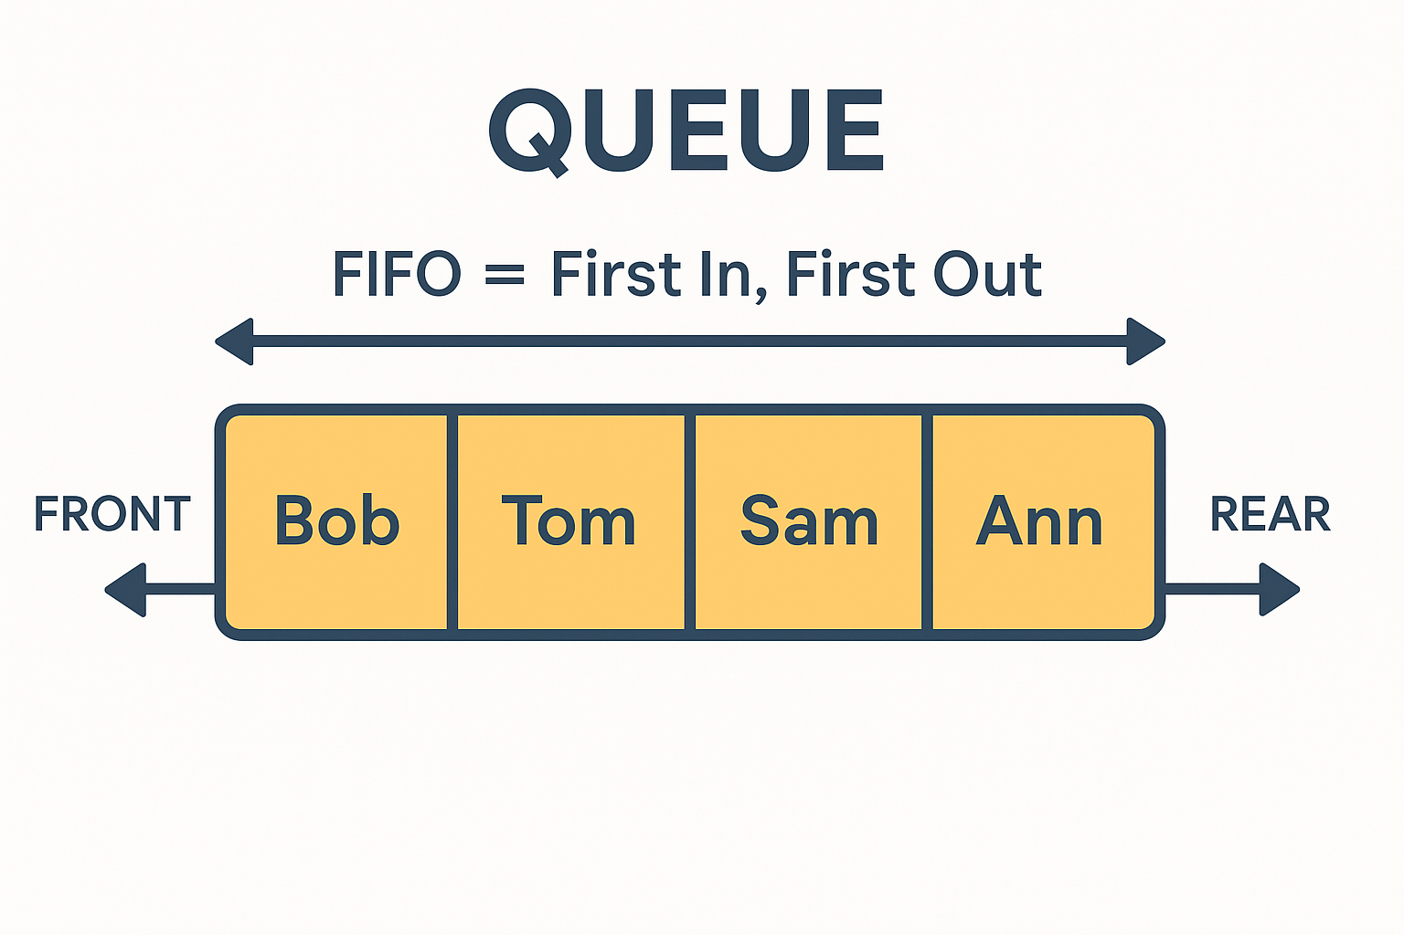
FIFO – First In, First Out
A queue works on the principle of FIFO
The item at the front of the queue is the first one to be processed
A good example would be batch processing jobs
Data Analysis
Image rendering
Sending information to peripherals

Slide 9
Coding a queue in Python
# Queue example
queue = []
queue.append("Student A")
queue.append("Student B")
queue.append("Student C")
print("Queue now:", queue)
# First in line leaves
first = queue.pop(0)
print("Removed:", first)
print("Queue after pop:", queue)
.pop(0) removes the first item in the queue

Slide 10
Task: Coding a queue
Create an empty queue
Enqueue (.append) to the queue FIVE names
Dequeue (pop(0)) the names one by one and print them
Next: do this using a for loop (if you didn’t before)
What happens when you try pop(0) on an empty queue?

Slide 11
Independent Task
Working Independently
Create a queue list.
Add 4 passenger names.
“Bus arrives”: remove 2 passengers from the front.
Print the remaining queue.
Extension: Let users input() names until they type “stop”. Then dequeue everyone until the queue is empty.
10 mins

Slide 12

Stacks
I have a lot of paperwork on my desk:
Your REACH plans,
Your homework
Memos from my boss
When a put another piece of work on the pile, it is at the top
It is the first piece of work I can get from that pile
This stack of papers are represented in computing as a Stack

Slide 13
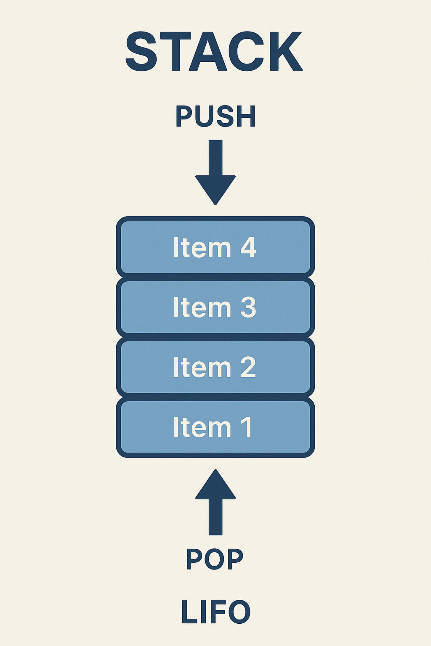
LIFO – Last In, First Out
Stacks therefore are LIFO – Last In First Out
The last item of data is the first item that I access.
This is used for:
Undo/Redo Functionality
Syntax Parsing
Reversing words or strings

Slide 14
Coding a stack
# Stack example
stack = []
stack.append("Plate 1")
stack.append("Plate 2")
stack.append("Plate 3")
print("Stack now:", stack)
# Remove the top plate
top = stack.pop()
print("Removed:", top)
print("Stack after pop:", stack)
.pop() removes the LAST item in the queue

Slide 15
Stack Task
Start with an empty stack.
Let the user type in 3 items (use input()).
Removes all the items one at a time, printing them in order.
Extension: Make the program keep asking until the stack is empty.

Slide 16
Combined Task
Working Independently
Write one program that:
Starts with a list of items.
Let the user choose:
“stack mode” (pop from the end)
OR “queue mode” (pop from the start).
Print the order items are removed.
Which data structure is better for an Undo button in Word?
Which is better for a printer job list?
20 mins

Slide 17
Homework
Deadline:
Midnight before next lesson
Part A – Stack Practice
Create an empty list called stack.
Use .append() to add 5 book titles to the stack.
Print the stack after all items are added.
Use .pop() twice to remove the top two items, printing each one as you remove it.
Print the final stack.
👉 Extension: Make the program keep removing items until the stack is empty, showing each removal.
Part B – Queue Practice
Create an empty list called queue.
Use .append() to add 5 student names to the queue.
Print the queue.
Use .pop(0) to remove and print the first student in line.
Continue until the queue is empty.
👉 Extension: Ask the user to type in names until they enter "stop". Then remove everyone from the queue one by one, printing as they leave.

Slide 18












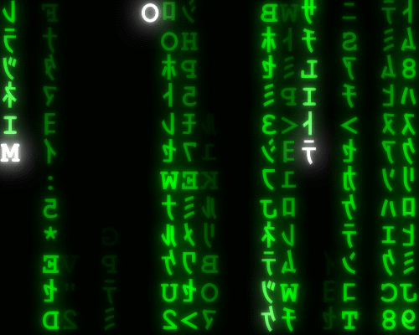


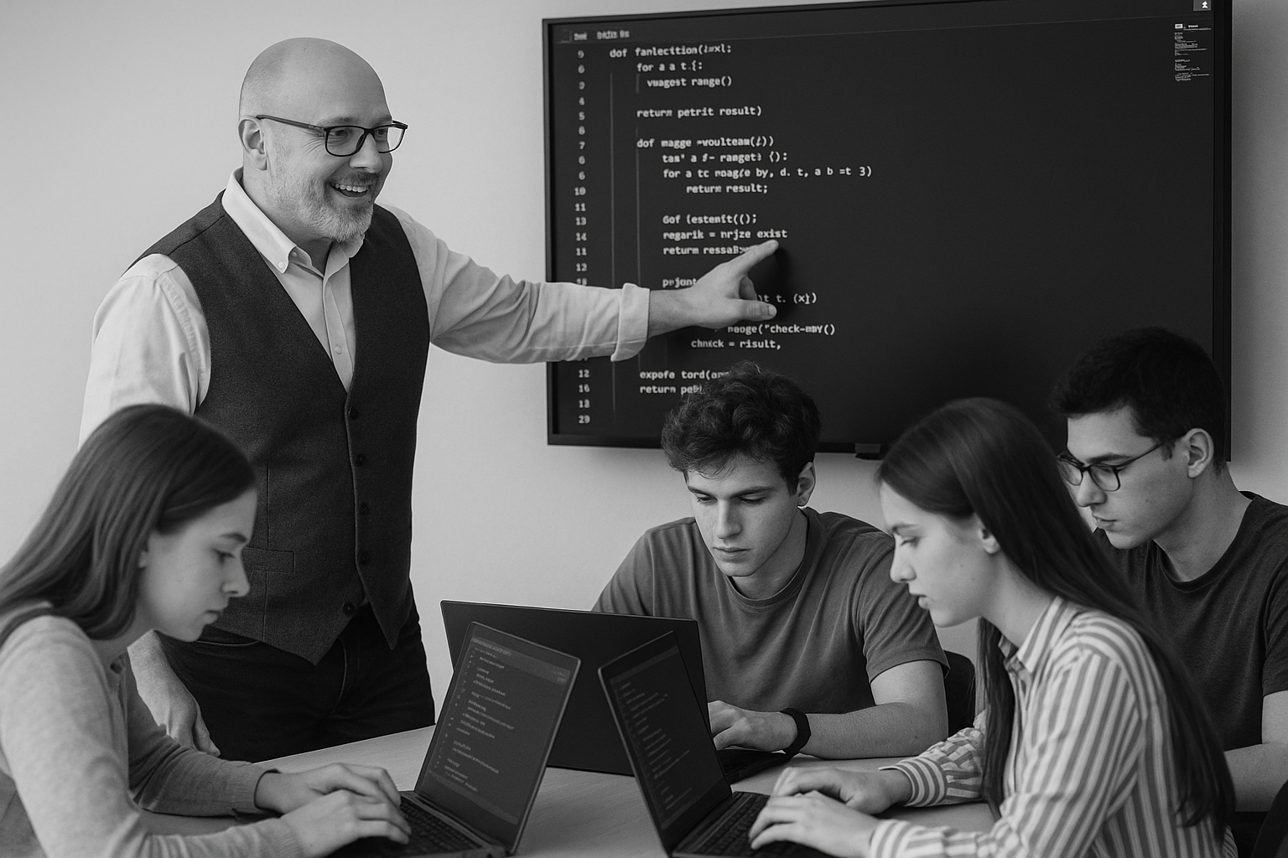
<title>
Note this down
Deadline:
Midnight before next lesson
Xmins
In small groups
Working Independently
In pairs
Do not delete this slide nor move it from the second last slide in the deck

