Slide 1
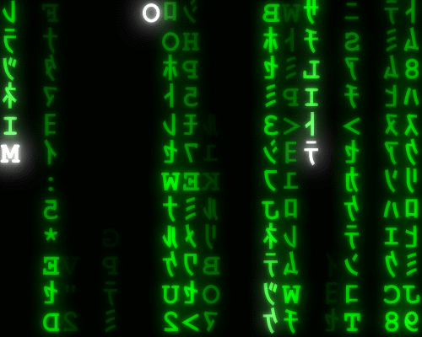
Writing Code
Lesson 4

Slide 2
Recall
Do the recall quiz based upon the last lesson
https://forms.microsoft.com/e/GpGdYAceTf

Slide 3

From the specification:

Slide 4
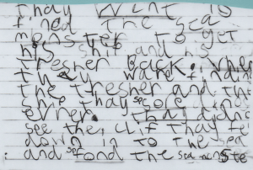
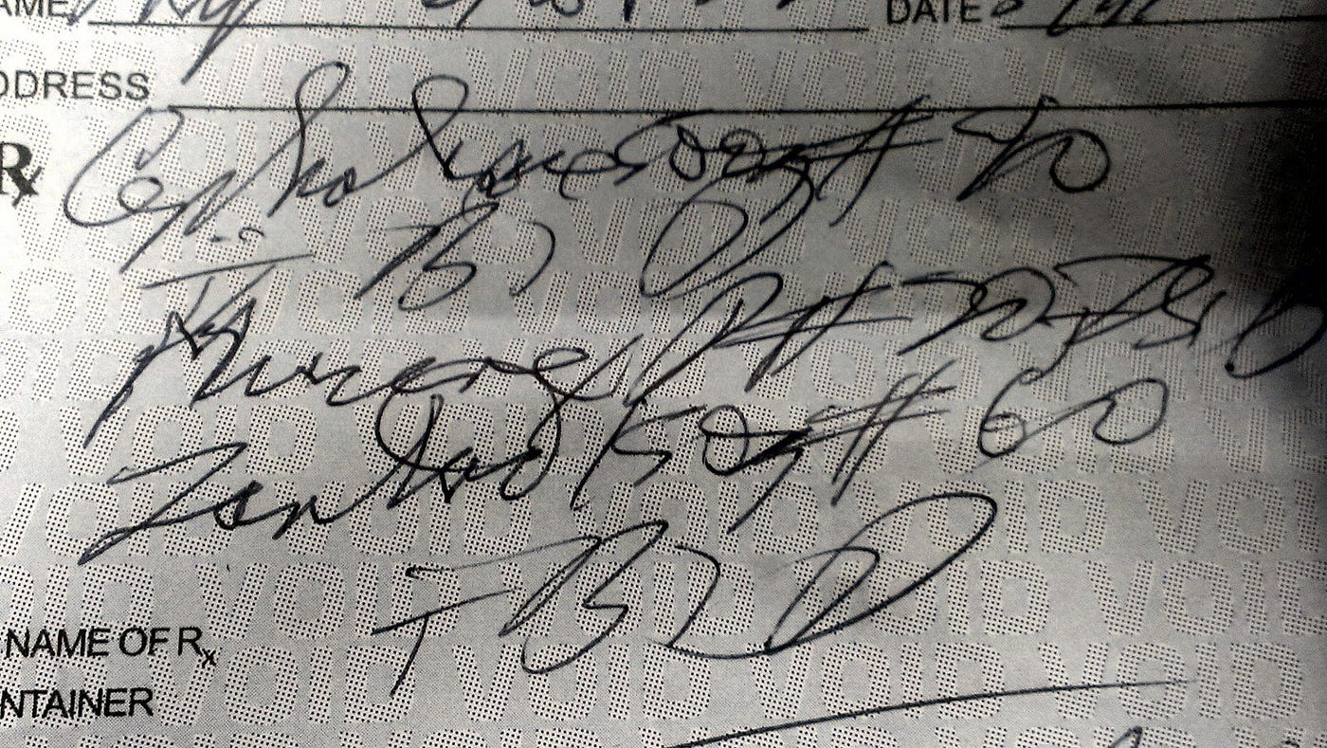
How’s your handwriting?

Slide 5
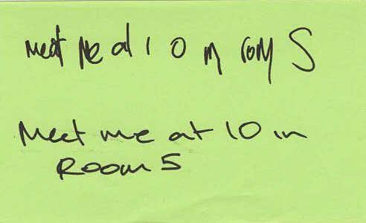
What does this message say? How confident are you that you’ve read it correctly?
What was the problem with the first version?

Slide 6
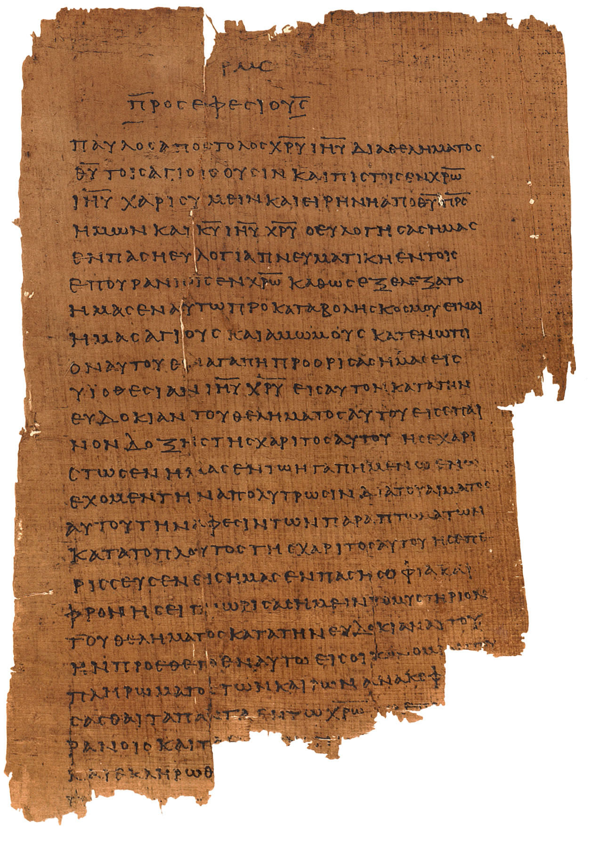
Old Manuscripts
Really difficult to read!
Manuscript P46 (175-225CE)
of Ephesians1.3

Slide 7
Old Manuscripts
Ancient Greek was written with
NOSPACESANDALLINCAPITALLETTERS
Again, what might be the problem with this?
Really difficult to read!
Manuscript P46 (175-225CE)
of Ephesians1.3

Slide 8
The same thing happens in coding.
If you don’t space things out, indent properly, or choose clear names, your code becomes like bad handwriting — difficult for others (and even yourself!) to understand.
Note this down

Slide 9
Obfuscated Code Competitions
Each year there are competitions for developer to produce the most incomprehensible yet working code
There are competitions in Perl, C and Brainf***
The winners are completely baffling!
B,i,y,u,b,I[411],*G=I,x=10,z=15,M=1e4;X(w,c,h,e,S,s){int t,o,L,E,d,O=e,N=-M*M,K
=78-h<<x,p,*g,n,*m,A,q,r,C,J,a=y?-x:x;y^=8;G++;d=w||s&&s>=h&&v 0,0)>M;do{_ o=I[
p=O]){q=o&z^y _ q<7){A=q--&2?8:4;C=o-9&z?q["& .$ "]:42;do{r=I[p+=C[l]-64]_!w|p
==w){g=q|p+a-S?0:I+S _!r&(q|A<3||g)||(r+1&z^y)>9&&q|A>2){_ m=!(r-2&7))P G[1]=O,
K;J=n=o&z;E=I[p-a]&z;t=q|E-7?n:(n+=2,6^y);Z n<=t){L=r?l[r&7]*9-189-h-q:0 _ s)L
+=(1-q?l[p/x+5]-l[O/x+5]+l[p%x+6]*-~!q-l[O%x+6]+o/16*8:!!m*9)+(q?0:!(I[p-1]^n)+
!(I[p+1]^n)+l[n&7]*9-386+!!g*99+(A<2))+!(E^y^9)_ s>h||1<s&s==h&&L>z|d){p[I]=n,O
[I]=m?*g=*m,*m=0:g?*g=0:0;L-=X(s>h|d?0:p,L-N,h+1,G[1],J=q|A>1?0:p,s)_!(h||s-1|B
-O|i-n|p-b|L<-M))P y^=8,u=J;J=q-1|A<7||m||!s|d|r|o<z||v 0,0)>M;O[I]=o;p[I]=r;m?
*m=*g,*g=0:g?*g=9^y:0;}_ L>N){*G=O _ s>1){_ h&&c-L<0)P L _!h)i=n,B=O,b=p;}N=L;}
n+=J||(g=I+p,m=p<O?g-3:g+2,*m<z|m[O-p]||I[p+=p-O]);}}}}Z!r&q>2||(p=O,q|A>2|o>z&
!r&&++C*--A));}}}Z++O>98?O=20:e-O);P N+M*M&&N>-K+1924|d?N:0;}main(){Z++B<121)*G
++=B/x%x<2|B%x<2?7:B/x&4?0:*l++&31;Z B=19){Z B++<99)putchar(B%x?l[B[I]|16]:x)_
x-(B=F)){i=I[B+=(x-F)*x]&z;b=F;b+=(x-F)*x;Z x-(*G=F))i=*G^8^y;}else v u,5);v u,
1);}}
This is a working chess program in C!

Slide 10
“Hello World” in Brainf***
++++++++[>++++[>++>+++>+++>+<<<<-]>+>+>->>+[<]<-]>>.>---.+++++++..+++.>>.<-.<.+++.------.--------.>>+.>++.
undef $/;open(_,$0);/ \dx([\dA-F]*)/while(<_>);@&=split(//,$1);@/=@&;
$".=chr(hex(join("",splice(@&,0,2))))while(@&); eval$”;
($C,$_,@\)=(($a=$/[1]*4)*5+1, q| |x(0x20).q|\||.chr(32)x(0x10).q$*$.
chr(0x20)x(0x10).(pack("CC",124,10)), sub{s/.\|(\s*?)(\S)./\|$1 $2/},
sub{s/\|(\s*?).(\S)/ \|$1$2 /}, sub{$2.$1.$3},sub{$tt=(3*$tt+7)%$C},
sub{$1.$3.$2});
while ($_) {
select $/, undef, $/, $C/1E3;
(sysread(STDIN, $k, 1),s/(.)(\*)(.)/(&{$\[(ord($k)-44&2)+2]})/e)
if (select($a=chr(1),$/,$/,0));
print 0x75736520504F5349583B2024743D6E657720504F5349583A3A5465726D696F73
3B24742D3E676574617474722828303D3E2A5F3D5C2423292F32293B2024742D3E
365746C666C61672824742D3E6765746C666C6167267E284543484F7C4543484F4
7C4943414E4F4E29293B2024742D3E7365746363285654494D452C31293B24742D
E7365746174747228302C544353414E4F57293B24643D224352415348215C6E223B0A;
($p?(/.{70}\|$/):(/^\|/))||(&{$\[3]}<$/[0])?($p=!$p):&{$\[$p]}||die("$d");
(&{$\[3]}<$/[1])&&(s/ \|$/\|/);
(/\|.*\*.*\|$/)||die("$d");
}
A skiing game in Perl

Slide 11
Layout and naming matters
If only you can read your code, then it is a terrible program
All code should be written with readability and comprehension in mind
The work you have done in planning your design should be reflected in how you lay out and name your code.

Slide 12
Layout
Note this down
Spaces are your friend (Tabs if you are writing Python)
Indentation matters (especially in Python)
White space costs nothing!

Slide 13
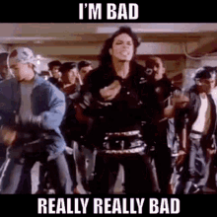
Bad:
function c(a,b){return a+b}let x=10;let y=20;console.log(c(x,y));

Slide 14

Good:
// Add two numbers together
function addNumbers(firstNumber, secondNumber) {
return firstNumber + secondNumber;
}
let numberOne = 10;
let numberTwo = 20;
console.log(addNumbers(numberOne, numberTwo));
JavaScript

Slide 15
Naming Conventions
We will be covering what these things actually are over the next few lessons/weeks
…but I want to talk about naming things.
It is a common mistake to forget that because Mathematics and Physics are not the only uses of Computing, we don’t have to use Algebra in our naming conventions.
Some programmers still use x, y, z and i as names of variables

Slide 16
Names should have meaning…
Snake Case
tells us what it is for
Far clearer than
simply x,y,I,j
record_count
recordCount
RecordCount
intRecordCount
camelCase
PascalCase
Hungarian Notation
tells us it is an integer as well as what it is for

Slide 17
Variable Naming Conventions
Note this down
Convention | Example | Where Used | Notes
snake_case | record_count | Python, file names, databases | All lowercase, words separated by underscores. Easy to read.
camelCase | recordCount | JavaScript, Java, C#, many languages | First word lowercase, following words capitalised. Common in variables.
PascalCase | RecordCount | C#, Java, .NET classes, some constants | Every word capitalised. Often used for classes, objects, or functions.
Hungarian notation | intRecordCount, strAnswer | Older Microsoft code, VBA, legacy C/C++ | Prefix shows type or purpose (e.g. int = integer, str = string). Rarer in modern coding.

Slide 18
Task: fix the variable names
Note this down
Below are some poorly named variables. Your job is to rewrite them using each of the four naming conventions:
let A1 = 15;
let Youranswer = "Yes";
let COUNTREC = 42;
Which convention feels cleares?
Why do teams benefit from consistency?
Instructions:
Rewrite each variable in snake_case.
Rewrite each variable in camelCase.
Rewrite each variable in PascalCase.
Rewrite each variable in Hungarian notation.
5 mins

Slide 19
Homework: Lesson 4
Task 1 – Fix the formatting (5 mins)
The following JavaScript is poorly laid out and has confusing names:
function d(a,b){return a*b}let x=5;let y=12;console.log(d(x,y));
Rewrite it so that:
It uses clear indentation and whitespace.
It has meaningful variable and function names.
Task 2 – Variable naming practice (5–10 mins)
Rewrite the following variable in all the four conventions we have explored so far:
totalmarks
Extension (optional)
Write one sentence explaining why consistent naming and layout are important when working in a coding team.
Deadline: Midnight Weds

Slide 20
Sample Texts
True / False:
PLEASE LOG IN
PLEASE LOG IN
Do not delete this slide nor move it from the second last slide in the deck

Slide 21















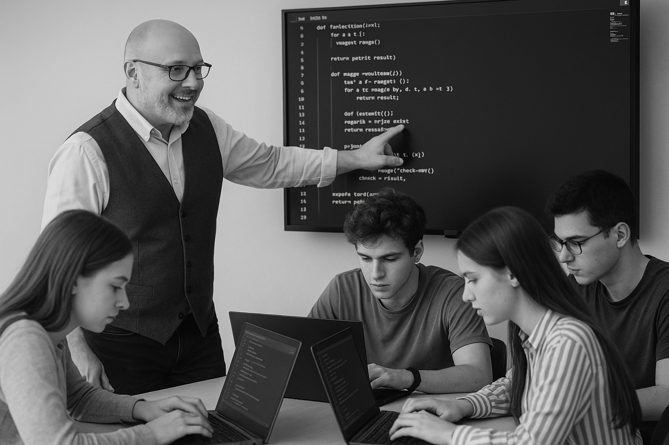
<title>
Note this down
Xmins
Do not delete this slide nor move it from the second last slide in the deck

