Slide 1

Collections
Lesson 10

Slide 2
Recall from last lesson
https://forms.microsoft.com/e/4CA6hdcSbV
An email should by now have arrived with the link attached.

Slide 3
Collections
Lesson 10

Slide 4
Learning Objectives
By the end of this lesson, students will be able to:
Define what is meant by a “collection” in coding.
Recognise the difference between individual variables and collections.
Understand and use arrays/lists in Python.
Apply arrays/lists to small coding tasks.

Slide 5
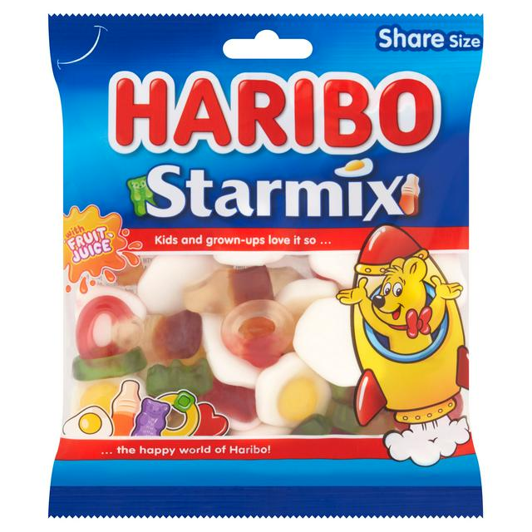
Collections
Note this down
If I had one sweet, I’d need one variable.
…what if I had 50 sweets?
Each sweet is a thing in itself, but the bag is a Collection of sweets
A Collection is a data structure which holds multiple items under one name

Slide 6
Arrays and Lists
Variables:
sweet1
sweet2
sweet3
Array/List:
sweets = [ ]
Array
  Fixed size
  Of the same type of data
List
  Dynamic size
  Can hold difference types of data

Slide 7
Python list syntax
fruits = ["apple", "banana", "cherry"]
print(fruits[0]) # apple
print(fruits[1]) # banana
We can refer to an item in a Collection by the order in which it appears
…but (confusingly) the numbering starts at 0 (zero)!
Let’s look at this in Programiz!

Slide 8
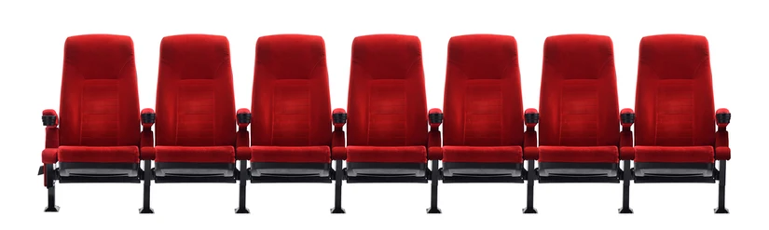
Cinema Seats
Arrays/Lists always start at [0]

Slide 9
In Programiz we will:
15 mins
Create a list.
Access elements with indexes
Add items with .append()
Remove items with .remove()
Show length with len()

Slide 10
Task
Colours, bands, video games, meals, I don’t mind
Working Independently
Make a list of 5 colours and print the 2nd colour.
Add a new colour.
Print the total number of colours.
Remove a colour.
Print the updated list.
15 mins

Slide 11
Extension Task
Write a Python program that:
Creates a list of 5 shopping items.
Prints each item in the list.
Adds 2 more items.
Removes 1 item.
Prints the final list with the number of items.
Working Independently
15 mins

Slide 12
Wrap-Up
What is a collection in programming?
Why are lists useful?

Slide 13
Homework
Write a Python program that stores your top 5 favourite films in a list. Print them one by one in a formatted message, e.g. “One of my favourite films is …”
Extension:
Have a number of different prompts depending what number or type of number it is, using if/elif statements

Slide 14
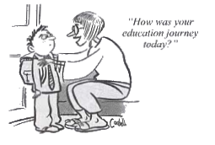







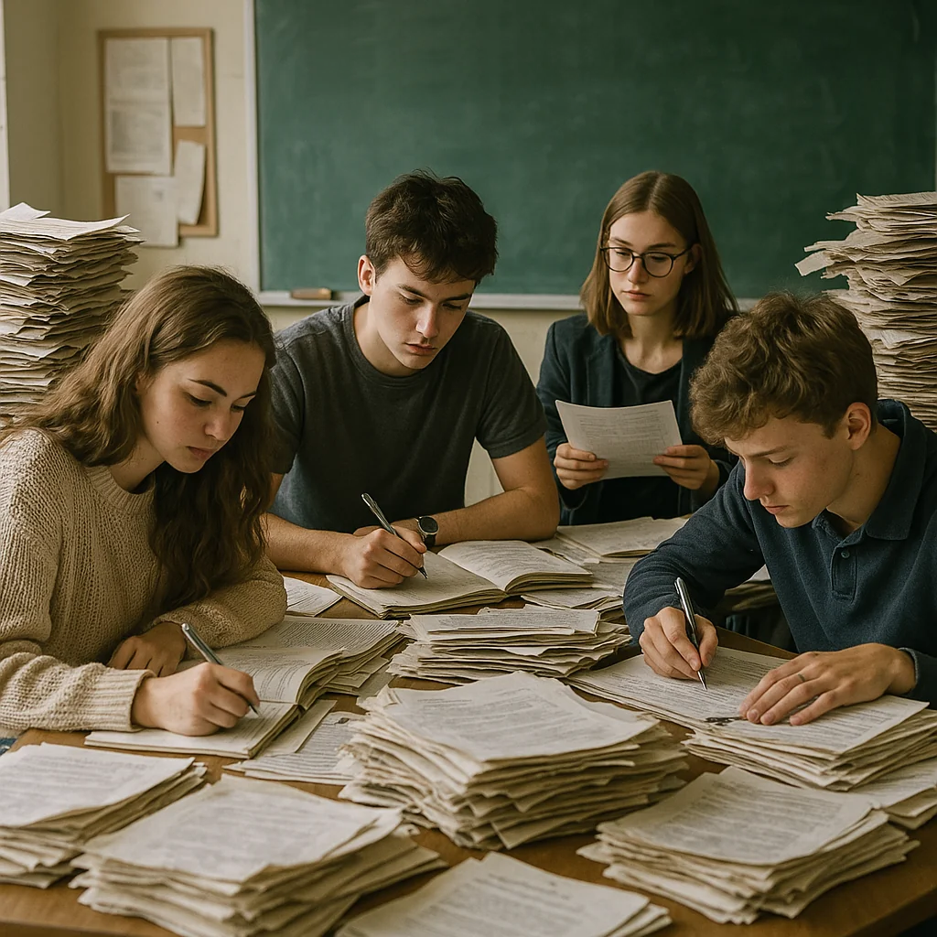



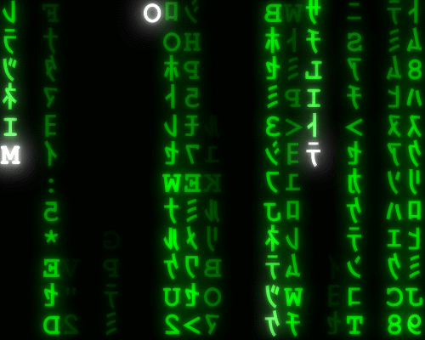
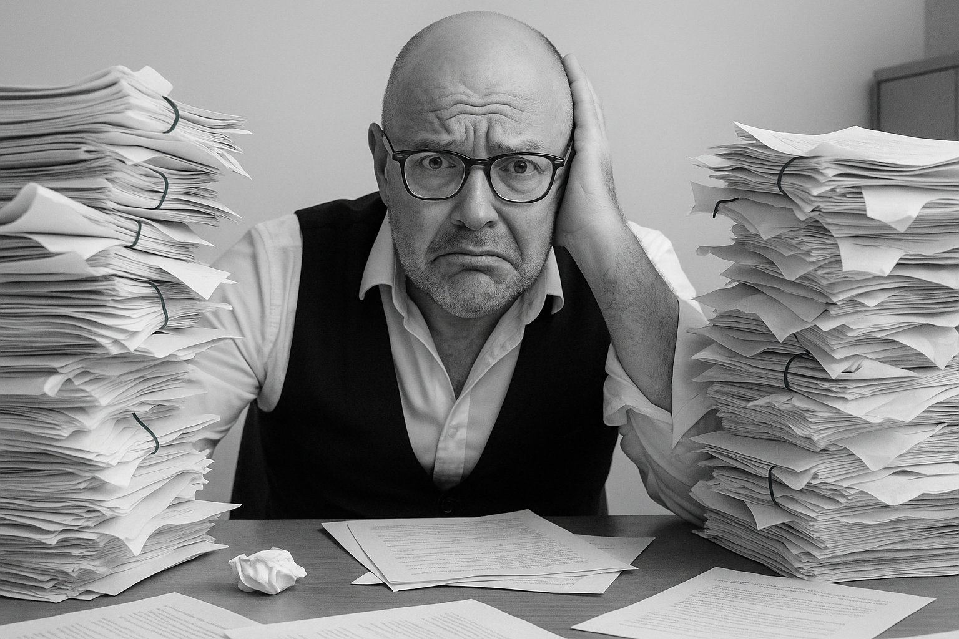

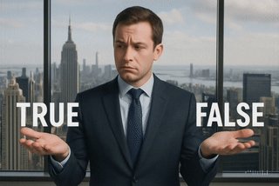
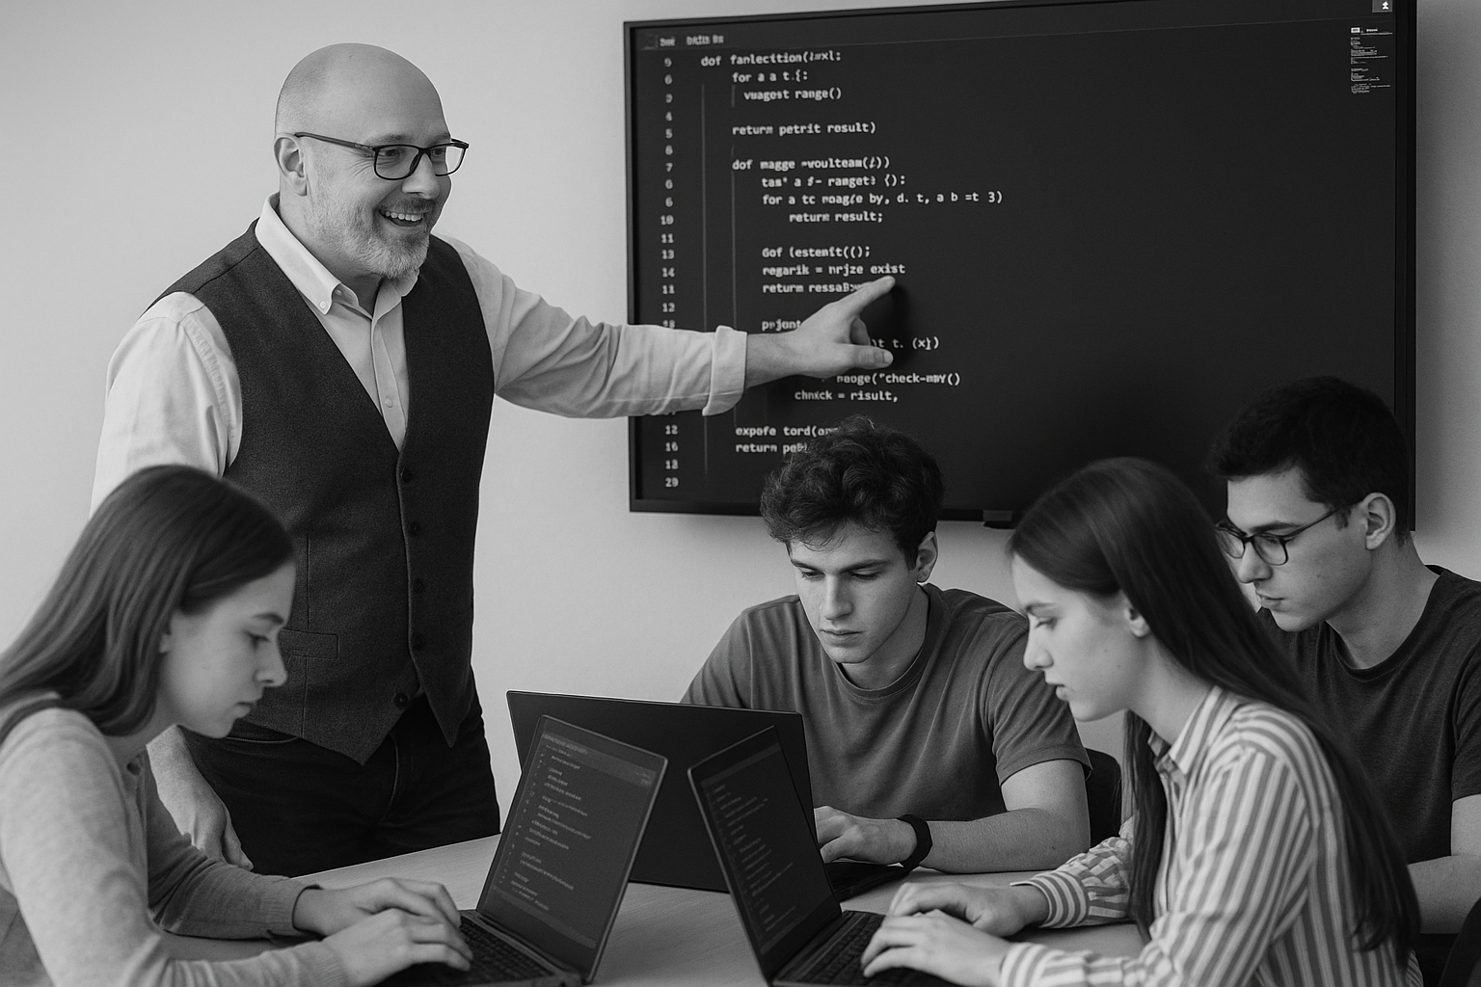
<title>
Note this down
Deadline:
Midnight before next lesson
Xmins
In small groups
Working Independently
In pairs
codeblock
Do not delete this slide nor move it from the second last slide in the deck

