Slide 1
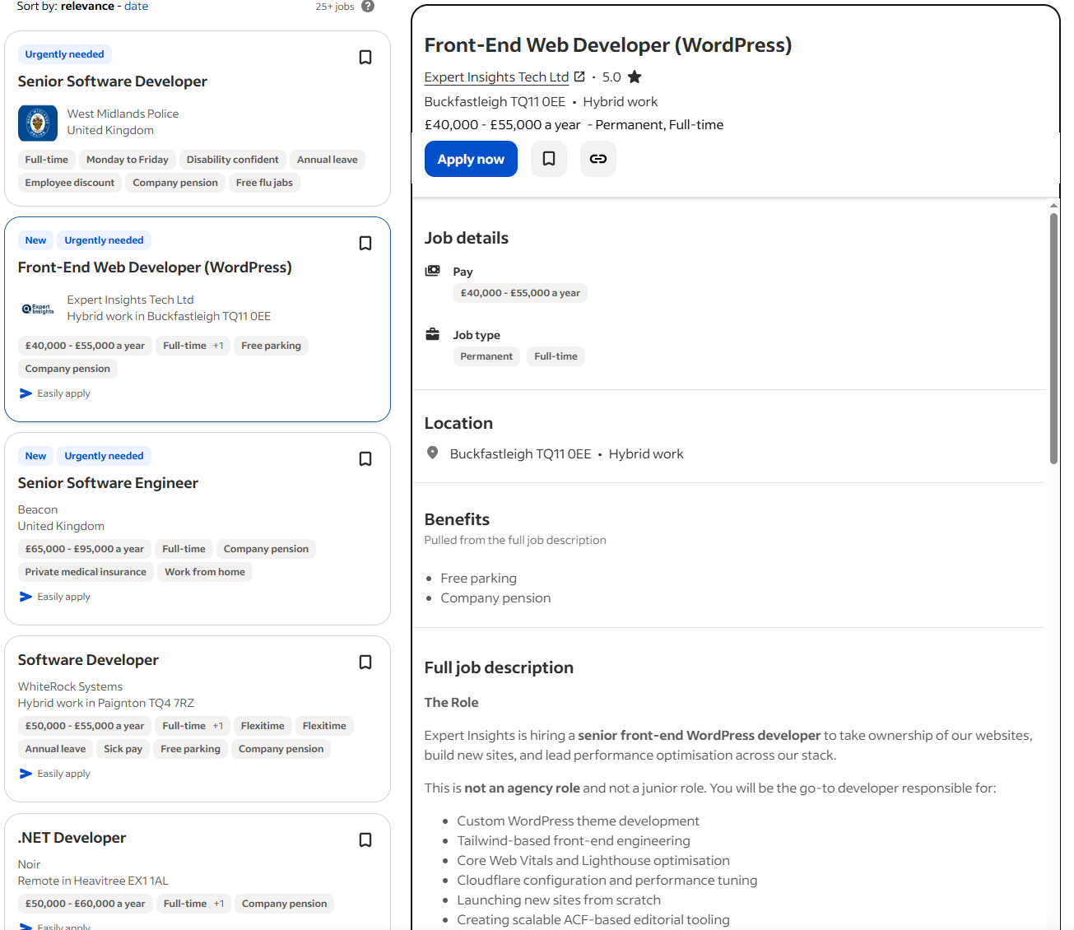
Roles in the Coding Industry
Lesson 05

Slide 2
Recall from last lesson
https://forms.microsoft.com/e/rLB1LCSUmR
An email should by now have arrived with the link attached.

Slide 3
Phones
a small reminder…
once you have authenticated phones should be in the pockets on the wall
There will be no more toilet breaks in my lessons. If you can’t manage to use the toilet in the breaks then you need to learn to. Going to the toilet is not an excuse for missing a substantial part of the lesson.

Slide 4
Roles in the Coding Industry
Lesson 05

Slide 5
Learning Objectives
By the end of the lesson, learners should be able to:
Identify at least 5 roles found in software and digital development teams.
Describe the main responsibilities of each role in simple terms.
Distinguish which roles focus on coding, testing, design, analysis, deployment and maintenance.
Relate roles to real-world products they use (apps, websites, games)

Slide 6




Who builds…?
Who designs how the app looks?
Who writes the code?
Who tests the features?
Who keeps the system running?
UI/UX Designer
Developer
Tester
DevOps Engineer

Slide 7
Activity: Career Card Sort
In small groups
Your group has a series of job roles and a number of responsibilities
Match the responsibilities to the roles
10 mins

Slide 8
Research
Working Independently
Visit https://nationalcareers.service.gov.uk/explore-careers/job-sector/digital
Explore some of the key roles in the Digital Sector
  What do they do?
  What skills do you need?
  What qualifications will you need?
  What is the Salary Range?
Make notes in your OneNote Notebook
Hint: many of the key roles are the ones on the previous exercise
20 mins
If you have time, look at some of the other digital roles mentioned by the careers service

Slide 9
Build a Tech Team
In small groups
Divide into 4 Groups
These are your briefs:
  Build an app to help students track homework
  Build a website for a local animal rescue
  Create a simple platform game
  Design a cinema booking system
Your group must decide:
  Which role writes the code?
  Who ensures it works?
  Who talks to the client?
  Who designs the interface?
  Who deploys it?
20 mins
Create a Team Plan on PowerPoint and when complete send it to simonrundell@exe-coll.ac.uk

Slide 10
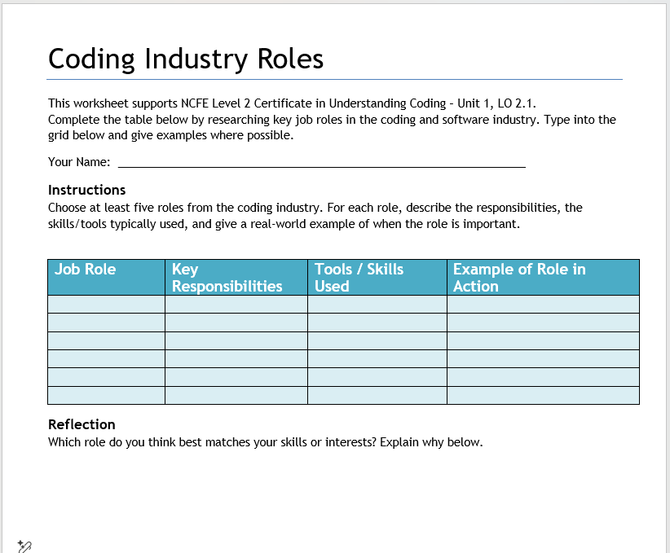
Worksheet
Working Independently
Download and complete a copy of the Worksheet of Job Roles from Teams / Classwork / Unit 1
When complete, save it in your OneDrive folder
15 mins

Slide 11

Reflect
Which role suits your personality and skills?
Which role do you think will become more important in the next 10 years and why?
How might AI change or support these roles?

Slide 12


Plenary: Two truths and a lie
I’m going to show you some of the roles
Two statements about the role are
One of them is
To win a sticker you must:
  Identify which statement is incorrect.
  Explain why it’s incorrect.
  Clarify the correct information.

Slide 13
Software Tester
Testers find bugs before software is released.
Testers create test cases and test plans.
Testers design how the user interface looks.

Slide 14
UI/UX Designer
UI/UX designers create wireframes and prototypes.
UI/UX designers fix server errors.
UI/UX designers focus on user experience.

Slide 15
DevOps Engineer
DevOps engineers design character animations in games.
DevOps engineers deploy updates.
DevOps engineers monitor system performance.

Slide 16
Business Analyst
Business analysts write all the project’s source code.
Business analysts gather requirements from clients.
Business analysts translate needs into documentation.

Slide 17
Homework
Deadline:
Midnight 6 days time
“When I grow up I want to be…”
Write 200 words on which of the jobs in Coding you think you’d like and tell me why.

