Slide 1
Functions
Lesson 05
Notes:
Notes will be here as additional guidance
Other resources:
https://www.w3schools.com/python/
especially:
https://www.w3schools.com/python/python_functions.asp

Slide 2
Recall Quiz
Microsoft Forms
https://forms.microsoft.com/e/cJt55JKrv9
Notes:
This quiz is on the previous lesson. It will show you where you are wrong.
Use it to support your learning by identifying what you need to revise.

Slide 3
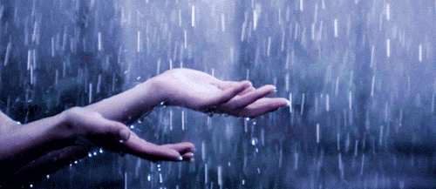
Would you rather be DRY or WET?
DRY – Don’t Repeat Yourself
WET – We Enjoy Typing
The principle way to stay DRY is to use functions whenever possible
Notes:
DRY code is about using functions, loops and other structures to ensure that we can reuse code as much as possible. So, you should always seek to write DRY code.
Functions are a good way of doing this.

Slide 4
Functions
Note this down
Functions are units of code which can be called repeatedly by a program
The way they are written differs from programming language to language
For the moment we will focus on Python
syntax
Notes:
The way code is written is called syntax, hence why when there is a mistake, like a typo the system often halts with “Syntax Error at line…”

Slide 5
Syntax
Rules for how code must be written
Think of it like grammar in English
If we make mistakes (ie mistype something) it is called a Syntax Error
Notes:
In Python we use tabs and colons, indentation and snake_case naming of variables as out syntax

Slide 6
Functions in Python
def myFunction (arguments):
[do stuff here]
return result
print(myFunction(parameters))
Notes:
Here’s an example:
def doubleNumber(startNumber):
result = startNumber * startNumber
return result
print(doubleNumber(2))
The expected output of this is 4 because 2 * 2 = 4
print() itself is an in-built function which puts output on the screen, so notice it has brackets in it. It will print to the screen whatever is in the brackets

Slide 7
Q: What are arguments and parameters?
A: Data passed to a function
arguments
function
Arguments are what are passed into a function from the code that calls it
The function receives it as parameters. Think of those as placeholders waiting to receive arguments.
Notes:
Arguments are what are passed into a function from the code that calls it
The function receives it as parameters. Think of those as placeholders waiting to receive arguments.

Slide 8
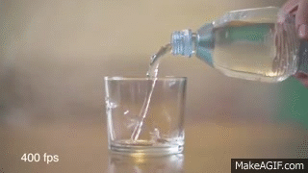
Argument
Function
Notes:
Think of it another way:
The program pours the arguments into the function.
The function will usually have different names for the parameters it receives. When working on these values inside the function it uses the names inside the function (we call it in the same scope)
So
def functionName(insideName):
print(insideName)
return
outsideName=5
functionName(outsideName)
(if this isn’t clear, why not copy it into Programiz.com and running it.

Slide 9
A simple example
This is the parameter
def doubleResult(input_number):
input_number = input_number * 2
return input_number
print(doubleResult(2))
This is the argument
Notes:
Remember: arguments are passed to functions, parameters are received into them.

Slide 10
A simple example
def doubleResult(input_number):
input_number = input_number * 2
return input_number
print(doubleResult(2))
The words def, the colon and return mark the function in the program
Notice that all the commands inside the function are indented. When the
code returns to the far left, we have moved out of the function.
print() itself is a function, built into Python to print output to the screen

Slide 11
You can have more than one argument…
def areaOfRectangle(height, width):
return height * width
my_rectangle = areaOfRectangle(5,7)
print(my_rectangle)
Notes:
This code calculates the area of a rectangle from 2 arguments passed to it.

Slide 12
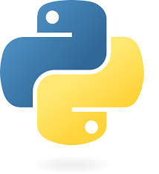
Let’s code some functions using https://www.programiz.com
Notes:
Put these into practice

Slide 13
Tasks
We are going to create some small functions to do the following tasks:
Take 2 numbers, add them together and print the result
Take the name of a person and print on the screen “Hello” followed by the name of the person
Use the in-built function input() to ask the user their name and print “Hello” + [their name]
After that you can experiment and extend your code!

Slide 14
Homework
Deadline:
Midnight before next lesson
Continue using Programiz to play around with Python.
See what else you can do with multiple functions?
Can you make me a simple interactive story?
Screenshot your code and output (you can put it in a Word document or a PowerPoint or save it as a graphic) and upload it to submit it.

Slide 15
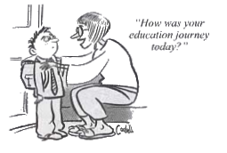
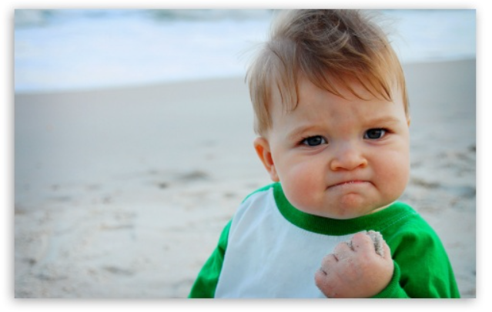




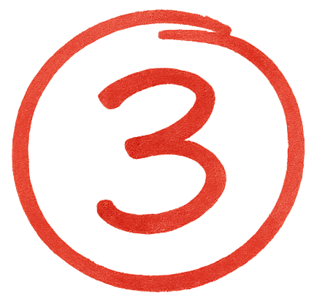

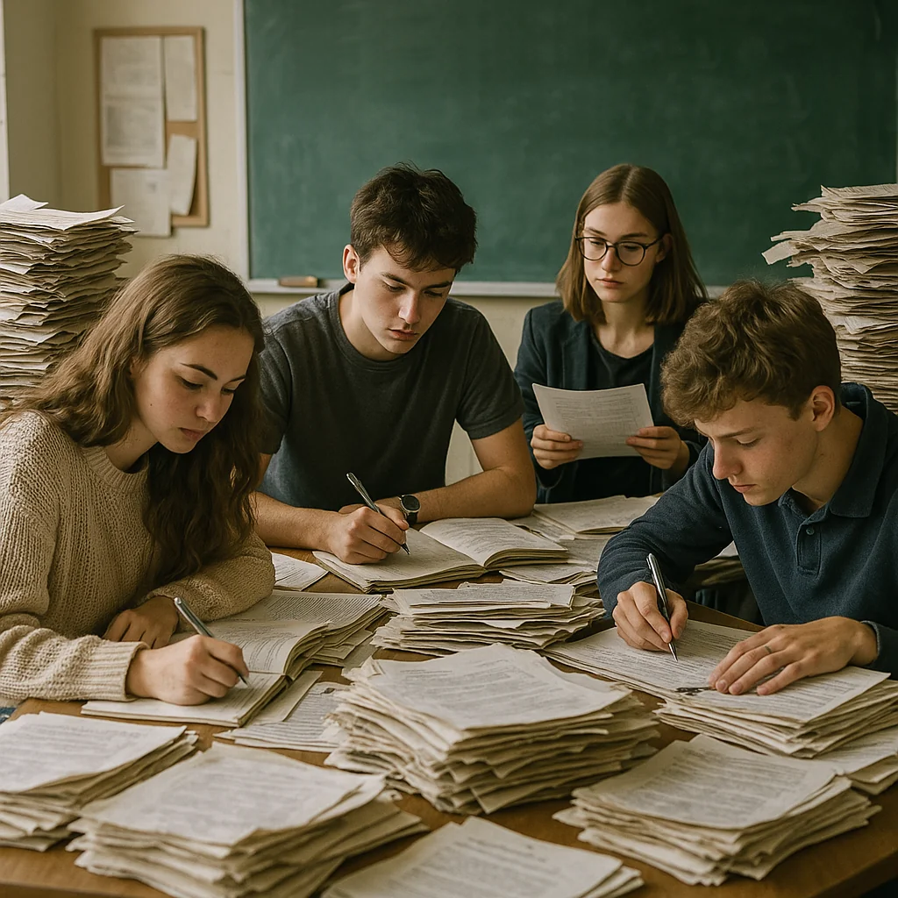


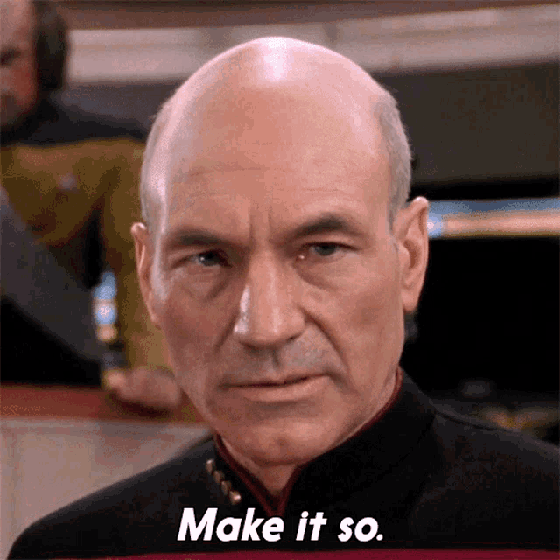
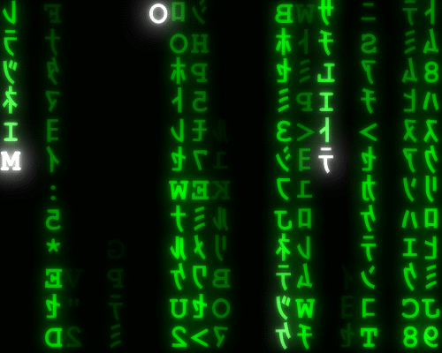
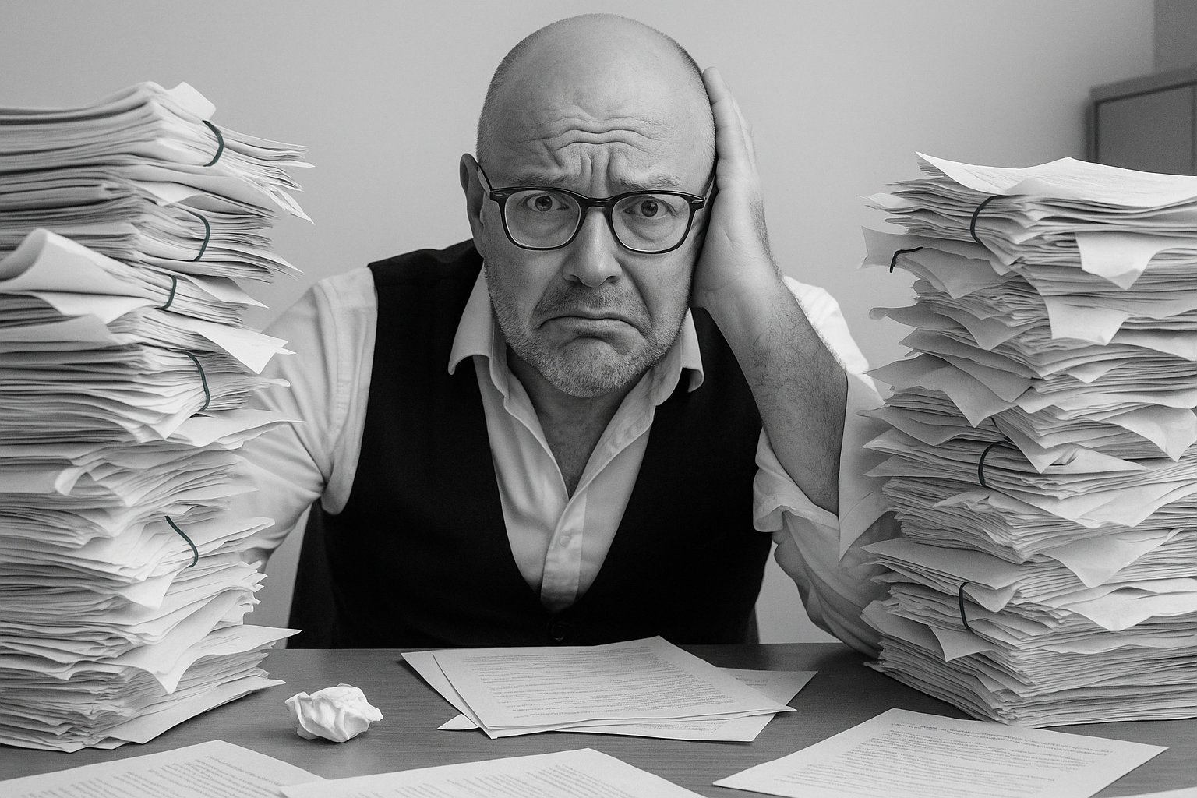
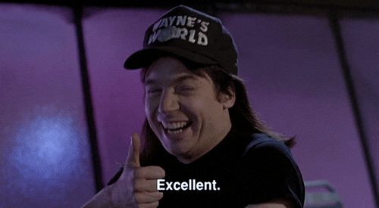
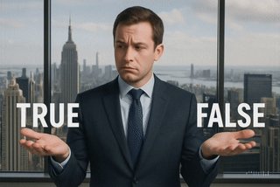
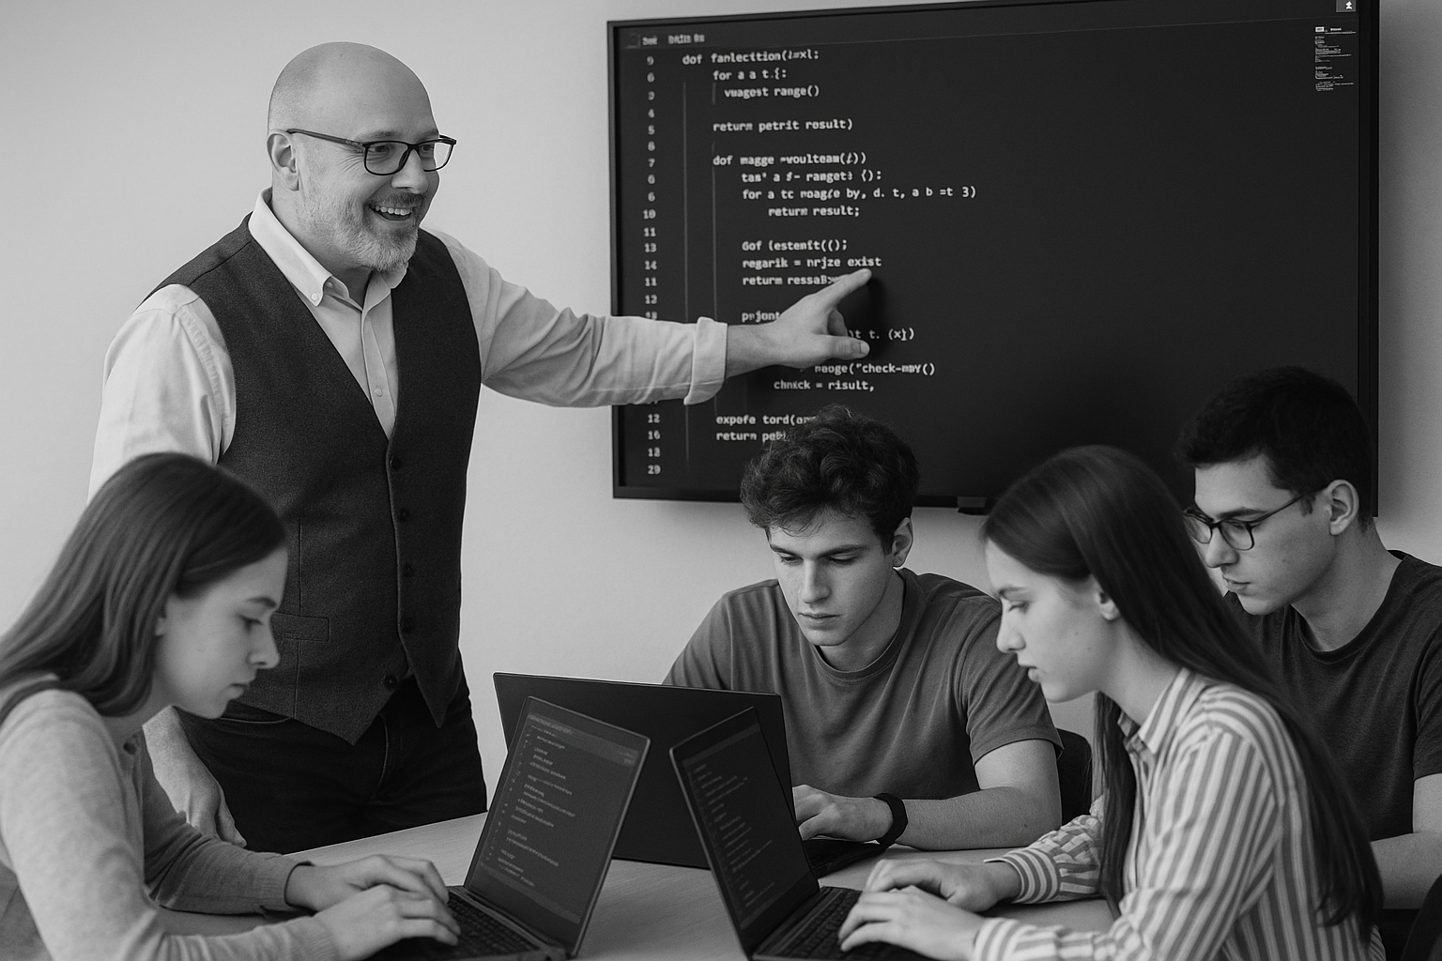
<title>
Deadline:
Midnight before next lesson
Note this down
Xmins
In small groups
Working Independently
In pairs
codeblock
Do not delete this slide nor move it from the second last slide in the deck

