Slide 1
Functions
See the notes at the bottom for additional help
Lesson 05
Notes:
Note will be here as additional guidance

Slide 2
Recall Quiz
Microsoft Forms
https://forms.microsoft.com/e/cJt55JKrv9

Slide 3
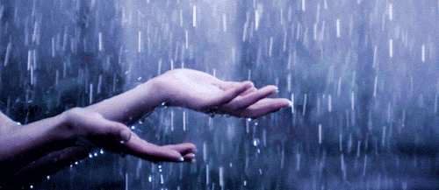
Would you rather be DRY or WET?
DRY – Don’t Repeat Yourself
WET – We Enjoy Typing
The principle way to stay DRY is to use functions whenever possible

Slide 4
Functions
Note this down
Functions are units of code which can be called repeatedly by a program
The way they are written differs from programming language to language
For the moment we will focus on Python
syntax

Slide 5
Syntax
Rules for how code must be written
Think of it like grammar in English
If we make mistakes (ie mistype something) it is called a Syntax Error

Slide 6
Functions in Python
def myFunction (arguments):
[do stuff here]
return result
print(myFunction(parameters))

Slide 7
Q: What are arguments and parameters?
A: Data passed to a function
arguments
function
Arguments are what are passed into a function from the code that calls it
The function receives it as parameters. Think of those as placeholders waiting to receive arguments.

Slide 8
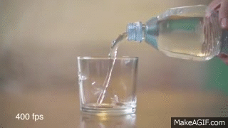
Argument
Function

Slide 9
A simple example
This is the parameter
def doubleResult(input_number):
input_number = input_number * 2
return input_number
print(doubleResult(2))
This is the argument

Slide 10
A simple example
def doubleResult(input_number):
input_number = input_number * 2
return input_number
print(doubleResult(2))
The words def, the colon and return mark the function in the program
Notice that all the commands inside the function are indented. When the
code returns to the far left, we have moved out of the function.
print() itself is a function, built into Python to print output to the screen

Slide 11
You can have more than one argument…
def areaOfRectangle(height, width):
return height * width
my_rectangle = areaOfRectangle(5,7)
print(my_rectangle)

Slide 12
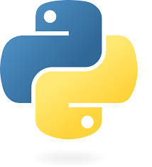
Let’s code some functions using https://www.programiz.com

Slide 13
Tasks
We are going to create some small functions to do the following tasks:
  Take 2 numbers, add them together and print the result
  Take the name of a person and print on the screen “Hello” followed by the name of the person
  Use the in-built function input() to ask the user their name and print “Hello” + [their name]
After that you can experiment and extend your code!

Slide 14
Homework
Deadline:
Midnight before next lesson
Continue using Programiz to play around with Python.
See what else you can do with multiple functions?
Can you make me a simple interactive story?
Screenshot your code and output (you can put it in a Word document or a PowerPoint or save it as a graphic) and upload it to submit it.

Slide 15
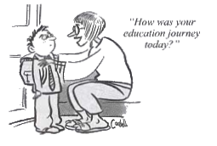
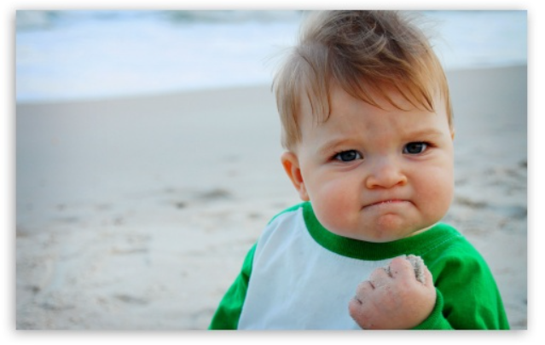


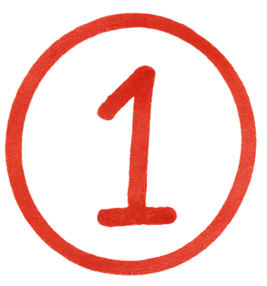
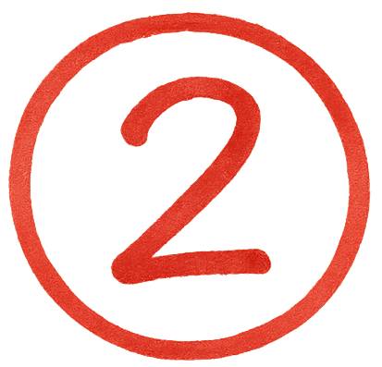
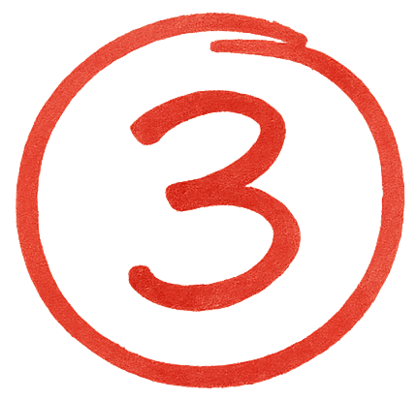

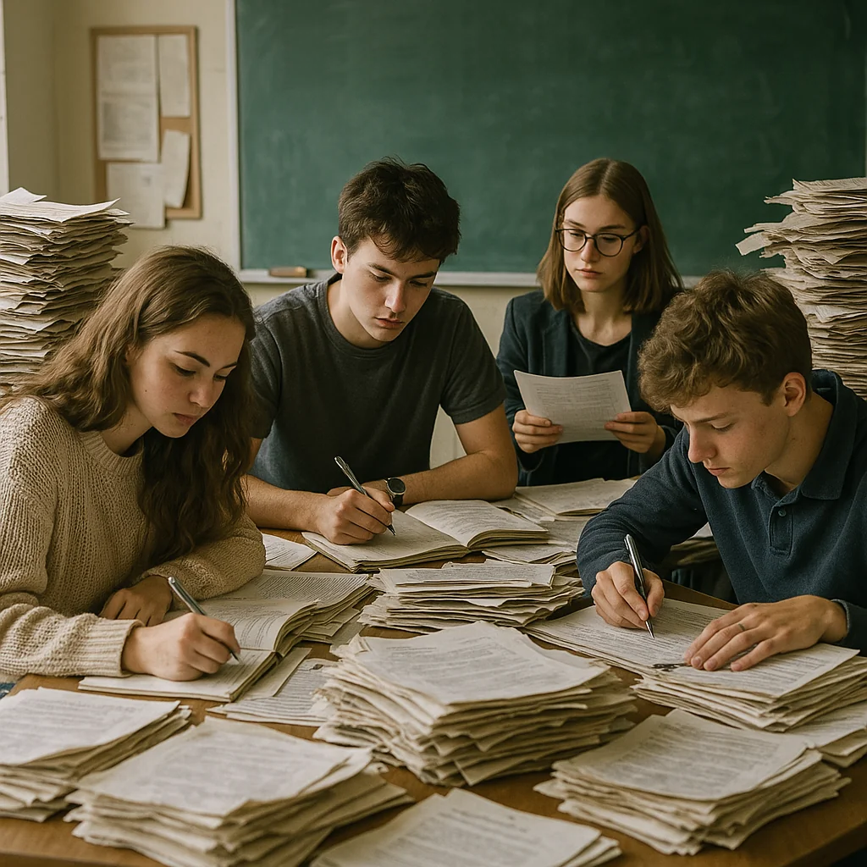


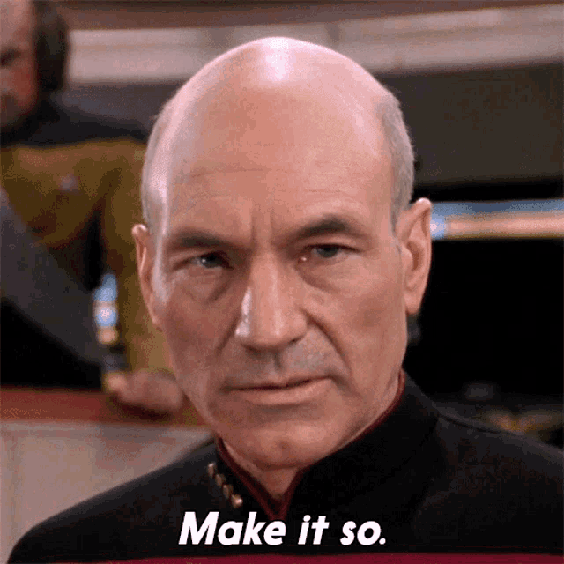
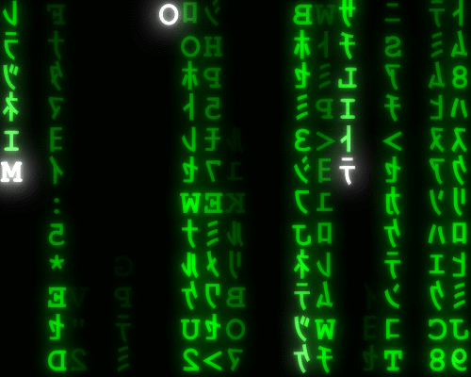
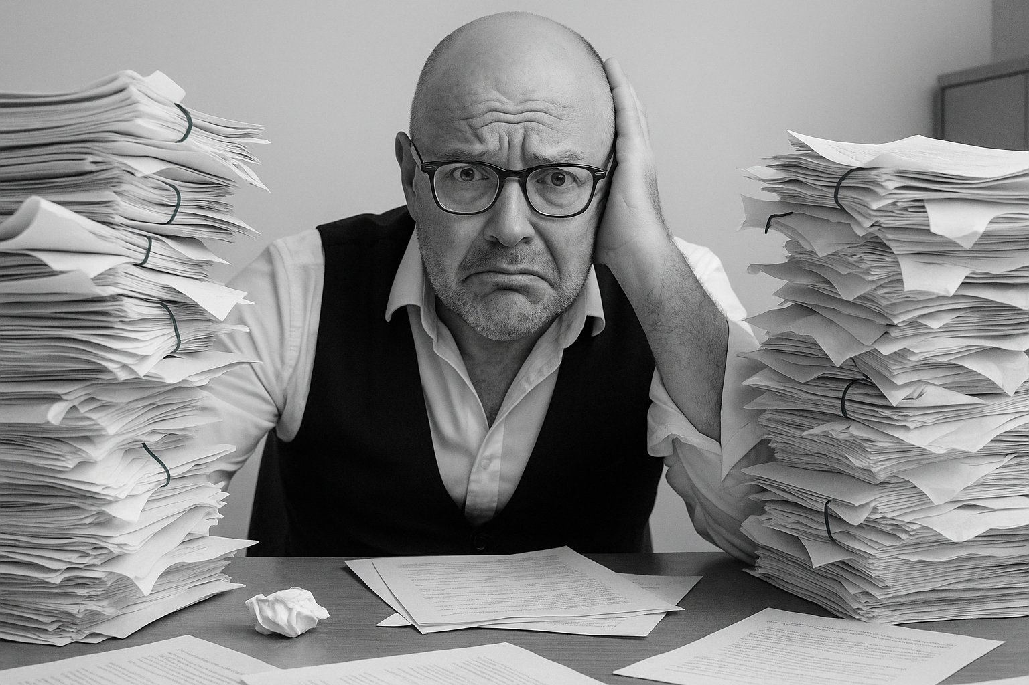
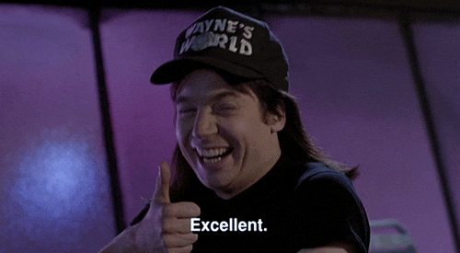
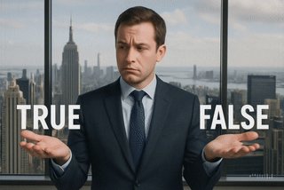
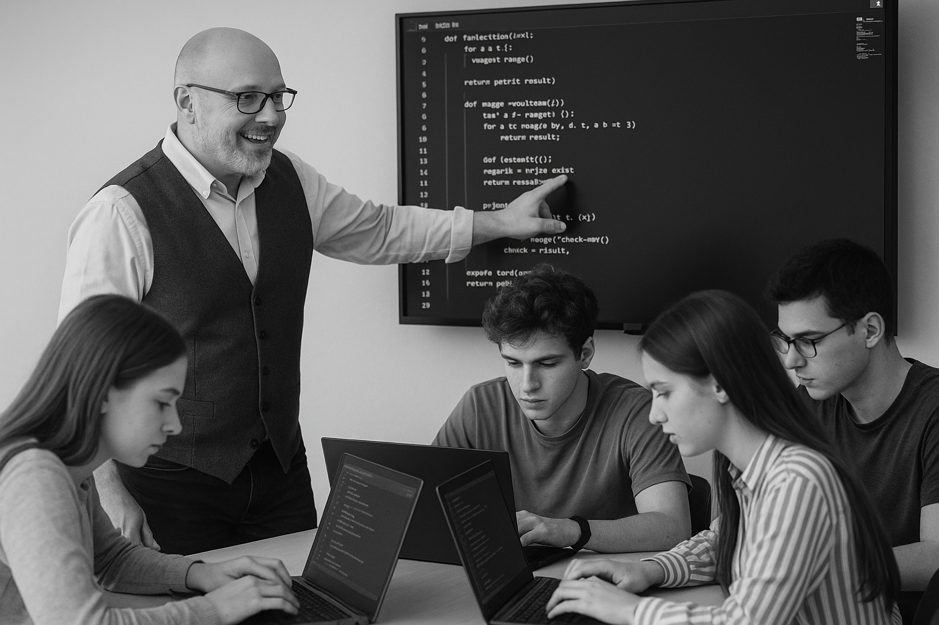
<title>
Deadline:
Midnight before next lesson
Note this down
Xmins
In small groups
Working Independently
In pairs
codeblock
Do not delete this slide nor move it from the second last slide in the deck

