Slide 1
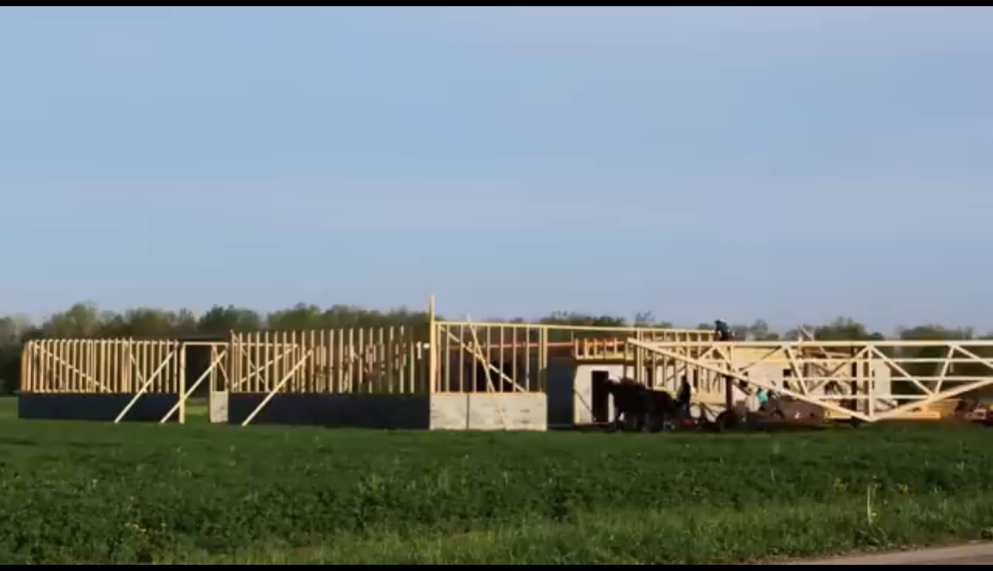
Skills and Teamwork in Coding
Lesson 06

Slide 2
Recall from last lesson
https://forms.cloud.microsoft/e/XYMzXMRrm6
An email should by now have arrived with the link attached.

Slide 3
Skills and Teamwork in Coding
Lesson 06

Slide 4
Phones
a small reminder…
once you have authenticated phones should be in the pockets on the wall
There will be no more toilet breaks in my lessons. If you can’t manage to use the toilet in the breaks then you need to learn to. Going to the toilet is not an excuse for missing a substantial part of the lesson.

Slide 5
Learning Objectives
By the end of this lesson, you should be able to:
Identify key skills needed for coding
  Recognise both technical skills (e.g., problem-solving, debugging, reading code)
  and soft skills (e.g., communication, teamwork, perseverance)
Explain why these skills are important in coding work
  Understand how these skills help with building reliable, readable, and maintainable code
  Explain the impact poor skills can have on a project (bugs, delays, miscommunication)
Describe why teamwork is essential in coding projects
  Understand how team members depend on each other
  Recognise the consequences of poor collaboration
  Describe how coders share ideas, review work, and solve problems together
Identify the different roles within a coding team and how they work together
  Developer, tester, UX designer, analyst, DevOps, project manager
  Understand how their responsibilities connect during a project
  Recognise how teams combine skills to complete a task successfully

Slide 6
Sort these Skills
Which of these are Technical Skills and which are Soft Skills?
Working Independently
Testing
Communication
5 mins
Collaboration
Logical thinking
Problem solving
Planning
Version control
Creativity
Reading documentation
Debugging
Time management
Adaptability

Slide 7
Technical
Soft Skills
Testing
Communication
Collaboration
Logical thinking
Problem solving
Planning
Version control
Creativity
Reading documentation
Debugging
Time management
Adaptability

Slide 8
Technical
Soft Skills
Communication
Testing
Planning
Collaboration
Creativity
Version control
Debugging
Problem solving
Reading documentation
Time management
Adaptability
Logical thinking

Slide 9
What makes a good coder?
Good coders don’t just write code—they:
  Think logically
  Work well in teams
  Communicate clearly
  Learn continuously
  Break big problems down
Which skill do YOU think is most important and why?
Which skills do you already have?

Slide 10
Key Skills Needed for Coding
Note this down
Problem-Solving – breaking down complex tasks
Logical Thinking – understanding step-by-step flow
Attention to Detail – catching bugs
Creativity – designing solutions
Technical Skills – languages, tools, debugging
Perseverance – code rarely works first time

Slide 11
Why these skills matter
Note this down
Why are these skills important?
Code must be reliable, readable, and secure
Teams rely on shared understanding
Unclear communication = broken features
Strong skills = faster development and fewer bugs
A developer who doesn’t explain their code makes testing harder.
Poor planning leads to projects running late

Slide 12
Pseudocode Challenge
In small groups
Write instructions for making a cup of tea
The group must write some instructions for making a cup of tea
One of you is “the robot” who must follow the instructions absolutely literally
Let’s see what happens…
15 mins
Instructions
Must be clear
Must be step-by-step
Must be testable by another group

Slide 13
Why Teamwork Matters in Coding
Coding projects are too big for one person. Teams need to:
Share skills
Review each other’s work
Fix bugs found by others
Collaborate to meet deadlines
Communicate clearly to avoid mistakes
Building software is like building a house – everyone has a role.

Slide 14
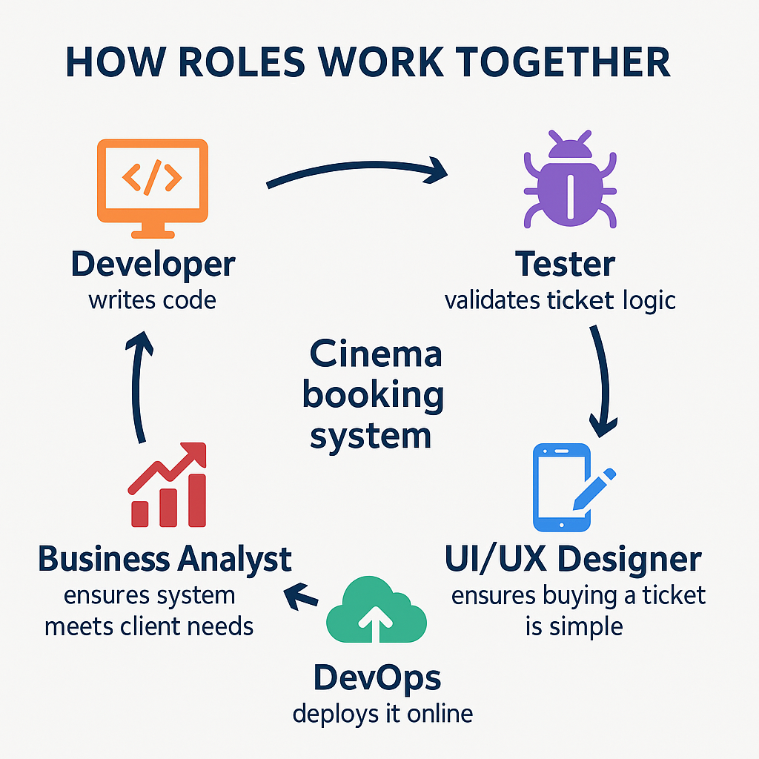

Slide 15

Reflect
What skills do YOU bring to a team?
Which skill in your group is most important and why?
Describe a time you worked well in a team (in class or outside).
Reflect on this in your OneNote Notebook

Slide 16
Homework
Deadline:
Midnight 6 days time
Write 150-200 words on
Which coding skill do you most need to develop, and how will you improve it?

Slide 17










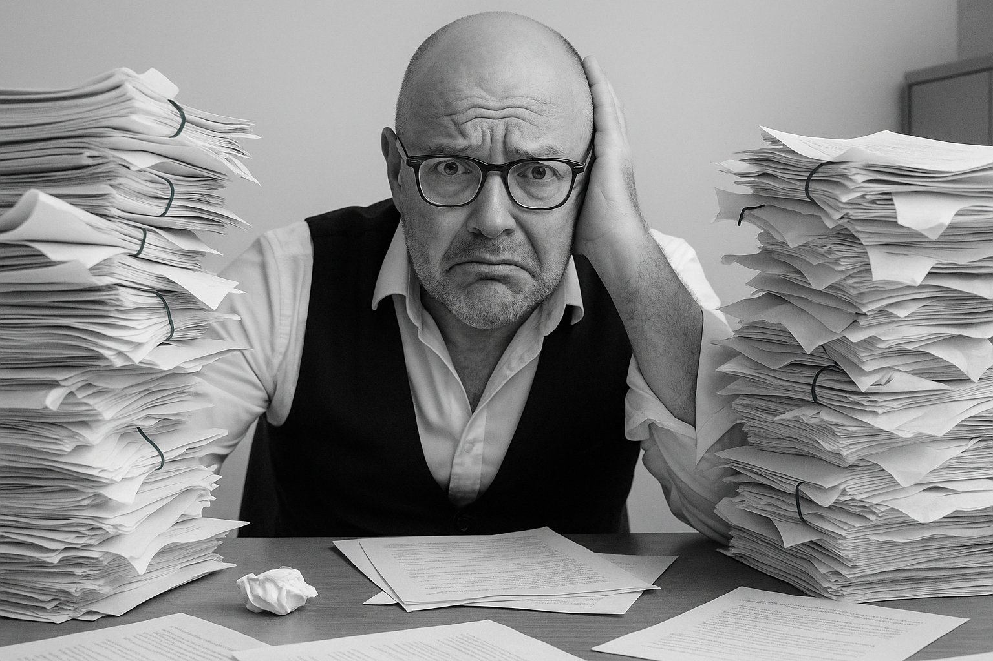



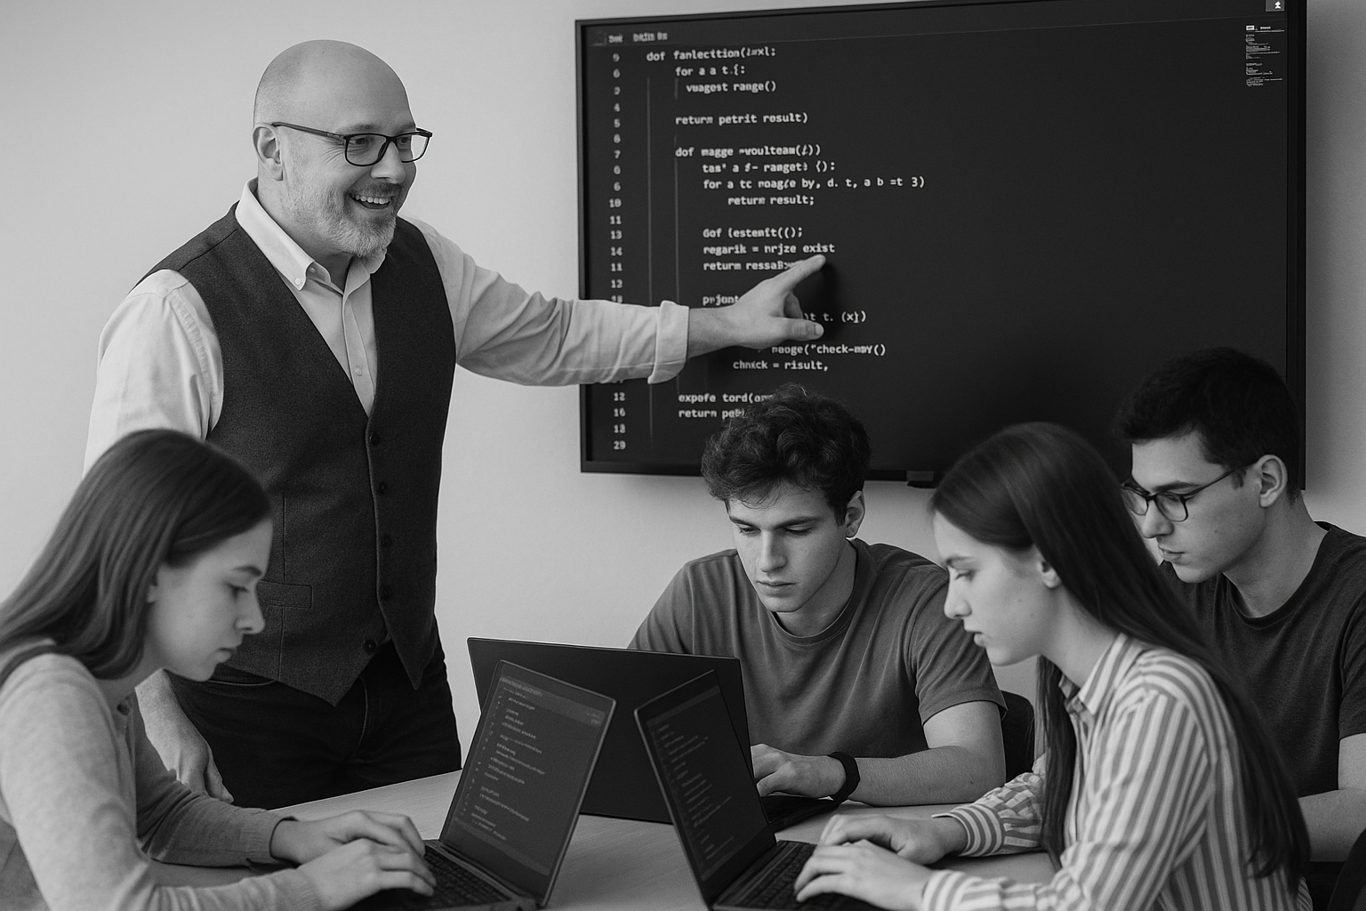






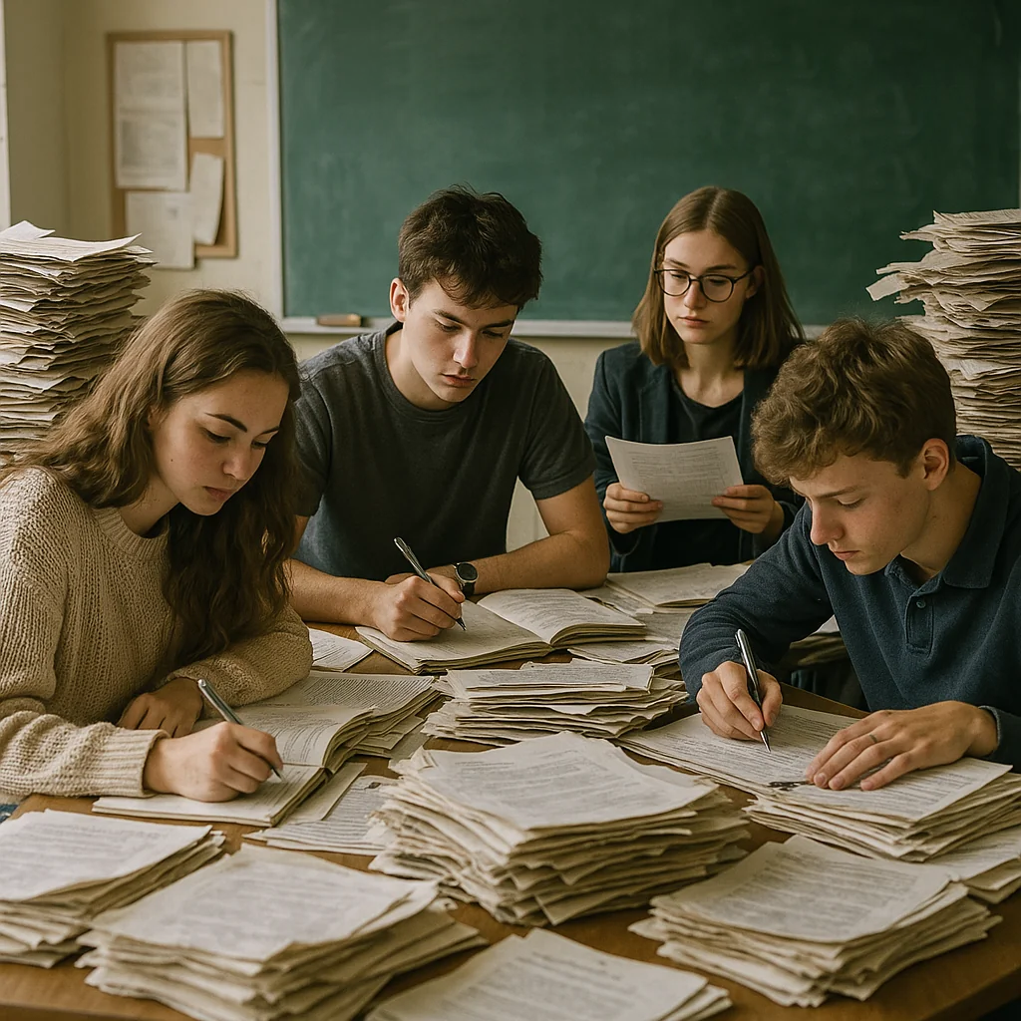

<title>
Note this down
In pairs
Working Independently
In small groups
Deadline:
Midnight before next lesson
Xmins
Do not delete this slide nor move it from the last slide in the deck

