Slide 1
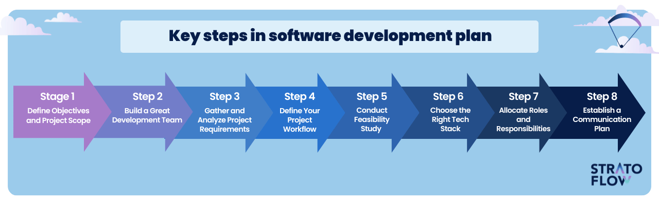
Planning a Software Project
L2 Coding

Slide 2
Recall from last lesson
https://forms.microsoft.com/e/xj7BDyyGe6
An email should by now have arrived with the link attached.

Slide 3
Phones
a small reminder…
once you have authenticated phones should be in the pockets on the wall
There will be no more toilet breaks in my lessons. If you can’t manage to use the toilet in the breaks then you need to learn to. Going to the toilet is not an excuse for missing a substantial part of the lesson.

Slide 4
Planning a Software Project
L2 Coding

Slide 5
Learning Objectives
By the end of the lesson students will be able to:
Identify the key stages of the Software Development Lifecycle (SDLC).
Explain what happens in the planning stage, including requirements analysis and design.
Describe why planning is important in preventing risk, reducing cost/time overruns, and ensuring clear requirements.
Apply planning techniques to outline a small software project.

Slide 6
Robot Planning
I need a robot…
…and I need a programmer
Rules:
Programmer can only speak, no pointing/gestures.
Robot follows instructions literally.

Slide 7
Output

Slide 8
Conclusion
What went wrong?
Why didn’t the robot match the intended design?
Which instructions were unclear or missing?
How does this relate to planning a software project?
What do you think is included in the planning stage of the SDLC?

Slide 9
Emoji Instructions Challenge
In pairs
🔑 ➡️ 🚪 ➡️ 🙂
☕ ➕ 🔥 ➕ 💧 ➡️ 😀
💻 ➡️ 📝 ➡️ 💾 ➡️ ✔️
🏠 ➡️ 🚌 ➡️ 🏫
👨‍💻 ➡️ 🐞 ❗ ➡️ 🔧 ➡️ 😀
7 mins
This is like interpreting unclear client requirements

Slide 10
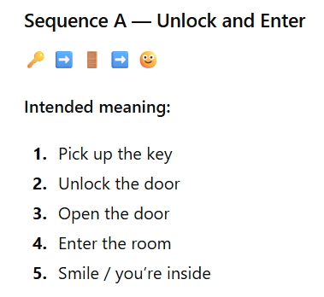
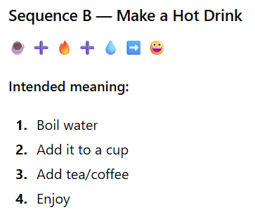
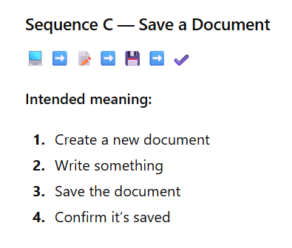
Answers

Slide 11
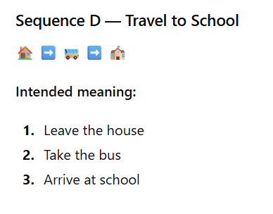
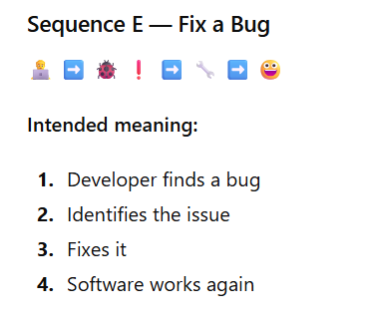
Answers

Slide 12
Debrief
Did everyone interpret the emojis the same way?
Why not?
How does this show that clients often provide unclear requirements?
What must developers do during the planning stage to avoid misunderstandings?

Slide 13
Planning =
Requirements
+ Design

Slide 14
Requirement Gathering
Note this down
Understanding what is required
Who will be using the software?
In what circumstances?
What data do I need?
What do I need to do to that data?
What do I need to output?

Slide 15
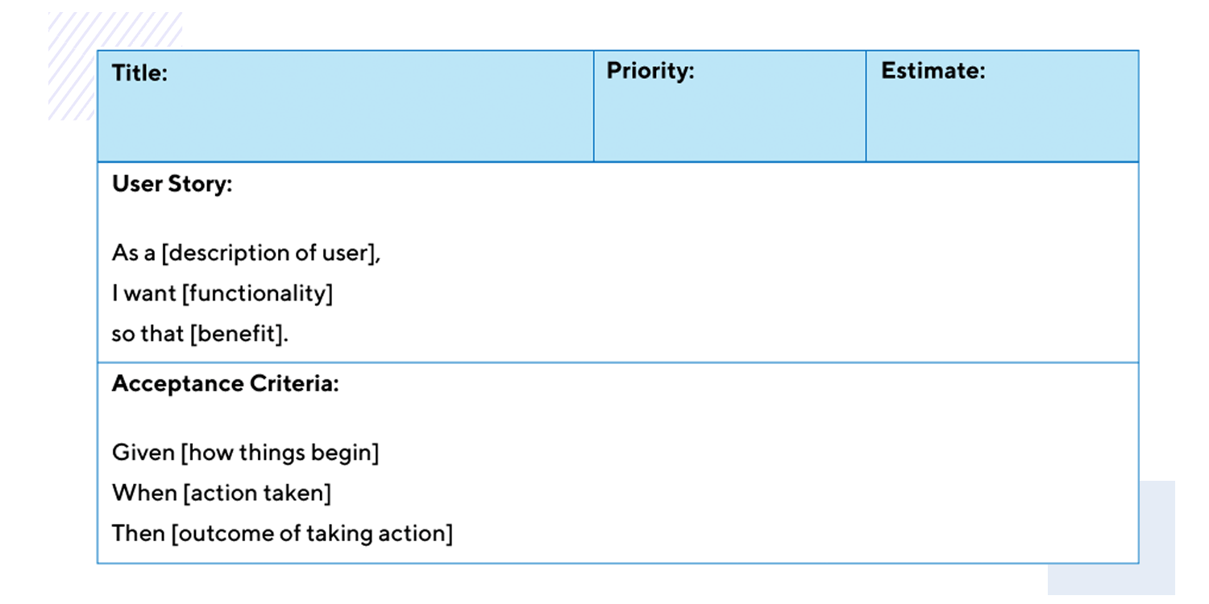
User Stories
Note this down
These are descriptive sentences which describe what users will do.
“As a customer, I want to add items to my shopping cart and be able to modify quantities or remove items before checkout"
"As a new user, I want to register an account so that I can log in and save my preferences for next time"

Slide 16
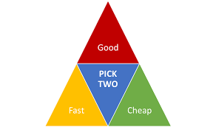
Constraints
Note this down
Budget
Time
Scope (what we are doing)
The Project Management Triangle highlights necessary trade-offs:
Quickly + Cheaply = Not Well Speed and affordability often lead to lower quality, potential errors, or an end product that does not fully meet requirements.
Quickly + Well = Not Cheap Achieving high quality on a tight deadline requires significant investment, such as additional resources, overtime, or top-tier talent, all of which increase costs.
Well + Cheaply = Not Quickly Prioritizing high quality and a low budget means progress will be slower, as limited resources result in extended timelines.

Slide 17
Design decisions
Note this down
With the Constraints in mind, certain design decisions must be made
Things to include
Things to delay until the next version
Things to not do
This is often referred to as MoSCoW
Must have, Should have, Could have, Won’t have
This ensures the project doesn’t get so large it can never be delivered.

Slide 18
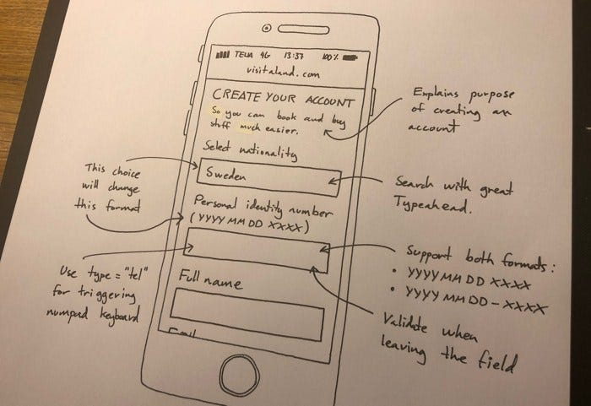
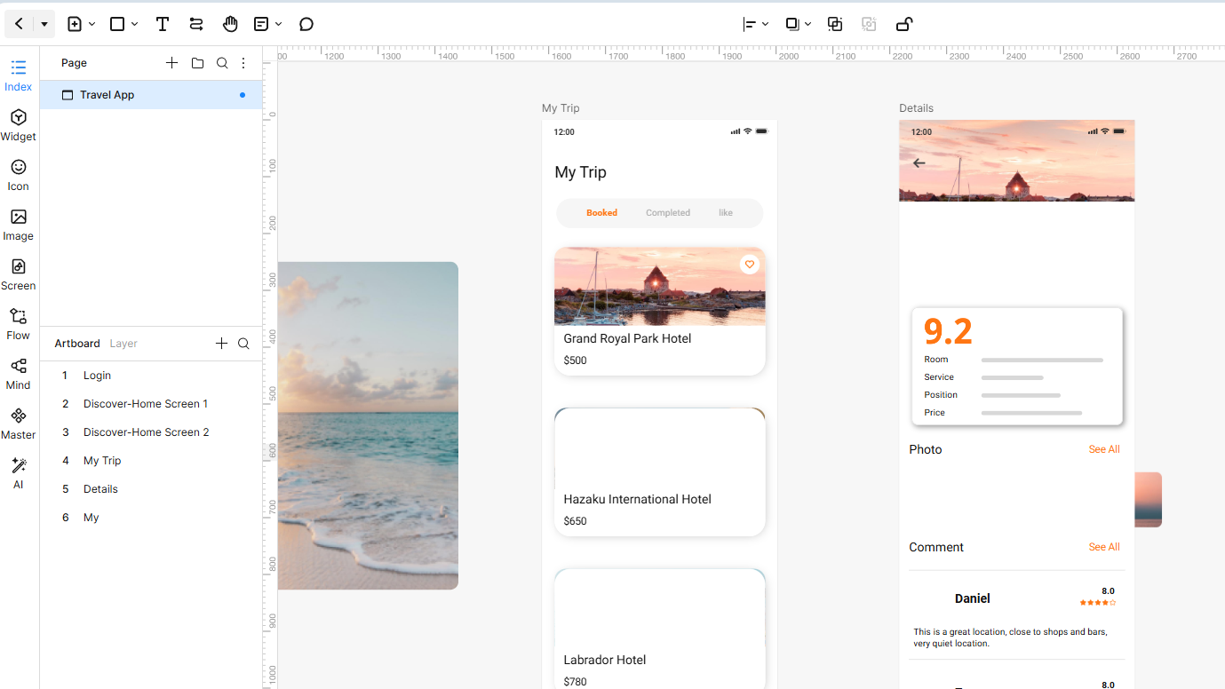
Wireframes
Note this down
Designing the layout.
Often starts on paper with a pencil
Then moves to a wireframe app like Mockitt or Canva
Can demonstrate functionality and user flow

Slide 19
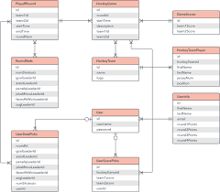
Data Structures
Note this down
Entity Relationship Diagrams (ERD)
Show data fields, data types and the relationships between tables

Slide 20


Technologies to use
Note this down
Is this a Mobile App?
Native Android or iOS?
Hybrid App?
Web Only App?
Desktop App – Windows, OSX, Linux?

Slide 21
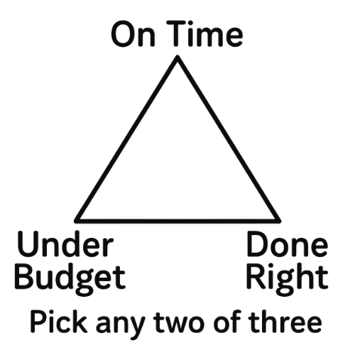
Project Risks
Note this down
The project scope might change in the middle of development
Staff may leave and new staff might need to be brought up to speed
Other risks might be identified which can place the project in jeopardy

Slide 22
Why planning matters:
What could go wrong if planning is skipped?
Avoids scope creep
Ensures developers know what to build
Reduces bugs in later stages
Saves time/cost
Allows teams to work in parallel

Slide 23
Research Task: How Do Real Companies Plan Software?
In small groups
10 mins researching
I will allocate to you one method for you to research:
Agile User Stories
Kanban boards
Gantt charts
UML diagrams
Wireframes
Functional & Non-Functional Requirements
MoSCoW prioritisation
Flowcharts
Produce a 1-2 minute explanation:
What the method is
Who uses it
Why it is useful in planning
You will all be asked to present to the class. EMail Powerpoints to simonrundell@exe-coll.ac.uk

Slide 24
Mini-Project Planning Task
Working Independently
Your brief: “Create a simple quiz app for 10–12-year-old users. The app should allow multiple-choice questions, track scores, and show a final result.”
Produce a planning sheet containing
Requirements list (functional + non-functional)
Stakeholders
Constraints (time, budget, skills)
Wireframe or sketch
Success criteria
20 mins
“Who will use it?”
“What must it do?”
“What would be nice but not essential?”

Slide 25

One thing I learned today…

Slide 26
Homework
Deadline:
Midnight 6 days time
Refine your mini-project planning sheet into a formal document including:
Purpose of the software
Expected users
System requirements
Risks and mitigations
Annotated design
Outline SDLC plan

Slide 27








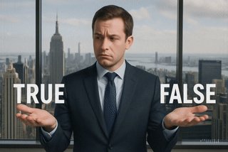
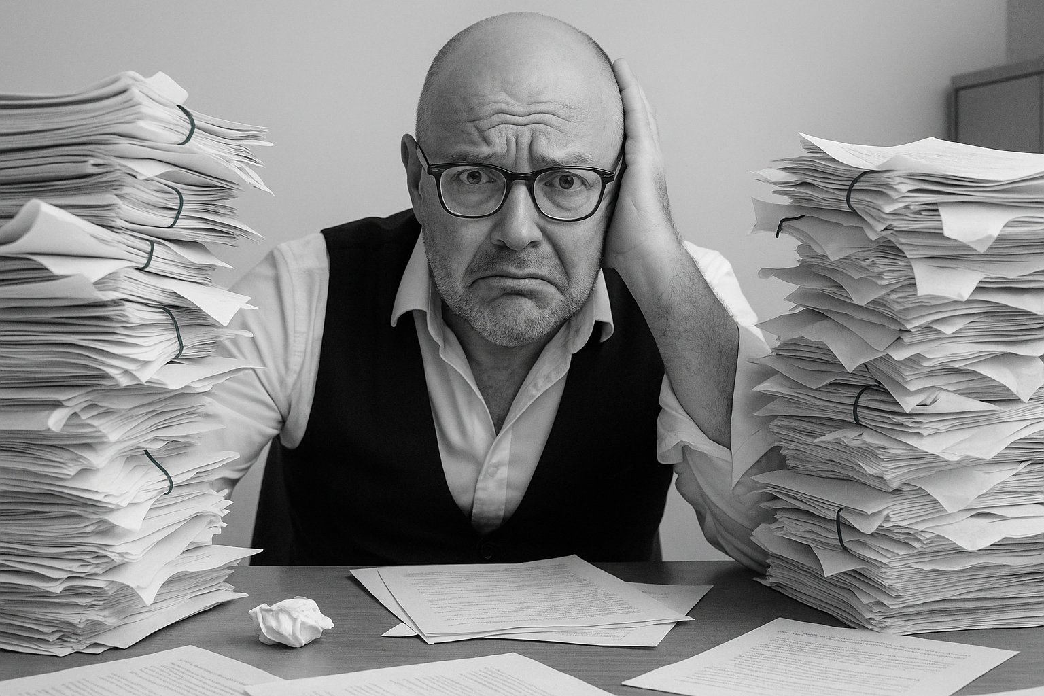


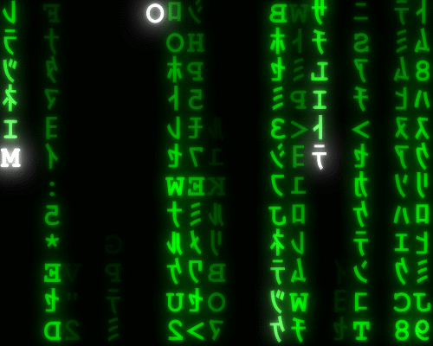
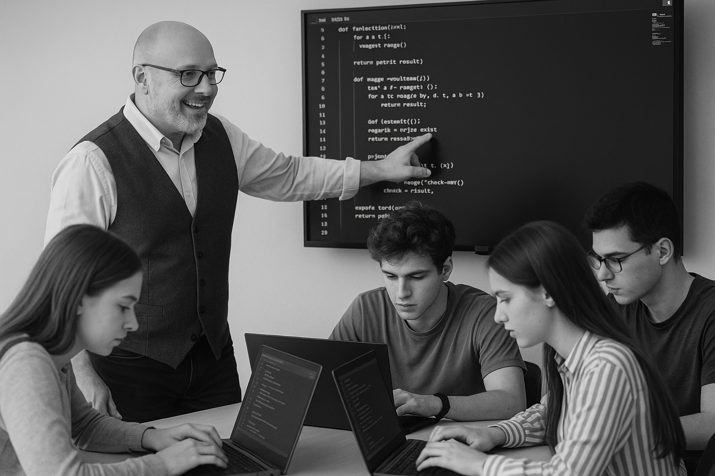
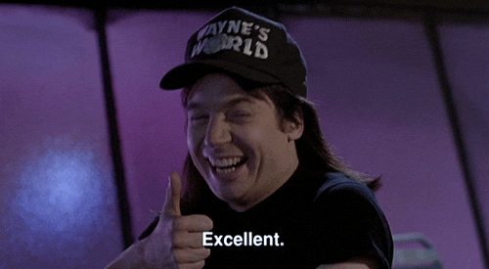
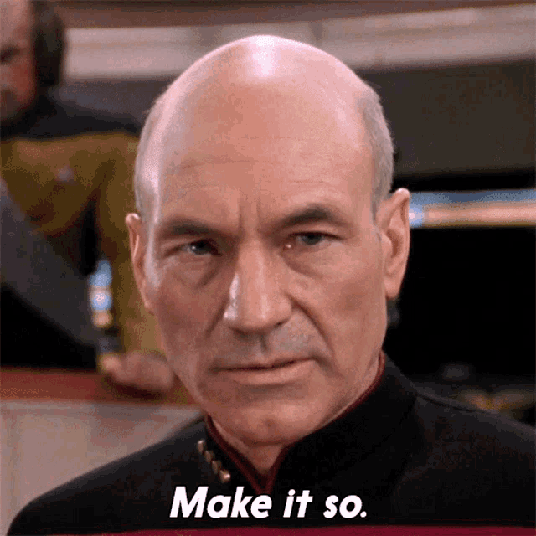






<title>
Note this down
In pairs
Working Independently
In small groups
Deadline:
Midnight 6 days time
X mins
Do not delete this slide nor move it from the last slide in the deck

