Slide 1
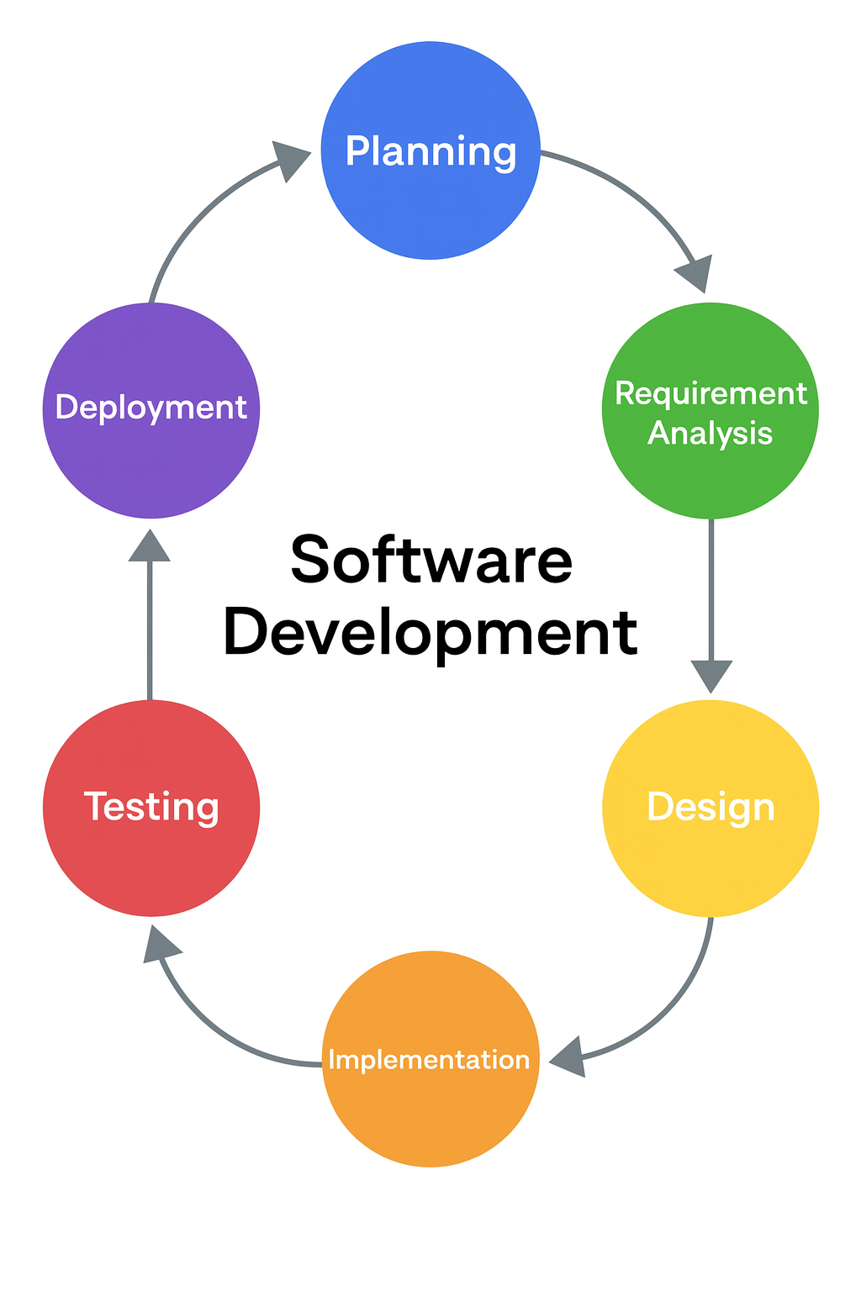
Software Development Lifecycle
Lesson 07

Slide 2
Phones
a small reminder…
once you have authenticated phones should be in the pockets on the wall
There will be no more toilet breaks in my lessons. If you can’t manage to use the toilet in the breaks then you need to learn to. Going to the toilet is not an excuse for missing a substantial part of the lesson.

Slide 3
Software Development Lifecycle
Lesson 07

Slide 4
Learning Outcomes
By the end of the lesson, students will be able to:
List the main stages of the Software Development LifeCycle (SDLC)
Describe the purpose of each stage
Explain how SDLC stages link together to form a process
Apply SDLC thinking to a simple real-world scenario

Slide 5
Guess the Stage
Guess which SDLC stage each description matches
The team interviews the client to find out what they want.
The developers turn the plan into working code.
The software is released and users start using it.
The team checks for errors and bugs.

Slide 6
Introducing the SDLC
Note this down
Definition:
A structured process software teams use to plan, build, test and release software.
Why it exists:
  consistency,
  quality,
  communication,
  reduced risk.

Slide 7
The Six Classic Waterfall SDLC Stages
Note this down
Requirements / Analysis
Design
Implementation (Coding)
Testing
Deployment
Maintenance

Slide 8
How to remember it…
Planning
Analysis
Design
Implementation
Testing
Deployment
Maintenance
People
Always
Do
Interesting
Things
During
Meetings
People Always Do Interesting Things During Meetings

Slide 9
Building a Pizza Restaurant App is like cooking a meal.
Requirements ⇢ What meal is needed?
Design ⇢ Recipe + steps
Implementation ⇢ Actually cooking
Testing ⇢ Tasting + fixing
Deployment ⇢ Serving the meal
Maintenance ⇢ New menu items; fixing problems

Slide 10
SDLC Roleplay
Working independently
around the room
Build an app for students to track their homework.
Requirements: What does the client want the app to do?
Design: Sketch the interface or database.
Implementation: Examples of tasks a developer would do.
Testing: What would you check?
Deployment: How would users get it?
Maintenance: What updates might be needed later?
25 mins

Slide 11
Build your own SDLC Diagram
Working Independently
Using a charting tool such as www.lucid.app
Create your own Software Development Life Cycle Diagram
Add notes to each step of the cycle to show what happens during each stage
When complete, submit it as a part of the assessment
20 mins

Slide 12
Why stages link together
One stage naturally leads onto the next
Poor requirements = poor project
Testing catches many mistakes from implementation
Maintenance keeps the software relevant.

Slide 13

SDLC in real life
Snapchat adds a new feature
Design: how dark mode should look
Implementation: code + UI changes
Testing: check on Android/iOS
Deployment: App Store update
Maintenance: fix brightness bugs

Slide 14

SDLC in one sentence
Visit: https://forms.microsoft.com/e/psyuw3AwNU
If you are lucky, I might post it in Teams for you…

Slide 15
Homework
Deadline:
Midnight 6 days time
Choose one of the following technologies:
  A banking app
  A smart speaker
  A self-checkout system
  A social media app
Describe how the SDLC applies to that technology, using one sentence per stage.
150-200 Words

Slide 16









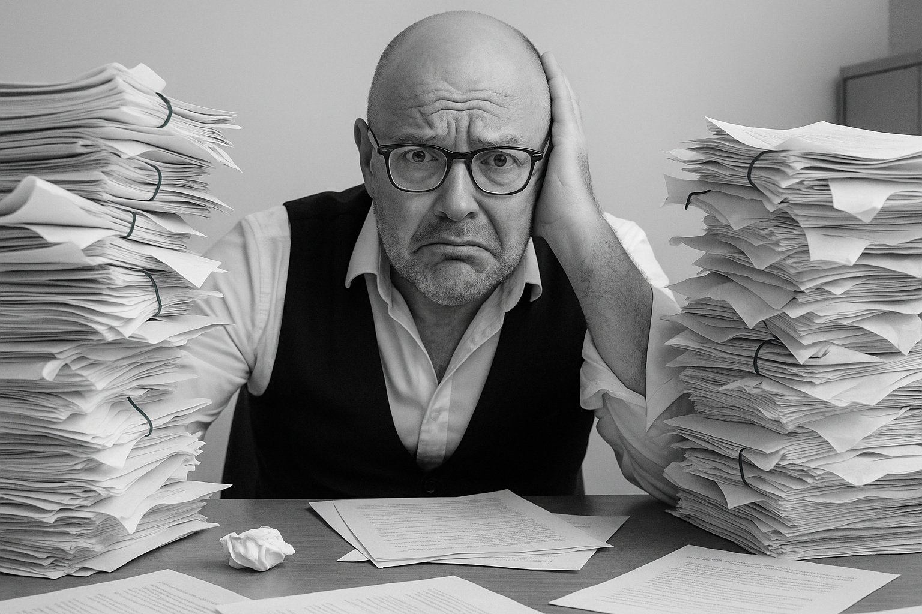


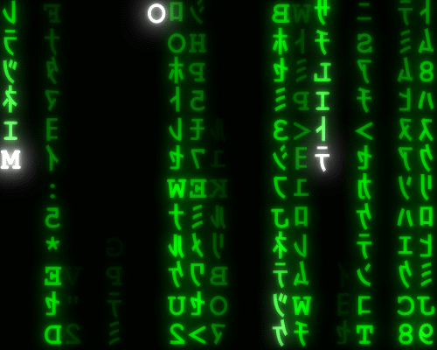
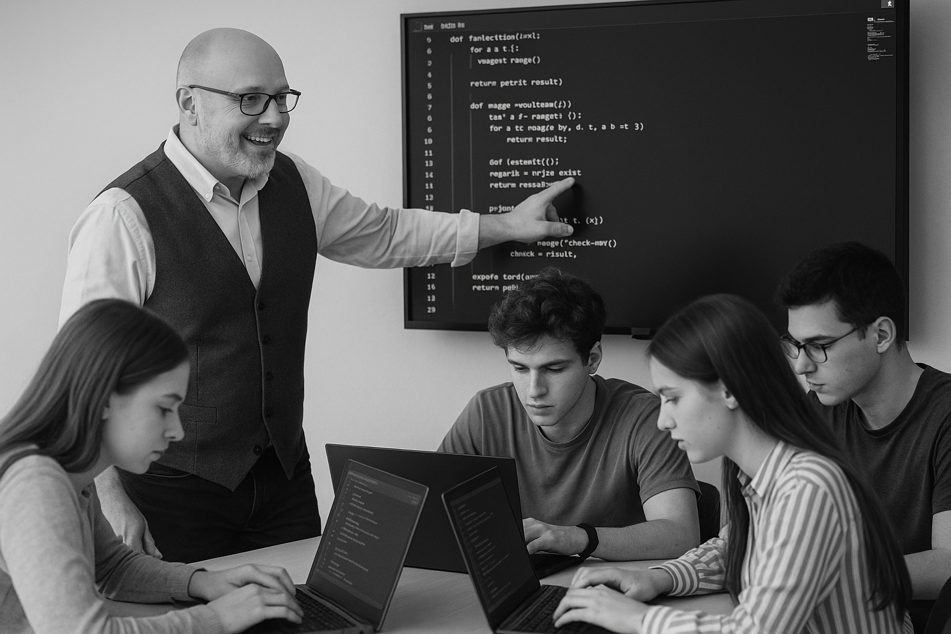

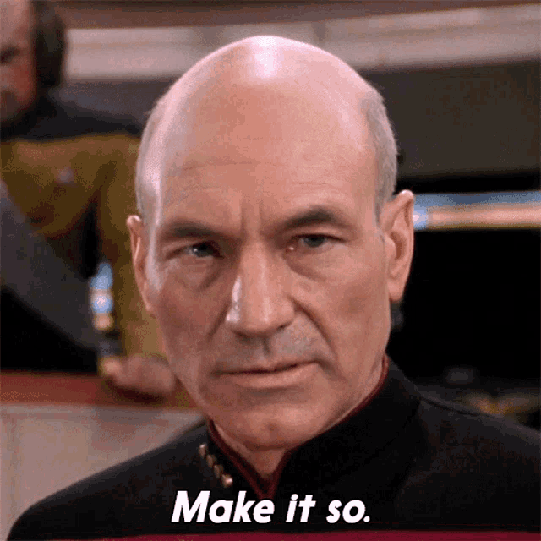






<title>
Note this down
In pairs
Working Independently
In small groups
Deadline:
Midnight 6 days time
X mins
Do not delete this slide nor move it from the last slide in the deck

