Slide 1
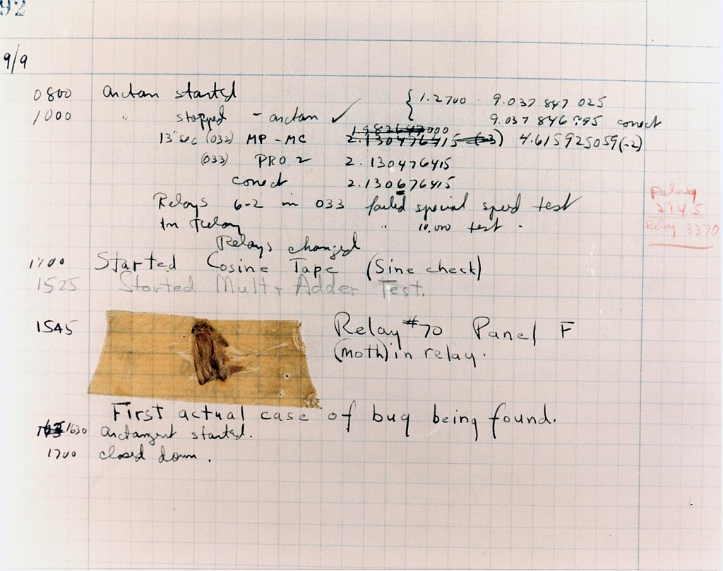
Testing
Lesson 1

Slide 2
Recall
Please do the recall quiz about the last few lessons at
https://forms.microsoft.com/e/z8LwVfrgwc
It should also in your email shortly

Slide 3
Testing
Lesson 1

Slide 4
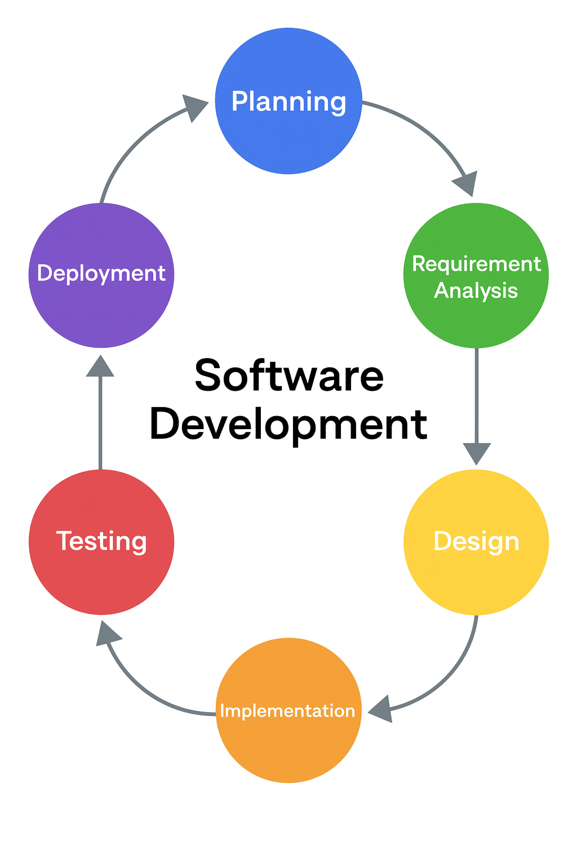
Software Development Life Cycle
Note this down
This is so important

Slide 5

The history of the bug
Note this down
In 1947, a small Moth flew into the large room where the Harvard Mk II, one of the earliest computers was housed.
It landed between two valves and electrocuted itself
It caused a short-circuit which stopped the computer working.
The engineers had to hunt through the thousands of values to find and fix the short-circuit.
Any software error has been called a bug ever since.
Rear Admiral Grace Hopper, US Navy
One of Computing’s pioneers

Slide 6

When has a software bug ruined your life?
When have you been frustrated by a bug in any Software, Apps or Websites that you use?
In small groups
Is this Bradley?

Slide 7
The importance of Software Testing
See “Programming’s Greatest Mistakes” by Mark Rendel
Software bugs can cause potential monetary and human loss. There are many examples in history that clearly depicts that without the testing phase in software development lot of damage was incurred. Below are some examples:
1994: China Airlines Airbus A300 crashed due to a software bug killing 264 people.
1996: A software bug caused U.S. bank accounts of 823 customers to be credited with 920 million US dollars.
1999: A software bug caused the failure of a $1.2 billion military satellite launch.
1999: Fujitsu’s Horizon IT system caused more than 900 Subpostmasters to be wrongly accused and even prosecuted for theft and fraud, caused by bugs in the system,
2015: A software bug in the F-35 fighter plane resulted in making it unable to detect targets correctly.
2015: Bloomberg terminal in London crashed due to a software bug affecting 300,000 traders on the financial market and forcing the government to postpone the 3bn pound debt sale.
2023: Starbucks was forced to close more than 60% of its outlet in the U.S. and Canada due to a software failure in its POS system.
Which example was worse: financial loss or human loss?

Slide 8
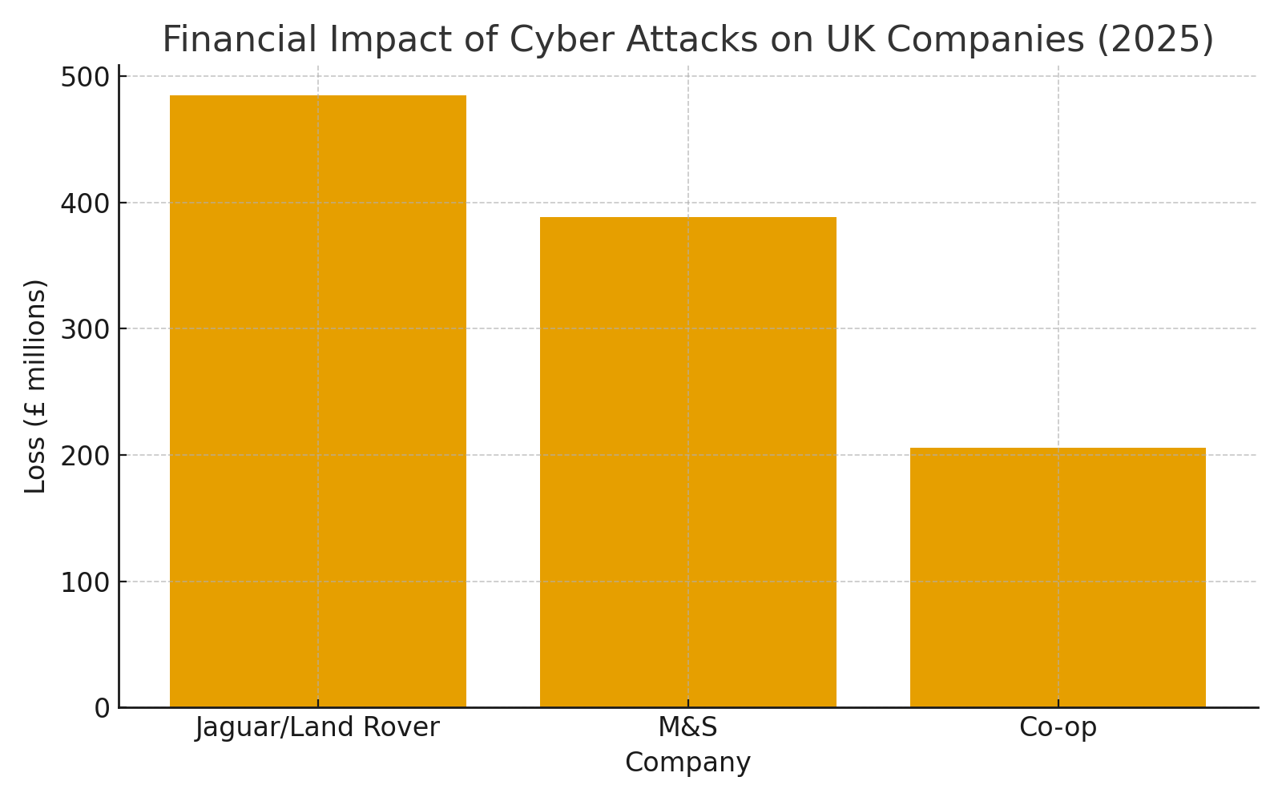
This year alone…
Jaguar/Land Rover posted a £485m loss compared with a profit of £398m for the same period a year ago as a result of the cyber attack that shut down their production in September 2025
Not to mention all the companies that make and supply parts to JLR who couldn’t work either!
M&S profits slumped by 99% from £391.9m to £3.4m after it’s cyber attack
Co-op lost £206m in lost sales due to a cyber attack

Slide 9

“You do not write code, you debug it”
Simon Rundell
September 2025
(and lots of times before & since)

Slide 10
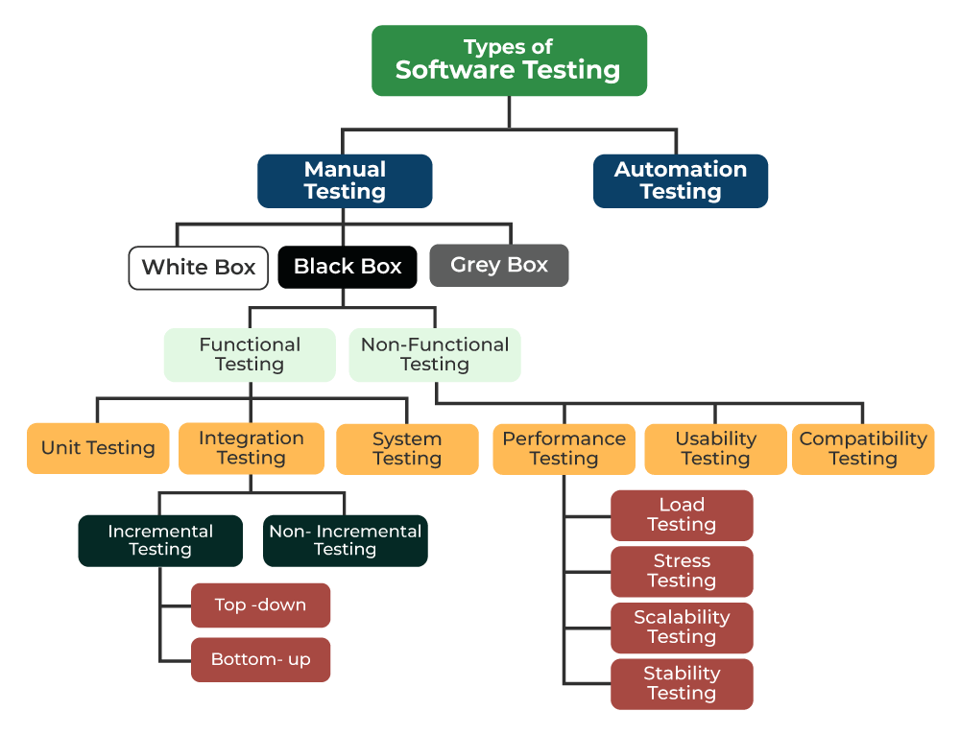
Human action to test correct operation
Note this down

Slide 11
What are the colour boxes?
White Box
Black Box
Gray Box
Focus on internal operation with ref to Source Code
Focus on function only
A mix of White & Black Box testing
Usually done by developers
Can be done by anyone
Often done by end-users

Slide 12
Testing Strategies - Smoke Tests
Note this down
aka confidence testing, sanity testing, build verification test (BVT) and build acceptance test)
Preliminary testing to reveal simple failures severe enough to halt further testing.
It is a subset of test cases that cover the most important functionality of a component or system
Used to aid assessment of whether main functions of the software appear to work correctly.
If software passes Smoke Testing it may be subjected to further, more fine-grained testing, so it might be called a pretest or an intake test.
“Does it work at all?”

Slide 13
Different Levels of Software Testing
In Software testing there are Different Levels of Testing can be majorly classified into 4 levels:
Unit Testing: In this type of testing, errors are detected individually from every component or unit by individually testing the components or units of code to ensure that they are fit for use by the developers. It is the smallest testable part of the software.
Integration Testing: In this testing, two or more modules which are unit tested are integrated to test i.e., technique interacting components, and are then verified if these integrated modules work as per the expectation or not, and interface errors are also detected.
System Testing: In system testing, complete and integrated Software are tested i.e., all the system elements forming the system are tested as a whole to meet the requirements of the system.
Acceptance Testing: This is a kind of testing conducted to ensure that the requirements of the users are fulfilled before its delivery and that the software works correctly in the user’s working environment.

Slide 14
Levels of testing
Note this down
Acceptance Testing
System Testing
Integration Testing
Unit Testing

Slide 15
Often used in Agile from start to finish, using software tools to replace manual testing

Slide 16
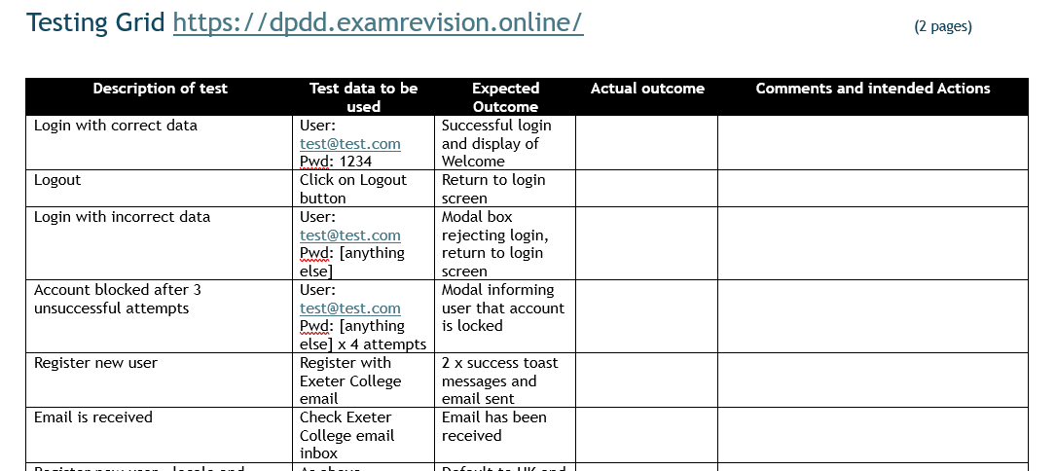
Unit Testing Practice

Slide 17
Some real testing based upon a simple login function
Download a copy of the Test Grid from the Teams / Coursework/ Unit 1/ Lesson 09 Testing Grid
Visit: https://dpdd.examrevision.online/
Undertake the tests on the website login function
Attach your test grid to your Class Notes
20 mins

Slide 18
Homework
Deadline:
Midnight 6 days time
Task 1 – Everyday Bugs (5 minutes)
Write down two examples of software “bugs” or failures you’ve personally experienced (apps, websites, games, or devices).
For each:
Describe what went wrong.
Explain how it affected you or others (frustration, wasted time, data loss, etc.).
Task 2 – Testing Levels (10 minutes)
Imagine you are helping to test a food delivery app. Choose one feature (e.g., logging in, adding food to a cart, making payment, or tracking delivery).
For that feature, explain what you would check at each level of testing:
Unit Test – What is one small piece of code you’d test?
Integration Test – How would you test two parts working together?
System Test – What would you test across the whole app?
Acceptance Test – What would you ask a user to check before release?

Slide 19










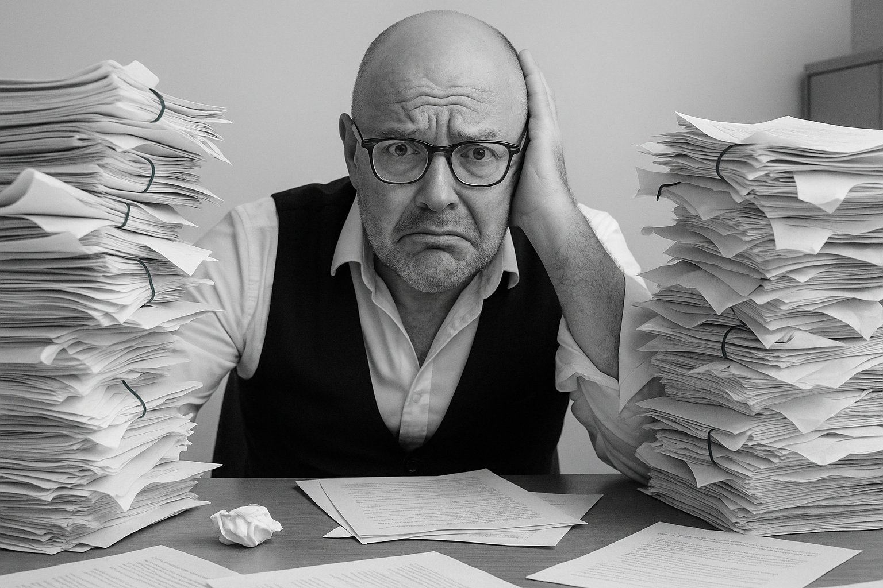


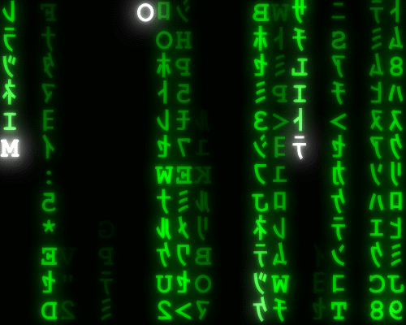


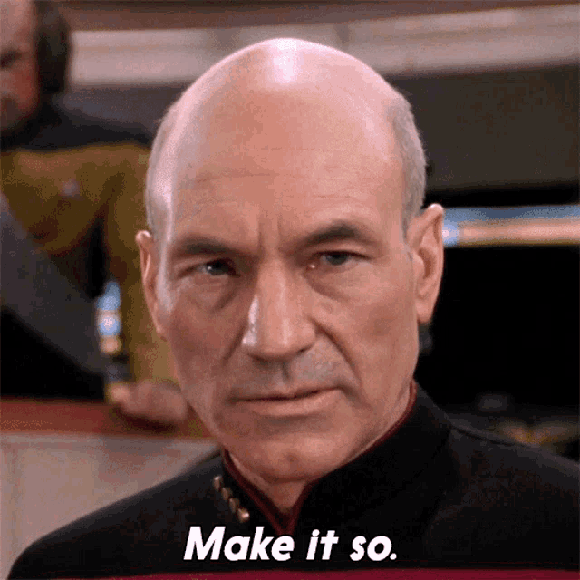






<title>
Note this down
In pairs
Working Independently
In small groups
Deadline:
Midnight 6 days time
X mins
Do not delete this slide nor move it from the last slide in the deck

