Slide 1
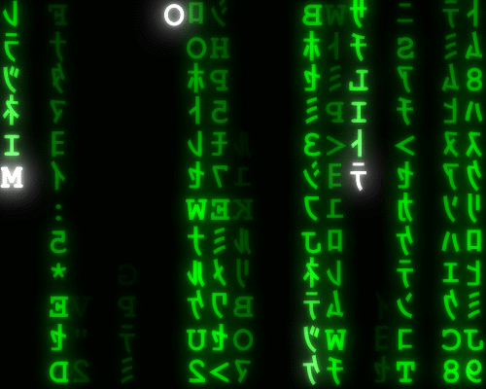
Implementation Phase: Coding the Code
Lesson 11.1

Slide 2
Recall from last lesson
https://forms.microsoft.com/e/WDNMTrfcqR
An email should by now have arrived with the link attached.

Slide 3
Phones
a small reminder…
once you have authenticated phones should be in the pockets on the wall
There will be no more toilet breaks in my lessons. If you can’t manage to use the toilet in the breaks then you need to learn to. Going to the toilet is not an excuse for missing a substantial part of the lesson.

Slide 4
Implementation Phase: Coding the Code
Lesson 11.1

Slide 5
Learning Objectives
By the end of the lesson, students will be able to:
Define what the implementation stage is in the SDLC.
Identify actions that take place during implementation, including:
Writing code
Creating functions and modules
Following coding standards
Integrating components
Applying version control
Writing internal documentation/comments
Explain the purpose of those actions in a simple project.
Apply their learning to a small scenario-based task.

Slide 6
Fix this:
In pairs
DISPLAY “Welcome”
END PROGRAM
INPUT age
IF age ≥ 18 THEN
DISPLAY “You can enter”
10 mins
What’s missing?
What belongs in the implementation stage?
What order code should go in?
Implementation is about writing, organizing and structuring code

Slide 7
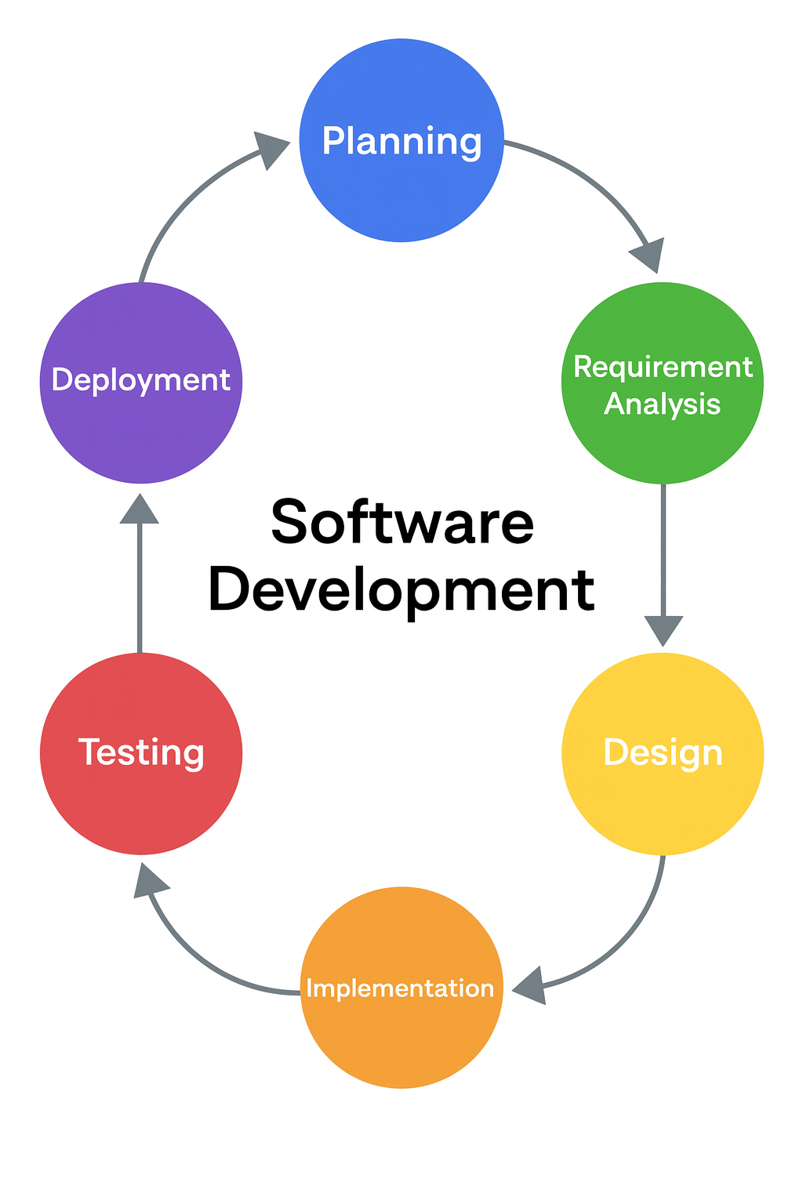
SDLC Recap
Planning
Requirements
Design
Implementation (coding)
Testing
Deployment
This is where we build it!

Slide 8

What implementation includes:
Note this down
Translating the design into code
Writing functions, algorithms, modules
Using coding standards
indentation, naming conventions
Adding comments
Using version control (Git)
Integrating various parts of the codebase
Running basic checks on the code

Slide 9
What it does not include:
Full testing stage
Requirements gathering
UI sketching
Final deployment

Slide 10
Implementation Stage Carousel
Working Independently
In your OneNote identify whether these actions are:
✔ Implementation stage
or
✖ Not implementation
“Write a loop that repeats three times.”
“Create a function to calculate total score.”
“Set up a Git repository and commit the first file.”
“Refactor code to make it simpler.”
“Add comments to explain each section.”
“Integrate two pieces of code from different team members.”
20 mins

Slide 11
Writing Good Code
Implementation is not just writing code: it’s writing maintainable, readable code.
def calculate_total(price, tax):
total = price + tax
return total
def CT(p,t):return p+t
Which one would you prefer?

Slide 12
Scenario Sorting
In small groups
A team is building a simple mobile app that displays bus times
Here is a list of tasks:
Draw a wireframe
Write the program loop
Comment the code
Interview users
Add new features to GitHub
Write pseudocode
Connect the UI to the database
Perform a final user acceptance test
Fix a merge conflict
Build a login function
20 mins
In a OneNote identify whether these actions are:
✔ Implementation stage
or
✖ Not implementation

Slide 13
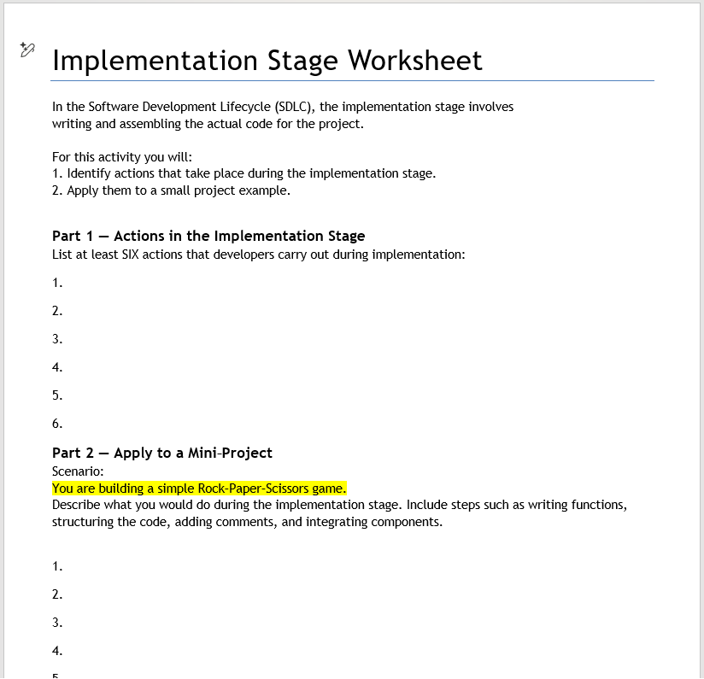
Implementation Worksheet
Working Independently
In Teams / Classwork / Unit 1 / Implementation Stage Worksheet
20 mins

Slide 14


Two truths and a lie…
Two of the following statements are
One of them is

Slide 15
Question 1
The implementation stage involves writing the actual code.
Developers may create functions and modules during implementation.
The implementation stage includes gathering requirements from the client.

Slide 16
Question 2
Developers add comments to explain how parts of the program work.
Implementation includes final deployment to end users.
Version control tools like Git are often used during implementation.

Slide 17
Question 3
Implementation includes creating UI wireframes and sketches.
Integrating different pieces of code from multiple team members can happen during implementation.
Implementation includes refactoring code to improve readability.

Slide 18
Question 4
During implementation, developers follow naming conventions and coding standards.
Implementation includes debugging small errors as code is written.
Implementation includes running full user acceptance testing.

Slide 19
Question 5
The implementation stage is where the design is translated into actual working code.
Implementation tasks may include writing algorithms and loops.
Implementation includes deciding the project’s budget and timeline

Slide 20
Homework
Deadline:
Midnight 6 days time
“Why is the implementation stage important in the SDLC?
How does good implementation help coding teams work effectively?

Slide 21













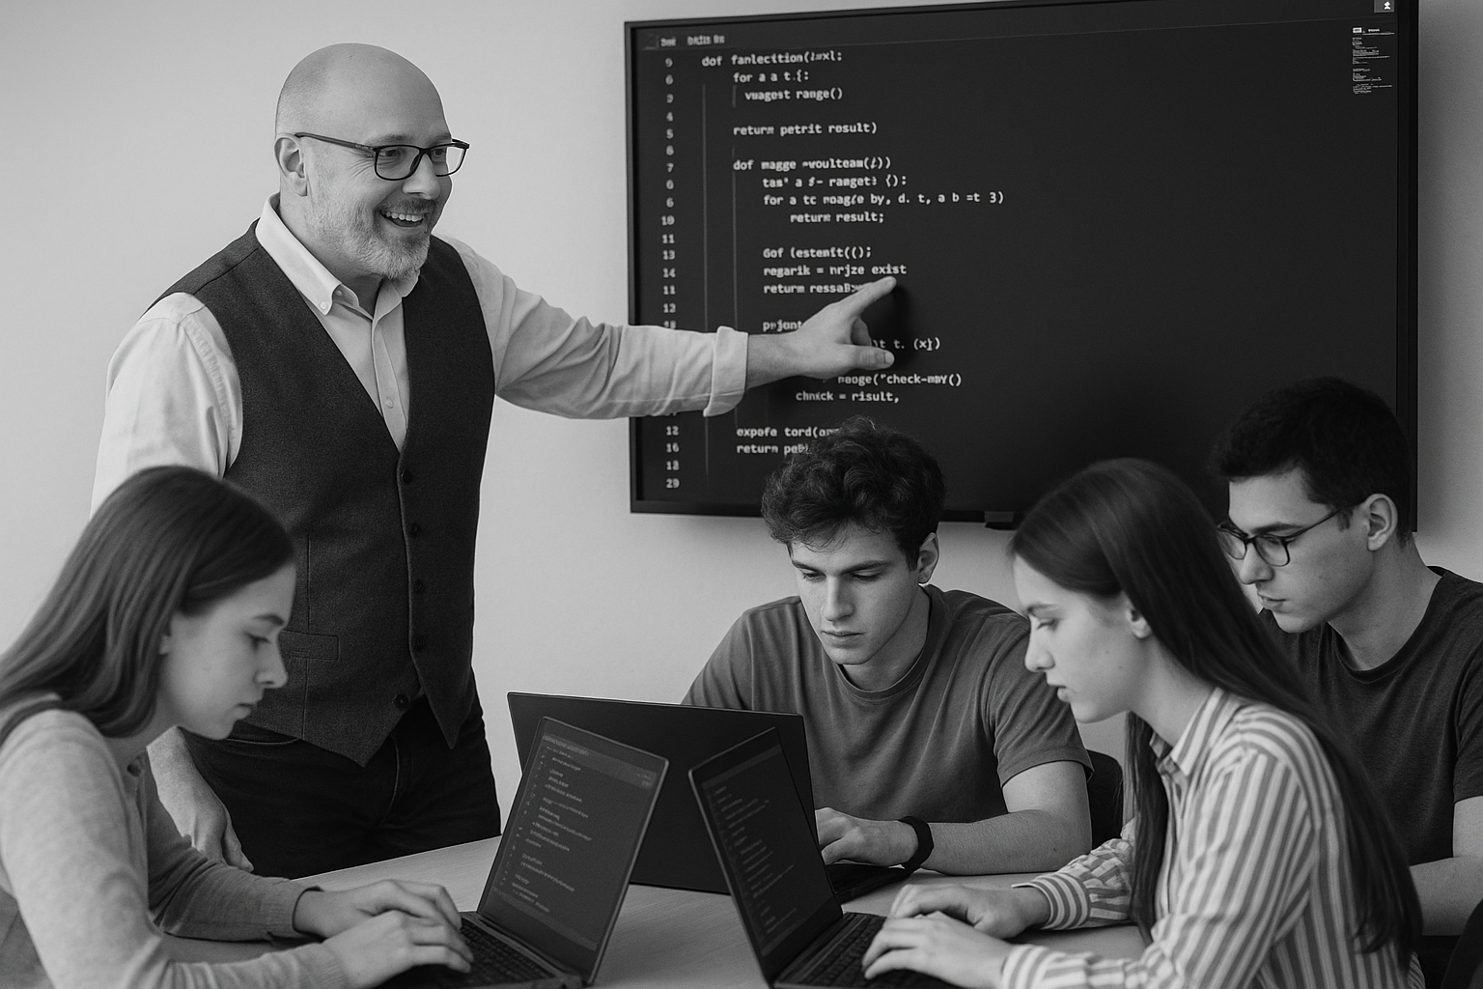






<title>
Note this down
In pairs
Working Independently
In small groups
Deadline:
Midnight 6 days time
X mins
Do not delete this slide nor move it from the last slide in the deck

