Slide 1
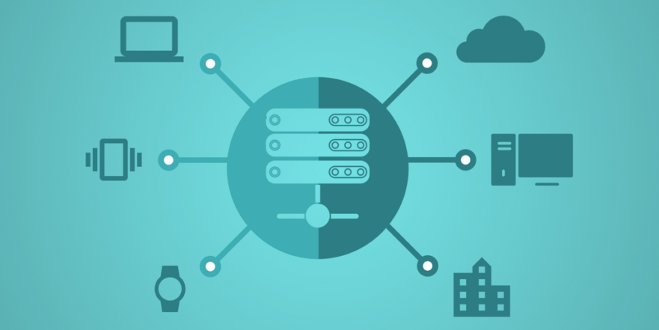
What happens after Implementation?
Lesson 11

Slide 2
Recall from last lesson
https://forms.microsoft.com/e/ZrPc2bPMLV
An email should by now have arrived with the link attached.

Slide 3
Phones
a small reminder…
once you have authenticated phones should be in the pockets on the wall
There will be no more toilet breaks in my lessons. If you can’t manage to use the toilet in the breaks then you need to learn to. Going to the toilet is not an excuse for missing a substantial part of the lesson.

Slide 4
What happens after Implementation?
Lesson 11

Slide 5
Learning Objectives
By the end of this lesson, students will be able to:
Describe actions that may take place during the deployment stage.
Explain the importance of the maintenance stage in the software development cycle.
Identify real-world examples of deployment and maintenance issues.
Apply understanding through scenario-based tasks.

Slide 6
Software gone wrong!
Is it…
❌ Deployment stage issue
or
🔧 Maintenance stage issue
A mobile app update causes phones to crash.
A game update deletes player save files.
A website launches but all payment transactions fail.
A school system update makes logins impossible.
A patch introduces a security hole.
A company delays deploying a fix for a bug and loses customers.

Slide 7
Answers
1. “A mobile app update causes phones to crash.”
➡️ Deployment issue
Reason: The update was deployed incorrectly or insufficiently tested before release.
2. “A game update deletes player save files.”
➡️ Deployment issue
Reason: A critical bug slipped into the released build—often a packaging or version-control error during deployment.
3. “A website launches but all payment transactions fail.”
➡️ Deployment issue
Reason: Payment API configuration, database migration, or live environment setup issue during launch.

Slide 8
Answers
4. “A school system update makes logins impossible.”
➡️ Deployment issue (with maintenance implications)But for the starter classification: Deployment issue
Reason: Incorrect configuration during update deployment.
5. “A patch introduces a security hole.”
➡️ Maintenance issue
Reason: They were maintaining the system (issuing a patch), but it created a new vulnerability. This happens post-release during maintenance.
6. “A company delays deploying a fix for a bug and loses customers.”
➡️ Maintenance issue
Reason: The fix belongs to the maintenance stage; failure to act during maintenance caused the loss.

Slide 9
Deployment Stage – What happens?
Actions may include:
Final Testing Before Release
smoke tests, usability checks, compatibility checks.
Packaging & Distribution
creating installers, publishing to app stores, hosting on servers.
User Training / Documentation
manuals, online help, walkthroughs.
Data Migration
transferring old user data into the new system.
Deploying to Live Environment
releasing v1.0, scheduling release windows, avoiding peak times.
Rollback Plans (VERY important)
what to do if the deployment fails.
Monitoring the Release
checking for errors, feedback, system performance.

Slide 10
Maintenance Stage – Why It Matters?
The maintenance stage is essential because systems are never finished.
Corrective Maintenance
fixing bugs that appear after release.
Adaptive Maintenance
changes due to new hardware/software (e.g., iOS updates).
Perfective Maintenance
improving performance, adding features.
Preventative Maintenance
stopping future issues (e.g., security patches).
Importance:
Keeps the system secure
Improves performance over time
Ensures user satisfaction
Prevents financial loss
Ensures legal compliance (e.g., data protection vulnerabilities)

Slide 11
You are the Deployment Team
In small groups
30 mins
A school is launching a new homework-submission system. Your team must plan the deployment.
What actions must take place before deployment?
What must happen during the deployment?
What could go wrong?
How will you monitor and test after release?
What maintenance tasks will be needed in the first month?
Produce a short Powerpoint of 5 or so slides and email to simonrundell@exe-coll.ac.uk to deliver a 2 min presentation to the class

Slide 12
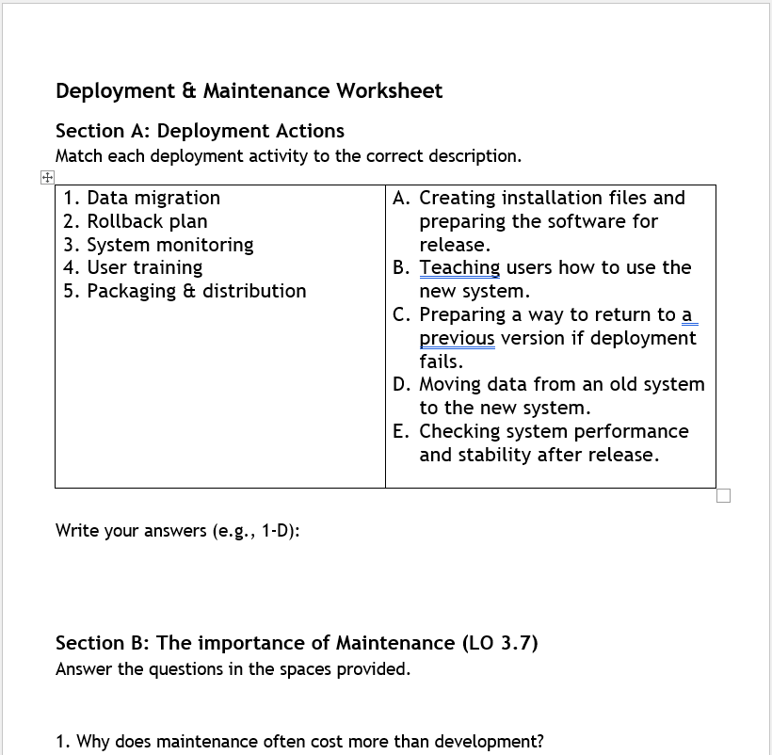
Worksheet Task
Working Independently
20 mins
Go to Teams / Classwork / Unit 1 / Deployment and Maintenance Worksheet
Complete the sheet

Slide 13

Exit Ticket
“What is ONE action that happens during deployment, and ONE reason why maintenance is important?”
https://forms.microsoft.com/e/TEx71NHCvs
If you have been good, I’ll put the link on eMail.

Slide 14
Homework
Deadline:
Midnight 6 days time
Find a real example of a software update that caused problems after launch (e.g., Tesla, Apple, NHS IT). Write 100–150 words explaining:
What went wrong?
Whether it was a deployment or maintenance problem
What the company did to fix it

Slide 15

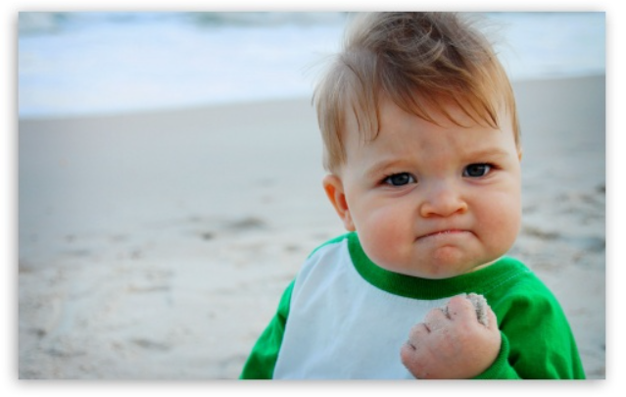






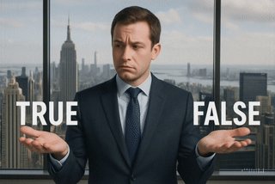
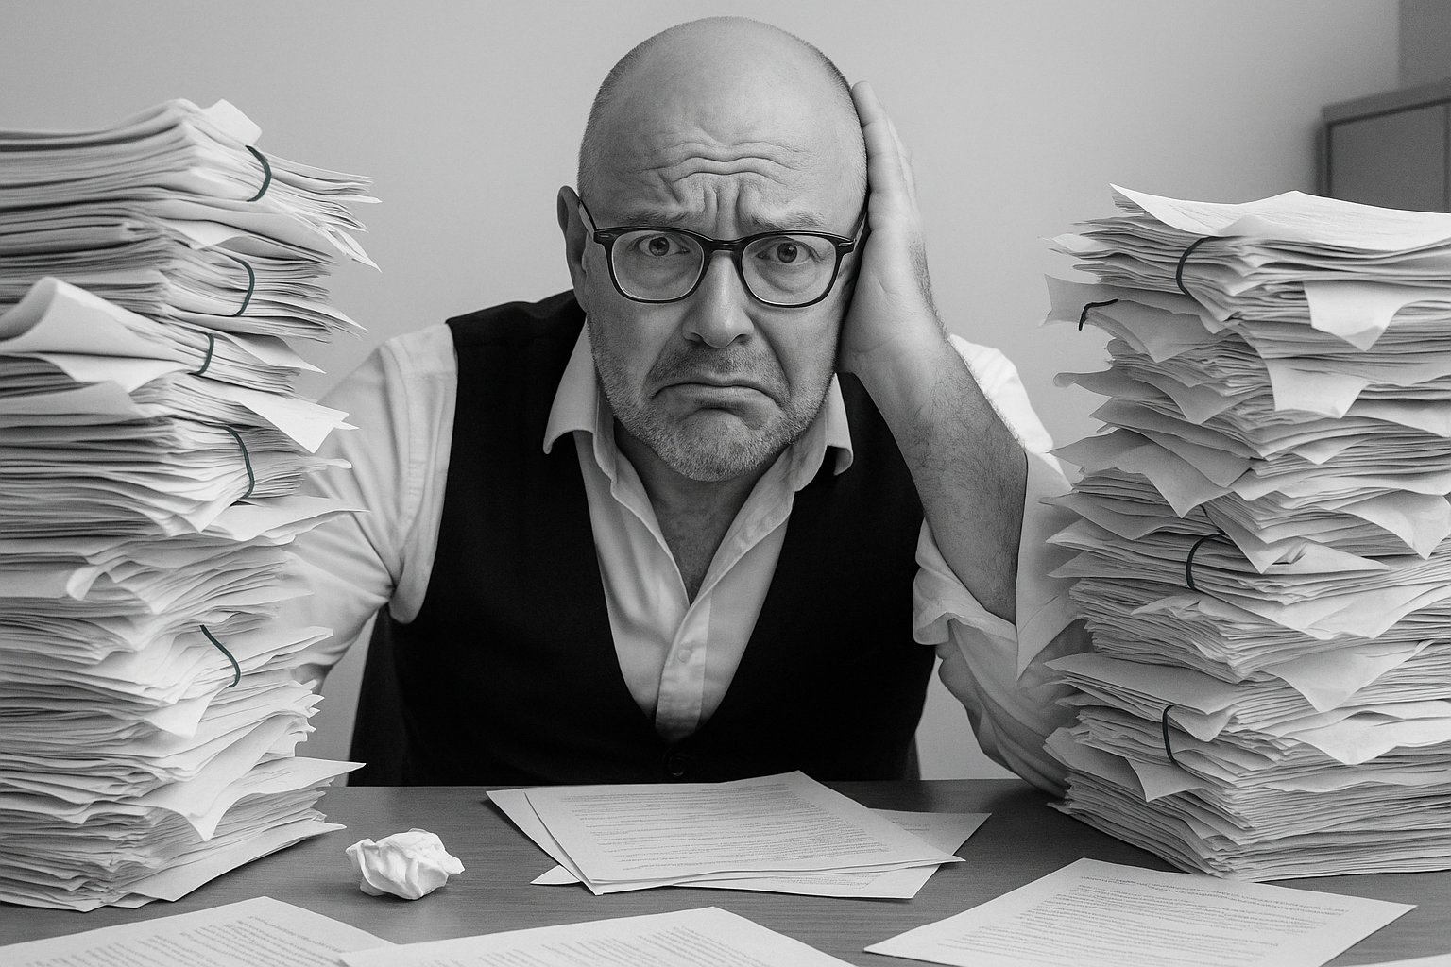


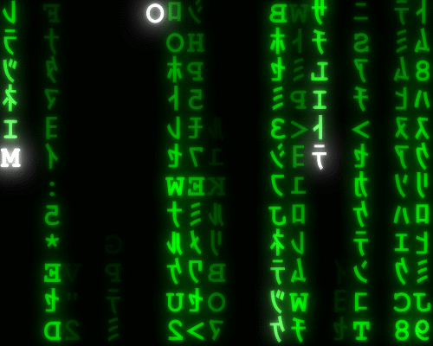
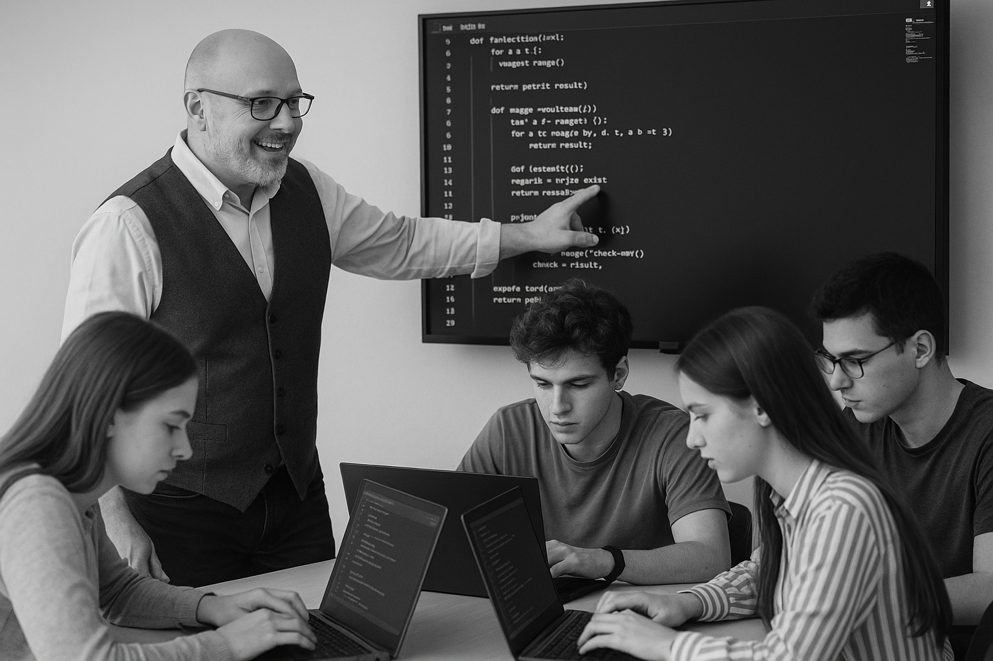
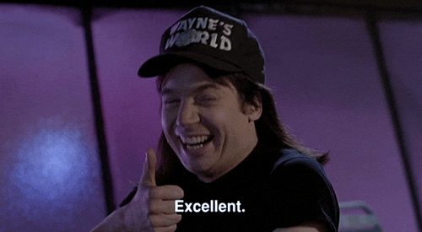
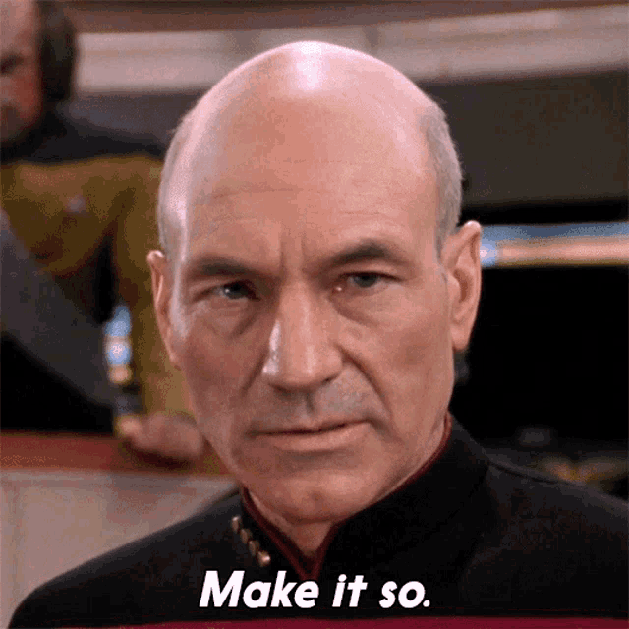






<title>
Note this down
In pairs
Working Independently
In small groups
Deadline:
Midnight 6 days time
X mins
Do not delete this slide nor move it from the last slide in the deck

