Slide 1
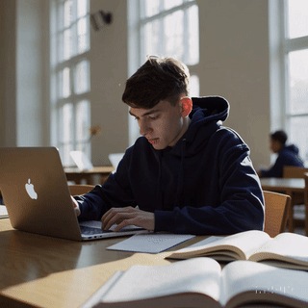
Practice
Lesson 11 Onwards

Slide 2
Recall
https://forms.microsoft.com/e/TfySueVpRY
An email should by now have arrived with the link attached.

Slide 3
Aims for the next few lessons
To develop confidence in the programming we have covered so far
To play with your code and extend it as you deepen your knowledge

Slide 4
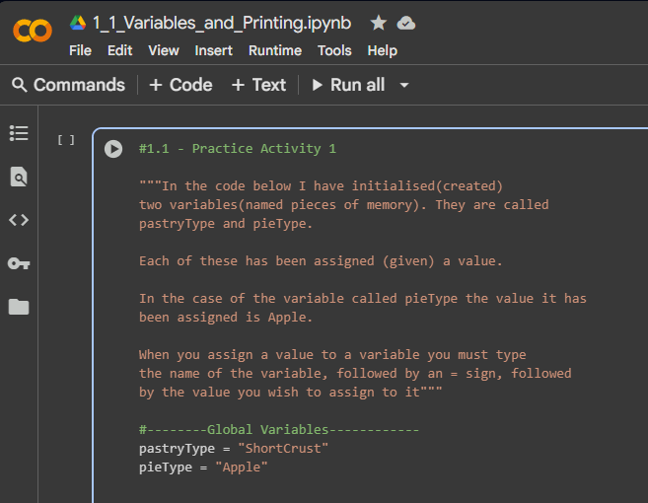
Introducing Google Colab
Colab is a collaborative environment which supports text and small sections which can run code.
Each section of code can be run by clicking on the play button in each section.
It means that you can work on code and see the results below each section
Run button

Slide 5
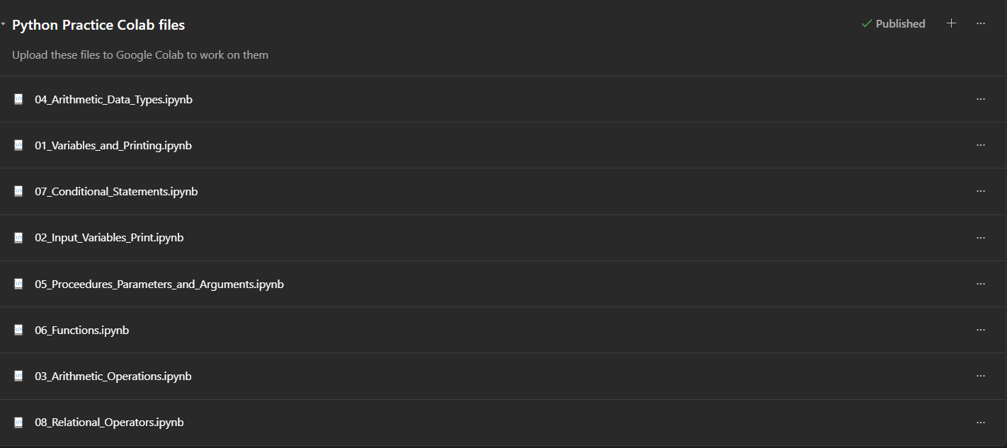
Working with Google Colab
From the Teams Classwork folder
Go to “Python Practice Colab files”
Download these files to an appropriate folder in your OneDrive
Change to filename to include your own name
Upload the file to Colab and work on it as the instructions indicate

Slide 6
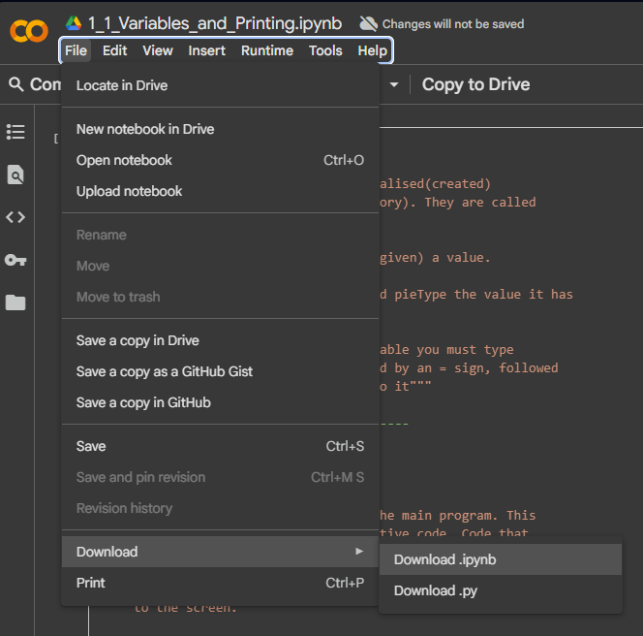

Working with Google Colab
If you have a Google Account, it will offer to save your work in your personal Google Drive
This is great for you to work on outside of class but I can’t see or mark that
At the end of today’s session, I will ask you to download your file (which they call notebook) and submit it to me so I can see your progress
Download it as a .ipynb file
Saving this means you can upload it again and work on it in next lessons

Slide 7
Moving towards independence
I will be circulating
However, there will be no examples on the board
If you get stuck why not look up some internet resources:
https://www.w3schools.com/python/
https://developers.google.com/edu/python/introduction

Slide 8
Independent work
SILENCE AS STANDARD
I am circulating to help you as you need it.

Slide 9
Recap
Download your work file as a .ipynb
There will be a class assignment on the system
Upload your work to that so I can check your progress
I will provide support as you need in the next lesson

Slide 10
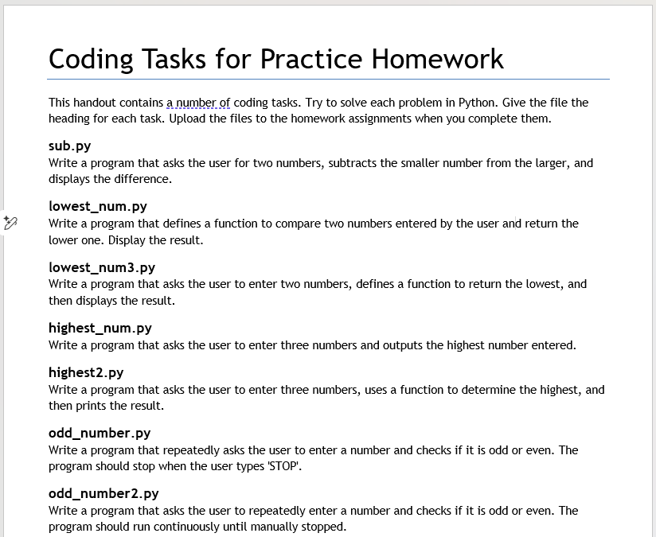
Homework
See the Coding_Tasks.docx document
Undertake the tasks in order
This homework will take several homework sessions so don’t feel you have to rush through them
Save them as each heading indicates and upload to the Homework assignment.

Slide 11
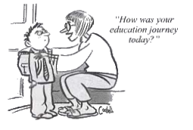







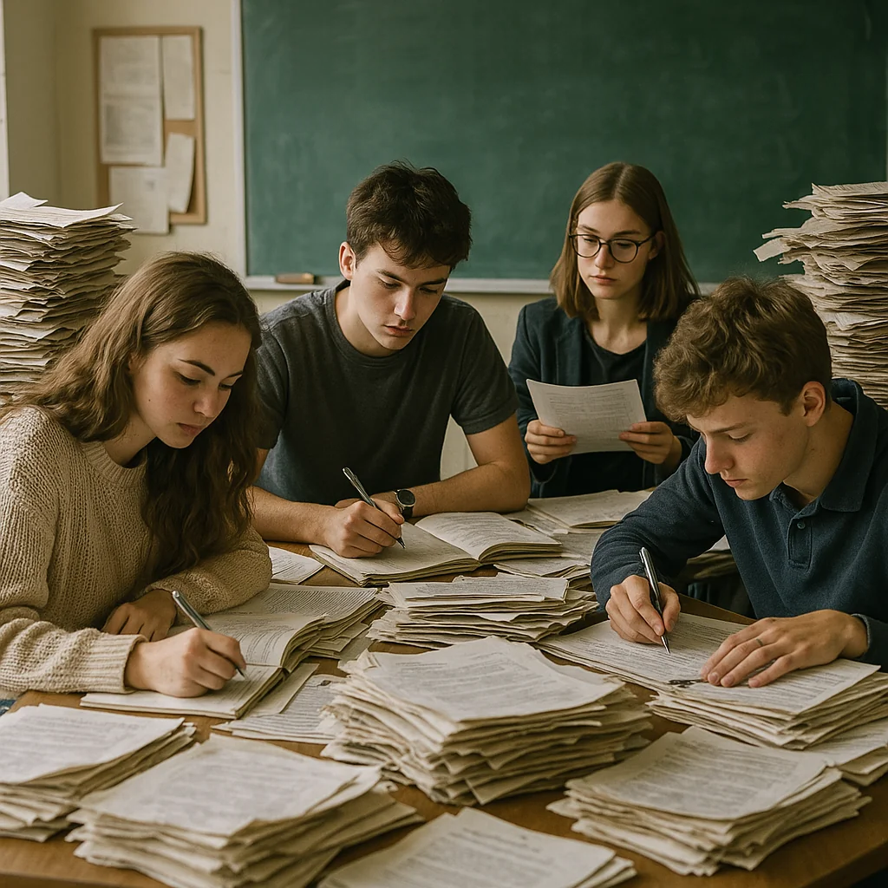




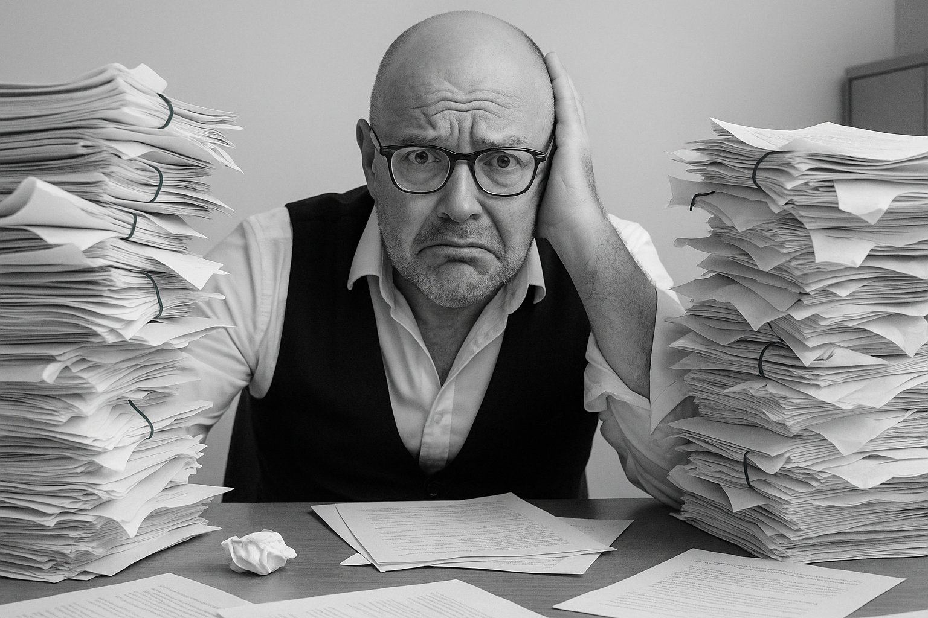


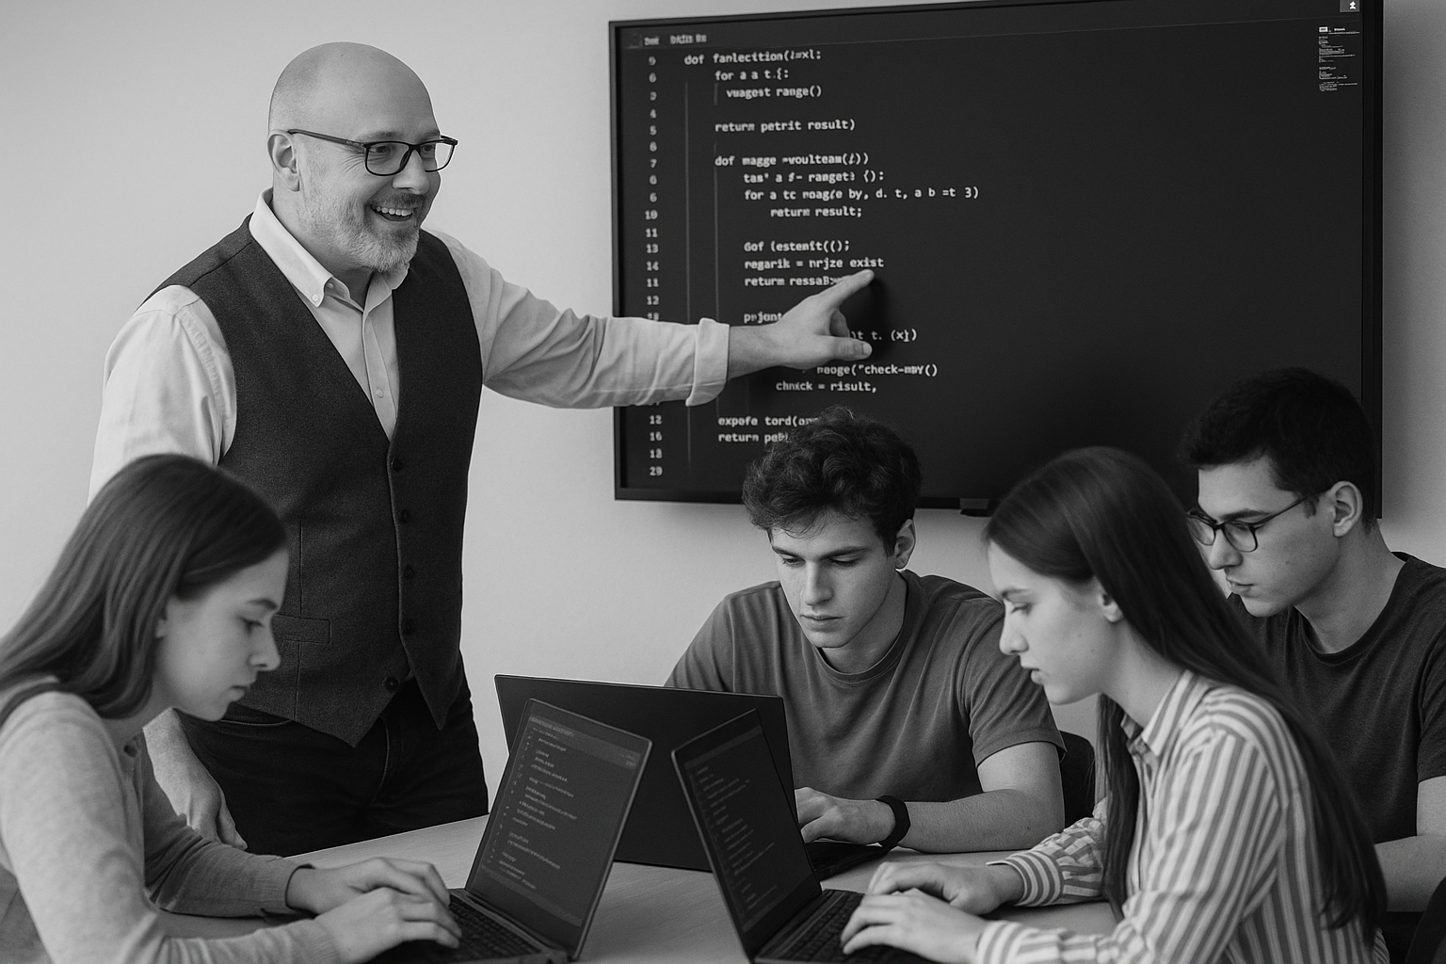
<title>
Note this down
Deadline:
Midnight before next lesson
Xmins
In small groups
Working Independently
In pairs
Do not delete this slide nor move it from the second last slide in the deck

