Slide 1

Unit 3
Introduction to Coding Paradigms
Lesson 01

Slide 2
Recall Quiz from last Unit
https://forms.microsoft.com/e/yfLYPXCR7P
An email should by now have arrived with the link attached.

Slide 3
Phones
a small reminder…
once you have authenticated phones should be in the pockets on the wall
There will be no more toilet breaks in my lessons. If you can’t manage to use the toilet in the breaks then you need to learn to. Going to the toilet is not an excuse for missing a substantial part of the lesson.

Slide 4
Unit 3
Introduction to Coding Paradigms
Lesson 01

Slide 5
Lesson Objectives
To review some things we looked at last term
To identify the different purposes of code
To appreciate the history of the development of programming languages
To be able to break down actions into clear steps

Slide 6
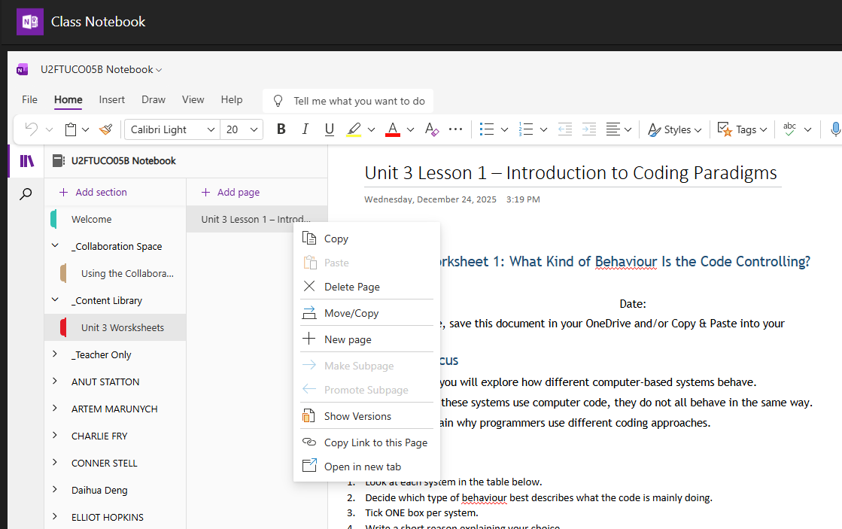
More OneNote this term…
Move/Copy to your own section

Slide 7
What kind of behaviour is the code controlling?
These systems all use code, but what kind of behaviour is the code mainly controlling?
Traffic lights
Washing machine
Microwave oven
ATM
Smartphone app (e.g. messaging app)
Smart thermostat
In OneNote, do the worksheet
There is no single correct answer. You must justify your choice

Slide 8
Code is a set of instructions, not intelligence
Step-by-step → imperative / procedural
Responding to events → event-driven
Keeping a rule true → declarative
Multiple tasks → functional & parallelisation

Slide 9
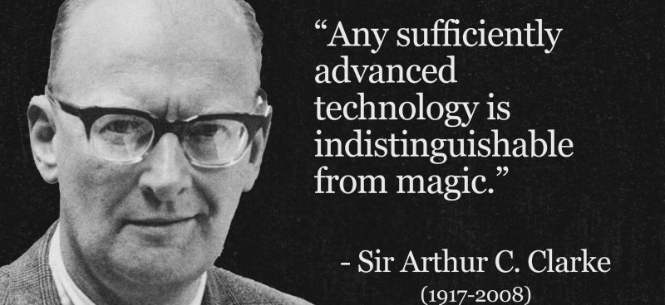
Remember this…
…especially when people talk of “Artifical Intelligence”

Slide 10
What is a Coding Paradigm?
A style or approach
We know that Code is…
  Instructions given to a computer
We know that a Program is…
  A set of instructions written for a computer to follow
We have already encountered different ways of doing this…
  Procedural Programs
  Object-orientated Programs
  Event-driven Programs
All of these different ways (and some more to follow) are programming paradigms.

Slide 11

Giving Directions
Give Step-by-Step instructions on paper
Draw a diagram/map
Give a verbal explanation
All of these achieve the same goal but use different methods.

Slide 12
Where is code used?
Working Independently
Research two everyday systems that rely on computer code
In your OneNote notebooks identify:
  What does the system do?
  Why does it need instructions?
  What could go wrong
15 mins

Slide 13
A (very) brief history of Programming Languages - 1
1842 – Ada Lovelace’s Algorithm for the Analytical Engine
1940s – Assembly Language (written for Collossus, Bletchley Park, UK)
1950s – Autocode Compiler (written for Manchester Mk I, UK)
1954 – FORTRAN (FORmula TRANslator) by John Backus
1958 – LISP by John McCarthy (at MIT, USA)
1958 – ALGOL (ALGOrithmic Language) by John Backus
1959 – COBOL (COmmon Business Orientated Language) by Grace Hopper

Slide 14
A (very) brief history of Programming Languages - 2
1965 – BASIC (Beginners All Purpose Symbolic Instruction Code) by John Kemeny and Thomas Kurtz, Dartmouth College, USA
1967 – Logo (Turtle Graphics)
1969 – B by Dennis Ritchie and Ken Thompson, Bell Labs, USA
1970 – Pascal by Niklaus Wirth, Switzerland
1972 – C also by Ritchie and Thompson
1972 – Smalltalk (OOP forerunner)
1978 – SQL (Structured Query Language)

Slide 15
A (very) brief history of Programming Languages - 3
1980 – C++ (C with classes) by Bjarne Stroustrup, Denmark
1983 – Ada, used in Military, Aviation & Defence systems
1987 – Perl (Practical Extraction and Reporting Language) by Larry Wall
1991 – Python by Guido van Rossum, Holland
1995 – Java, Sun Microsystems, now Oracle, USA
1995 – JavaScript by Brendan Eich (in 10 days!)
1995 – PHP by Rasmus Lerdorf, Denmark
2002 – Scratch by MIT, USA

Slide 16
A (very) brief history of Programming Languages - 4
2010 – Swift by Chris Lattner, Apple, USA
2012 – TypeScript – JavaScript with strong Typing
Source:
https://en.wikipedia.org/wiki/History_of_programming_languages

Slide 17
Why Isn’t There Just One Programming Language?
In small groups
10 mins
Identify at least 2 reasons why there isn’t just one programming language in the world.
Different devices
Different tasks
Speed vs ease of use
Team size

Slide 18
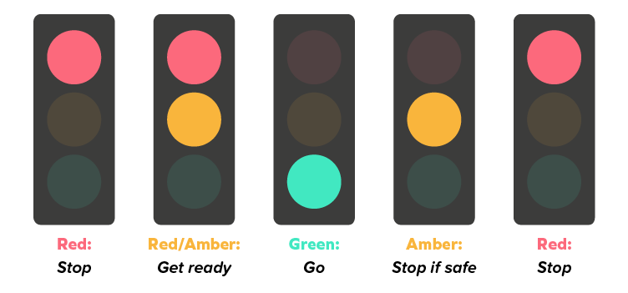
Task (in OneNote)
Describe without code the steps that display the sequence of Traffic Lights, which lights are switched on and which are switched off in order

Slide 19
Task
Describe without code the steps that display the sequence of Traffic Lights, which lights are switched on and which are switched off in order

Slide 20
Task
Describe without code the steps that display the sequence of Traffic Lights, which lights are switched on and which are switched off in order

Slide 21
Task
Describe without code the steps that display the sequence of Traffic Lights, which lights are switched on and which are switched off in order

Slide 22
Task
Describe without code the steps that display the sequence of Traffic Lights, which lights are switched on and which are switched off in order

Slide 23
Possible Answer:
Turn the red light on
  Wait 60 seconds
Turn amber light on
  Wait 10 seconds
Turn amber and red lights off
Turn green light on
  Wait 60 seconds
  …etc

Slide 24
Final Task / Homework
10 mins
In your own words in your OneNote:
Define what is meant by a coding type or coding paradigm.
(This might be useful for the final Unit Assessment)

Slide 25









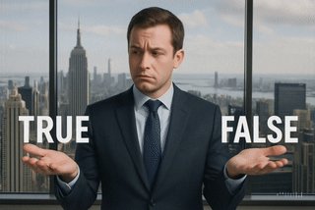
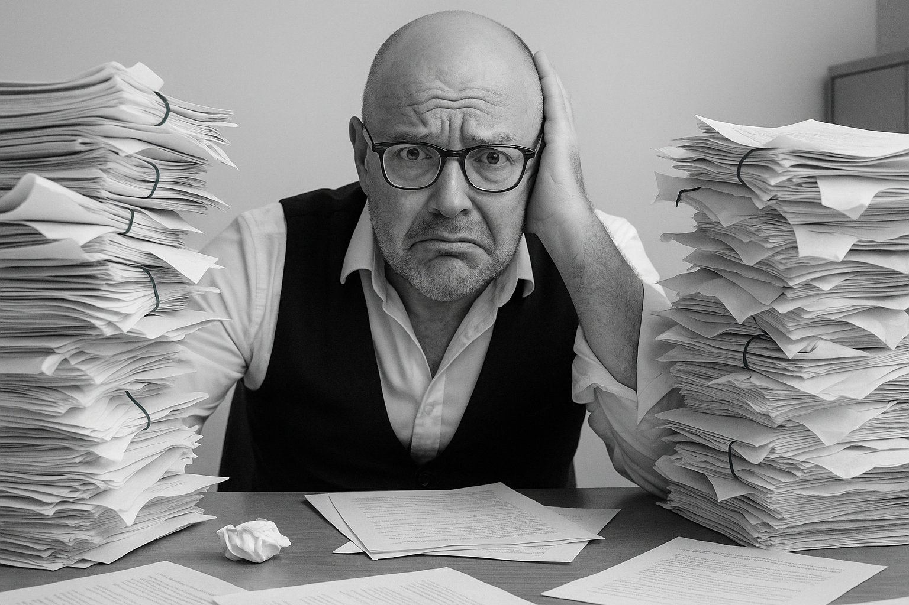


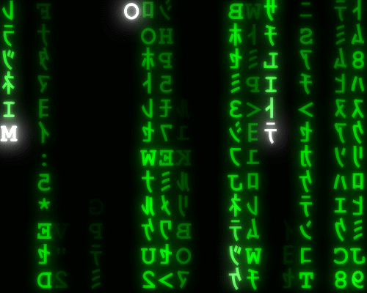
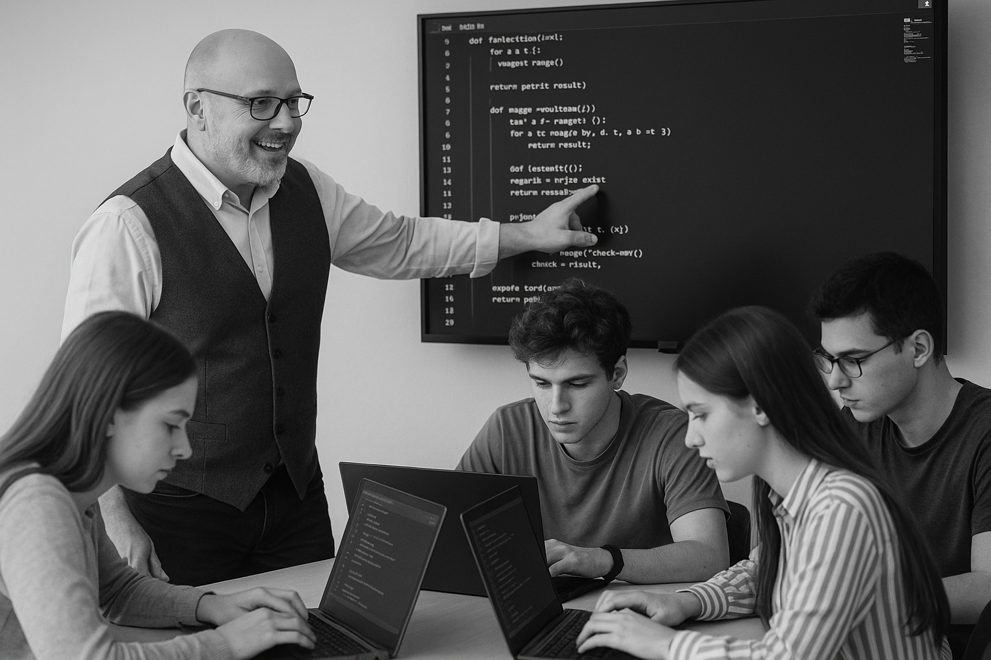

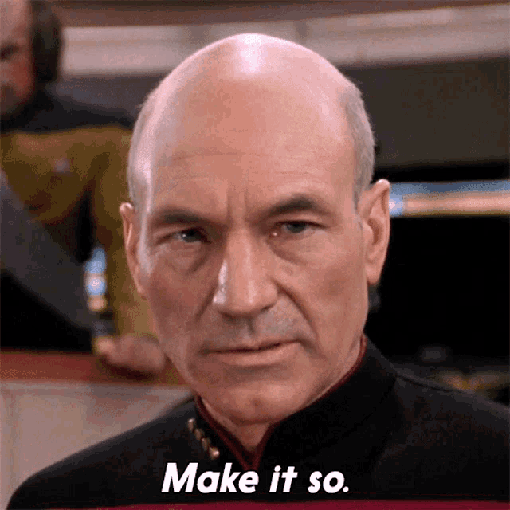






<title>
Note this down
In pairs
Working Independently
In small groups
Deadline:
Midnight 6 days time
X mins
Do not delete this slide nor move it from the last slide in the deck

