Slide 1

Unit 3
Imperative Coding
Lesson 02

Slide 2
Recall Quiz from last Unit
https://forms.microsoft.com/e/5yatZb4vdd
An email should by now have arrived with the link attached.

Slide 3
Phones
a small reminder…
once you have authenticated phones should be in the pockets on the wall
There will be no more toilet breaks in my lessons. If you can’t manage to use the toilet in the breaks then you need to learn to. Going to the toilet is not an excuse for missing a substantial part of the lesson.

Slide 4
Unit 3
Imperative Coding
Lesson 02

Slide 5
Learning Objectives
By the end of the lesson, learners will be able to:
Define imperative coding
Describe imperative coding as a step-by-step approach
Identify systems where imperative coding is suitable

Slide 6
Key Vocabulary
Imperative
Instruction
Sequence
Program
Step-by-step

Slide 7
From Behaviour to Paradigm
Last lesson, you described systems that follow a step-by-step process. Today we give that approach a name.
Imperative Coding
Imperative = telling the computer exactly what to do and in what order

Slide 8


What Is Imperative Coding?
Imperative coding:
  Gives instructions one after another
  The order matters
  The computer follows commands exactly
Assembling Furniture
Following a recipe

Slide 9
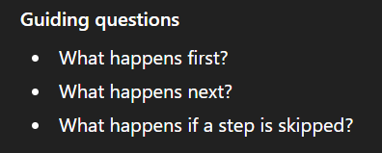
Research: Where is Imperative Coding Used?
Working Independently
15 mins
Research one system that relies on step-by-step instructions:
  Washing machine
  Traffic lights
  Microwave
  Simple game logic
  …anything else which interests you

Slide 10
Writing Imperative Instructions
Working Independently
Choose ONE system and write in OneNote:
  A numbered list of instructions
  No programming language
  Clear and unambiguous instructions
Example systems:
  Traffic lights
  Making toast
  ATM cash withdrawal
Rules:
  One instruction per line
  Assume the computer has no common sense
20 mins

Slide 11

Does order matter?
Give / eMail your instructions to a partner
Get them to follow it through (acting it out, perhaps)
What would break if the order changed?
This is why sequence is important in Imperative Code

Slide 12
Task / Homework (in your OneNote)
10 mins
Define what is meant by imperative coding
You should:
  Mention step-by-step instructions
  Mention order or sequence
  Use your own words
This might be useful for the Unit 3 Assessment

Slide 13

Give one example of where imperative coding would be useful.

Slide 14













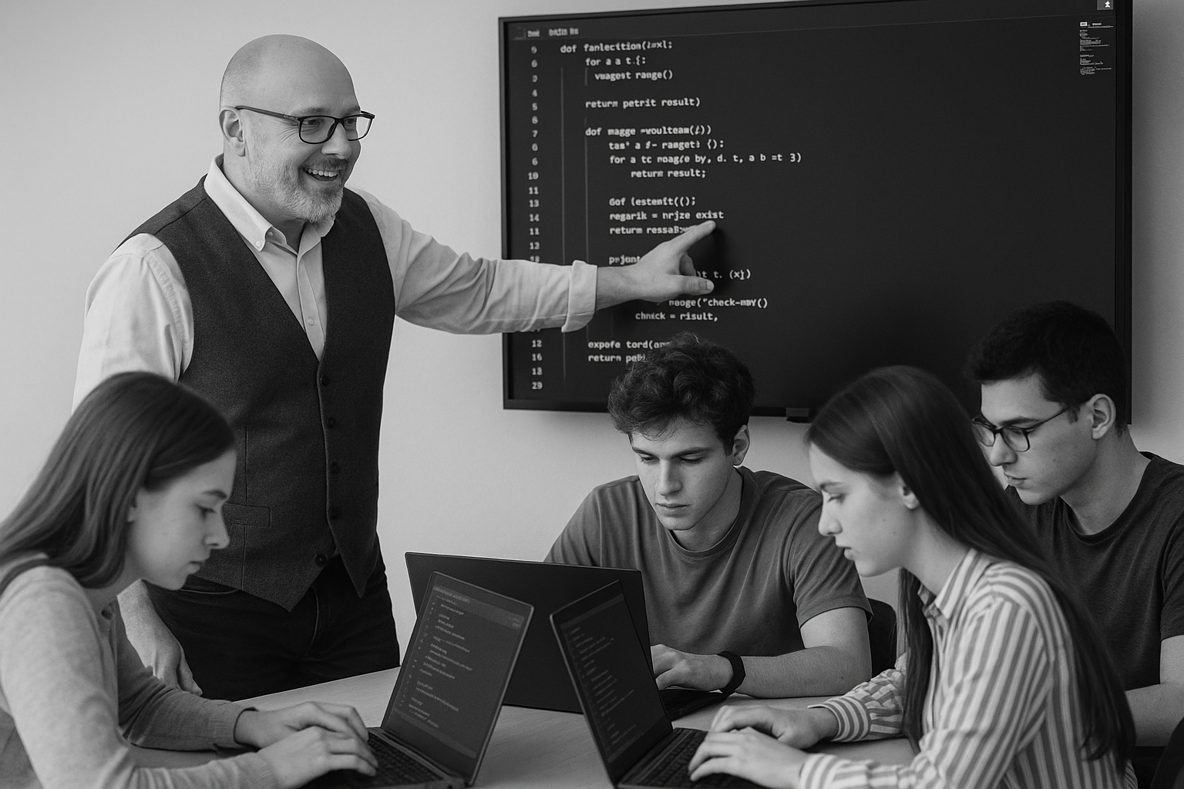








<title>
Note this down
In pairs
Working Independently
In small groups
Deadline:
Midnight 6 days time
X mins
Do not delete this slide nor move it from the last slide in the deck

