Slide 1

Unit 3 Imperative Coding
Lesson 03

Slide 2
Recall Quiz from last Unit
https://forms.microsoft.com/e/PcL4WHG8MK
An email should by now have arrived with the link attached.

Slide 3
Phones
a small reminder…
once you have authenticated phones should be in the pockets on the wall
There will be no more toilet breaks in my lessons. If you can’t manage to use the toilet in the breaks then you need to learn to. Going to the toilet is not an excuse for missing a substantial part of the lesson.

Slide 4
Unit 3 Imperative Coding
Lesson 03

Slide 5
Learning Objectives
By the end of the lesson, learners will be able to:
Define declarative coding
Explain how declarative coding differs from imperative coding
Identify situations where declarative coding is suitable

Slide 6
Key Vocabulary
Declarative
Condition
Rule
State
Outcome

Slide 7
From Imperative to Declarative
Last lesson, you told the computer how to do something.
What if instead we only told it what we want?
Declarative Coding
Imperative → how
Declarative → what

Slide 8
Declarative Coding
Declarative coding:
Describes the desired result
Does not specify every step
Focuses on rules or conditions
Examples
“Show all students with attendance above 90%”
“Make the page text blue”

Slide 9
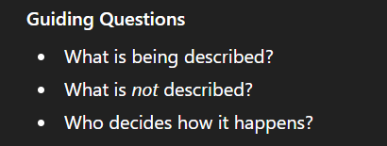
Research: Where is Declarative Coding Used?
Working Independently
30 mins
10 min each
Research these declarative-style technology:
HTML (page structure)
SQL (data queries)
CSS (page appearance)

Slide 10
Imperative vs Declarative
You want a room to stay at 20°C.
Write:
One imperative-style description (step-by-step)
One declarative-style description (rule)
Rules
Plain English only
No programming keywords
20 mins

Slide 11
Imperative
At start:
Sample Temperature
If the temperature is below 19º increase heat
If the temperature is above 21º decrease heat
Wait 5 minutes
Return to start
Why this is a good imperative model:
Instructions are explicit and ordered
The sequence matters
The system is told what actions to take
It reflects the idea of step-by-step control, even if some steps repeat

Slide 12
Declarative
SET temperature to 20º
Why this is a good declarative model:
Focuses on the desired outcome
Does not describe steps
Leaves the how to the system
Expresses a rule or condition

Slide 13
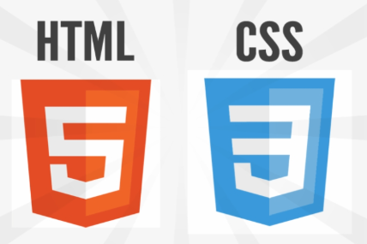

SQL, HTML & CSS
These are good examples of declarative code in action
I maintain they are not programming languages but descriptive languages
HTML describes the structure of text, but leaves it to the browser to interpret that
CSS describes the structure of the layout, but this is still interpreted by the browser
SQL provides the data and relies on other tools to manipulate the records and data returned

Slide 14
Why Use Declarative Coding?
Which version was easier to write?
Which would be easier to change later?
What happens if conditions change?
Declarative Coding is useful for:
Simplicity
Maintainability

Slide 15
Plenary
Give one situation where declarative coding would be useful.

Slide 16























<title>
Note this down
In pairs
Working Independently
In small groups
Deadline:
Midnight 6 days time
X mins
Do not delete this slide nor move it from the last slide in the deck

