Slide 1

Unit 3 Functional Coding
Lesson 04

Slide 2
Recall Quiz of this week’s lessons
https://forms.microsoft.com/e/UT9NkK2rey
An email should by now have arrived with the link attached.

Slide 3
Phones
a small reminder…
once you have authenticated phones should be in the pockets on the wall
There will be no more toilet breaks in my lessons. If you can’t manage to use the toilet in the breaks then you need to learn to. Going to the toilet is not an excuse for missing a substantial part of the lesson.

Slide 4
Unit 3 Functional Coding
Lesson 04

Slide 5
Learning Objectives
By the end of the lesson, learners will be able to:
Define functional coding
Explain how functions act as building blocks
Describe input, output, and stateless behaviour

Slide 6
Key Vocabulary
Function
Input
Output
Stateless
Result

Slide 7
From Outcomes to Functions
So far, we’ve talked about steps and rules
What if we focus on taking something in and giving something out?
A function is a process with an input and an output

Slide 8
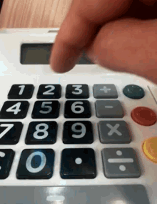


What Is Functional Coding?
Functional coding:
Uses functions as building blocks
Each function:
Takes input
Produces output
Does not remember previous runs (stateless)
Analogy:
Vending machine
Calculator
Recipe card that never changes

Slide 9
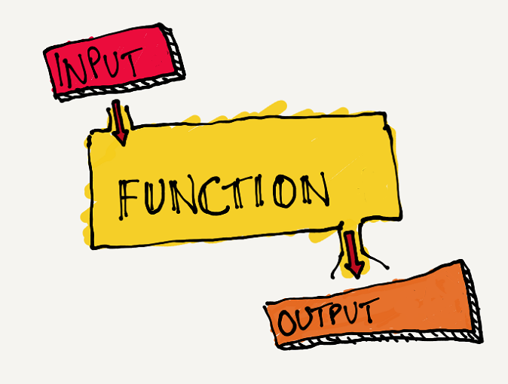
Functional Process Diagrams
Let’s create a simple diagram showing:
Examples:
Number → double it → result
Price → add VAT → final price
Temperature → check → heater on/off
Let’s open up Lucid.app and draw some!

Slide 10
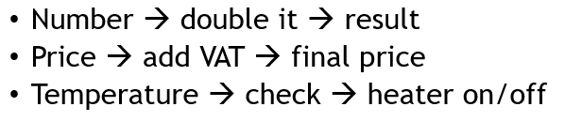
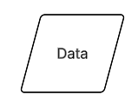
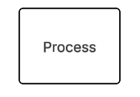
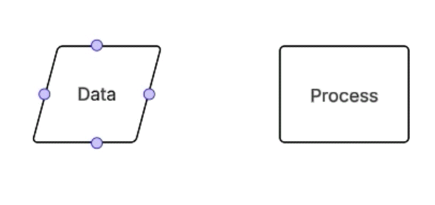
Lucid.app
Create a blank template
This is the symbol for an input
When you click on the text you can specify what the input/output represents
This is the symbol for a process
The text indicates the process we will apply
We join the two with an arrow to indicate the flow of the process
Working Independently
15 mins

Slide 11
Real-World Functional Examples
If you give the same input, do you always get the same output?
Calculator
Ticket machine
Photocopier
Consider:
Why remembering past actions would cause problems

Slide 12
Task: Stateless thinking
A calculator adds two numbers
What are the inputs?
What is the output?
Why does it not need to remember previous calculations?
Extension: have we encountered another situation which is stateless?

Slide 13
Task / Homework
Working Independently
Explain what is meant by functional coding.
Mention functions as building blocks
Mention input and output
Mention stateless behaviour (or equivalent wording)
Use your own words as much as you can
This might be useful for your final assessment
10 mins

Slide 14























<title>
Note this down
In pairs
Working Independently
In small groups
Deadline:
Midnight 6 days time
X mins
Do not delete this slide nor move it from the last slide in the deck

