Slide 1

Unit 3
Object Orientated Coding
Lesson 05

Slide 2
Recall Quiz of this week’s lessons
https://forms.microsoft.com/e/7auu48p6QN
An email should by now have arrived with the link attached.

Slide 3
Phones
a small reminder…
once you have authenticated phones should be in the pockets on the wall
There will be no more toilet breaks in my lessons. If you can’t manage to use the toilet in the breaks then you need to learn to. Going to the toilet is not an excuse for missing a substantial part of the lesson.

Slide 4
Unit 3
Object Orientated Coding
Lesson 05

Slide 5
Learning Objectives
By the end of the lesson, learners will be able to:
Define object-oriented coding
Identify objects, attributes (properties), and methods
Use real-world examples to explain object-oriented ideas

Slide 6
Key Vocabulary
Object
Class
Attribute
Method
Instance

Slide 7
From Functions to Objects
So far, we’ve looked at steps, rules, and functions.
What if we group data and behaviour together?
Object-oriented coding organises code around objects

Slide 8
What Is Object-Oriented Coding?
Let’s start with a Class
The class I am teaching has Students
Students have Attributes (aka properties)
Students do things which we call Methods

Slide 9
Task: Think about a Car class
Working Independently
10 mins
Here is a list of attributes and methods. Sort them in your OneNote worksheet into the right category
Colour
Start engine
Weight
Open door
Fuel level
Sort into Attributes and Methods

Slide 10
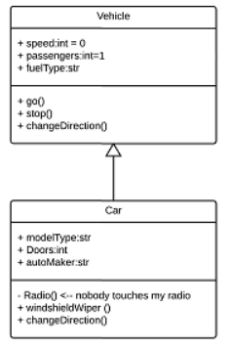
Class Diagram Sketches
<Name of Class>
<Attributes>
<Methods>

Slide 11
Task
Working Independently
In the OneNote worksheet:
Choose a real-world object:
  Phone
  Student
  Game character
  Vending machine (or something else)
Draw in Lucid.app:
  Class name
  List of attributes
  List of methods
Rules:
  Boxes and bullet points only
  No programming language
15 mins

Slide 12
Objects in the Real World
Working Independently
In your OneNote Notebooks
How does your chosen object represent something from the real world?
What data does it need to store?
What actions does it need to perform?
15 mins

Slide 13

Exit Ticket
What is one advantage of organising code into objects?

Slide 14
Task / Homework
Working Independently
Define what is meant by object-oriented coding and give one example
Mention objects and classes
Mention attributes and methods
Use a real-world example
Use your own words as much as you can
This might be useful for your final assessment
10 mins

Slide 15






















<title>
Note this down
In pairs
Working Independently
In small groups
Deadline:
Midnight 6 days time
X mins
Do not delete this slide nor move it from the last slide in the deck

